Slide 1

IGNITE MENTORING
Adedoyin Adeleke

Slide 2


Purpose
“Each week, we volunteer our time to tutor, build relationships and have fun”, with the children of Park Place elementary.
Ignitenorfolk.com/ignitementoring

Slide 3
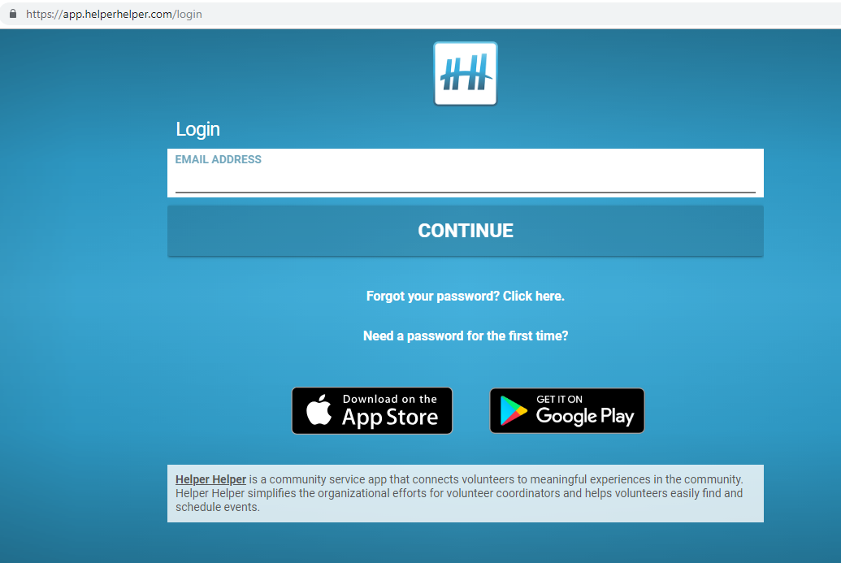
How to sign up
helper linked to ODU
enter student email
Select volunteer work
Look out for reminder emails

Slide 4

Transportation & meeting times
Every Thursday from 2:15 to 5 pm
Mentors gather at IGNITE church, then carpool to park place

Slide 5

Proposal
What needs to be improved:
more meeting times and days
more activities
More provisions

Slide 6
Work cited
www.Ignitenorfolk.com/ignitementoring
https://app.helperhelper.com/login

