Slide 1
Proofreading TECHNIQUES
Marie R. Herman, CAP, OM, ACS, MOSM
MRH Enterprises LLC
www.mrhenterprises.com
Notes:
I’m so happy to be here today providing this webinar for the IAAP Norfolk Branch.
I have everyone muted during the presentation, but you can type any questions in the chat window as we go along. I will be watching it.

Slide 2
Agenda
Characteristics of effective communication
Proofreading
Editing tips
Notes:
Proofreading Properly - Your message could come across entirely different than you meant it if you don't proofread properly. Proofreading not only catches typographical errors, but also factual mistakes, contextual blunders and more. Poor proofreading has resulted in embarrassment, lost money, and even lawsuits. Discover the key considerations of proper proofreading.

Slide 3
Copy Editing
Punctuation
Style & Usage
Grammar
Accuracy
Formatting
Graphics
Notes:
Copy editing is an attempt to prevent errors in spelling, grammar, usage, style, and other content inconsistencies.
A copy editor:
• knows the rules of grammar, punctuation, and standard usage of language;
• can help to organize written information effectively;
• understands the fundamentals of design and layout;
• understands working with graphics and illustrations (both from a logistical and design perspective);
• knows the basic elements of printing and the most commonly used printing technologies.

Slide 4
“C” Characteristics of Effective Communication
Complete
Clear
Correct
Concise
Courteous
Considerate
Notes:
Complete - Make sure it gives the reader all information they need. (who, what, where, when, why, how).
Clear – reader should be able to determine the purpose of the correspondence.
Correct – information should be factually correct (check dates, dollar amounts, names, etc.)
Concise – to the point, with well chosen words. Use short sentences, easy to understand words, bullets/numbered lists when possible, avoid repetition, eliminate excessive information and avoid wordy phrases.
Courteous – Treat the reader with respect and show that you care about them. Do not show your anger in communication.
Considerate – Create a positive message for the reader, even if the news is negative.

Slide 5
General tips
Do not proofread a document immediately after keying it. Let it sit for a bit.
Plan to read the document multiple times, but focusing on different areas.
You may find it helpful to read the document by sentence in reverse.
Don’t rely on spellcheck.

Slide 6
steps to follow for thorough proofreading

Slide 7
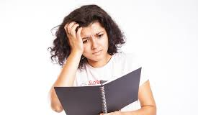
Understand what’s going on
What’s the purpose of the document?
Who is the intended audience?
How “permanent” is it?

Slide 8
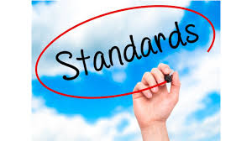
Corporate standards
Is there a corporate template (for fonts, colors, style guidelines, etc.)?
Is the latest version of the template being used?
Ensure corporate policies and branding are followed.
Check copyrights and trademarks
Confirm corporate logo is correctly used.
Check for appropriate required legal disclaimers and policy statements.

Slide 9
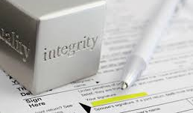
integrity
Check cross references (i.e. see Page X for “ABC” – did you verify that the information is actually on Page X and called ABC?)
Have any referenced appendices been included?
Do figures include captions? Should there be a table of figures?
If a table of contents is included, are the page numbers correct and are all items included that should be in the table of contents?
Are footnotes listed accurately and with correct formatting?
Are all numbered lists correctly numbered?

Slide 10
Minimum language check
Grammar
Punctuation
Subject-verb agreements
Are sentences complete?

Slide 11
Formatting Overview
Review the document by looking only at the pages as a whole (preferably printed if the final product will be). Check for the overall layout and appearance – headers, footers, page numbers, margins/white space, font consistency, etc.

Slide 12
Formatting items to consider
Are margins consistent?
Are headers and footers correct throughout and consistent?
Are all page numbers consistent?
Are fonts consistent?
Are titles styled consistently?

Slide 13
grammar
Do not overlook proofreading the subject line, names and address of recipients and electronic letterhead.
Watch closely for omissions of endings of words (ed, ing, s) as well as the word NOT which is omitted surprisingly often.
Watch for incorrect words (you instead of your, there/their/they’re, etc.)
Keep a current reference manual at your desk to look up grammar and punctuation rules.

Slide 14
Overall language
Capitalization consistent?
Acronyms explained?
Watch for redundancies.

Slide 15
accuracy
If text references Saturday, August 18, 2018, is August 18 actually a Saturday? Is the year correct?
Doublecheck email addresses too!
Notes:
It is especially common to miss the change of a year when updating a past document for current use.

Slide 16
content
Does the document read at an appropriate level for the audience?
Does it flow well?
Is it coherent?
Is it complete? Are all relevant facts and information included?

Slide 17
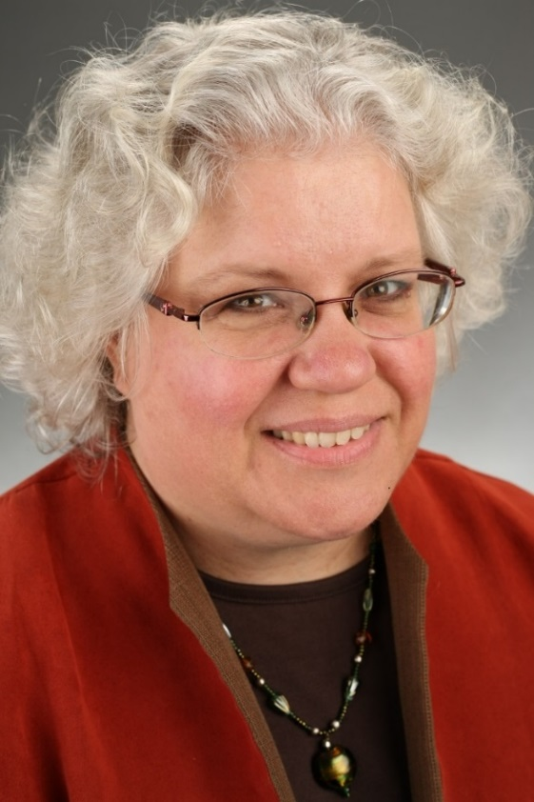
Marie Herman, CAP-OM, ACS, MOSM MRH Enterprises LLC www.mrhenterprises.com iaap@mrhenterprises.com https://www.facebook.com/MRHTraining
Private tutoring for CAP, Microsoft Office Specialist exams; online study groups; advanced Microsoft Office training (points for recertification!)
Notes:
(STOP RECORDING – AFTER PRESENTATION)

