Slide 1
The Museum of Tolerance
By Casey Slaughter

Slide 2
What door would you go through?

Slide 3
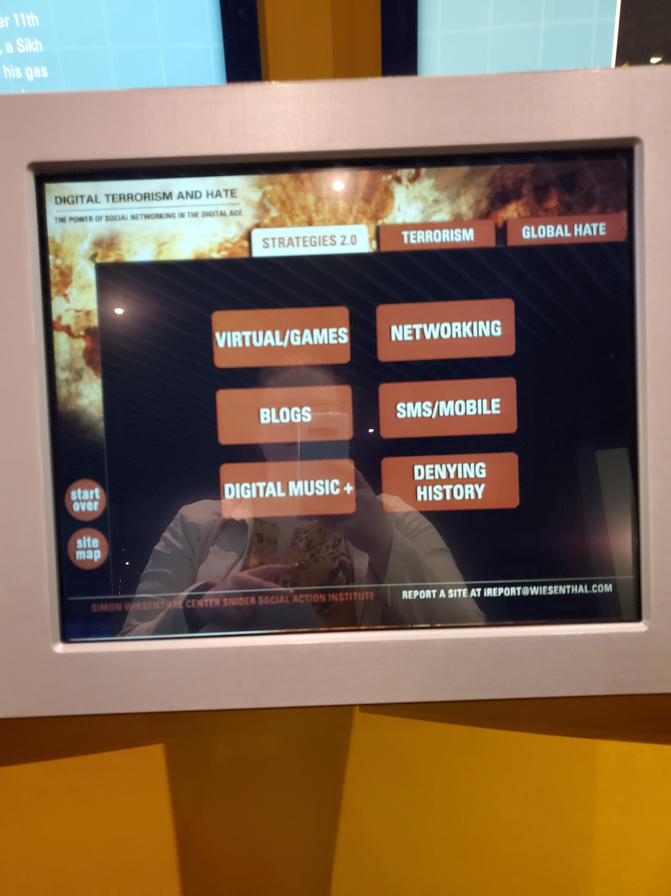
Globalhate.com

Slide 4
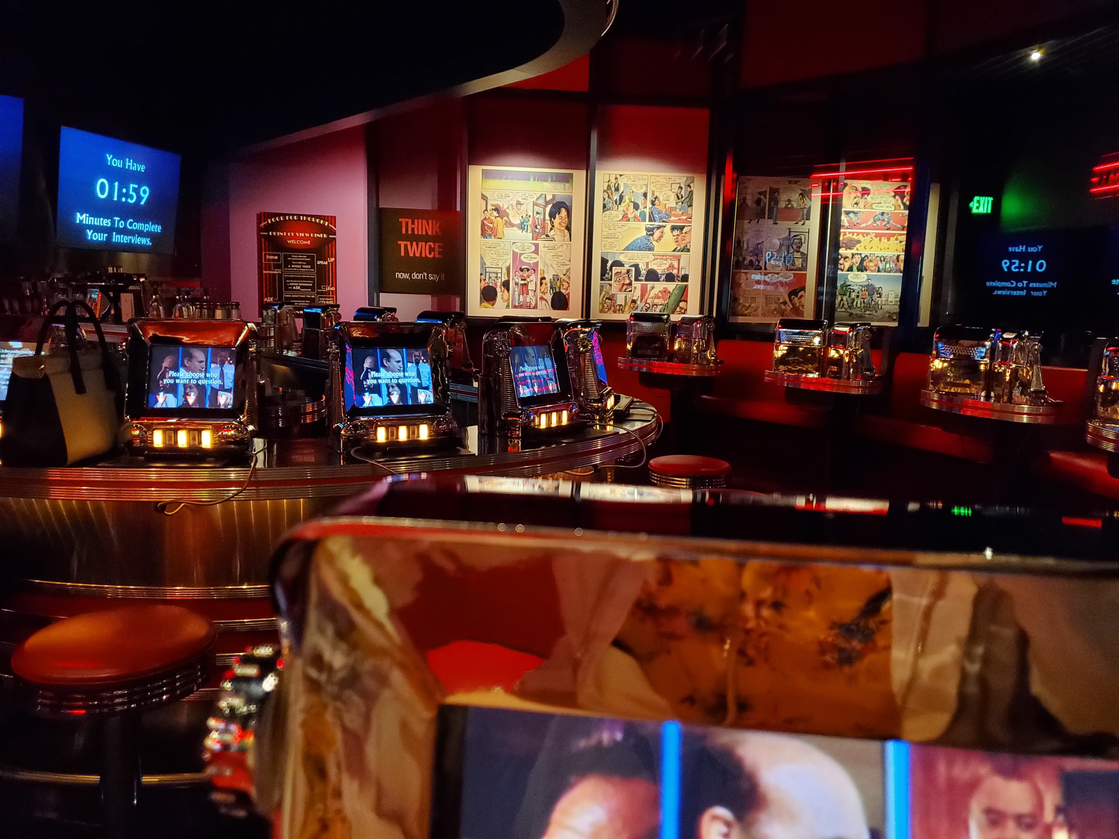
Point of view diner
Will you stand up for what is right?

Slide 5
Millennium Machine

Slide 6
The power of words

