Slide 1
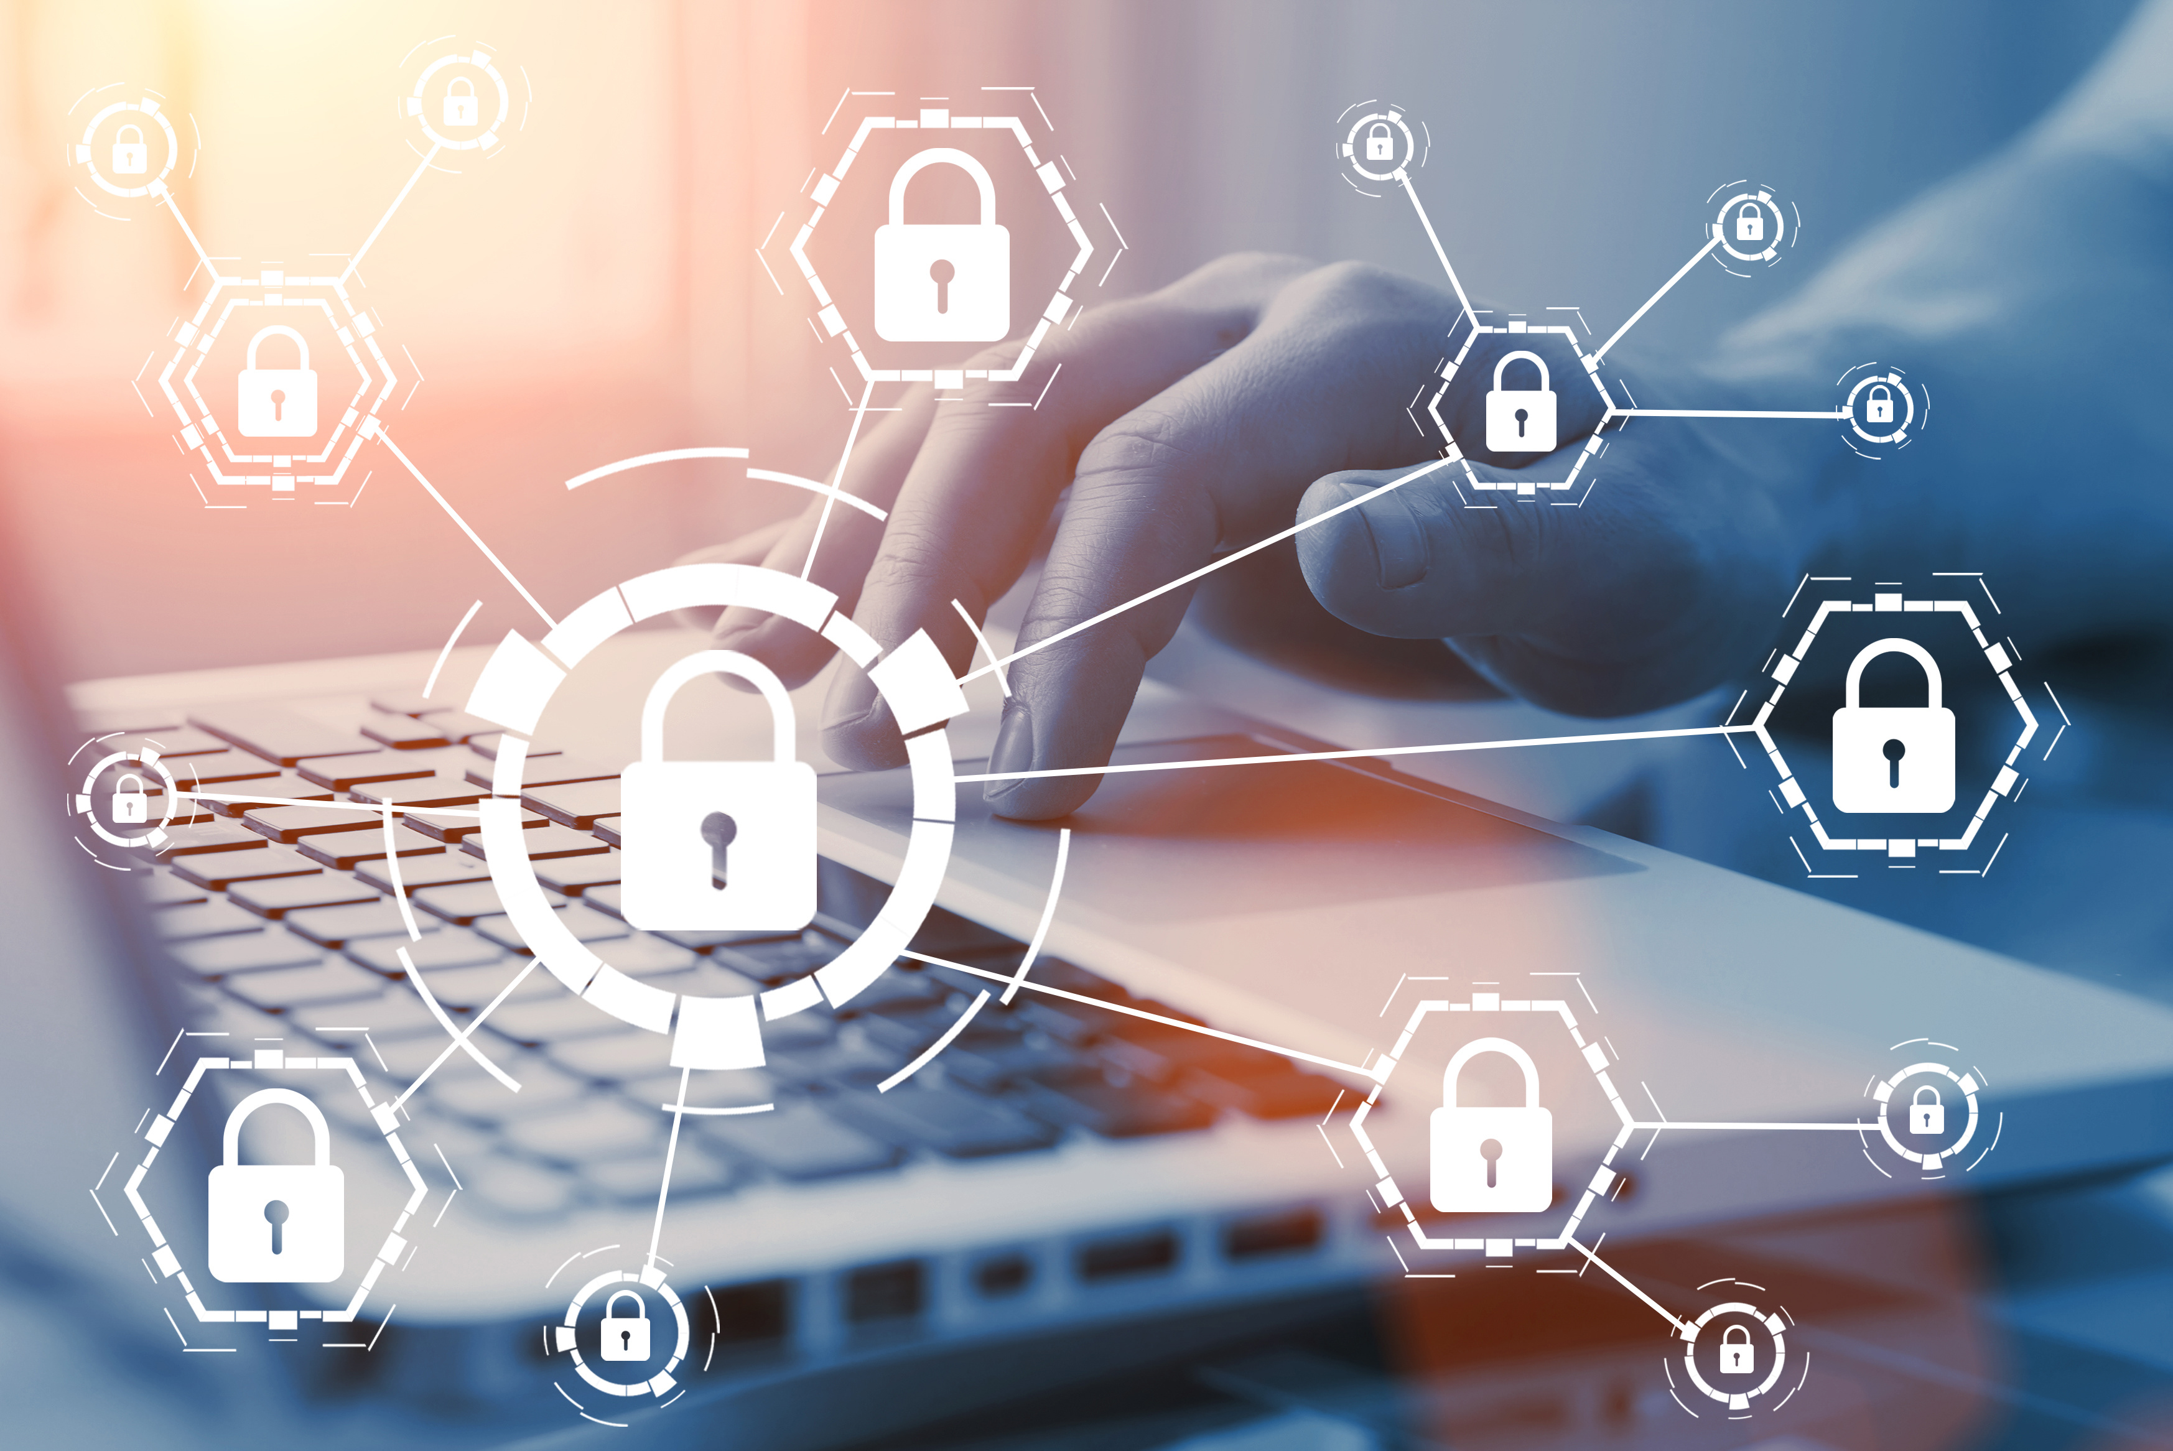
Syngia Research
Developed under the Team8 venture capitalist company builder in Israel.
Acquired by Singaporean government-controlled Temasek for $250 million.
Still operating as an independent org.
Offering: Incident response, Forensics support, Advanced monitoring, Red Teaming and War games.
Offices in Israel, New York and Singapore.
No info on specific tools, clients or markets.

