Slide 1
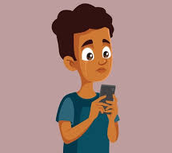

Cyberbullies Beware: Stay Safe Online
By: Derrick Amissah, Destin, & Martin

Slide 2

Cyberbullying in Plain Words
Cyberbullying is the use of digital platforms to repeatedly harass, threaten, or humiliate someone. It can happen through texts, social media, or online games, often anonymously, making it hard for victims to escape.
Common Forms
Common forms include posting mean comments, sharing embarrassing photos, creating fake profiles, and spreading rumors. Victims may feel constantly targeted, affecting their mental health and daily life.

Slide 3
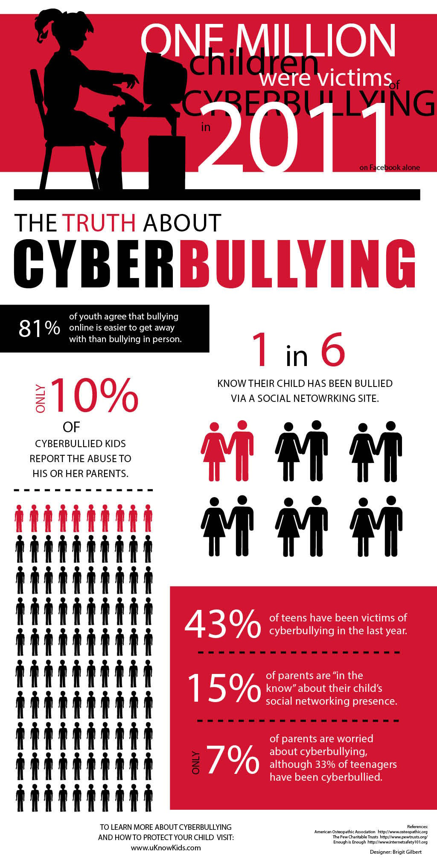
Quick Stats That Matter
Approximately 25% of teens experience cyberbullying, with girls facing more issues on social media and boys encountering more problems in online gaming environments.
Victims often suffer from anxiety, depression, social withdrawal, and academic decline. In severe cases, cyberbullying can lead to self-harm or suicidal thoughts, highlighting the urgency of addressing this issue.
A study found that cyberbullying victims were twice as likely to show signs of severe emotional distress compared to non-victims, emphasizing the significant psychological toll of online harassment.

Slide 4

How It Hurts Inside
Psychological Trauma
Cyberbullying causes real psychological trauma, leading to anxiety, depression, and sleep disorders. Victims often feel constantly stressed and unsafe in their own homes.
Social Withdrawal
Victims may withdraw from social activities, lose friends, and avoid school or work. The fear of further humiliation can lead to long-term social anxiety and isolation.
Academic Decline
The emotional distress from cyberbullying often results in a decline in academic or work performance. Victims may struggle to focus and feel unmotivated.

Slide 5

Simple Legal Facts
Criminal Charges
Threats, stalking, and sharing private information without consent can be criminal offenses. Victims can report these actions to law enforcement for legal action.
Civil Remedies
Victims can also pursue civil remedies such as injunctions, restraining orders, and compensation for emotional distress. Legal action can help hold perpetrators accountable.
State-Level Laws
Many states have specific anti-cyberbullying laws that define and criminalize the behavior. Schools are often required to have policies in place to address and prevent cyberbullying.

Slide 6
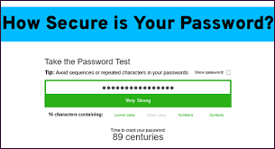
Cyber Trick To Prevent Cyberbullying
Strong Passwords
Use strong, unique passwords for all accounts. Avoid easily guessable information like birthdays or names. Strong passwords help prevent account hijacking.
Two-Factor Authentication
Enable two-factor authentication (2FA) on all platforms that support it. This adds an extra layer of security, making it harder for bullies to access your accounts.
Privacy Settings
Regularly review and adjust privacy settings on social media and other platforms. Limit who can see your posts, send you messages, and view your profile information.
Report and Block
Most platforms allow you to report abusive content and block users. Use these tools to protect yourself and prevent further harassment.

Slide 7
Citations
Vogels, Emily A. Teens and Cyberbullying 2022. Pew Research Center, 15 Dec. 2022, https://www.pewresearch.org/internet/2022/12/15/teens-and-cyberbullying-2022/.
Journal of Adolescent Health. Journal of Adolescent Health, Elsevier, https://www.jahonline.org/. Accessed 11/12/2025.

