Slide 1
Storage system characteristics
Drequan WILSON

Slide 2
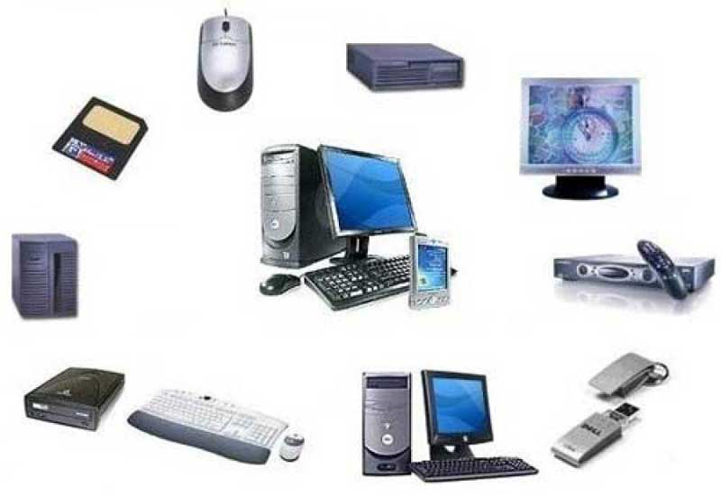
CHARACTERISTICS
All storage systems have specific characteristics, consisting of having both a storage medium and a storage device, how portable and volatile the system is, how data is accessed and represented, and the type of storage technology used.
Computer storage is measured in bytes, kilobytes, gigabytes and terabytes.

Slide 3
STORAGE MEDIA AND STORAGE DEVICES
There are two parts to storage system, which are the storage medium and the storage device.
A storage medium is the hardware where data is actually stored; a storage medium is inserted into its corresponding storage device in order to be read from or written to.
Storage devices can be internal, external, or remote. Internal devices have the advantage of requiring no additional desk space and are usually faster that their external counterparts.
Storage devices can be internal, external, or remote. Internal devices have the advantage of requiring no additional desk space and are usually faster that their external counterparts.
External devices, however, can be easily transported from one location to another to. They can also be removed from the computer and stored in a secure area.

Slide 4
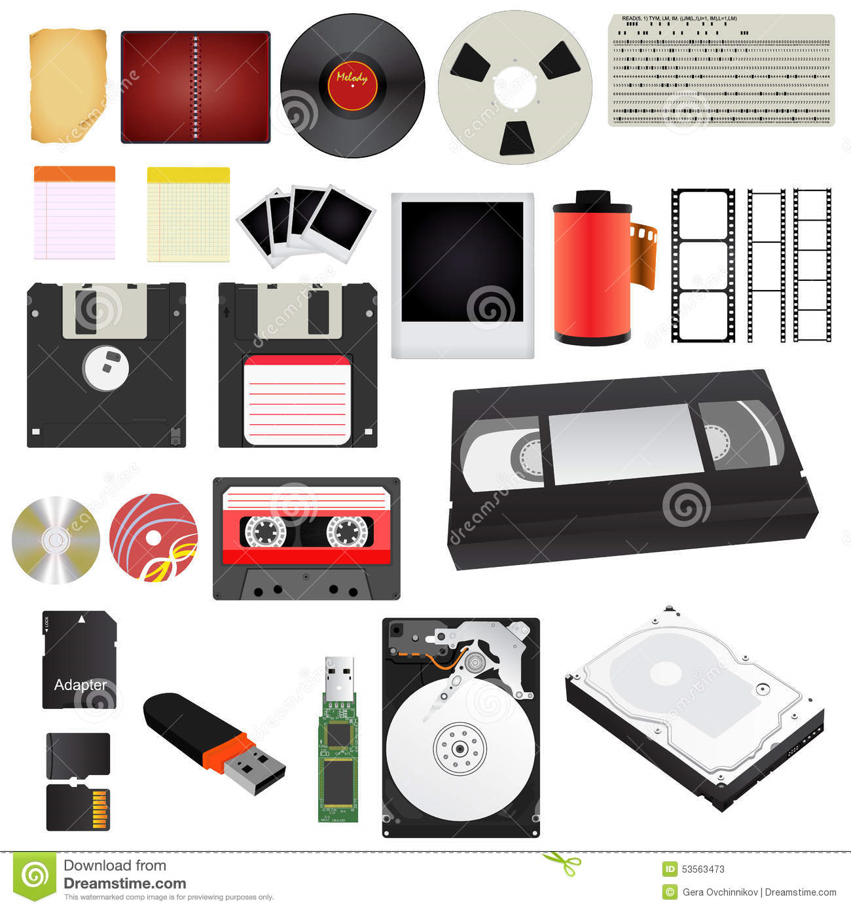
Storage media AND STORAGE DEVICES

Slide 5
Volatile and nonvolatile Storage Devices
Volatile storage memory that can only be used when the computer or laptop is on.
The type of volatile storage memory is typically the RAM in the computer.
Nonvolatile storage is memory that remains on media even when the power to the computer or laptop is turned off.
A type of nonvolatile storage memory is a flash drive.
Both are used for saving documents and anything that a person wants to save for the moment and come back to work on or look at later.

Slide 6
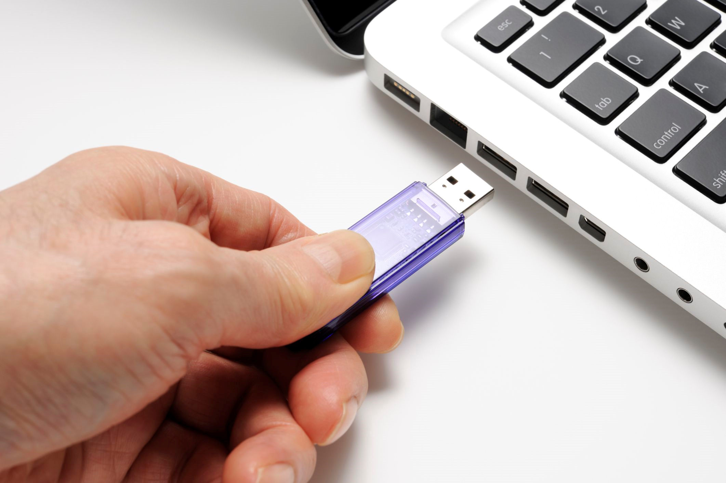
Volatile and nonvolatile storage device

Slide 7
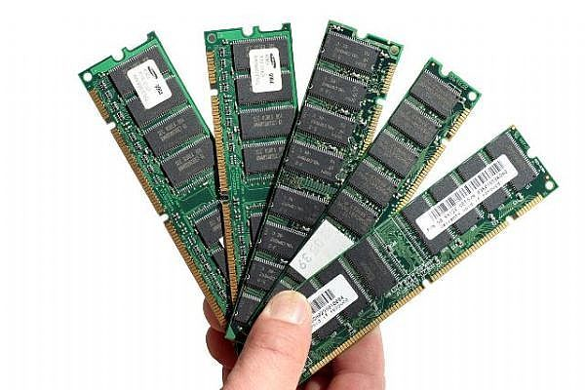
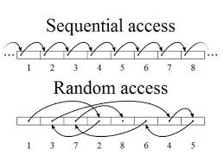
ACCESS
There are two ways to access your requested data.
Random access is data that can be chosen at any location and any order
Another access is sequential access, which only can get its data from in order of how it was stored.

Slide 8
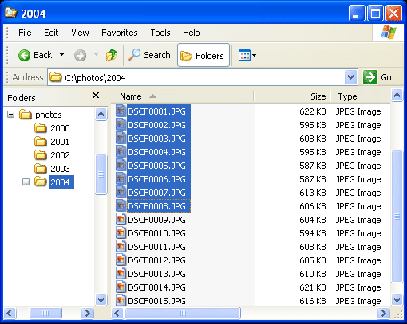
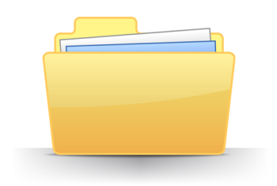
REPRESENTATION
Everything that is stored on a storage medium is called a file.
Documents are organized into specific folders.

Slide 9
TYPES OF STORAGE TECHNOLOGY USED
There are two ways that data is stored on storage media; magnetically or optically

Slide 10
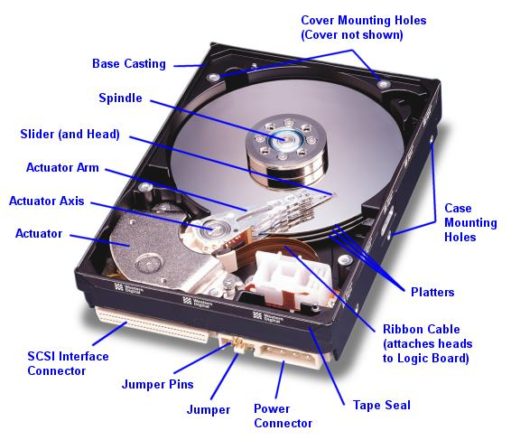
Magnetic storage system
Magnetic storage systems data is stored magnetically on the storage medium, the data 0s ands are shown using different magnetic alignments.
The storage device can change the alignment whenever, allowing data to be written to the medium, deleted or rewritten.

Slide 11
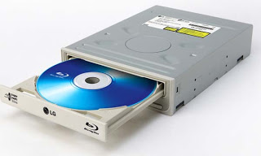
Optical Storage media
Optical storage media uses lasers to store data.
On some optical storage media, lasers leave permanent marks to show 0s and 1s in the medium o the data can not be erased or rewritten.
A few of these are CDs, DVDs, and Blu-Ray disk.

Slide 12
references
Barnatt, C. (n.d.). Computer Storage. Retrieved September 11, 2017, from http://www.explainingcomputers.com/storage.html
Hopper, G. M., & Mandell, S. L. (1990). Understanding computers. St. Paul: West Pub. Co.
M. (2006, October 18). Volatile and Nonvolatile Storage Devices. Retrieved September 11, 2017, from https://msdn.microsoft.com/en-us/library/ms940147(v=winembedded.5).aspx

