Slide 1
Free Education
Drequan wilson

Slide 2
Intro
During junior and senior year of high school, the cost of college becomes the main discussion.
Parents and future college students begin to wonder about how they are going to pay for there Childs education.

Slide 3
Thesis
Due to increased inflation in college tuition, teens may face the process of applying for scholarships, grants, and unfortunately student loans, so that the desire for free education increases.

Slide 4
Research

Slide 5
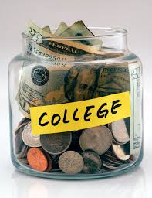
College Cost
Allowing college application cost to be equal.
College cost is high due to bills that have to be paid like light, water, and heat.

Slide 6
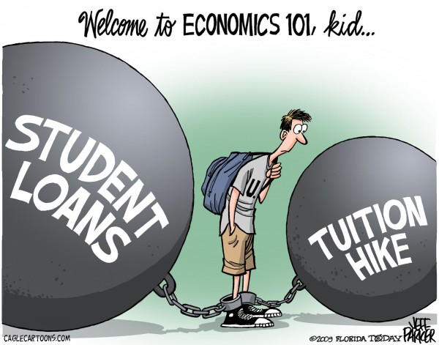
College Cost

Slide 7
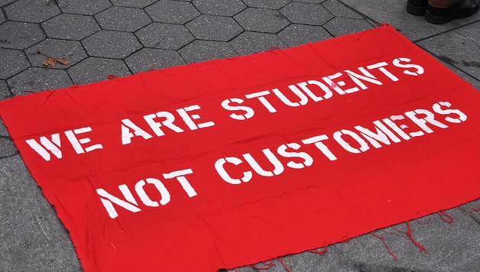
Free College
Free college would allow families to save money.
It would allow more students the opportunity to attend college.
Students wouldn’t have to worry about getting a job to pay for there education.

Slide 8
Education
Education leads to important things in life, like becoming a valuable person to a company or to a country.
The world thrives on education and wants college graduates rather than high school graduates.
College graduates get paid more than high school graduates.
It leads to a higher chance of becoming employed.

Slide 9
https://trends.collegeboard.org/sites/default/files/2016-trends-college-pricing-web_0.pdf
https://www.google.com/search?q=college+tuition&biw=1920&bih=935&source=lnms&tbm=isch&sa=X&ved=0ahUKEwjLh_HJlM_QAhVM2xoKHTxeC2QQ_AUIBygC#tbm=isch&q=education&imgrc=C4KX3ykpZNLQpM%3A
https://www.google.com/search?q=college+tuition&biw=1920&bih=935&source=lnms&tbm=isch&sa=X&ved=0ahUKEwjLh_HJlM_QAhVM2xoKHTxeC2QQ_AUIBygC#tbm=isch&q=education&imgrc=ByTvT_XD0NHMeM%3A

