Slide 1
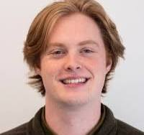
Michael Sauls
Sports Reporter

Slide 2
Education
Bachelor of Arts- BA, Journalist from the University of South Carolina
Concentration in sports media, minor in sports management
GPA:3.7

Slide 3
Work Experience
Managing Editor, Sports and News, Daily Gamecock 2019-2022
Staff Writer with the Gamecock Central
Reports for the Carolina News
Sports Reporting intern for Hampton Roads sports.
Sports Reporter, covering Norfolk State and Hampton University through the Virginian-Pilot
Sports Reporter- The State Newspaper, Covering University of South Carolina women’s basketball

Slide 4
Getting involved
Michael Sauls speaks about how important getting involved is especially in college when you have access to the University’s sports. Michael was involved with many campus jobs that helped him get his current position with the Carolina State Paper.
Michael was a student journalist at the University of South Carolina, where he won multiple awards for his writings. He stresses that starting early is what helped him get his dream job not long after graduating college.

Slide 5
Michael’s Awards and Recognition
Micheal was awarded the Region 3 Mark of Excellence Award (Sports writing) which was issued by the Society of Professional Journalists.
He also won the First Place Sports Story from the South Carolina Press Association.
He was awarded Second and Third Place in Sports Stories throughout his time at the University.

