Slide 1
MET 330 Fluid Mechanics Design Project
Michael Delacruz
William Gemo
Daniel Tamayo

Slide 2
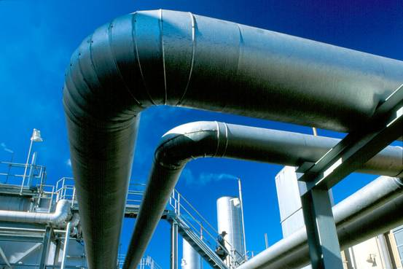
purpose
Design an efficient system for the transfer of coolant from each storage tank
Develop a cost effective system that does not compromise with performance at hand.
Develop a very simplistic design for ease of installation.

Slide 3
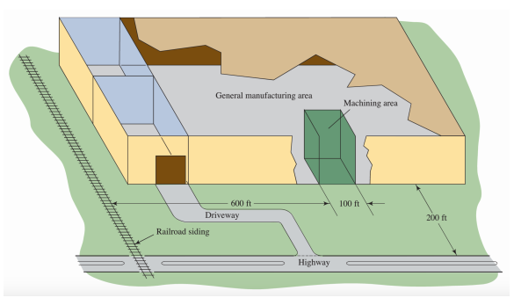
Location
Dayton, Ohio
Temperature Range
-20 F to +105 F
Average Wind Speed
9.2 mph
Highest Average Day
January 15
11.7 mph

Slide 4
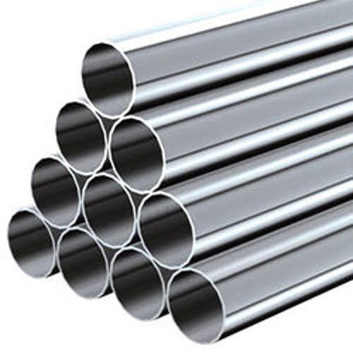
Materials
Schedule 40 Steel Pipes
Brand new, clean commercial steel pipes
Sulzer Pumps
Tanks are A36 Steel
Storage tanks: 15000 gal tank, 6000 gal tank, and a 1000 gal tank

Slide 5
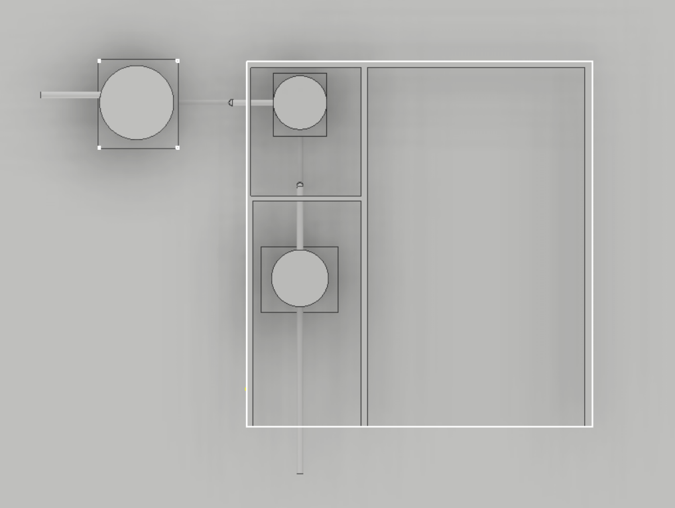
Preliminary drawings & sketches

Slide 6
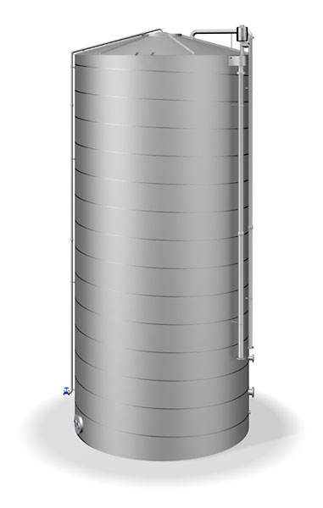
Tank specifications
A 15000 gallon tank that was allocated to the railroad piping and piping towards the 100o gallon tank.
A 1000 gallon tank that was allocated inside the upper left corridor of the building attached with piping lead to the 15000 gallon tank and the 6000 gallon tank.
A 6000 gallon tank that was allocated to the garage exit and its piping is attached to the 1000 gallon tank and the truck.

Slide 7
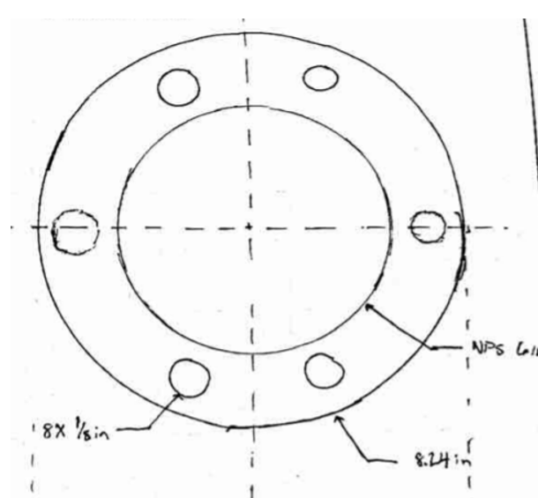
Blind flange
The blind flange was designed to be a future drain connection and with our calculations, it was shown that the design of the blind flange would prove reliable for the storage tanks.

Slide 8
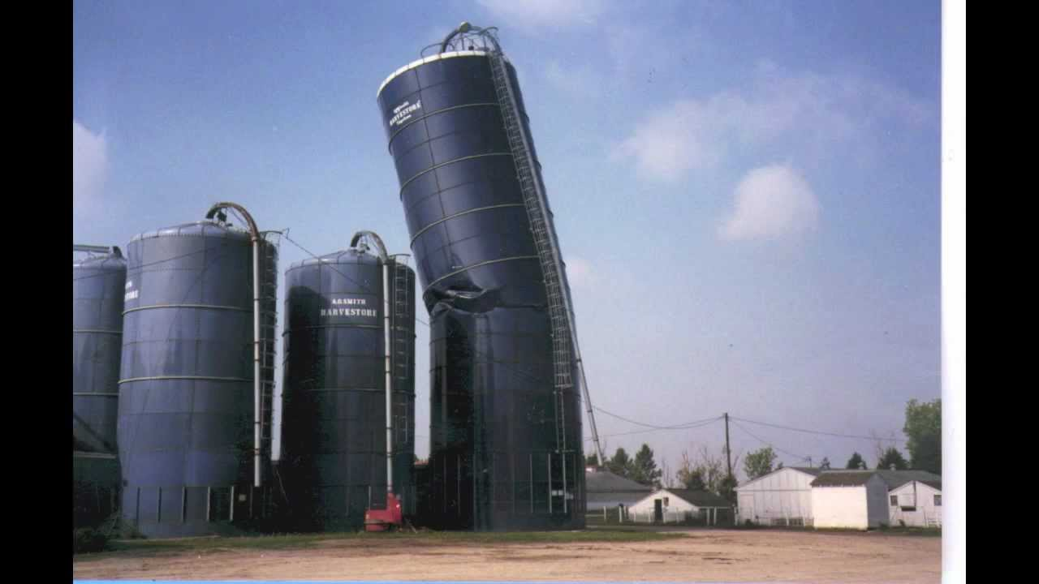
Other tank specifications
Wind load: It was determine through our calculations for one of the tanks, if it would experience any wind load, as soon as we computed it we then handed off the results to our civil engineer colleagues to see if there will be any wind load.
Open Channel design: The calculations for our open channel design in case of failure were to occur on one of the tanks proved to be sufficient enough in the worst case scenario.

Slide 9
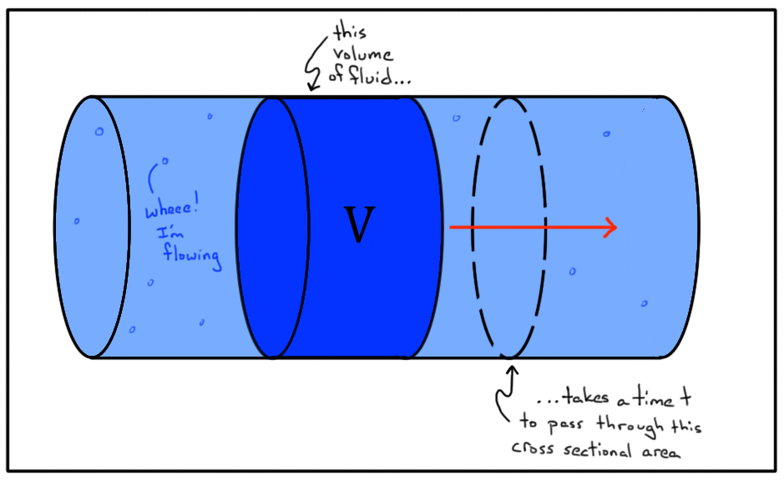
Flow rate
The flowrate for each system was determined to be appropriate for each tank, as it accommodated for the dimensions of the tanks, as well as the volumes and showed that the flow rates were realistic for each tank.

Slide 10
Pipe system
The pipe layout design for this project had two considerations needed: inexpensive, stable and minimizing any complications.

Slide 11
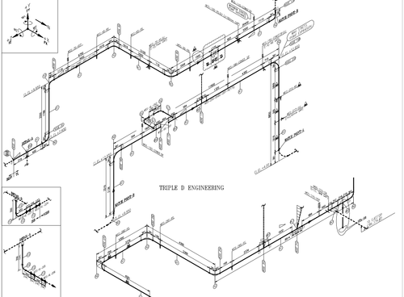
Pipe sizing
The dimensions of the pipes to be used in the system such as the diameter, lengths, and thickness were nominal enough as the numerical values for each dimension was not extraneously large.

Slide 12
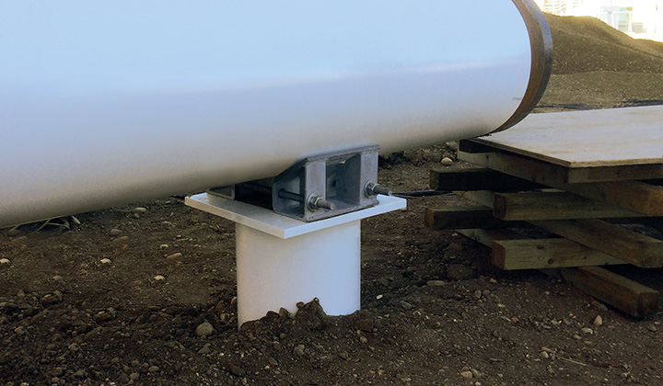
Pipeline support
The type of support for the pipes will be placed under each system as the fluids are coming from the highest part of the tanks.
Calculations have been made for each support in order for them to compensate the amount of force each will follow.

Slide 13
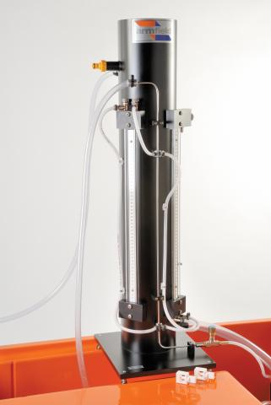
Energy losses
The energy losses that were calculated throughout the system, were shown to be very minor and because of that, it will not hinder the flow of the fluids throughout the system

Slide 14
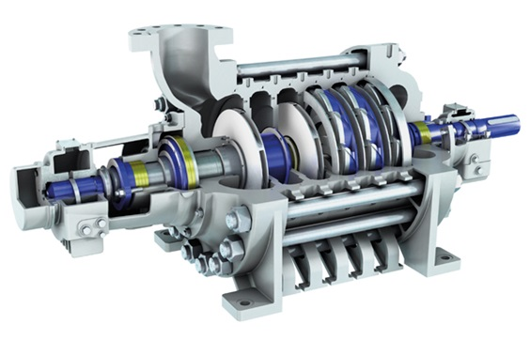
Pump selection
The type of pump that will used for this system is a Sulzer pump
The Sulzer pump will give us the best results needed for the pipeline system

Slide 15
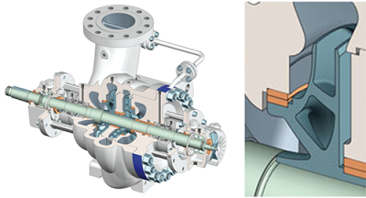
Type of pumps
The type of Sulzer pump we will be using is a kinetic pump as this kind of pump would be appropriate for the pipe system for it being cheap and easier to control.

Slide 16
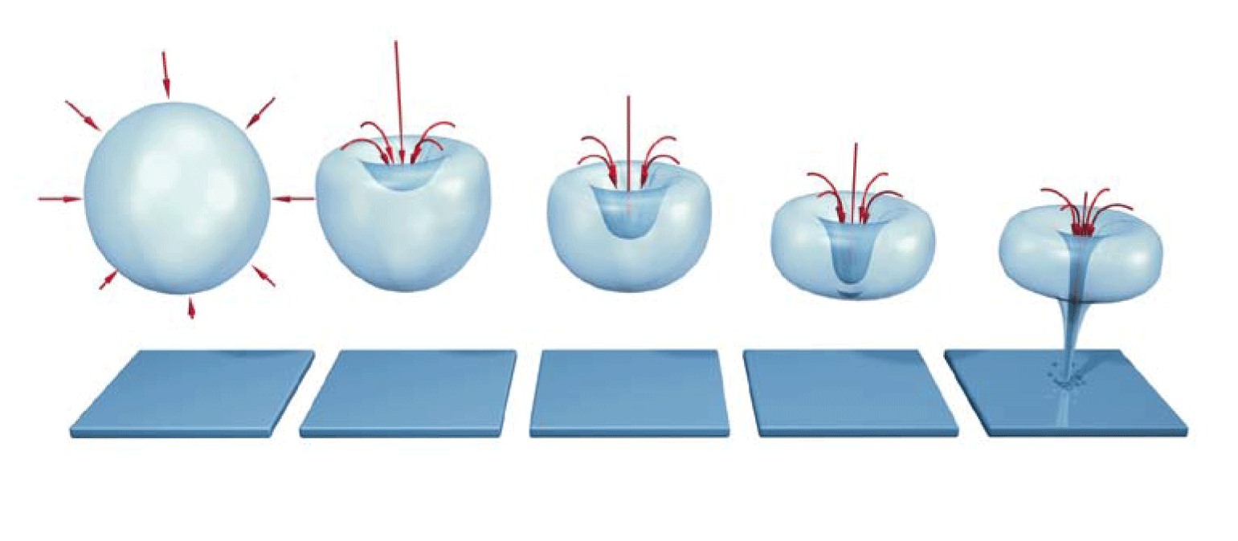
Cavitation
The risk of cavitation within the system has been taken noticed and has been calculate, and fortunately from our calculations it shows that there is no cavitation within the system.

Slide 17
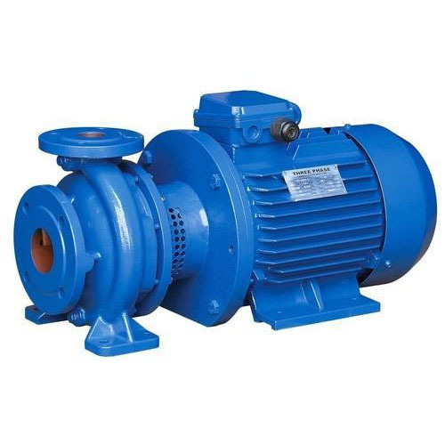
Electrical motor requirement
We computed the electrical motor requirement that is needed for our electrical engineering colleagues, and the results from it seem appropriate for the system.

Slide 18
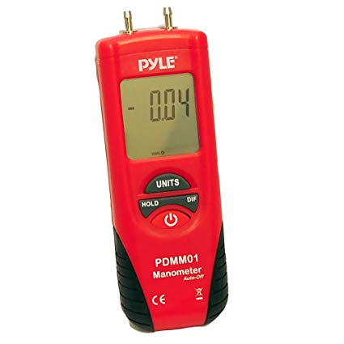
Instrumentation
The chosen instrument to use for this pipe design was a digital manometer, and the reason for that was it could easily read the pressure and flow going on within each system of the layout

Slide 19
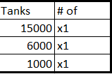
Bill of materials

Slide 20
Final remarks
We believe that this design for the pipe system should be approved as the design itself is not complicated to understand or install, as well as it is cost effective and efficient because of how simple the design and materials that are being used within the system.

