Slide 1
Flip Out with
Flipgrid
By Rachel Kidd and Amanda Shepperd

Slide 2
What is Flipgrid?
FlipGrid is a video discussion platform. It allows teachers to create "grids" that serve as message boards where teachers can pose questions, called "topics," and their students can post video responses that appear in a tiled grid display.

Slide 3
Examples:
Can be used to help teach any subject:
Book Talk in Language Arts
Students record themselves solving a problem in Math
Students give a 30 second explanation of a new Science concept
Teachers also have access to Grids created by other teachers

Slide 4
Why we would use Flipgrid:
Integrates technology into the classroom.
Engaging for students.
Works on peer communication.
Free to educators!

Slide 5
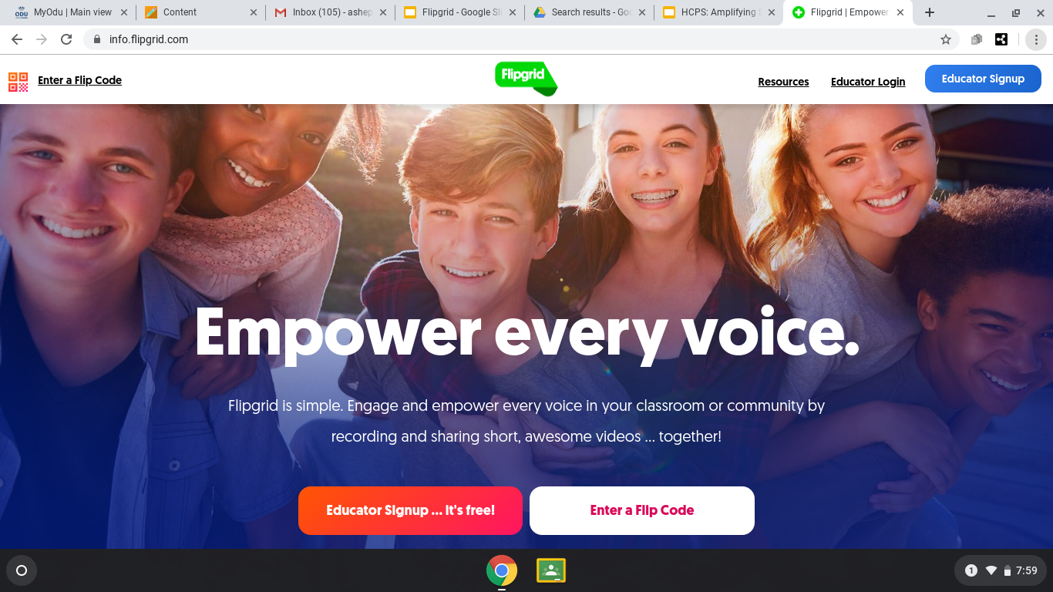
Sign up at https://flipgrid.com/

Slide 6
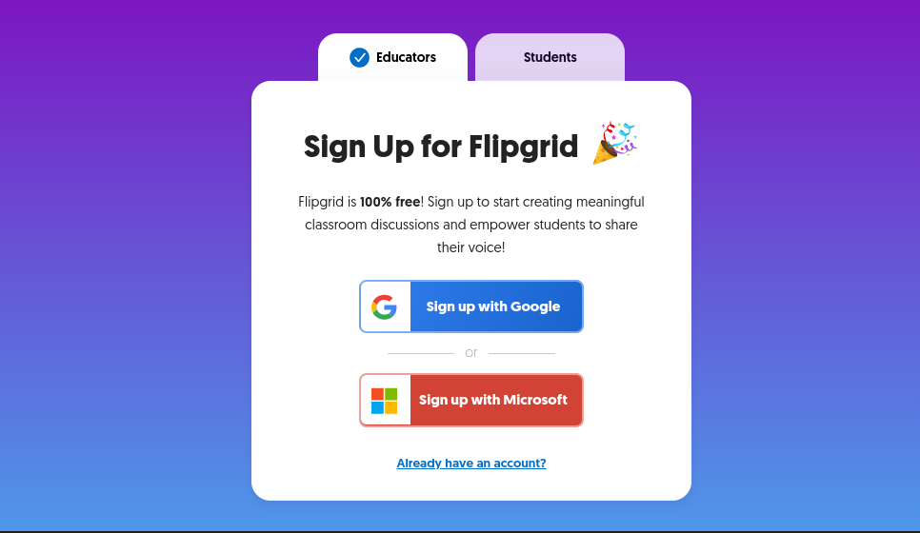

Slide 7
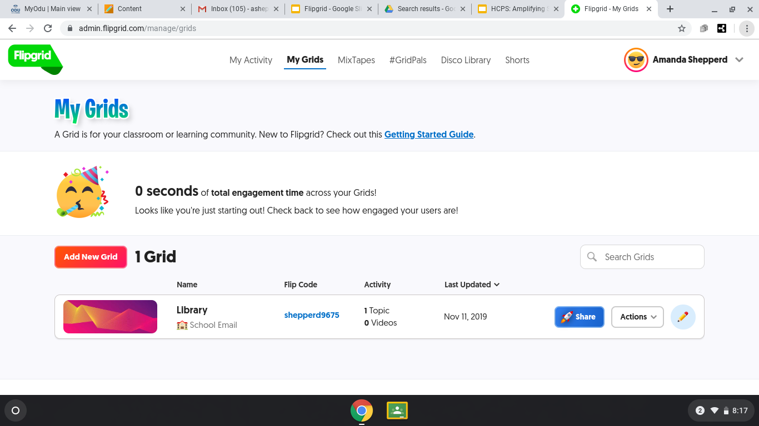
Fill in the information and set up your grid...

Slide 8
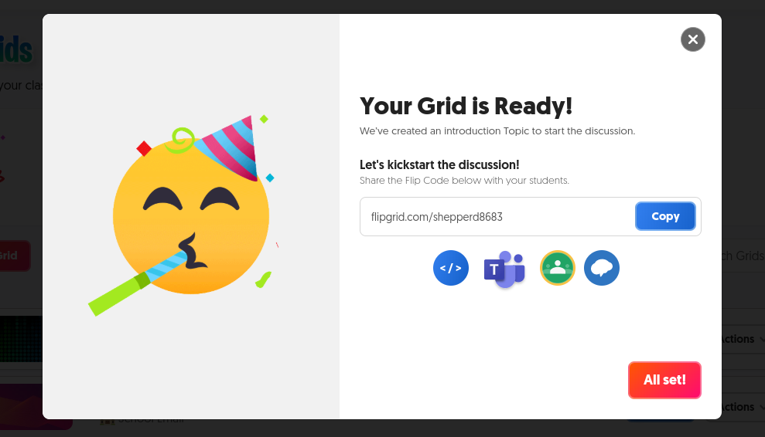

Slide 9
Educators Guide:
Click here!

Slide 10
Demo Time!

Slide 11
Exit Ticket
How would you use Flipgrid in your class?
Fill out the survey that is passed out to you. When you turn this survey in, this will also be your attendance record for today’s PD session.

