Slide 1
Paired Book Science Lesson Second Grade
Amanda Shepperd
LIBS 642

Slide 2
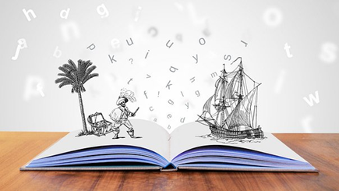
Pre-Reading Warm Up Activity:
Display the covers of each books. In small groups, have the students predict what the stories will be about and what they think the two books will have in common. Share their ideas with the class.
Talk about science safety and the steps that you must take to ensure safety during experiments.
Photo citation: T. (2019, May). [Storytelling Tale Teller]. Retrieved from https://pixabay.com/illustrations/storytelling-story-telling-tale-4203628/

Slide 3
Fiction selection: Synopsis of - Zoey and Sassafras: merhorses and bubbles by Asia Citro
Merhorses and Bubbles is the third book in a wonderful series of fictional stories that encourage a love for science. With a little magic and scientific techniques, Zoey and her cat complete some fun scientific experiments. In this particular story, her investigations take place at the stream where she typically plays at. It covers lessons about the animals living in the stream but also about recycling and keeping our water clean.
About the author: Asia Citro was a science teacher before she became a stay at home mom/children’s book author. Along with numerous science inspired children’s books, she has also written activity books and is the author of a blog about children’s activities.
Citro, Asia. (2017). Zoey and Sassafrass: merhorses and bubbles. Illus. by Marion Lindsey. Woodinville, WA: The Innovative Press. 96 pgs.

Slide 4
Non-Fiction selection: Synopsis of – Over and Under the Pond by Kate Messner
A beautifully illustrated book that teaches children that the world under the surface of a pond is fascinating. A little, African American boy and his mom discover the wonders above and below the surface. The top of the water is the mirror image of the sky but underneath the surface is an entire world of living plants and animals.
About the author: Kate Messner has written numerous fiction and nonfiction books for children that inspire creativity and wonder. She has written award winning picture books, easy readers and chapter books. She writes about a variety of topics; science, racism, social issues, and mysteries.
Messner, Kate. (2017). Over and under the pond. Illus. by Christopher S. Neal. San Fransisco, CA: Chronicles Publishing. unp.

Slide 5
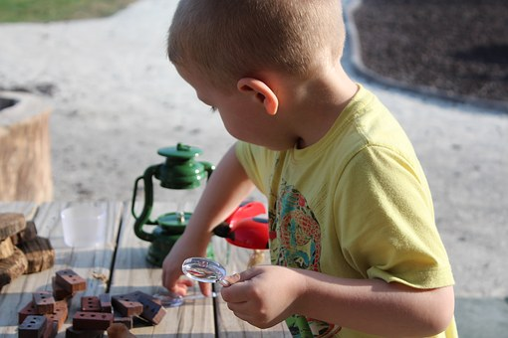
VA Science SOL’s
Scientific Investigation, Reasoning, and Logic
2.1 The student will demonstrate an understanding of scientific reasoning, logic,
and the nature of science by planning and conducting investigations in which
a) observations and predictions are made and questions are formed;
c) observations are repeated to ensure accuracy;
d) two or more characteristics or properties are used to classify items;
j) conclusions are drawn;
k) observations and data are communicated
Living Systems
2.5 The student will investigate and understand that living things are part of a
system. Key concepts include
a) living organisms are interdependent with their living and nonliving
surroundings;
b) an animal’s habitat includes adequate food, water, shelter or cover, and
space;
c) habitats change over time due to many influences
S. (2016, January). [Explore Child School Play]. Retrieved from https://pixabay.com/photos/explore-child-school-play-fun-kid-1140431/

Slide 6
VA Reading SOL’s
2.8 The student will read and demonstrate comprehension of fictional texts.
a) Make and confirm predictions.
c) Ask and answer questions about what is read.
d) Locate information to answer questions.
i) Draw conclusions based on the text
K. (2017, October). [Book Record Read]. Retrieved from https://pixabay.com/illustrations/book-record-read-a-pile-of-books-2841864/

Slide 7
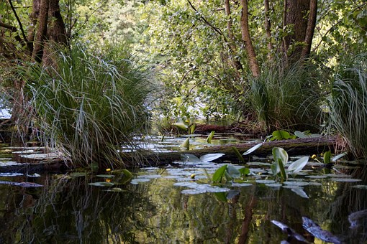
Lesson in the Library:
This activity can be done before or after the lessons from the books. In the library, students will research pond and stream animals. In small groups, students will choose at least one book per group to look up a variety of creatures that live in streams and ponds. They can draw pictures of the creatures and copy the names to share. Groups will share with the class, the book that they chose and the drawing of creatures they created.
I. (2015, July). [Lagoon Edge of the Pond]. Retrieved from https://pixabay.com/photos/lagoon-pond-water-plants-857619/

Slide 8
Lessons for the classroom:
Reading Lessons:
Discuss the difference between fiction and non fiction.
Make predictions about both stories.
Ample creative writing ideas; what magical creature would you like to meet if you were Zoey?, illustrate and describe merhorses and their caves, etc.
Science lessons:
After reading Merhorses and Bubbles, students will discuss Zoey’s scientific journal and create their own to learn how to journal when completing experiments.
Create water viewers as Zoey does to be able to see under water.
Go on a walking field trip to a pond or stream near the school to observe the creatures that live near by.
Students can sketch in their journals the creatures that they see.
If pond or stream creatures are not easily seen, students can sketch the environment to predict what could live in or around the water.
Was the water clean and well taken care of or was there pollution? This activity can also lead into a lesson on recycling and clean drinking water.

Slide 9
Discussion Questions:
Which of the two stories is fictional and which is nonfictional?
What science safety steps did Zoey use throughout the book?
Why is it important to use those safety steps we talked about while conducting experiments?
Why does Zoey think it was an unlucky day?
What fictional pond creature stood out to you from the story?
Does this creature remind you of an actual creature that you have learned about in this activity?
What are some of the creatures that you learn about in the story Over and Under the Pond?
Are there creatures from this story that you have seen or see near your homes?
Why is it important to keep the water in our streams and ponds clean?
Which story did you enjoy most and why?
Were your predictions about the stories correct from the prereading activities?

Slide 10
Websites:
Zoey and Sassafras book site:
https://www.zoeyandsassafras.com/extensionactivities/
Water science experiment site:
http://onetimethrough.com/water-pollution-for-kids-fun-science-activities/
Over and Under the Pond site:
https://www.katemessner.com/over-and-under-the-pond/
Over and Under the Pond read aloud: (sound effects with the book but you read the words)
https://www.youtube.com/watch?v=tOzspL1n-bw
Exploring water bugs – video for teachers
https://www.youtube.com/watch?v=dD9KCO636xc
Aquakids – Lake superior storm water management
http://www.aquakids.tv/project/ak-2016-17-13-lake-superior-stormwater-management-01-09-17/

Slide 11
Further Readings:
Other Zoey and Sassafras books:
Citro, Asia. (2017). Zoey and Sassafrass: dragons and marshmallows. Illus. by Marion Lindsey. Woodinville, WA: The Innovative Press. 96 pgs.
Citro, Asia. (2017). Zoey and Sassafrass: monsters and mold. Illus. by Marion Lindsey. Woodinville, WA: The Innovative Press. 96 pgs.
Citro, Asia. (2017). Zoey and Sassafrass: caterflies and ice. Illus. by Marion Lindsey. Woodinville, WA: The Innovative Press. 96 pgs.
Citro, Asia. (2018). Zoey and Sassafrass: the pod and the bog. Illus. by Marion Lindsey. Woodinville, WA: The Innovative Press. 96 pgs.
Citro, Asia. (2018). Zoey and Sassafrass: unicorns and germs. Illus. by Marion Lindsey. Woodinville, WA: The Innovative Press. 96 pgs.
Citro, Asia. (2019). Zoey and Sassafrass: grumplets and pests. Illus. by Marion Lindsey. Woodinville, WA: The Innovative Press. 96 pgs.
2. Other books by Kate Messner:
Messner, Kate. (2011). Over and under the snow. Illus. by Christopher Silas Neal. San Francisco, CA: Chronicle Books. 44 pgs.
Messner, Kate. (2017). Up in the garden, down in the dirt. Illus. by Christopher Silas Neal. San Francisco, CA: Chronicle Books. 56 pgs.
Messner, Kate. (2015). Tree of Wonder: the many marvelous lives of a rainforest tree. Illus. by Christopher Silas Neal. San Fracisco, CA: Chronicle Books. 36 pgs.
Books about Ecology:
Cole, Joanna. (2004). Magic school bus: at the waterworks. Illus. by Bruce Degen. New York, NY: Scholastic Press Publishing. 40 pgs.
Milbourne, Anna. (2007). In the pond. Illus. by Matt Russell. London: Usborne Publishing LTD. 24 pgs.

Slide 12
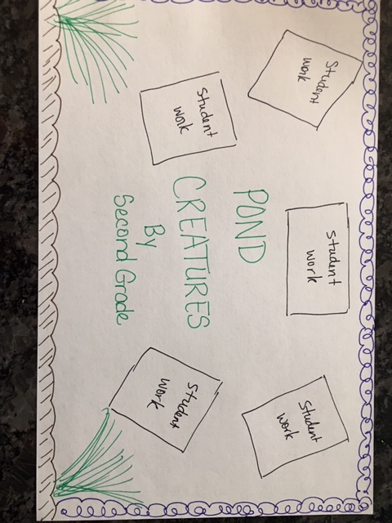
Library Bulletin Board Sketch

