Slide 1
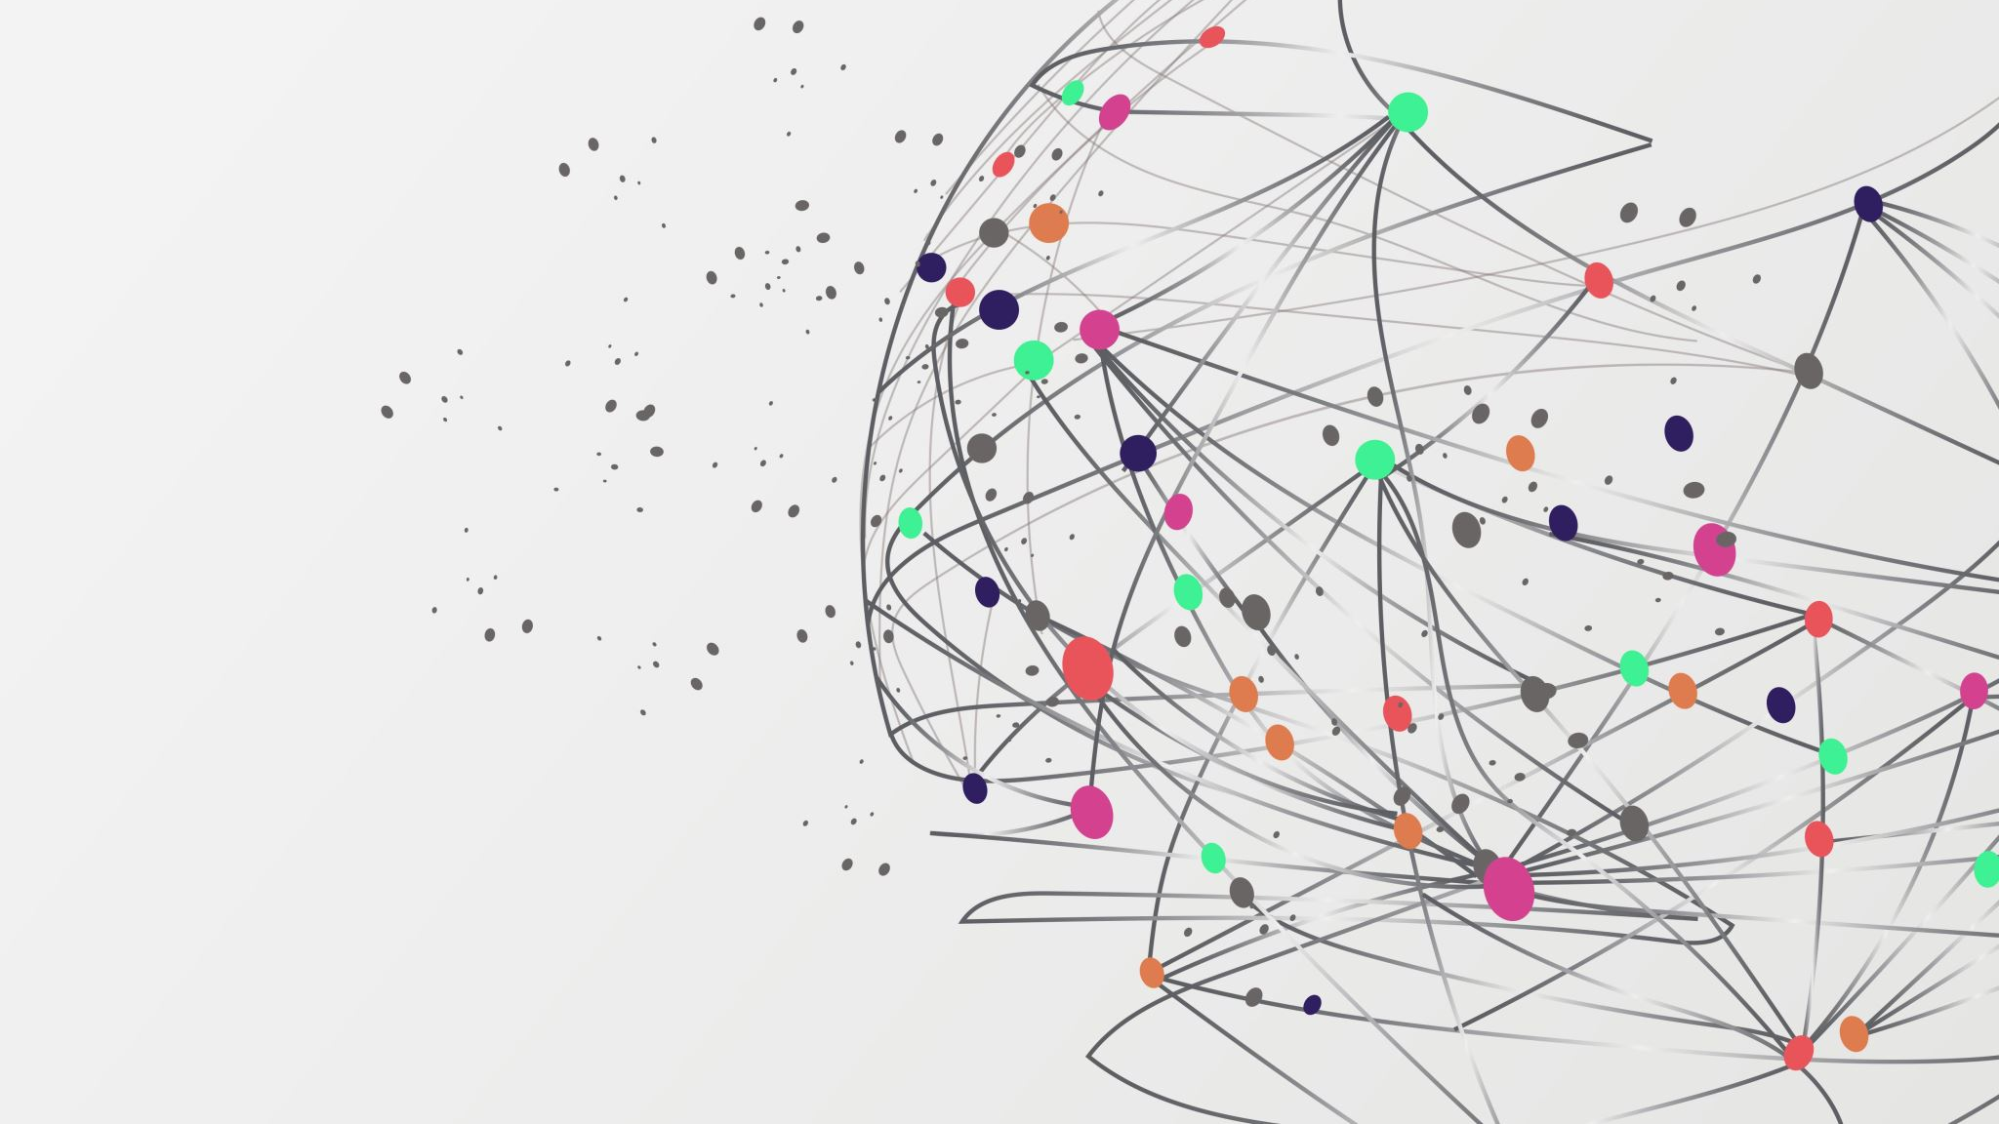
Understanding Cybercrime Categories
Nikole Tobin, Nataly Castaneda, Tellinna Force, Hussein Nafea
9.05.2023

Slide 2
Introduction to Cybercrime
Cybercrime involves illegal activities that are carried out using or aimed at networks and/or computers.
Understanding the different categories is key to developing effective strategies to prevent and respond to these threats.

Slide 3
Four Categories of Cybercrime
Cyberviolence (Crimes against individuals)
Cybertrespass (Crimes against property)
Cyberfraud (White collar crimes)
Cyberpornography (Crimes against society/morality)

Slide 4

Cyberviolence
This type of cybercrime is when a person uses technology to threaten, harm, or harass individuals.
For example,
Cyberstalking
Hate Speech
Online Harassment

Slide 5

Cybertrespass
This type of cybercrime is when an individual gains unauthorized access into networks or computer systems.
For example,
Hacking
Digital Espionage
Unauthorized Data Access

Slide 6

Cyberfraud
This type of cybercrime is when a person conducts fraudulent activities online to get financial or personal gain through deception.
For example,
Investment Fraud
Online Auction Fraud
Phishing Scams

Slide 7
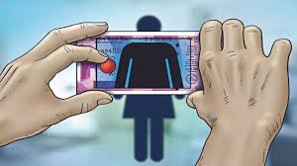
Cyberpornography
This kind of cybercrime is when an individual possesses or distributes illegal or inappropriate adult content through the internet.
For example,
Unauthorized Sharing of Illegal Adult Content
Child Exploitation

Slide 8
Matrix Chart of Cybercrime Categories
Category | Cyberviolence | Cybertrespass | Cyberfraud | Cyberpornography
Cyberviolence | Examples – cyberstalking, online harassment | - May involve harassment when already gained access | - Could use deceptive strategies involving personal threats/harm | - Harassment may happen in contexts involving illegal content
Cybertrespass | -Unauthorized access might be used to make harassment possible. (hacking to stalk) | - Examples – hacking, unauthorized data access | - Often involves unauthorized access to retrieve data | - Could involve unauthorized access to spread or view illegal content
Cyberfraud | - Deceptive practices may involve threats or harassment (schemes with threats) | - Fraud often calls for unauthorized access | Example – Phishing, fake online auctions | - Some fraud schemes may involve illegal content
Cyberpornography | - Distribution or possession of illegal content may involve harassment | - Unauthorized access to spread or view illegal content | - Some fraud schemes may involve illegal content | -Example – child exploration materials

Slide 9

Recent News Analysis
“Major Data Breach Exposes Sensitive Personal Information”
A recent breach involved unauthorized access to a big business's data in which it revealed sensitive personal information.
This would fall under the cybertrespass category because the breach involved an individual gaining unauthorized access to the organization's network and data.

Slide 10
Flowchart of Cybertrespass Incident
Step 1 – Discovery of weakness/es that can be exploited
Step 2 – Using the identified weaknesses to gain unauthorized access into the system/network.
Step 3 – Gain access and extract personal data
Step 4 - Implement response and recovery measures

Slide 11
Summary
1. Cyber Trespass:
- Unauthorized access to digital systems or networks. This can include hacking into systems, accessing data without permission, or bypassing security measures.
- Examples: Breaking into a private network to steal sensitive information, accessing restricted files or databases without authorization.
2. Cyber Pornography:
- The creation, distribution, or consumption of pornographic material via digital platforms. This can involve both legal and illegal content.
- Examples: Sharing or accessing explicit content online, illegal content such as child exploitation material, and the distribution of non-consensual explicit images.
3. Cyber Violence:
- Harmful behaviors perpetrated online can include harassment, threats, or psychological abuse. It often involves aggressive or violent actions taken through digital means.
- Examples: Cyberbullying, online stalking, and threats of violence sent through social media or email.
4. Cyber Fraud:
- The use of digital tools and platforms to commit deceptive activities with the intent to gain something of value, often through manipulation or deceit.
- Examples: Phishing scams, identity theft, online financial scams, and fraudulent schemes where attackers trick victims into giving up sensitive information or money.
Each of these categories addresses different aspects of digital misconduct and threats, reflecting the wide range of issues encountered in the realm of cybersecurity and online behavior.

