Slide 1

Teaching Geography
Norfolk Public Schools

Slide 2
Thoughts on Geography
What is your favorite geography word?
Geographic question?

Slide 3
Talk like a geographer
urban and rural
density and concentration
numerical and categorical data
density and distribution
distance
regions
patterns
Why does it matter?
Scale
Spatial distribution
Spatial association
Spatial interaction

Slide 4
Interpret maps like a geographer
Observe
Describe
Compare
Analyze
Reflect

Slide 5

Think like a geographer

Slide 6
Ask geographic questions
Where?
What’s there?
How are places alike and different?
How have people changed their environment?
How to places interact?
Why there?

Slide 7
Threads throughout the course
CLIMATE
Relative location
Relationships among variables
Repetition of key concepts in each unit
Application of geographic “rules”

Slide 8
Think like a geographer
Ask questions
Hypothesize
Draw conclusions
Make and test generalizations
Prove or disprove data
Select appropriate data

Slide 9
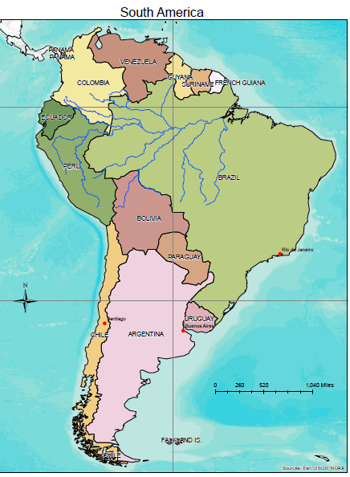
Evaluate
Shape
Size
Location
Why does accessibility matter?

Slide 10
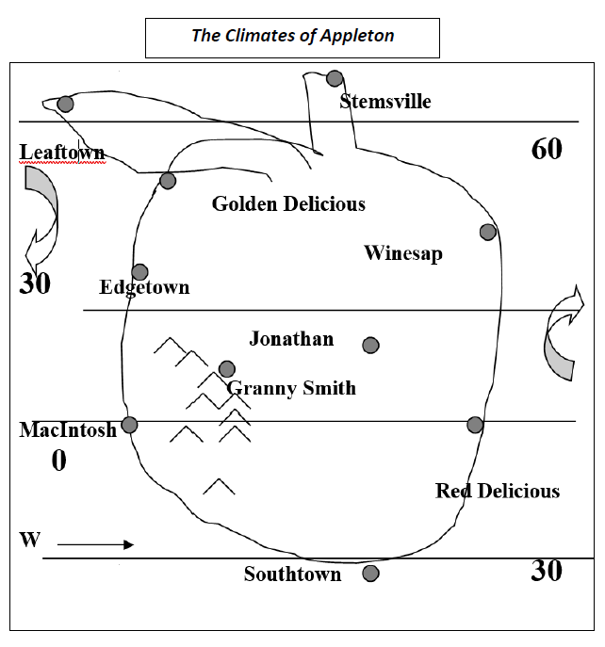

Slide 11
Use models -- Appleton
Use vocabulary and apply knowledge—Clyde’s Story
Apply concepts -- Economia
Atlas exercise
Analyze atlas exercise
Card sort

Slide 12
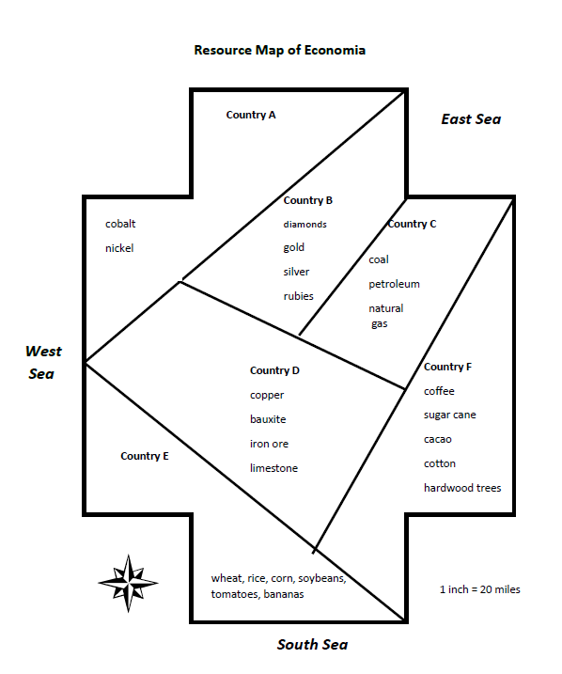

Slide 13
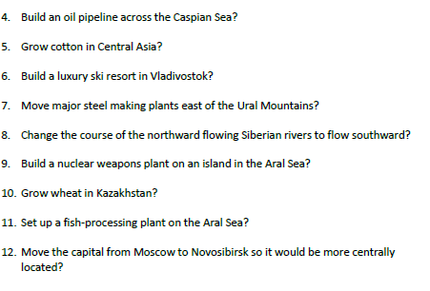
Decisions, decisions

Slide 14
Transform data to knowledge
Evaluating accessibility
Creating a choropleth map (Southeast Asia, peninsular and insular data)
Solving demographic data dilemmas
Creating and analyzing a climograph

