Slide 1
Consulting Proposal for Professional Development in Education
December 3, 2018
By Samantha Page
English 327W

Slide 2
Bilingual Education: A Niche Field

Slide 3
Understanding Bilingual Education
What is it?
What is it not?
What is needed?
Bilingual education is defined as the education of students in two languages so that they will achieve content and linguistic mastery in both. (Escamilla et al., 2017)
It is not proficiency in English, over another language like Spanish or Chinese (Cogner 2010).
High quality professional development for bilingual education.
-Grants for bilingual PD have been removed
-Bilingual education has been politicized. (Téllez & Varghese)

Slide 4
As Industry Experts in Professional Development (PD), You Can Reach This Market!

Slide 5
Researched-Backed Guiding Principles
As you develop and implement your brand of professional development, use the following researched-backed principles to create an effectual model for bilingual education.

Slide 6
4 Principles of Bilingual Professional Development
Active Participation
Facets of active teacher participation in professional development increase teacher participation (Bates & Morgan, 2018).
Long-Term
Bayar (2014) indicated short term professional development has a smaller impact on student outcomes than long term professional development.
Teacher-Centered
Teachers, as the leaders of the classroom and where the application of professional development occur, are where the professional development should focus (Kuijpers et al. 2010).
School-Centered
Bayar (2014) also identified professional development centered on a school as effective. School-centered PD will have the ability to modify for the individual needs expressed by administrators.

Slide 7
The Team
Within bilingual education’s professional development principles, there is a necessity for team collaboration in order for your professional development to be successful.

Slide 8
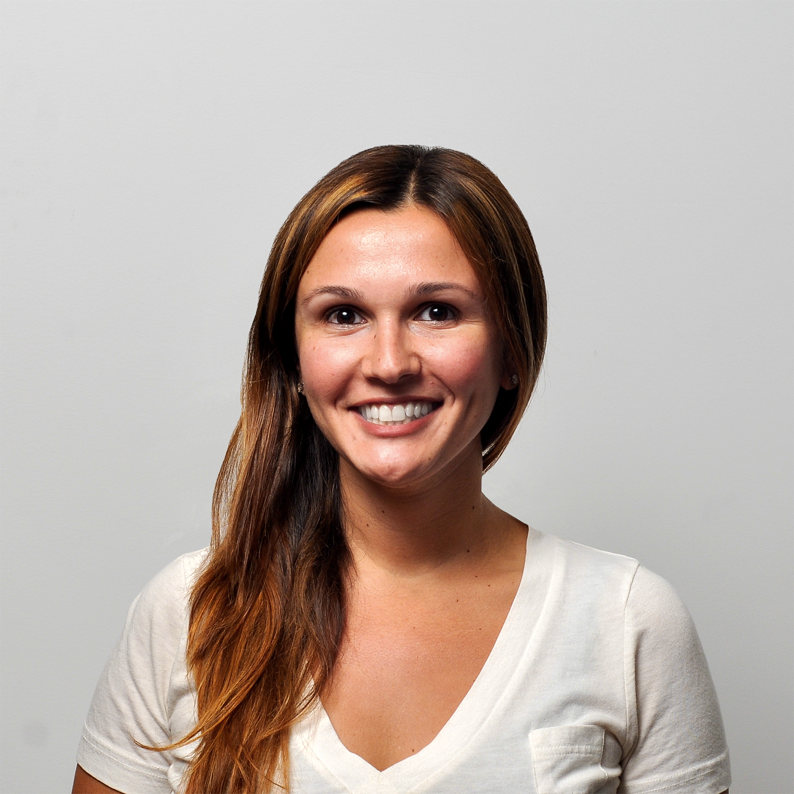
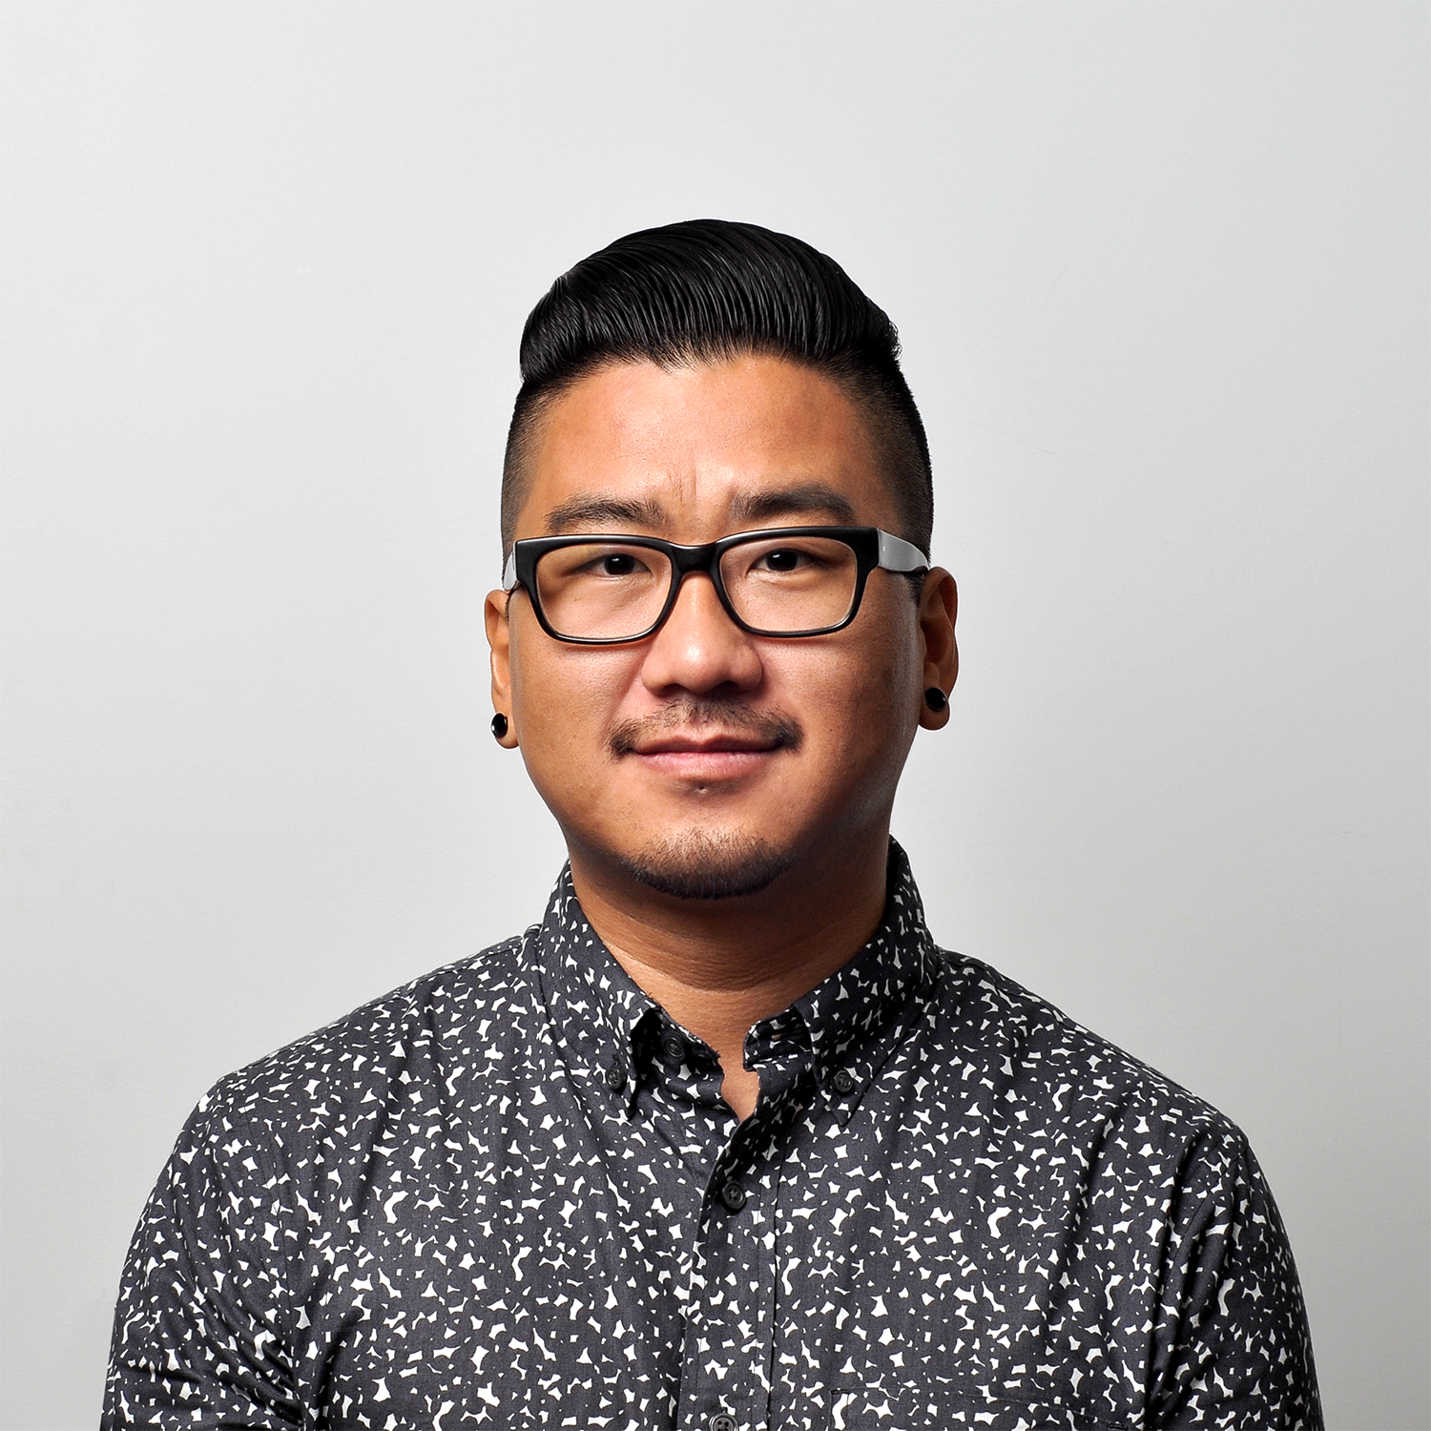
The Bilingual Education Professional Development Team
The Teacher
The Coworker
The Administrator
PD Staff
Receives professional development training over an extended duration and works to implement it in her bilingual education classroom
Works with fellow teachers, providing feedback and assistance in implementation of PD practices
Collaborates with PD staff and educators, to ensure the professional development aligns with the goals of the school
Implements professional development training, follow up coaching meetings and evaluations.

Slide 9
Using a combination of these principles with emphasis on all team members, the professional development model you develop for bilingual education will revolutionize the field!

