Slide 1
Letter Writing
by Nichole Tillinghast
February 22, 2018

Slide 2
Epistle
Literary genre of letter writing
Letter writing addressed to a person or group of people
Elegant, formal, and didactic (instructive/informative)
Ancient Egypt as part of the scribal-school writing curriculum
Letters in the New Testament from Apostles to Christians (“epistles” and “Pauline epistles”)

Slide 3

Modern Scribes
Source: https://en.wikipedia.org/wiki/Scribe

Slide 4
Instruments
Something to write with
“Style” instrument – wood, metal, reeds, or sharpened bone and pigments (ink from cuttlefish)
5th century quills (goose) in England – hollow shaft
14th century lead pencils
19th century firsts pens
Something to write on
Papyrus, vellum, parchment, animal skins, tree bark (beech), cotton, linen
Letter opener
Distinctive instrument in itself

Slide 5
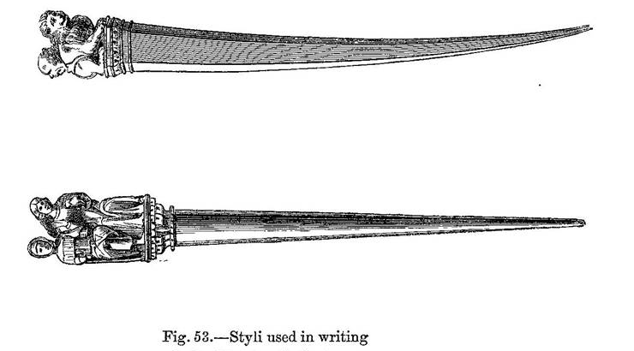
14th Century Styli
Source: www.historyofpencils.com/picture/picture-of-fourteenth-century-writing-implements/

Slide 6
Postal Services
Roman “positus” (carriers) - later “post”
Prior to postal services letters carried by courier and the recipient had to pay upon delivery
Communication between colonies and mother countries
1639 first colonial mail, then states
1840 Great Britain
1842 United States
Created in 1775 (Benjamin Franklin)
Postage based on sheets of paper and distance
The “Postmark”

Slide 7
1799-1815 U.S. Postage Rates
8 cents/sheet sent 40 miles or less
10 cents/sheet sent 41 to 90 miles
12 ½ cents/sheet sent 91 to 150 miles
17 cents/sheet sent 151 to 300 miles
20 cents/sheet sent 301 to 500 miles
25 cents/sheet sent more than 500 miles
(In 1815 it would have cost 25 cents for me to mail a single sheet of paper to Miranda in Colorado)

Slide 8
Wax Sealing
Could seal a single sheet of paper folded
The seal signified confidentiality
Correspondence limited to the sender and receiver
Use of the signet ring to stamp as identity
Printed in reverse
Family Crest
Melted down upon death of the owner

Slide 9
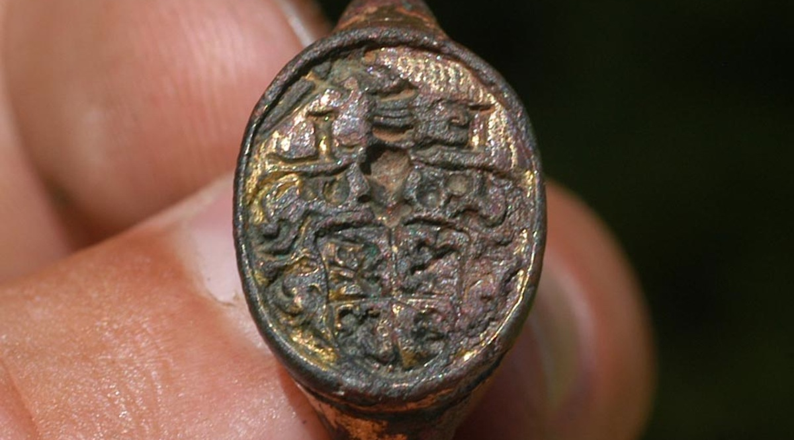
Signet ring found in 2005 at Jamestown archaeological site – circa 17th century
https://historicjamestowne.org/july-2005-2/

Slide 10
American Letter Writing
Means of communicating with Europe
Sponsors – monarchs, noblemen, wealthy
Families back in Europe
Amerigo Vespucci – Italian merchant
His letters published in Europe
Significant in war correspondence
Marginalization
Cost prohibitive
Illiteracy

Slide 11
Victorian Letter Writing
Manner of letter writing defined the class
Elegance and penmanship
“Proper” instruments
Stationary
Texts on proper letter writing emerged
Victorian etiquette of letter writing

Slide 12
Letters in Literature
Les Liaisons Dangereuses
Epistolary novel first published in 1782
Fictional letters by a fictional characters
Scandalous depiction of seduction and revenge
Metanarrative spaces
Political and historical impact
Critique of pre-revolutionary France
Pride and Prejudice
Jane Austen’s Emma
Cross writing (economy)
Notes:
Think here of how letters recount past events or act as metanarrative spaces. It is fascinating that the entire narrative is carried is forwarded by this recursive structure—it is all in letters to and from characters! If you want to just repeat what I’ve said, that works. But that’s the big deal about this enlightenment era work. And it was a big deal politically. Major critique of pre-rev France.
When you say fictional author do you mean fictional character?

Slide 13
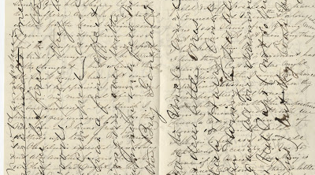
Example of Cross Writing (Civil War letter from Alexander Biddle to his wife, 1862)
Source: https://rosenbach.org/blog/cross-writing-and-cross-reading/

Slide 14
Poetry
Poetry as a letter
Love letter
I/Thou – Martin Buber
Prominent 20th century philosopher
1923 publication of Ich und Du (I and Thou)
“I-Thou” and “I-It” existence

Slide 15
Emily Dickinson
1839-1866
American poet
Poetry circulated through letters
Variation of words in duplication to different recipient
Sister burned her letters as promised upon her death
This was customary at the time
Discovered her poems
Dickinson’s letters to others still exist
Notes:
Do not make a qualitative judgement “greatest and most original”. You can assert that many people praise ED as “greatest” which is evidenced by # of anthologies of ED, # of occurrences on syllabi, # of festivals dedicated to ED, etc.
VERY important to say that ED circulated her poems through her letters. She had specific audiences in mind. She would change a few words (aka the variants) when she recopied the poem to send to someone else. Critics also debate where a poem ends and the rest of the letter begins. VERY interwoven.

Slide 16
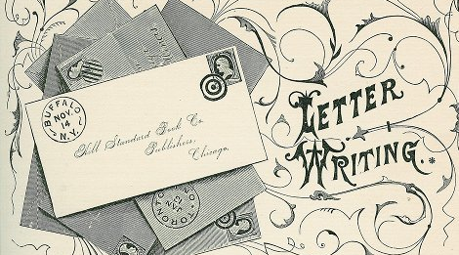
Thomas E. Hill Hill’s Manual of Social and Business Forms: A Guide to Correct Writing (1886)

Slide 17
Schools for Handwriting
Spencerian Script
Platt Rogers Spencer developed in 1840
Oval based penmanship
1850-1925 standard for handwriting
Spencerian Key to Practical Penmanship, 1866
Ford Motor Company and Coca-Cola logo
Palmer method
Developed around 1888
Became standard and most popular
Palmer’s Guide to Business Writing, 1894
Standardized writing
Followed by Zaner-Bloser and D’Nealian methods

Slide 18
Letter Writing Pre-Computer
Aspects of the hand written letter
Personal
An artifact
Biographical code
Historical
Primary source
Physical
Difference between letter writing and e-mail
Is there a difference?

Slide 19
Correspondence
Wartime
Decline in mail at end of wars
Love letters
Relationships formed via letters
Modern “seal”
Personalization
Compared to modern dating sites

Slide 20
Letters to…
Letters to God
“To God, Jerusalem”
Letters placed in cracks of the Wailing Wall
Transactional and therapeutic letter writing
Source of healing
Letters to self
Future
LettersIllNeverSend.com
Current movement of “notes”
The Kindness Rocks Project
https://www.youtube.com/watch?v=e_iBnQ19Yhs

Slide 21
Individuality of Handwriting
As individual as fingerprints
Handwriting analysis
Used in forensics
Change your handwriting, change your life
The Vimala Rodgers method

Slide 22
Current Debate
Handwriting in schools
Teaching of cursive removed from national SOL’s
Very few school districts still teach
Inability of students to read cursive
Declaration of Independence
Historical artifacts

Slide 23
Brain Actions
Difference between computer and handwriting
Current studies show students who take handwritten notes retain more information than those who type
Brain/hand function

Slide 24
Works Cited
Burke, Kathryn. Letter Writing In America. Smithsonian Institute, https:// postalmuseum.si.edu/letterwriting/index.html. Accessed 4 Feb. 2018.
“Epistle.” Wikipedia, 24 Dec. 2017, https://en.wikipedia.org/wiki/Epistle. Accessed 14 Feb. 2018.
History of Handwritten Letters.” Handwrittenletters.com, https://handwrittenletters.com/history-of- handwritten-letters.html. Accessed 11 February 2018.
“History of Writing Implements – Tools for Writing.” History of Pencils. 2018. http:// www.historyofpencils.com/writing-instruments-history/history-of-writing- implements/. Accessed 16 Feb. 2018.
“Martin Buber (1878-1965).” Internet Encyclopedia of Philosophy. https://www.iep.utm.edu/ buber/#SH2b. Accessed 19 Feb. 2018.
“The United States Postal Service – An American History
1775-2006.” United States Postal Service, 2018, https://about.usps.com/ publications/pub100/welcome.htm. Accessed 4 Feb. 2018.

Slide 25
Textual Practice
Compose a letter to a classmate
How is this different than an e-mail?
What “brain” actions do we use?
Mail your letter
Take a picture and post it to the class blog
What is it like to receive a hand-written letter?
Demonstration
Wax seal
What do we still use letters for?
Notes:
Rather than asking “what do we still use handwriting for” it would be better to say “what do we still use letters for”?

Slide 26
For further exploration:
Lakshmi Pratury at TED2007
https://about.usps.com/publications/pub100/welcome.htm
Smithsonian National Postal Museum
https://postalmuseum.si.edu/letterwriting/index.html
Signed, Sealed, Delivered: Celebrating the Joys of Letter Writing by Nina Sankovitch
http://www.simonandschuster.com/books/Signed-Sealed-Delivered/Nina-Sankovitch/9781451687163
Pen to Paper: Artists’ Handwritten Letters from the Smithsonian Archives of American Art
https://www.aaa.si.edu/publications/books/pen-to-paper-artists-handwritten-letters-from-the-smithsonians-archives-of

