Slide 1
Textual Practice
Matthew Wood
From Diary Keeping to Online Blogging
From Scrapbooks to Virtual Pinboards

Slide 2
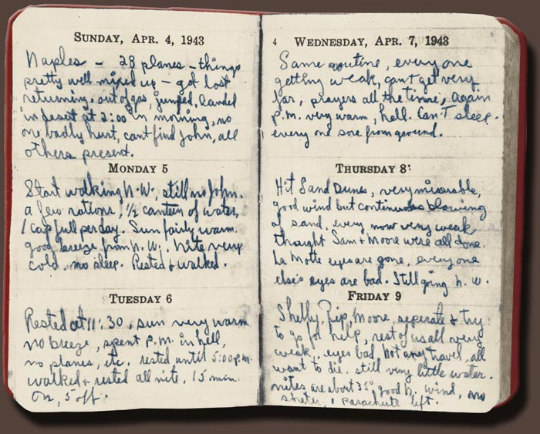
Diary Keeping
Diary – an individual’s written record of daily events which may express personal thoughts and opinions. Journal is the non-daily version.
Handwritten on Paper
Audience: Self, Book
Source: None
Earliest: Marcus Aurelius 161 AD
Historical Context:
Record Keeping
Recounting Events
Personal Reflection
Professional Recognition

Slide 3
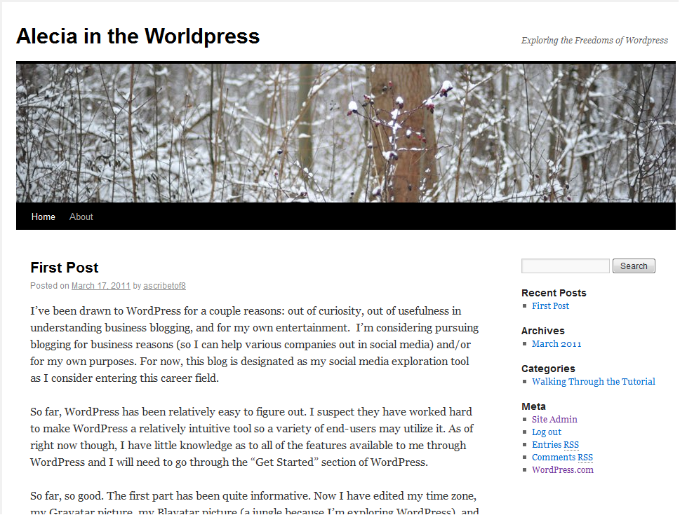
Online Blogging
Online Blog – an individual’s digital space used primarily for typing about daily experiences and social commentary.
Typed on Computer
Audience: Niche Groups, Strangers
Source: Extension of Textual Bulletin Boards
Earliest: Claudio Pinhanez in 1994
Historical Context:
Establishing Presence
Personal Reflection
Social Connection
Professional and Political Gain

Slide 4
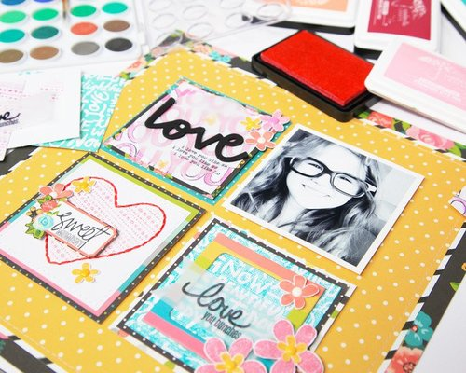
Scrapbooks
Scrapbook – a collection of personal photographs and other media which are artistically molded into the pages of a blank book.
Handcrafted with Tools in Kit
Audience: Self, Family
Source: Commonplace Books in Italy 1400s
Earliest: None
Historical Context:
Hodgepodge Keepsakes
Yearbooking
Preserving Material Representations

Slide 5
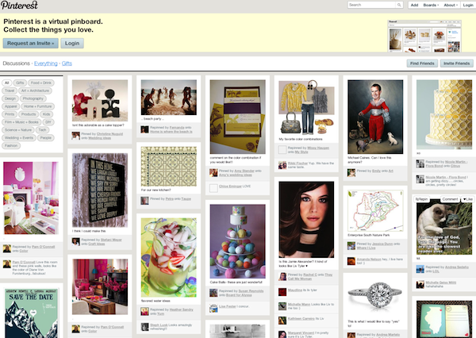
Virtual Pinboards
Virtual Pinboard – an online area used for posting photographs, announcements, and other visuals in a social community.
Contoured on Computer
Audience: Niche Groups, Strangers
Source: Corkboard by George Brooks 1924
Earliest: Ward Christensen Randy Suess 1976
Historical Context:
Keeping Notes and Small Items
Bulletin Board Systems Software
News and Social Connection
Sharing Ideas through Visuals

Slide 6
Cross Sections
Diary Keeping
Hand Made
Self and Artifact
Personal
Reflection
Recording Notes
Scrapbooks
Interests
&
Opinions
Virtual Pinboards
Visual Art
Preservation
Textual
Born Digital
Interest Groups & Strangers
Family & Close Friends
Online Blogging

Slide 7
Demonstration
Designing a Professional Book Cover
Students will have the opportunity to select a digital book cover template. The photos and texts are all able to be edited and changed to the student’s preferences. The students will design the cover as if they were going to publish their personal diary, blog, scrapbook, or pinboard. This plays into Bornstein’s description of semiotic features in books such as color, layout, line spacing, notes, prefaces, et cetera.
https://www.postermywall.com/index.php/l/book-cover

