Slide 1
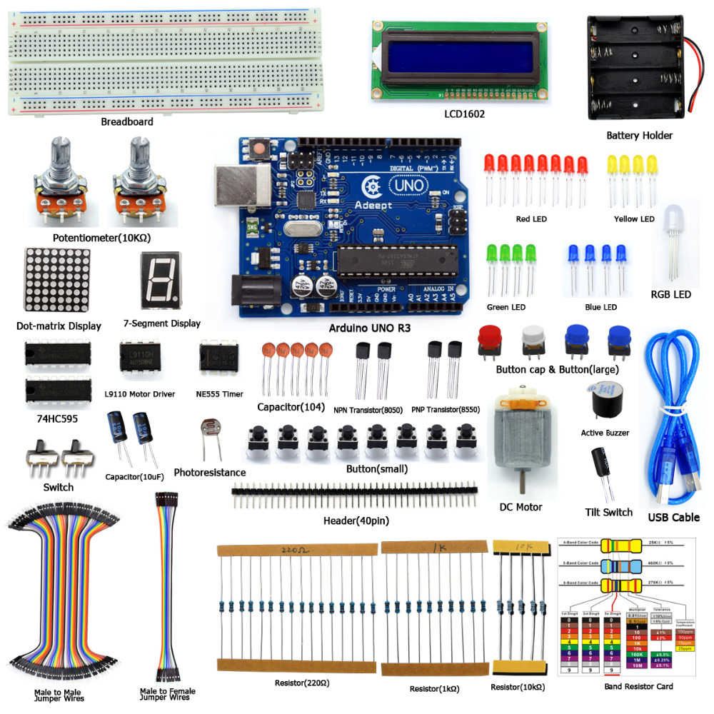
Arduino
Textual Practice
"Those who think of the text as the paradigm of all discourse need to face the fact that only the tiniest fraction of languages have ever been written or ever will be. Most have disappeared or are fast disappearing, untouched by textuality. Hardcore textualism is snobbery, often hardly disguised." –Walter Ong
Notes:
http://www.onsalevideogame.com/videogame-replacement-parts/adeept_diy_electric_super_starter_kit_for_arduino_uno_r3_with_guidebook_lcd1602_breadboard_freeshipping_book_headphones_diykit.html

Slide 2
1933 Telex
Notes:
“Telex messaging network comes out of the early period of Germany’s Third Reich. Telex starts as a way to distribute military messages, but soon becomes a world-wide network of both official and commercial text messaging that will persist in some countries into the 2000s. Telex uses teleprinters, which date back to the 1910s for use in telegraphy. But instead of using pricey dedicated telegraph lines, the telex system connects those teleprinters to each other over voice telephone lines, routed by modified telephone switches. Wireless versions of Telex soon connect remote regions of the developing world.”
http://www.computerhistory.org/timeline/1933/

Slide 3
1939 Elektro
Notes:
“Built by Westinghouse, the relay-based Elektro robot responds to the rhythm of voice commands and delivers wisecracks pre-recorded on 78 rpm records. It appeared at the World's Fair, and it could move its head and arms… and even "smoked" cigarettes.”
http://www.computerhistory.org/timeline/1939/

Slide 4
1961 IBM 7090
Notes:
http://www.computerhistory.org/timeline/1961/

Slide 5
Whole Earth Catalog (1968)
Notes:
“The Whole Earth Catalog (WEC) was an American counterculture magazine and product catalog published by Stewart Brand several times a year between 1968 and 1972, and occasionally thereafter, until 1998. The magazine featured essays and articles, but was primarily focused on product reviews. The editorial focus was on self-sufficiency, ecology, alternative education, "do it yourself" (DIY), and holism, and featured the slogan "access to tools". While WEC listed and reviewed a wide range of products (clothing, books, tools, machines, seeds, etc.), it did not sell any of the products directly. Instead, the vendor's contact information was listed alongside the item and its review. This is why, while not a regularly published periodical, numerous editions and updates were required to keep price and availability information up to date.” https://en.wikipedia.org/wiki/Whole_Earth_Catalog
Image: http://www.vintageadbrowser.com/books-and-magazines-ads-1970s/2

Slide 6
MIT Center for Bits and Atoms (FabLab)
Notes:
From www.computerhistory.org “Professor Nicholas Negroponte and former MIT President Jerome Wiesner, a former science advisor to President John F. Kennedy, founds the MIT Media Lab in 1980. The Media Lab opened in an I.M. Pei-designed building, initially focusing on the 'Digital Revolution' in areas as wide-ranging as electronic music, machine learning, holography, computer graphics, and art. Work at the lab has led to hundreds of patents and many spin-off companies.”
Photo by Alan Lishness: https://www.flickr.com/photos/lishness/2061446074

Slide 7
Maker Timeline
Notes:
https://www.preceden.com/timelines/65940-history-of-maker-movement

Slide 8
2005 Arduino
Notes:
“Harkening back to the hobbyist era of personal computing in the 1970s, Arduino begins as a project of the Interaction Design Institute, Ivrea, Italy. Each credit card-sized Arduino board consisted of an inexpensive microcontroller and signal connectors which made Arduinos ideal for use in any application connecting to or monitoring the outside world. The Arduino used a Java-based integrated development environment and users could access a library of programs, called “Wiring,” that allowed for simplified programming. Arduino soon became the main computer platform of the worldwide “Maker” movement.”
http://www.computerhistory.org/timeline/2005/

Slide 9
757 Maker Space, Norfolk, VA
Notes:
ttps://www.preceden.com/timelines/65940-history-of-maker-movement

Slide 10
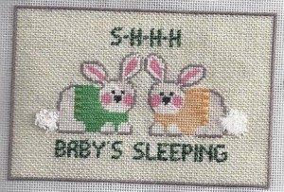
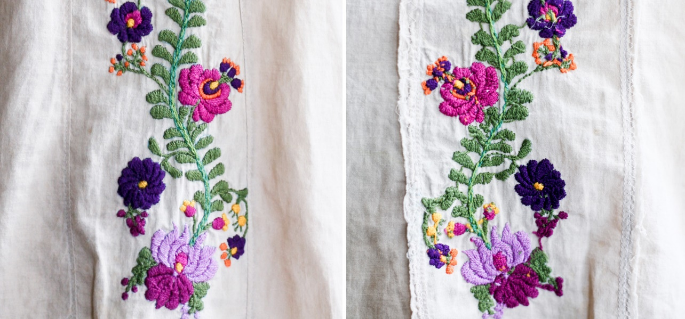
Two Sides
Notes:
https://kate-and-rose.com/learn/about-the-back-of-embroidery/
https://www.linkedin.com/pulse/leadership-like-needlepoint-robert-j-hunt

Slide 11
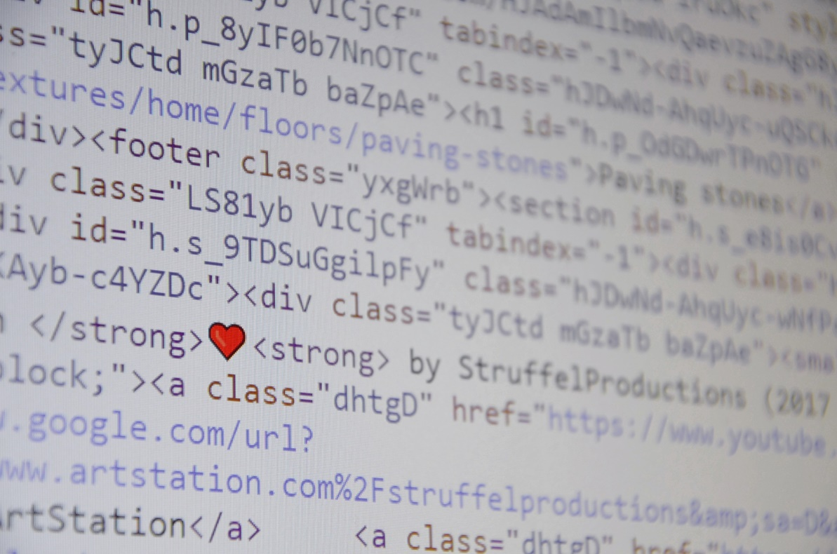
Interface
Code
Notes:
Images from Pixabay

Slide 12
Arduino Starter Kit (plus some)

Slide 13
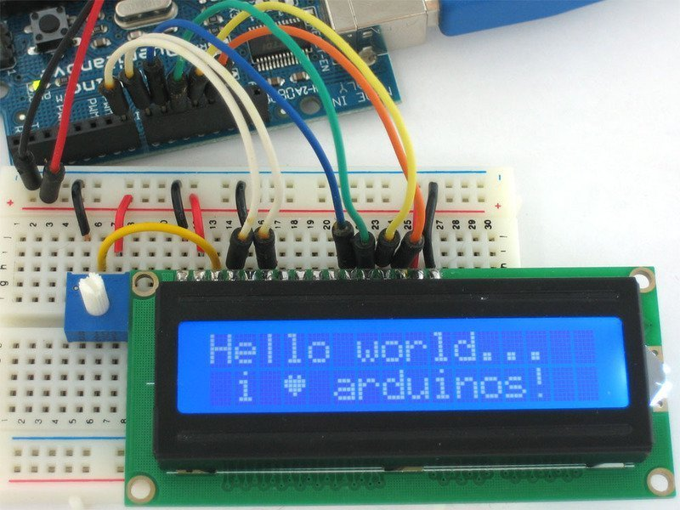
Changing Arduino Code
*I wanted to show “Hello World,” but I failed, so this is someone else’s “Hello World.”
Notes:
https://learn.adafruit.com/character-lcds?view=all

Slide 14
Arduino LoveOMeter Code

Slide 15
Arduino Board (wired)

Slide 16
Arduino (with breadboard)

Slide 17
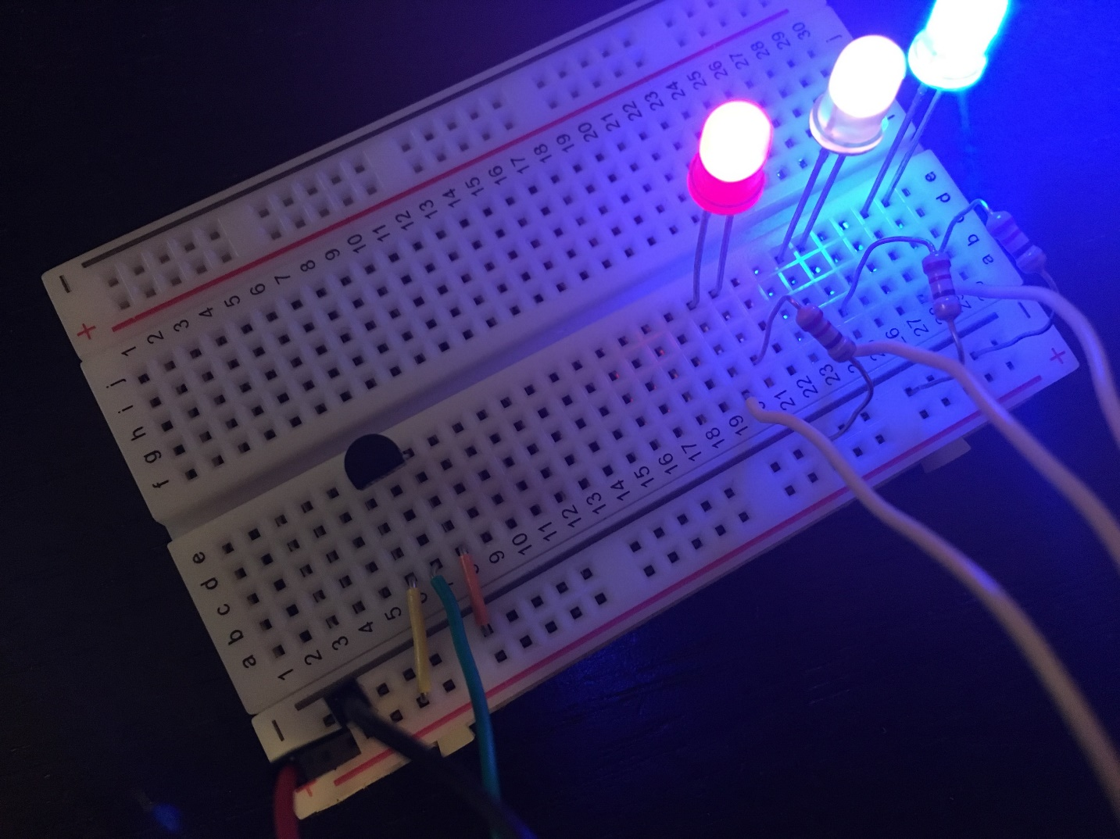
Arduino (with lights)
*The lights came on for LoveOMeter!

Slide 18
Connecting the LoveOMeter

Slide 19
ACTIVITY: Arduino LoveOMeter
Notes:
https://programminginarduino.wordpress.com/2016/02/29/projecte-3/

Slide 20
Works Cited
Works Cited
Camille, Michael. “Sensations of the Page: Imaging Technologies and Medieval Illuminated Manuscripts.” The Iconic Page in Manuscript, Print, and Digital Culture, edited by George Bornstein and Theresa Tinkle. Ann Arbor, MI: University of Michigan Press, 1998, pp. 33-53.
Endres, William. “More than Meets the Eye: Going 3D with an Early Medieval Manuscript.” Proceedings of the Digital Humanities Congress 2012. 2013. The University of Sheffield, www.dhi.ac.uk/openbook/chaptere/dhc2012-endres. Accessed 25 Jan. 2018.
Kruger, Kathryn Sullivan. “Myth, History, and the Material World.” Weaving the World: The Metaphorics of Weaving and Female Textual Production. Selingsgrove: Susquehanna University Press, 2000, pp. 21-33.
---. “The Semiotics of Cloth and Thetic (Re)Production.” Weaving the World: The Metaphorics of Weaving and Female Textual Production. Selingsgrove: Susquehanna University Press, 2000, pp. 34-52.
Ong, Walter. “Writing Is a Technology that Restructures Thought.” The Written Word: Literacy in Transition, edited by Gerd Baumann. New York, Oxford University Press, 1986, pp. 23-49.
Timeline of Computer History. 2018. Computer History Museum, http://www.computerhistory.org/timeline. Accessed 12 Feb. 2018.
“Whole Earth Catalog.” Wikipedia, https://en.wikipedia.org/wiki/Whole_Earth_Catalog. Accessed 14 Feb. 2018.
Images Sources
“Adeept DIY Electric Super Starter Kit for Arduino UNO R3 with Guidebook LCD1602 Breadboard Freeshipping Book headphones diykit.” Shopping ITrend.com, www.onsalevideogame.com/videogame-replacement-parts/adeept_diy_electric_super_starter_kit_for_arduino_uno_r3_with_guidebook_lcd1602_breadboard_freeshipping_book_headphones_diykit.html. Accessed 12 Feb. 2018.
“Books, Magazines and Newspaper Ads of the 1970s.” Vintage Ad Browser, www.vintageadbrowser.com/books-and-magazines-ads-1970s/2. Accessed 14 Feb. 2018.
“Character LCDs.” Adafruit, /learn.adafruit.com/character-lcds?view=all. Accessed 14 Feb. 2018.
“History of the Maker Movement.” Preceden, www.preceden.com/timelines/65940-history-of-maker-movement. Accessed 14 Feb. 2018.
757 Maker Space. Facebook, www.preceden.com/timelines/65940-history-of-maker-movement. Accessed 14 Feb. 2018.
Hunt, Robert J. “Leadership Is Like Needlepoint (work with me on this one).” LinkedIn, https://www.linkedin.com/pulse/leadership-like-needlepoint-robert-j-hunt. 12 Feb. 2018.
Kate & Rose, kate-and-rose.com/learn/about-the-back-of-embroidery/. Accessed 12 Feb. 2018.
Lishness, Alan. Flickr, www.flickr.com/photos/lishness/2061446074. Accessed 14 Feb. 2018.
Pixabay, www.pixabay.com. Accessed 12 Feb. 2018.
“Project 3: Love-O-Meter.” Programming in Arduino, programminginarduino.wordpress.com/2016/02/29/projecte-3/. Accessed 12 Feb. 2018.
Timeline of Computer History. 2018. Computer History Museum, www.computerhistory.org/timeline. Accessed 12 Feb. 2018.

