Slide 1
Cross-Stitch

Slide 2
Cross-Stitch Fundamentals
  Function
    Garments and household cloths
      Decoration
      Function
      Identity
      Status
  Practice
    Using fingers, the needle passes through the fabric several times to create an “x” or cross
    The cross fills the fabric square it is over
    All stitches must cross in the same way and same direction to preserve evenness

Slide 3
Materials
    Needle
    Evenweave fabric
    Embroidery thread
    Scissors/cutter
    Additional
      Wooden hoop
      Needle threader
      Pattern/design
      Seam ripper

Slide 4
History of Embroidery
  Prehistoric use of the needle
    Animal teeth/bones and beads decorating clothing
  Embroidered pieces found in Egyptian tombs dating to 2000 B.C.
  Embroidery in China and expanding through trade (200 B.C.-1400 A.D.)
  Western versions most likely a mix with heavy influence from Middle Eastern technique
    Crusades (1095-1291)
    Ministry
  Exploration spreads European versions further West (1500s-1700)

Slide 5
Bayeux Tapestry
  1070s
  Documenting the Norman Conquest by William of Normandy
    20 inches by 230 ft
  Unknown creator
    Queen Matilda
    Bishop Odo
  Stitching variety
    Running, satin, buttonhole, cross
http://www.precinemahistory.net/bayeux.htm

Slide 6
From Hand to Machine
  Printing
    1520s- Earliest printed pattern books in Germany
      Because printing was still developing in mass, this gives rise to samplers
    Mid to late 1500s- pattern books printed and more available to the public
      Samplers were handed down and less “valued”
  Stocking Frame
    1589- Created by William Lee
    1590s- Attempted to get approval from Queen Elizabeth I
    1710- workers begin protests
      1811-1818- Height of Luddite protests
  Embroidery Machine- Joseph Heilman in 1828
  Singer sewing machine- Elias Howe in 1851
    Mass production of clothing and fabrics
    Demand for hand-stitched items in decline
  1868- The disparity between handmade and machine stitches very slim

Slide 7
Samplers
  Originally served as a “bank” of favorite stitches and design; a full reference
  After print books, samplers passed on to daughters
  Samplers also served as resume for women
  18th century samplers displayed for visitors to see
  Often included virtues or statements of mourning
    When I am dead and in my grave
    And all my bones are rotten
    By this may I remembered be
    When I should be forgotten (Retrieved from thecrossstitchguild.com)

Slide 8
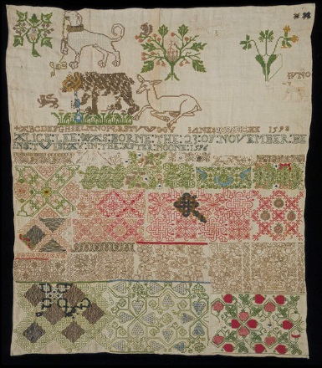
Mixed Medium
Visual and text (letters and words)
  A guide for stitching and literacy
Verse signature
  “This needle work of mine doth tell
  My name and age and where I dwell
  This needle work of mine doth tell
  What is my name and where I dwell
  Wrought by Miss Eliza Blaisdell” (Fratto, 1976, p.209)
Jane Bostocke sampler (1598)

Slide 9
A Stitch of Meaning
Prompt discussion from the reader
Carrier, transmitter, and receptacle of meaning
  Maker is both author and reader
  Maker fully understands the work; outsider sees only the object
Blending meaning with fabrics (quilting)
  Practical
    Useful skill and discipline
  Subversive
    Gendered roles
    Gendered “cross”
  Memorialize

Slide 10
Copy or Original?
If Mona Lisa is in the Louvre, then where is Hamlet?
Resemble works of art
  Still captures the process and the person
  Destabilizes “fine” art hierarchy of class
“Humble objects” that carry artful significance to the maker
  “Home maker”
    Mark of the stitch
    Framing the stitch

Slide 11
Cross-Stitch code
As a Computer?
  Jacquard Loom- programmable machine
    Removes the stitcher from the product (now programming the machine)
Patterns and code
Pixel and stitch

Slide 12
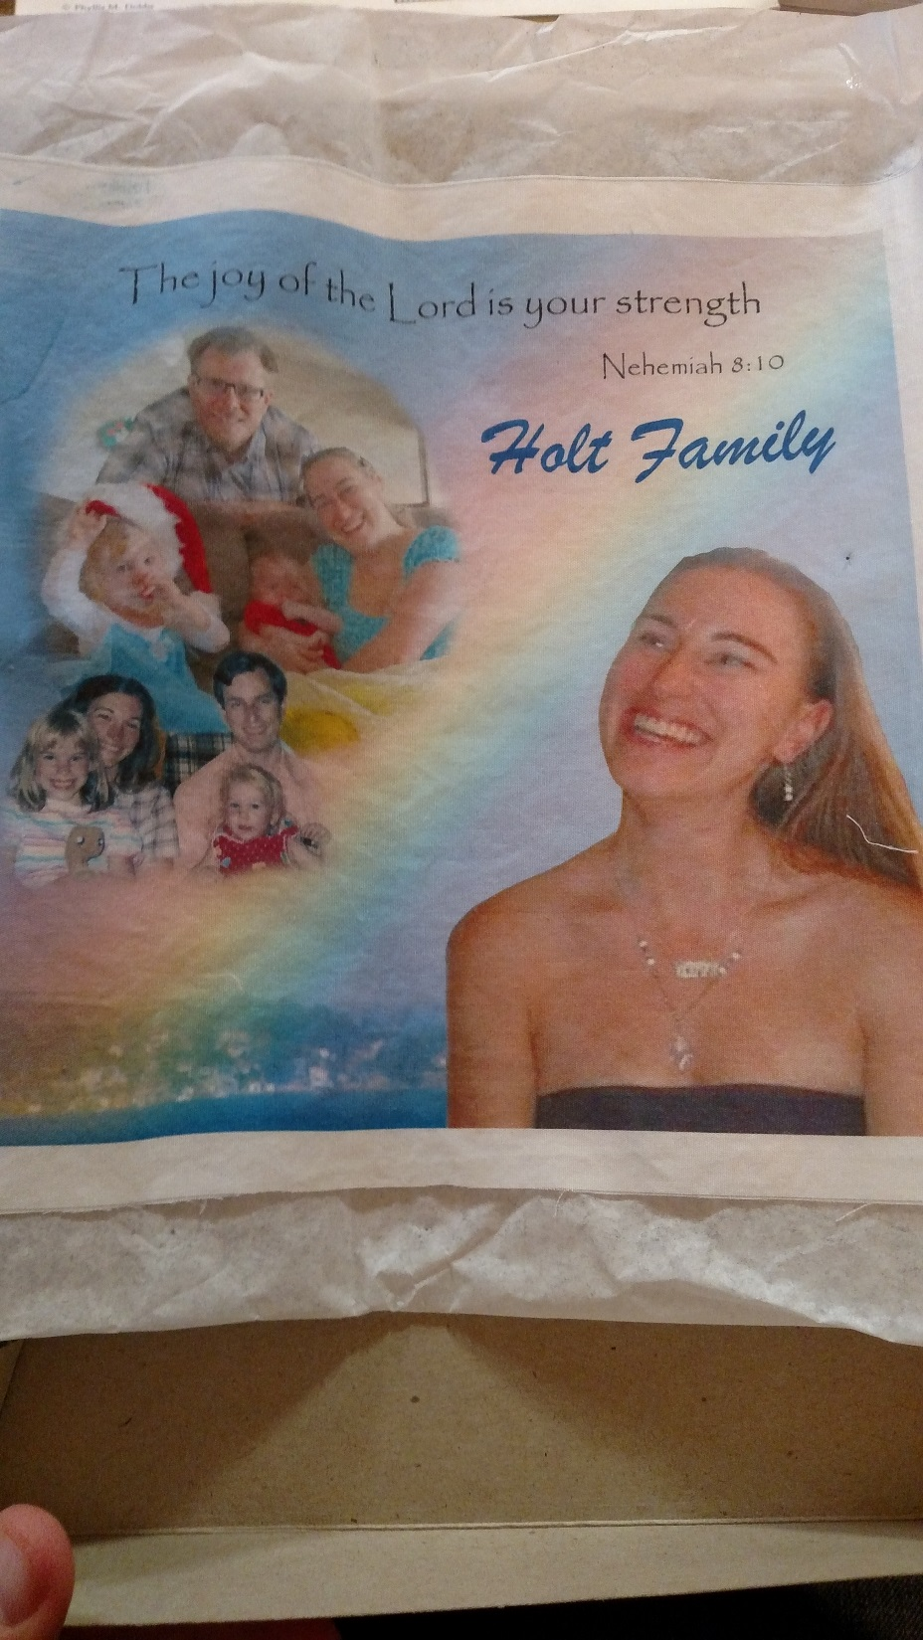
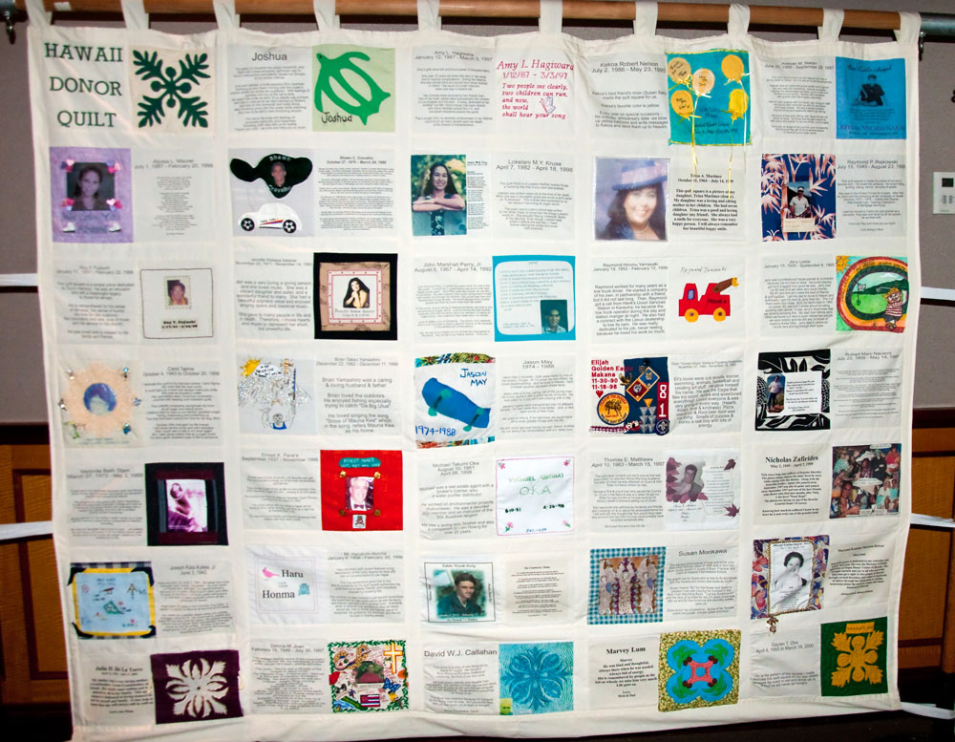

Slide 13
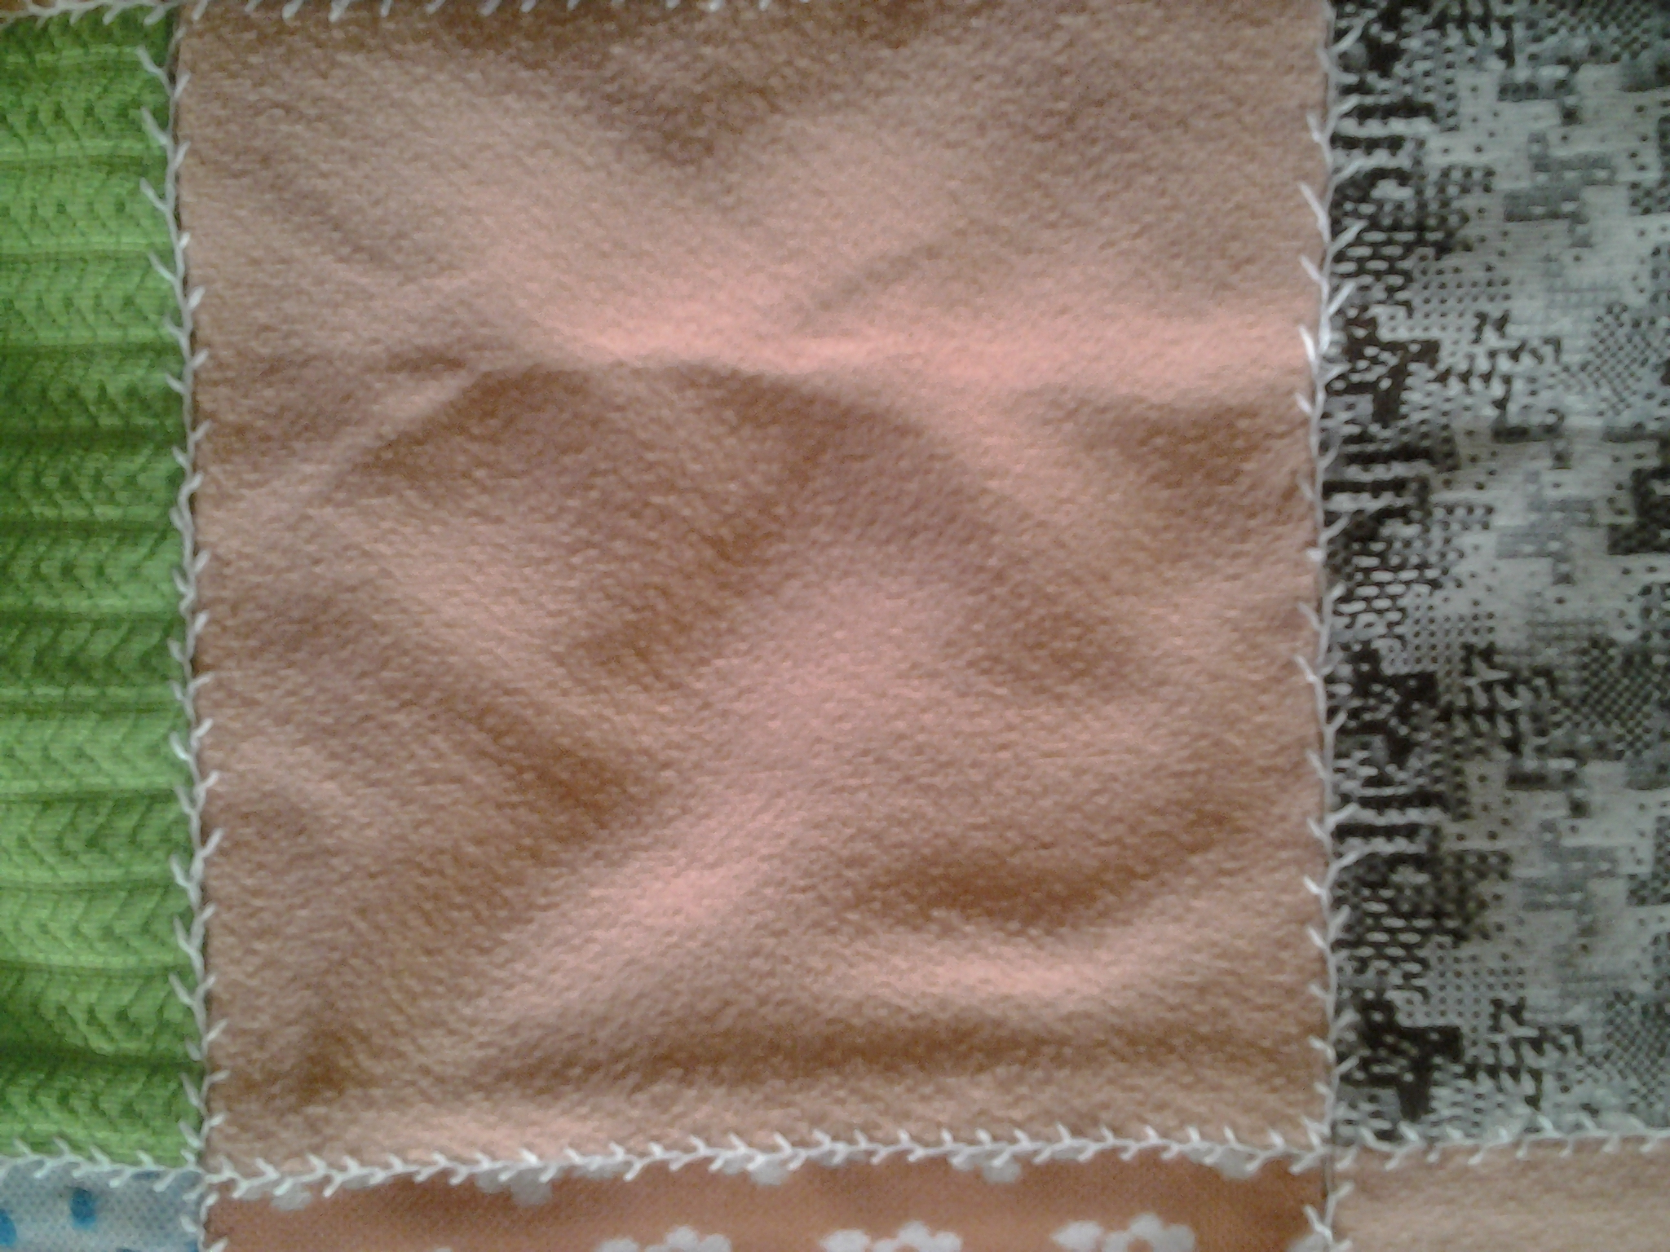
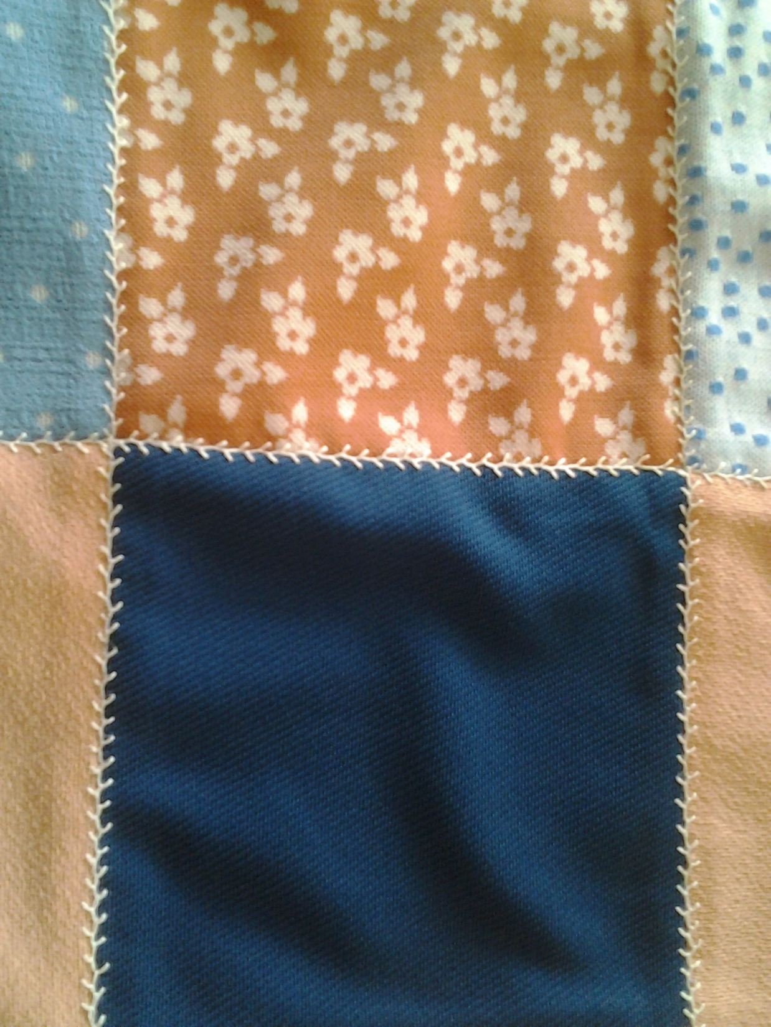

Slide 14
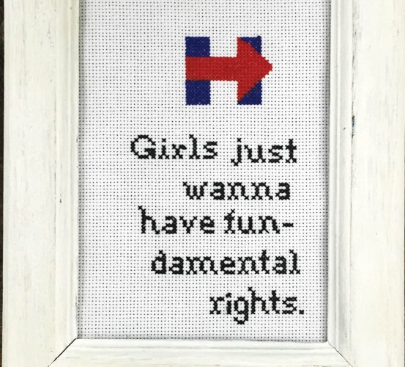
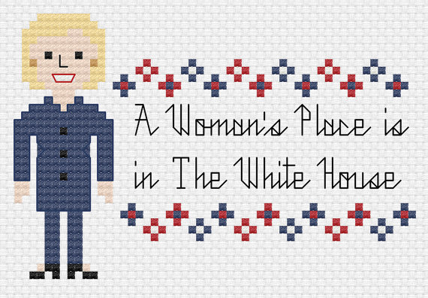
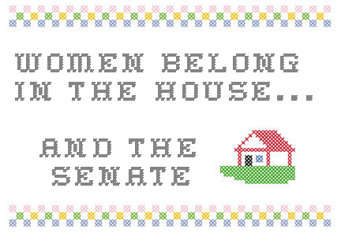
Subversive Message of Cross-Stitch

Slide 15
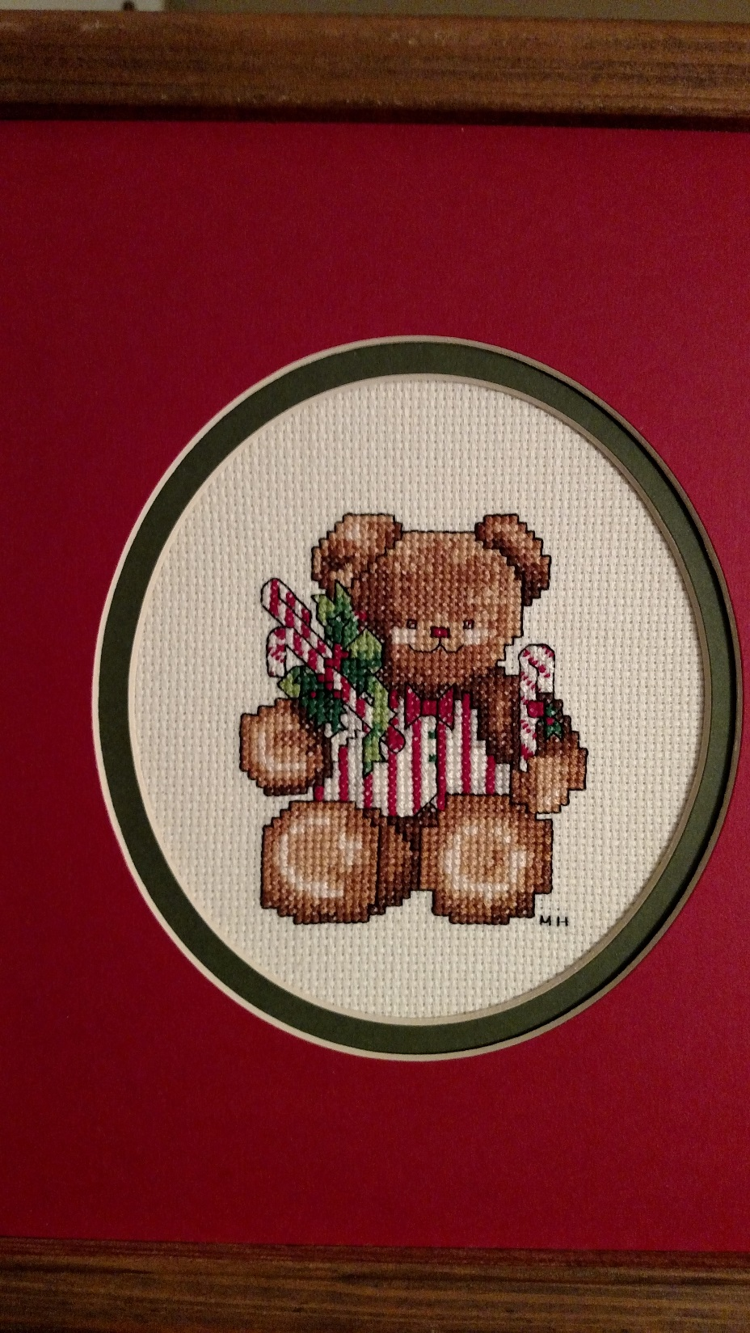
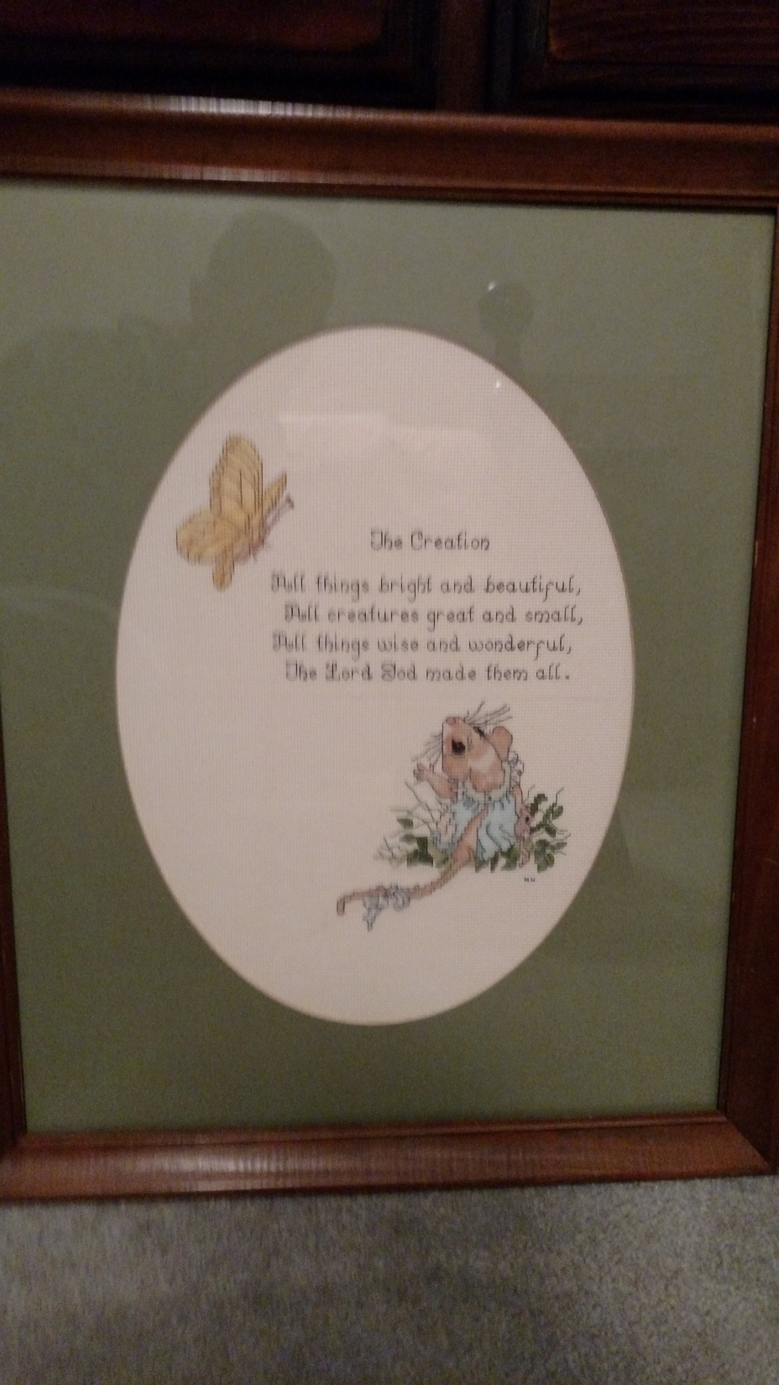
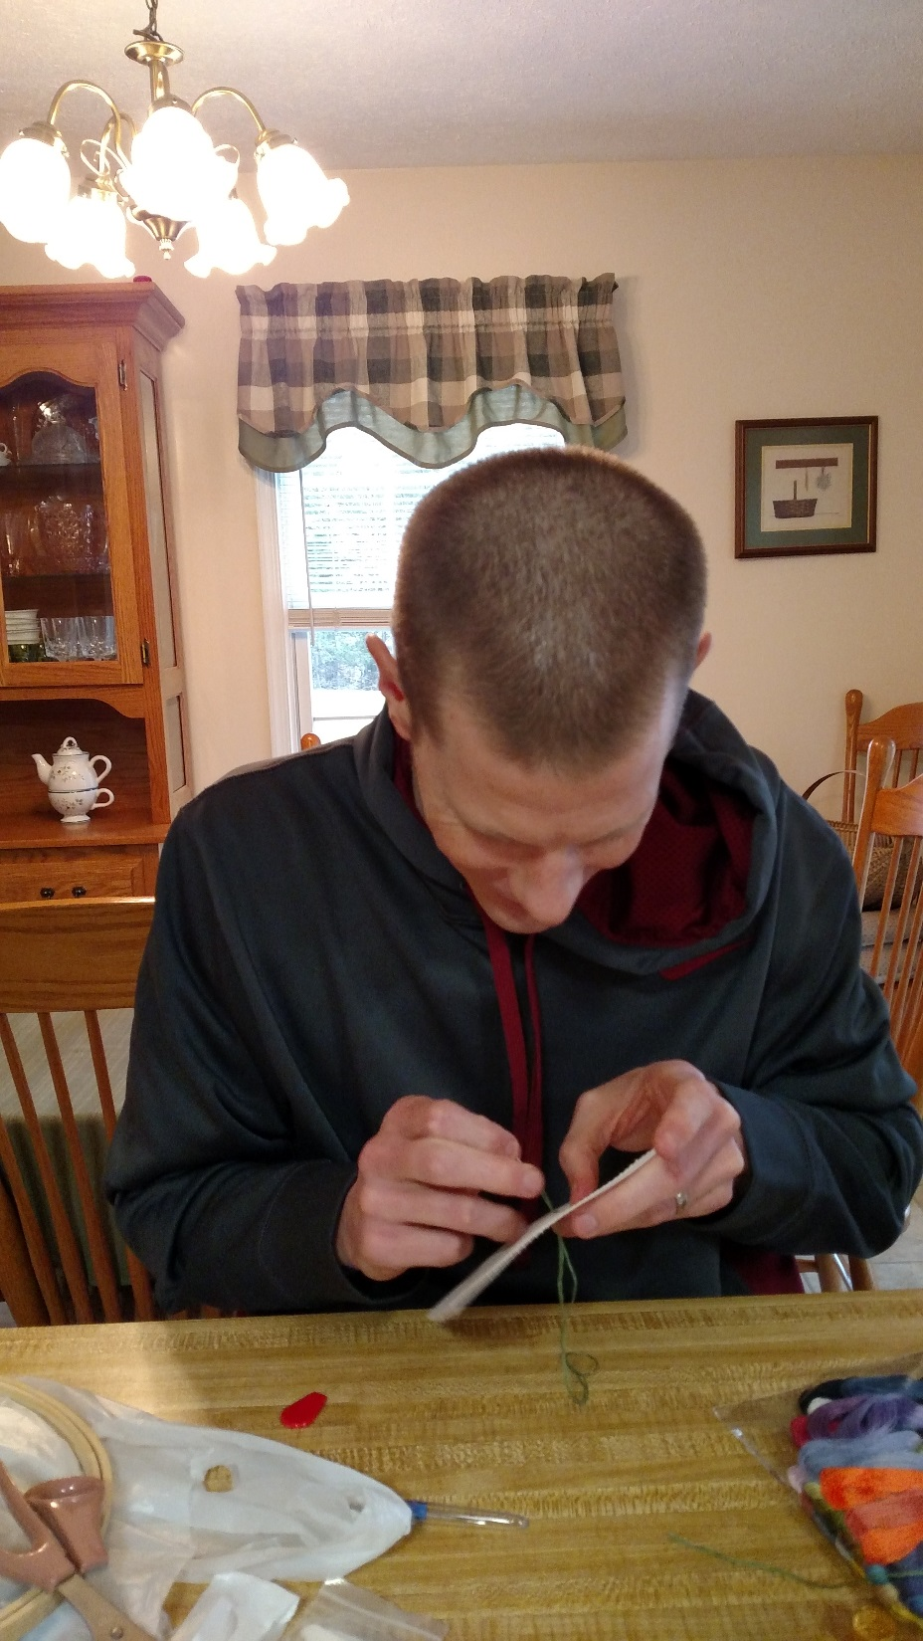

Slide 16
Pic2Pat
Try uploading an image or picture to the website Pic2Pat to generate a cross-stitch pattern to create a copy of the same image/picture.
https://www.pic2pat.com/index.en.html

Slide 17
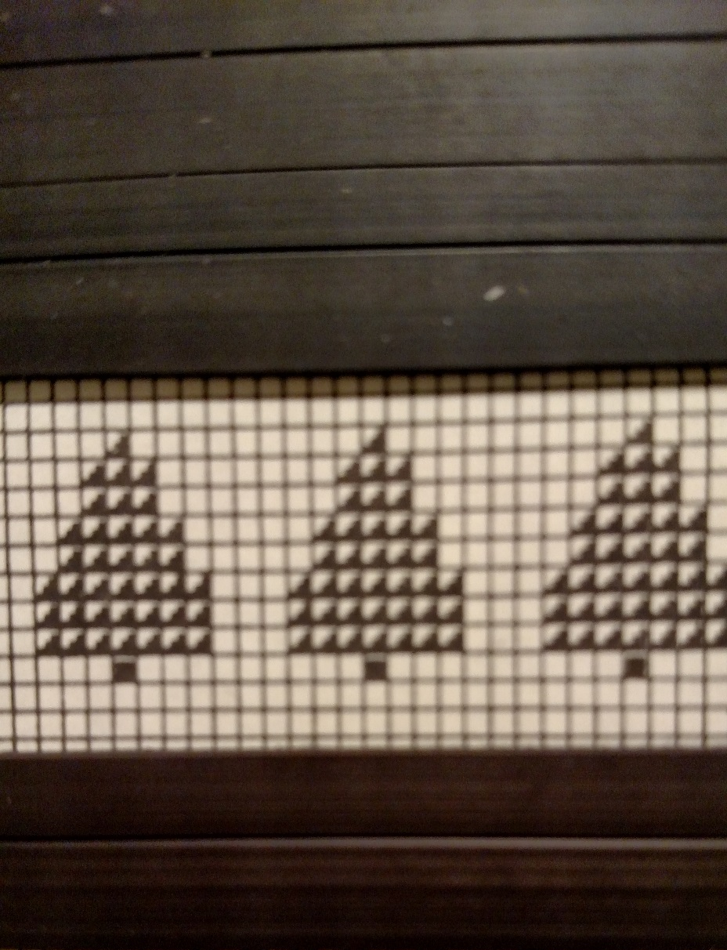
This tree design is fairly simple to work and should be good practice for those just beginning.
For more complex designs, simply google cross-stitch patterns to locate different PDF files.
Begin with the first stitch at the top of the tree. Try to center it on your fabric unless you want to do all three trees. (green)
Start each subsequent line with the far left square. Use the grid to count down and over from your previous stitch.
The final block is shaded differently, which designates a different color (brown).

Slide 18
References
Birnbaum, P. (2008). Elaine reichek: Pixels, bytes, and stitches. Art Journal, 67(2), 19-35. Retrieved from http://ezproxy.liberty.edu/login?url=https://search-proquest-com.ezproxy.liberty.edu/docview/223298156?accountid=12085
Born, D. (2005). From cross to cross-stitch: the ascendancy of the quilt. Mennonite Quarterly Review, 79(2), 179+. Retrieved from http://link.galegroup.com.ezproxy.liberty.edu/apps/doc/A202802502/AONE?u=vic_liberty&sid=AONE&xid=c25d3038
Classic Cross-Stitch (1998). The History of Needlework. Retrieved from https://classiccrossstitch.com/history.html
Day, L.F. and Buckle, M. (2009). Art in Needlework: A Book about Embroidery. Available from http://www.gutenberg.org/files/28269/28269-h/28269-h.htm. (Original work published in 1900).
Flores Fratto, T. (1976). "REMEMBER ME": THE SOURCES OF AMERICAN SAMPLER VERSES. New York Folklore, 2(3), 205. Retrieved from http://ezproxy.liberty.edu/login?url=https://search-proquest-com.ezproxy.liberty.edu/docview/1290828270?accountid=12085
Graham, R. (2015). Hillary’s Stitchery. Retrieved from https://www.theatlantic.com/politics/archive/2015/11/hillary-clinton-cross-stitch/416376/
Leslie, C. A. (2007). Needlework Through History : An Encyclopedia. Westport, Conn: Greenwood Publishing Group.
Pöllänen, S. (2013). The meaning of craft: Craft makers' descriptions of craft as an occupation. Scandinavian Journal Of Occupational Therapy, 20(3), 217-227. doi:10.3109/11038128.2012.725182
Reynolds, M. (2018). What I Learned about Masculinity When I Let Myself Start Cross-Stitching. Retrieved from https://www.huffingtonpost.com/entry/cross-stitching-new-hobby_us_5a8dd2a8e4b077f5bfea840a
Turney, J. (2004). Here's One I Made Earlier: Making and Living with Home Craft in Contemporary Britain. Journal of Design History, 17(3), 267-281. Retrieved from http://www.jstor.org/stable/3527117
Verso, J. (2015). Threads of History. Retrieved from https://www.thecrossstitchguild.com/cross-stitch-basics/stitchers-study/threads-of-history-by-jo-verso.aspx

