Slide 1
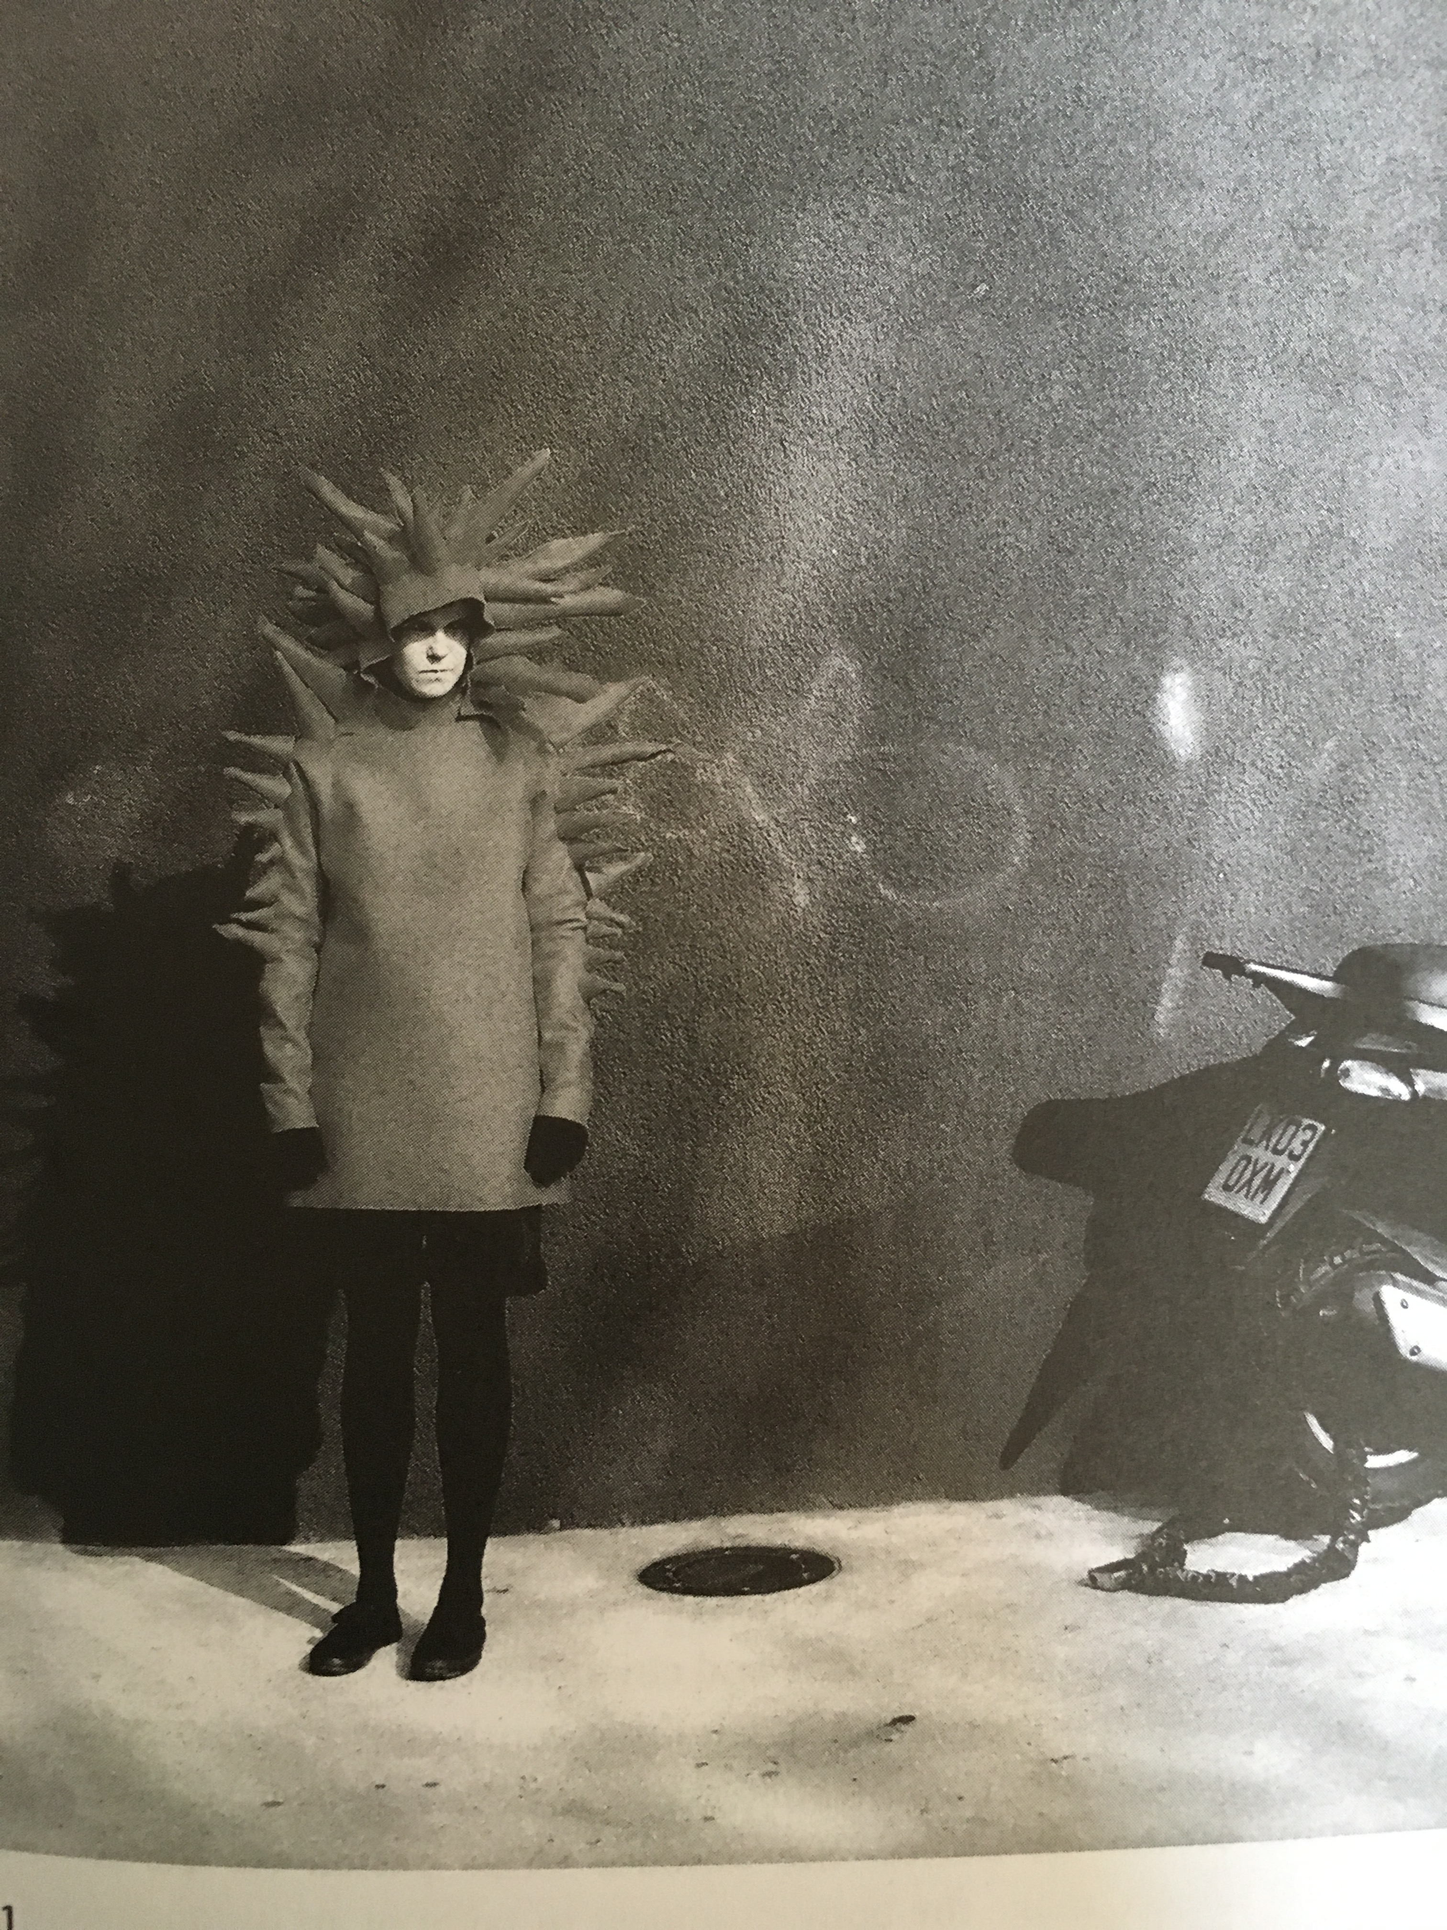
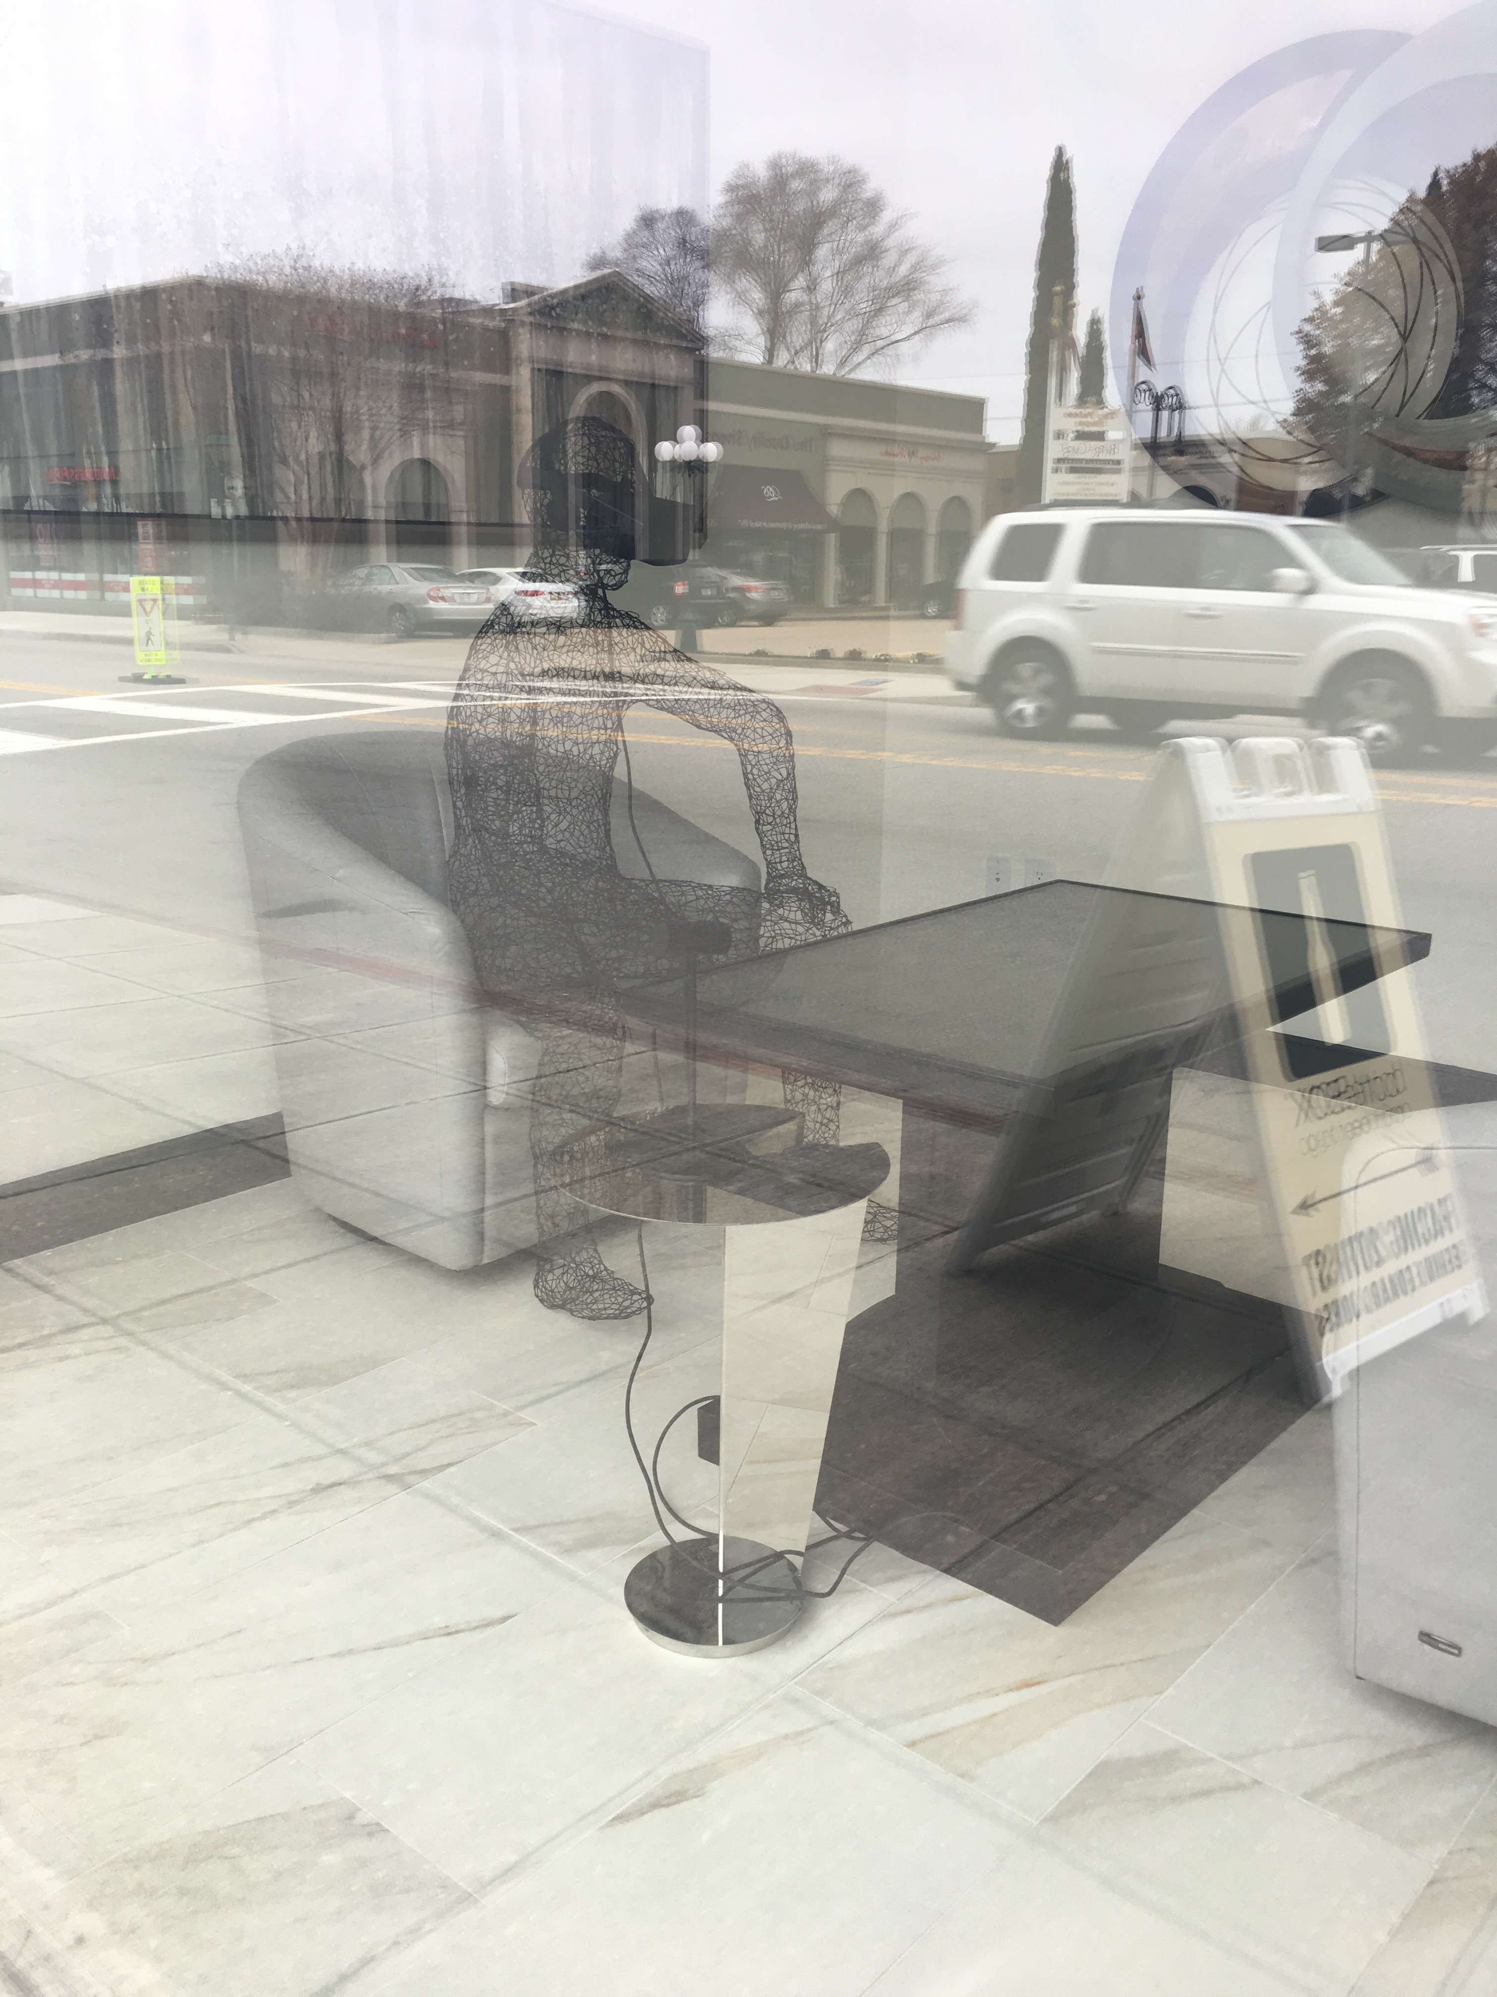
Notes:
Riitta Ikonen My Unexpressed Anger at Nothing in Particular 2008 and window display on 21st Street, furniture store, Norfolk 2018 Richard Brautigan as quoted in BBC Documentary https://vimeo.com/25887734

Slide 2
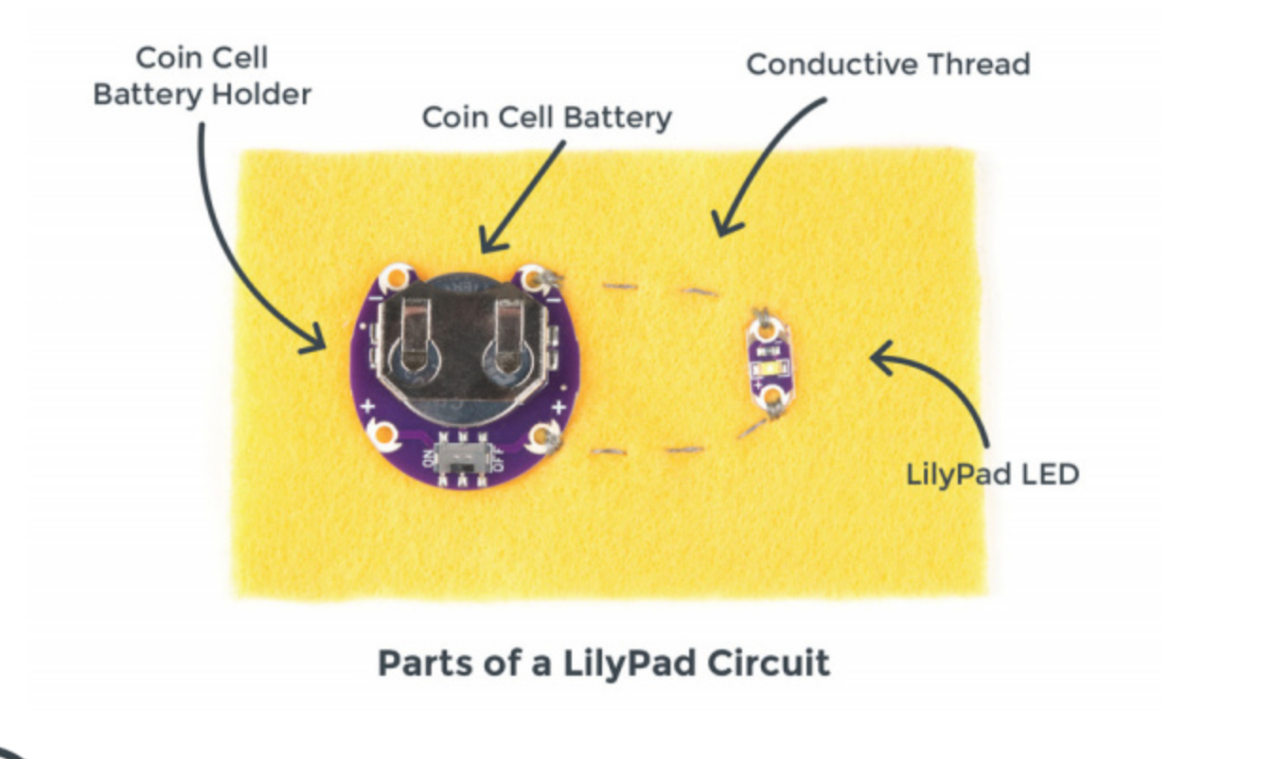
Lilypad arduino / a foray into wearables

Slide 3
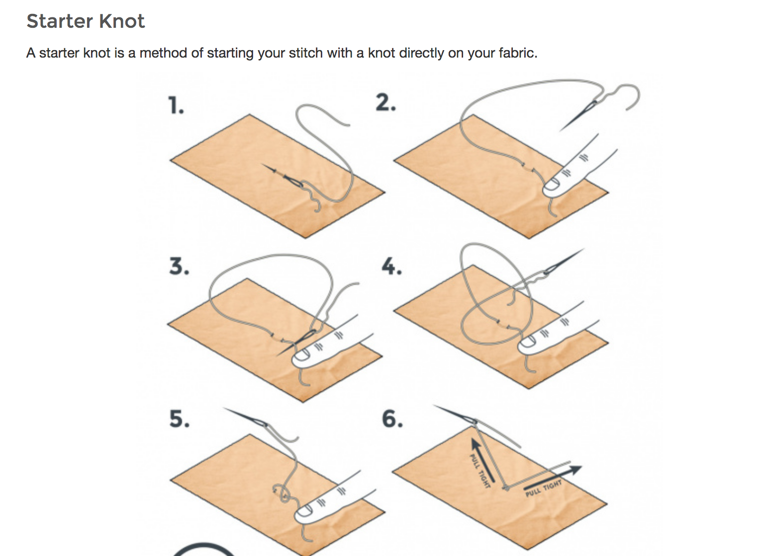

Slide 4
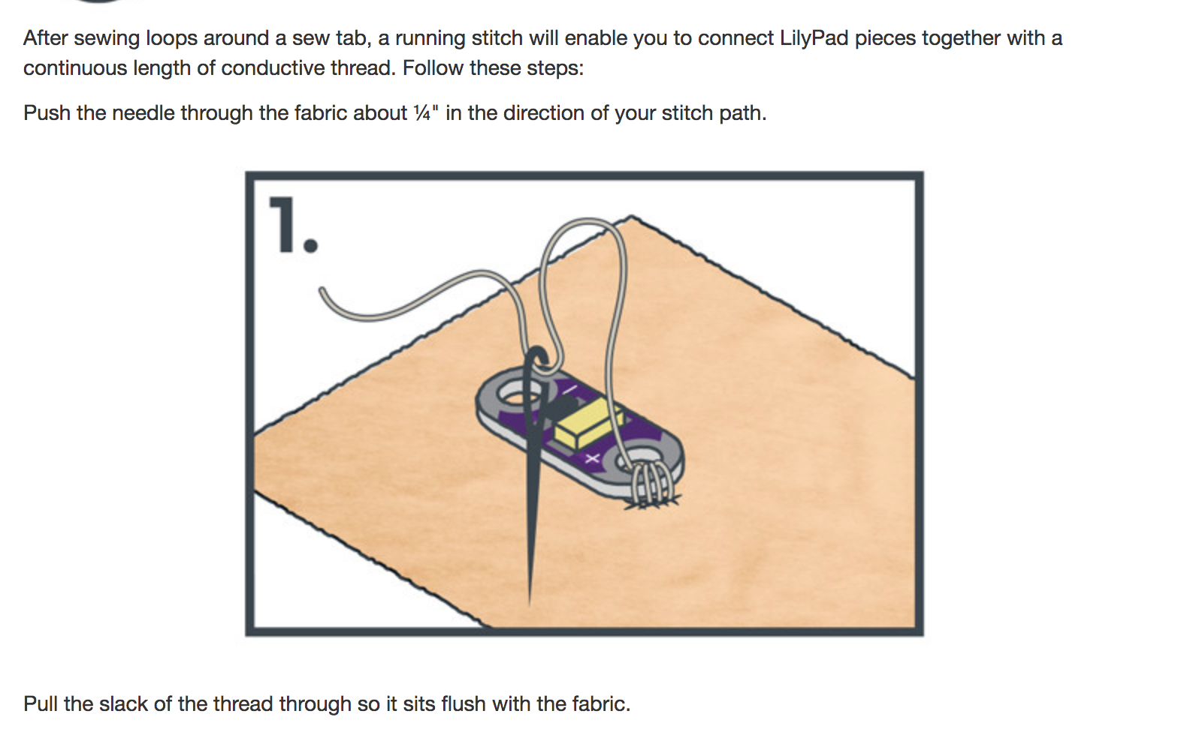
Notes:
https://learn.sparkfun.com/tutorials/lilypad-basics-e-sewing

Slide 5
A tutorial for a simple wearables LED project which we will use this evening.
https://www.sparkfun.com/tutorials/312

