Slide 1
Cryptography
Challenging dominant literacies…

Slide 2
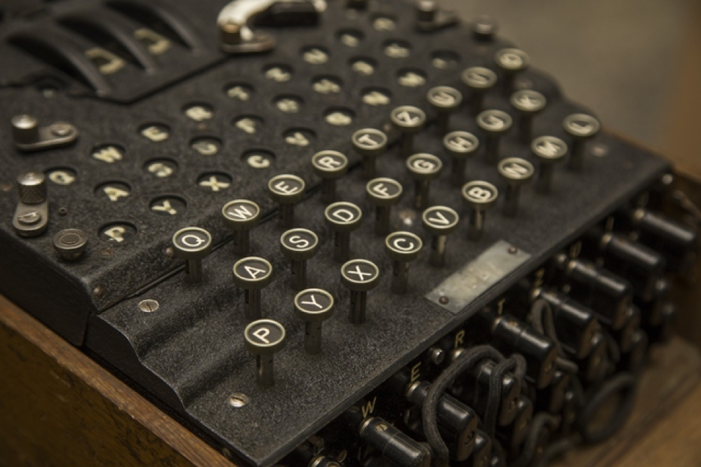
Terms to Know
Cryptography: the science or study of techniques of message hiding. [Etymology: Crypt (Greek) hidden or concealed and ography (styles of writing, graphic representation)]
Cryptographic Processes:
Encryption (process of turning plaintext into ciphertext), Decryption (turns ciphertext into plaintext), Cryptanalysis (code breaking)
Cipher: algorithm or method used for performing encryption or decryption

Slide 3
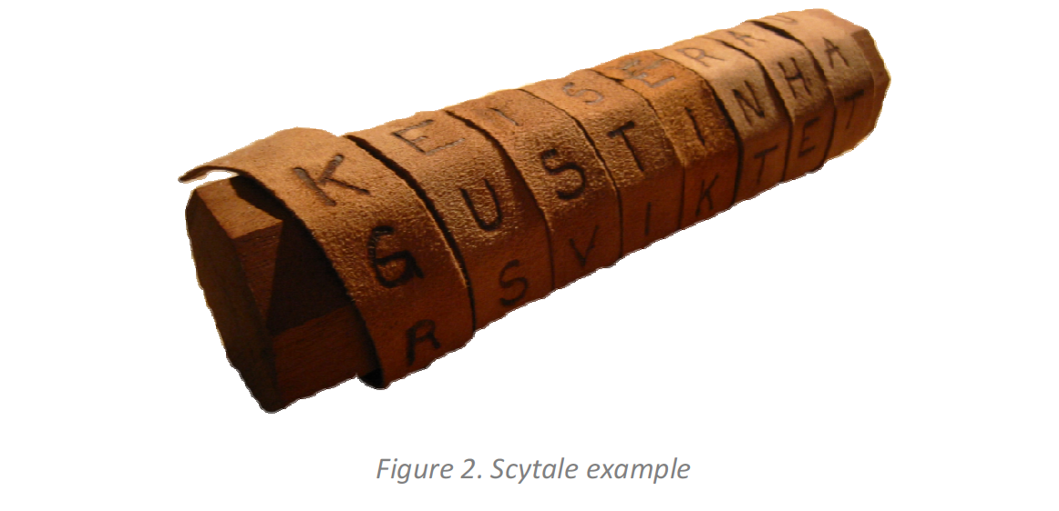
Key Questions
How does cryptography…
…provide an alternative lens through which to view the histories of literacy?
…help us ask questions about the relationships among reader, author, text?
…help us re-imagine the role of authorship & readership?
…disrupt the dominance of alphabetic text, especially in our pedagogies?
…help us theorize the way physical, material features of text inform the way they are consumed?
…help distinguish between ciphertext vs. a new language (e.g., Pig Latin)?
…help us test semiotic models of representation (e.g.,Saussurian structuralism vs. Peircian Semiotics)?

Slide 4
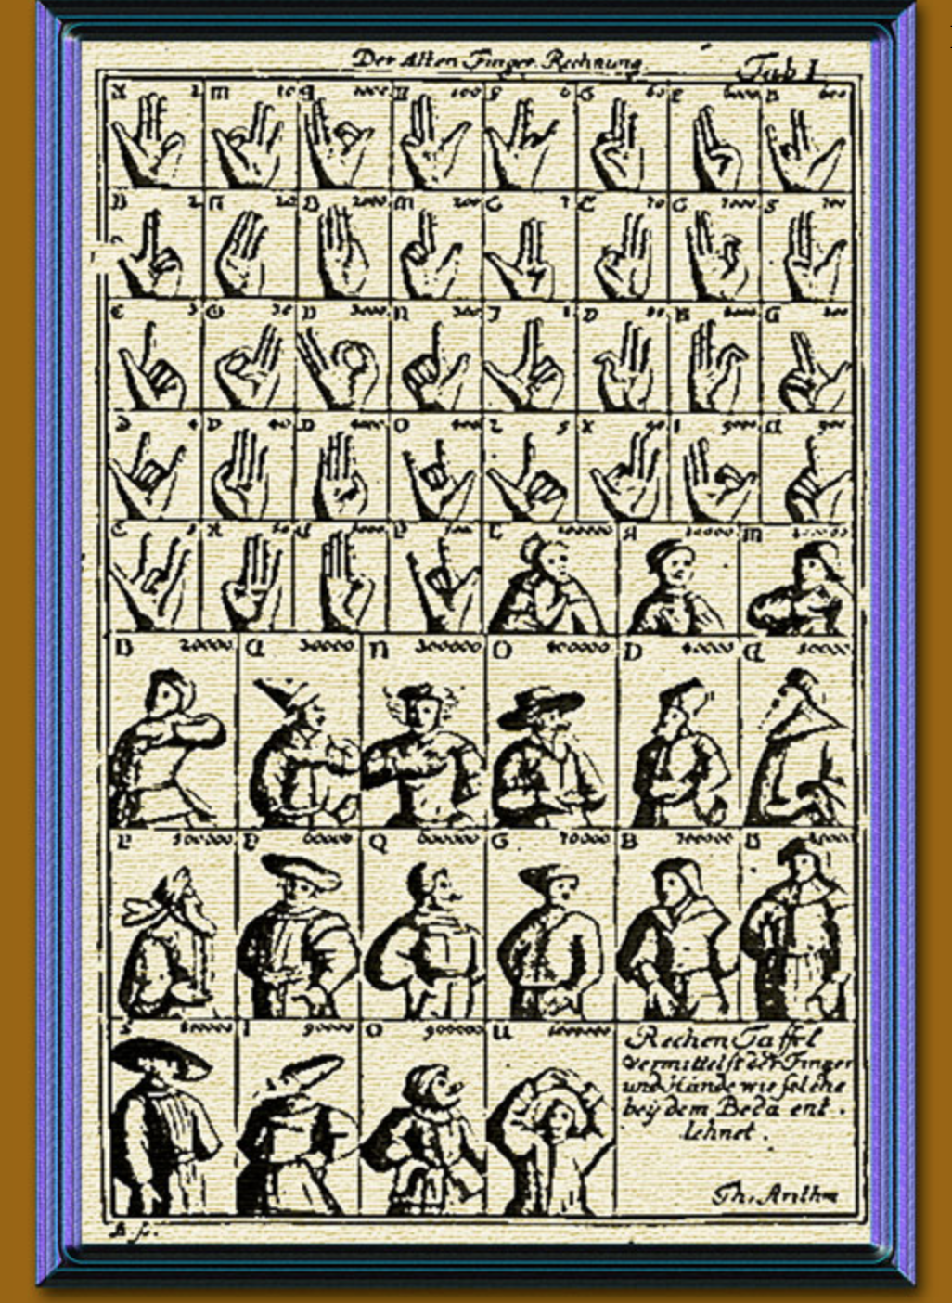
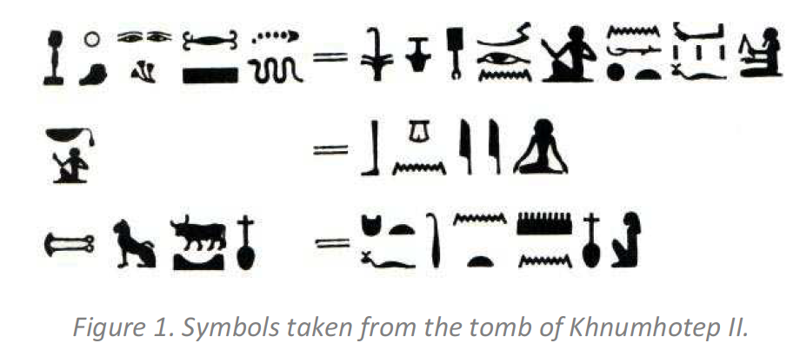
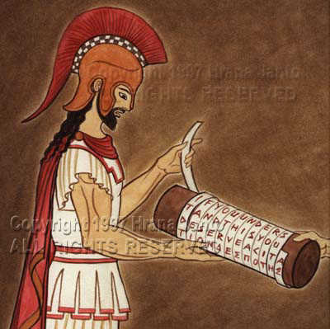
Ancient Ciphers

Slide 5
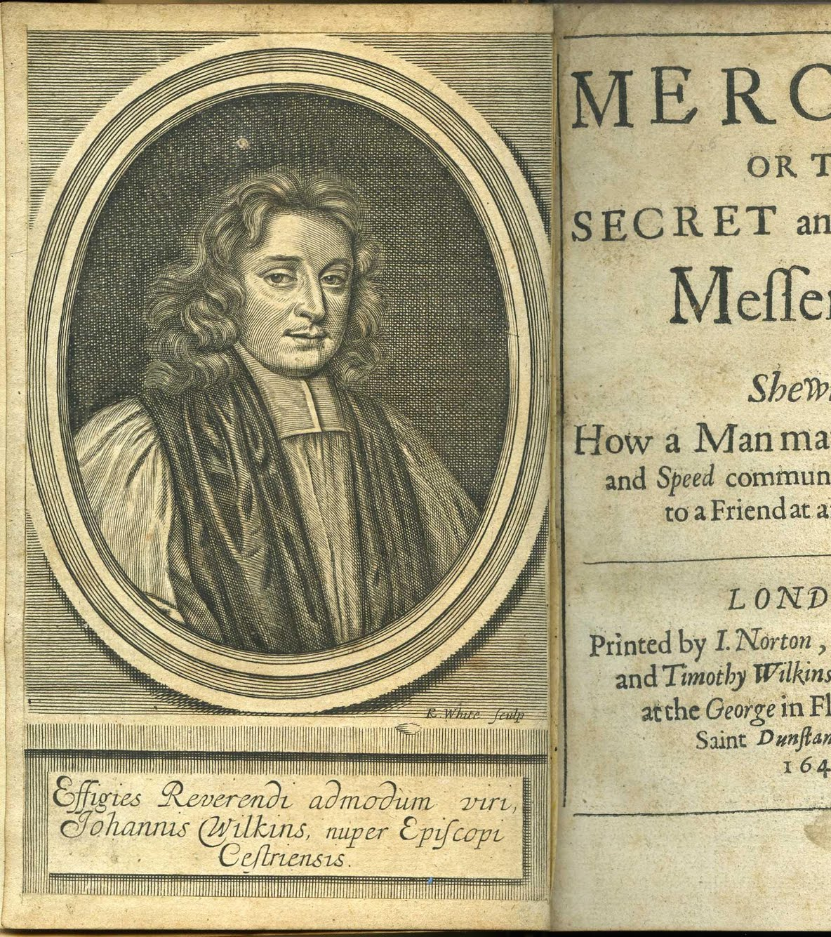
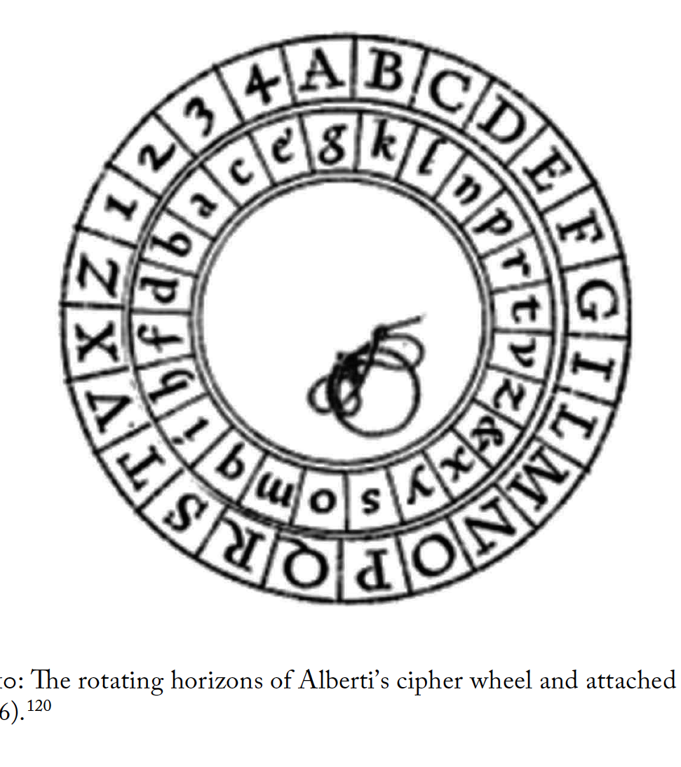
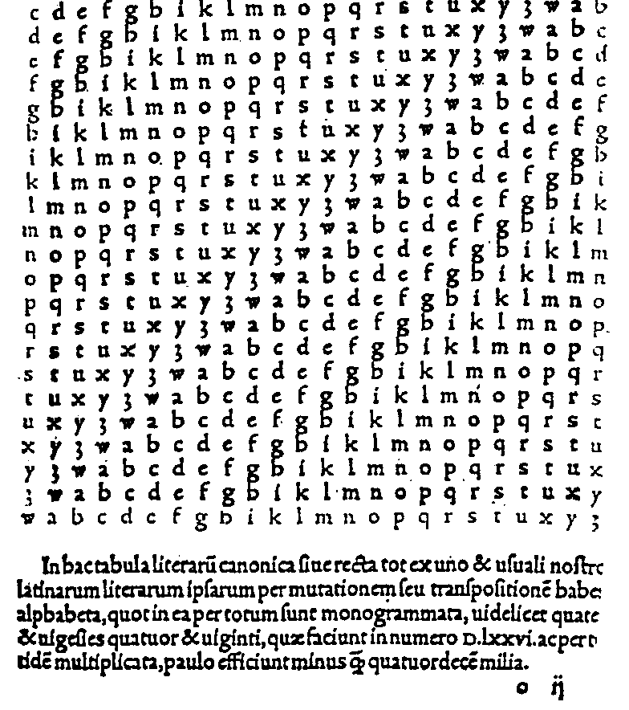
Ciphers of the Middle Ages & Renaissance
z
z

Slide 6
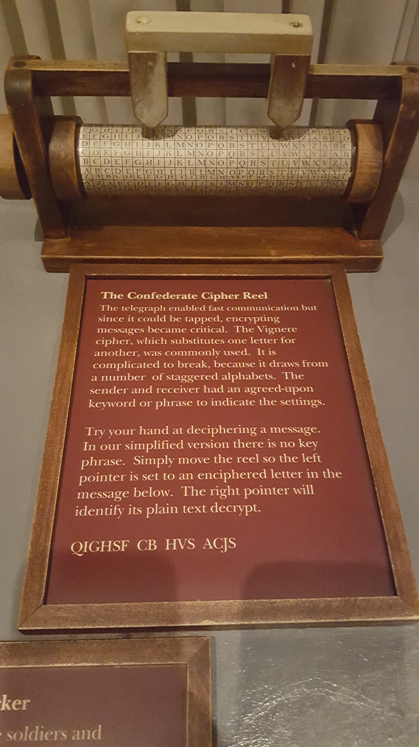
Ciphers of the Early Modern Era
“A Cypher Age”

Slide 7
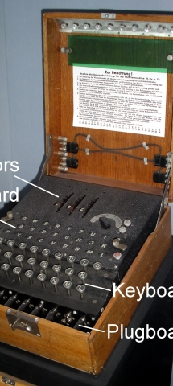
Ciphers of the Modern Era (WWII)
z
z

Slide 8
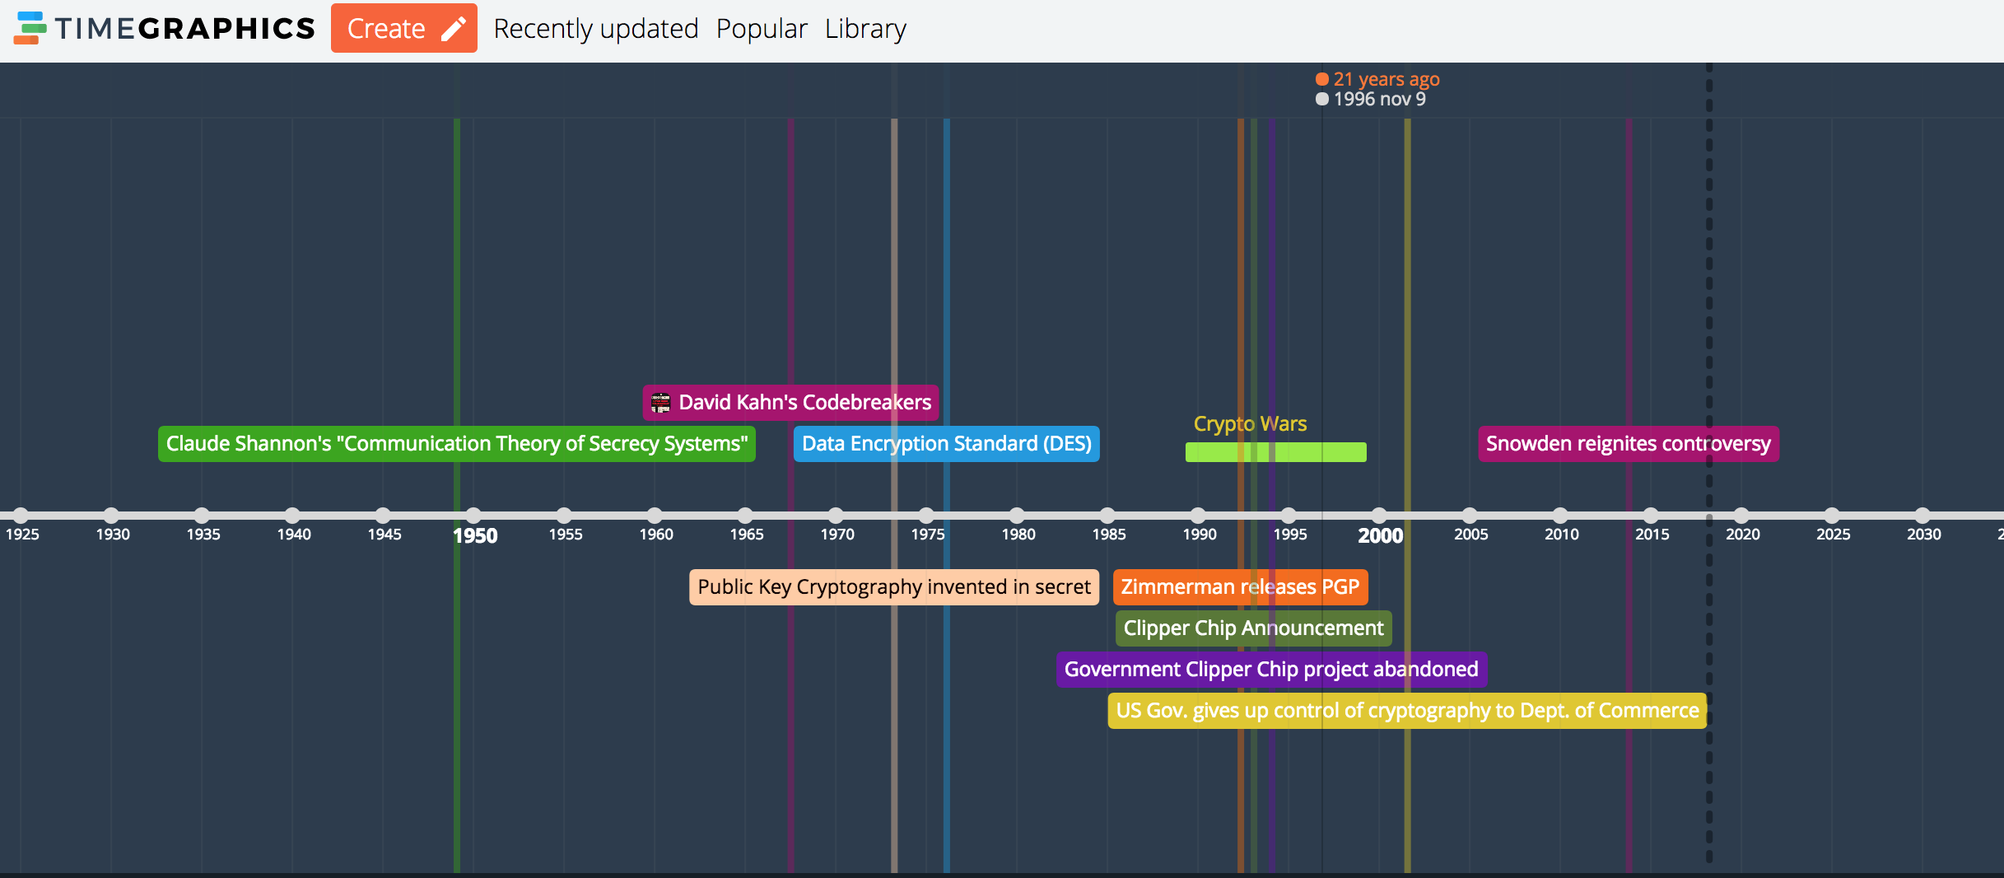
Contemporary Digital Ciphers

Slide 9
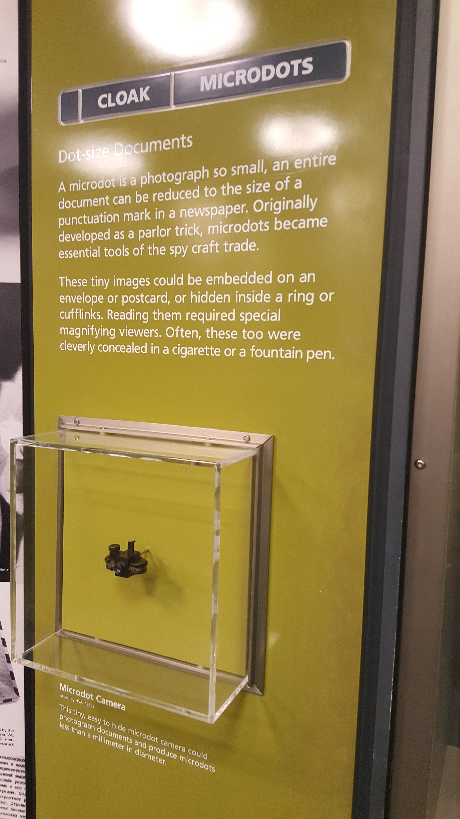
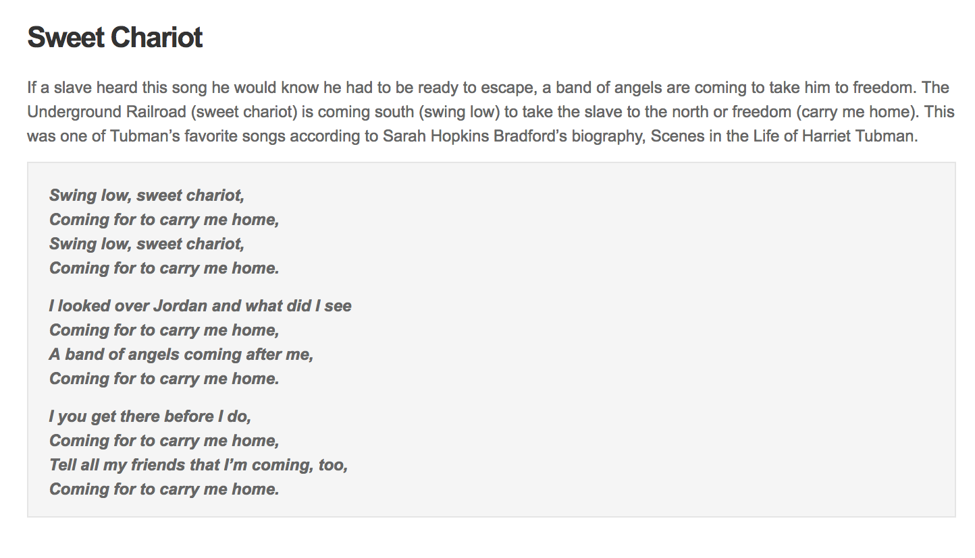
A bit about Steganography “security through obscurity”

Slide 10
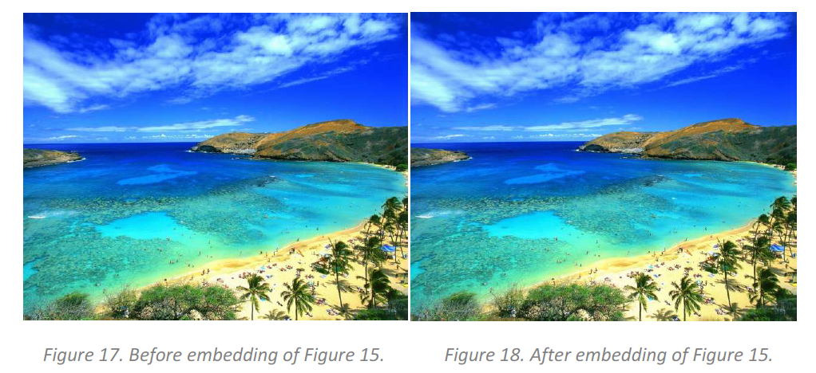
Contemporary Steganography
Figure 15

Slide 11
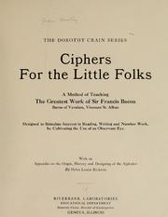
Cryptography as Education
z
Ciphers “Stimulate interest in Reading, Writing, and Number Work, by Cultivating the Use of an Observant Eye”

Slide 12
What I’ve Missed
Discussion of the Middle Eastern traditions of cryptography, currently being chronicled by the King Faisal Center for Research and Islamic Studies.
Asian traditions of cryptography, including the Japanese Purple machine (WWII)
Runic cryptography, Book ciphers, frequency analysis of deciphering
The significant impact of Sir Francis Bacon & the Bacon-Shakespeare projects
The discussion of ciphers as honoring silence (Spartans), not secrecy
The cross-disciplinary nature of ciphering and deciphering and the role Humanists have played in wartime counter-intelligence
The substantial impact of this literacy (e.g., Zimmerman telegram to Mexico, Iwo Jima win)
Varied contemporary encryption algorithms (AES, RSA, Diffie-Hellman, etc…)

Slide 13
What we learn about cryptographic literacies
Ciphers “mirror their cultures fantasies of literacy—and then shatter those mirrors to obscure the message.”
They challenge dominant histories of literacy and text, the impact of disproportionate privilege of alphabetic writing, the nature of reading.
Ciphering/deciphering calls on us to be flexible, nimble and more inclusive of alternative modes of meaning making.
They challenge binaries of material/immaterial, oral/written, body/thought, handwork/mindwork.
They remind us that literacy is inherently social, imbued with meaning based on relationships.
Recognize significant literary contributions of non-dominant populations in under privileged modes.
Reveals patterns of strong encryption = leader in military power.
Cryptography prepared us with a need for for algorithmic literacy.

Slide 14
Questions for Future Contemplation
What does it mean that cryptography is now ubiquitous to nearly all communication (encryption)? What is the impact on literacy and thought when writing is encrypted as a matter of routine?
Does cryptography help to reveal or obscure the digital world? (DuPont)
How can we take the history of ciphering/deciphering as a cue to teach a more nimble, more flexible, more multimodal approach to meaning-making and what might that mean for our students?

Slide 15
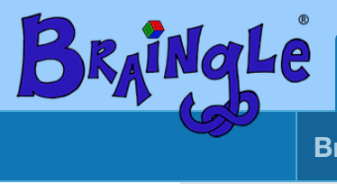
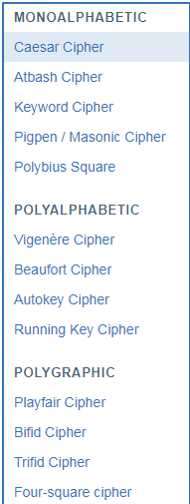
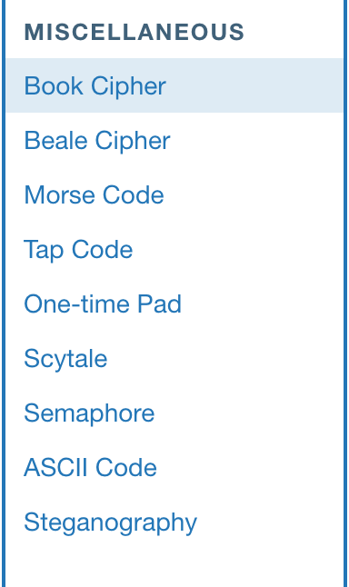
Cipher/Decipher for Yourself

Slide 16
If you’re interested in understanding the mechanics of Engima…
z
z

Slide 17
Sources
Damico, T. (2009). A brief history of cryptography. Inquiries Journal: Social Sciences, Art & Humanities 1 (11). Retrieved from: http://www.inquiriesjournal.com/articles/1698/a-brief-history-of-cryptography.
DuPont, I.Q. (2014). Unlocking the digital crypt: Exploring a framework for cryptographic reading and writing. Scholarly and Research Communication, 5 (2).
DuPont, I.Q. (2017). An archeology of cryptography: Rewriting plaintext, encryption, and ciphertext (Doctoral Dissertation). Retrieved from University of Toronto’s TSpace at http://hdl.handle.net/1807/78958.
Ellison, K. & Kim, S. (2018). A material history of medieval and early modern ciphers: Cryptography and the history of literacy (Material Readings in Early Modern Culture). New York: Routledge.
Hern, A. (2014). How did the Enigma machine work? The Guardian. Retrieved from: https://www.theguardian.com/technology/2014/nov/14/how-did-enigma-machine-work-imitation-game.
McDonald, N. (2009). Past, present and future methods of cryptography and data encryption. University of Utah Press. Retrieved from: http://www.eng.utah.edu/~nmcdonal/Tutorials/EncryptionResearchReview.pdf.
Rubin, J. (2008). Vigenere cipher. Retrieved from: http://www.juliantrubin.com/encyclopedia/mathematics/vigenere_cipher.html.
SysAdmin, Audit, Network and Security (2018). SANS Institute Reading Room Report. Information Security Reading Room. Retrieved from: https://www.sans.org/reading-room/popular/week.

