Slide 1
ODU Laptops
Start the computer.
Initally log in as Staff with password of staff
Then enter the password to access the ODU network.

Slide 2
Maps are More than Location

Slide 3

Core Principles
EVERYTHING occurs in time and space.
Maps form the basis for inquiry.
Inquiry unlocks meaning.
Interaction with maps engages students.
The use of GIS requires critical thinking.
Map interpretation is an essential literacy skill.

Slide 4
GeoInquiry
Close your eyes.
Select a random GeoInquiry from your folder.
You may need to copy the URL and paste it in the Browser.
15 minutes.
Think about what tools you used.

Slide 5
Customize a handout
The handout has answers on it . . .

Slide 6
Can you . . .
Access the Contents panel?
Turn on a layer?
Zoom to ?
Turn off a layer?
Find which tools work on the layer?
Open the legend with the map
Switch basemaps
Use a bookmark?

Slide 7
Geographic Information System
What is a GIS?
What is AGO?
What software is required?
Where are the data stored?
When does data become information?

Slide 8

The Science of Where
https://youtu.be/XrU8GX7manc

Slide 9
Problem solving based on
Concrete observations
Recognition of spatial patterns
Comparison of “what’s there?”
Analysis of map’s data
Create and test hypotheses
Propose possible explanations for “why there?”
To whom woud this information be useful
Present findings

Slide 10
Accounts
Public—everyone shared login
Limited data storage
Organization—each user has a unique login
Subscription content
Larger data uploads
Sheltered environment
Analysis tools
Web App Builder

Slide 11
Maps R US
Access handouts, links to GeoInquiries and more
http://sites.wp.odu.edu
/MapsRUS

Slide 12
Annotate a Map
Add images and information to a layer independent of the map
Think about 5 places your students need to know.

Slide 13
How to Retrieve a Map
Retrieve a GeoInquiry map
Create a presentation
  Select areas of the map to feature
  Add text
  Pose questions
  Change basemap
  Share

Slide 14
Orgs to explore
http://vbcps.maps.arcgis.com
http://norfolkps.maps.arcgis.com
http://vga.maps.arcgis.com
http://
Notice the pattern?

Slide 15
How to use in your classroom
GeoInquiries™
  One computer
  15 minutes
  Introduce a topic/key content
  Pre-prepared maps
  Guiding questions
  No account required to access maps
  To save maps, account is needed

Slide 16
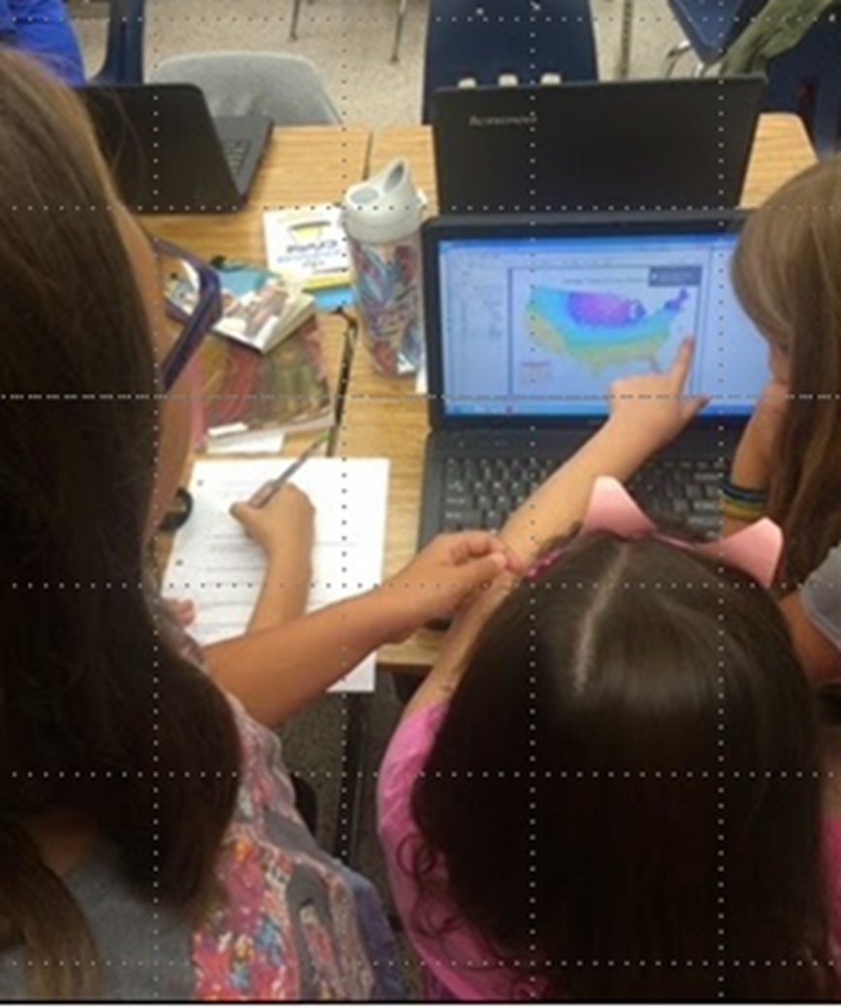
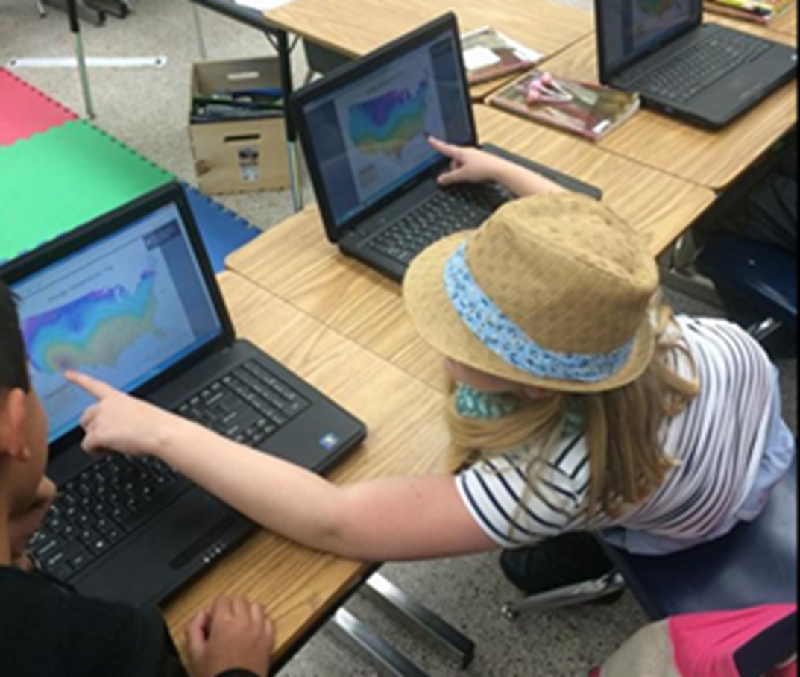
The Dynamic Link
Data at your finger tips
Earthquakes and Volcanoes
Explore relationships

Slide 17
Uses of GIS
Visualize the Earth
Obtain content information
Solve problems
Create location-based narratives
Organize information
Make decisions

Slide 18

ODCAR – Consistent Process
Observe
Describe
Compare
Analyze
Reflect

