Slide 1
Day 2
GIS 4 U
Mastering the Map

Slide 2
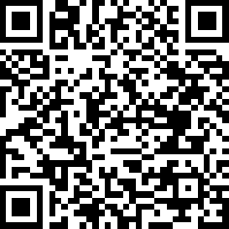
Experience Survey 123
Go to http://sites.wp.odu.edu/MapsRUs
Fall 2017
Day 2, 2017

Slide 3
Explore Your org
Log in to your school’s org.
What can you do.
How is it different from the public account.
The power of groups
Sharing with portal group places item on front page.

Slide 4
Public Account
Find the map you retrieved and saved.
How to make a prentation Rebecca

Slide 5
Org Account
Down load file from MapsRUS
Open file and SAVE AS .csv (comma separated values)
Publish file
Symbolize file
Filter File

Slide 6
Sharing and Groups
Why groups?
Map Portal Group—controls what is shown on the front page of your org
Each class as a group?
Removing something from the group does NOT trash it.
VBCPS sharing group.
All have been invited. Accept the invitation.
What do you now have access to?

