Slide 2
Analysis Tools in AGO
Only available with organizational account
Select only the layer on which to run the tool
Process and manipulate data for analysis
Each layer generated must have unique name

Slide 3
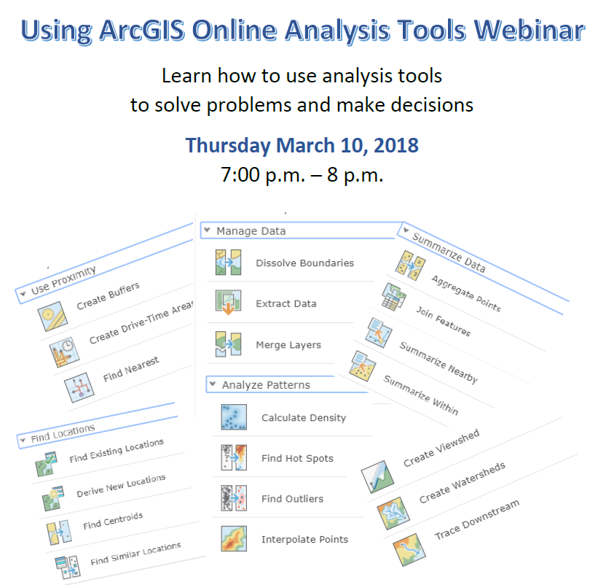

Slide 4
Trace Downstream
Search for layers, world hydro
Select World Hydro Reference Overlay from World Water Online, Add
Analysis button, Find Locations, Trace Downstream
Step 1: Place pin on river source
Step 2: Accept defaults
Step 3: Name the layer.
Decide about current map extent
Check credits, close that pop-up
RUN ANALYSISs
Generates a feature layer, can be added to any map

Slide 5
Buffer
Find areas that fall within a given distance from a point or line.
Select Analysis tool from the layer you will analyze,
Use Proximity, Buffer
Step 1: Select the Layer
Step 2: Select Distance, Click Options, select type of buffer, Dissolve
Step 3: name layer, check credits, keep current map extent checked.
RUN ANALYSIS

Slide 6
Overlay
Add layers from ArcGIS online search
Search for Federal Land, select Federal and Tribal Land.
Which portions of federal land are within the river buffer? Can you visualize it?
Manage data, Overlay Layers.
Step 1: Choose input layer—the buffer you created
Step 2: Choose the find layer.dd Mines and Mineral Resources layer.
Step 3: Choose the Overlay Method. In this case Intersect. Why?
Search for and Add the Mines and Mineral Resources layer.
You want to find all of the points that are within your river buffer
How would do that?
How many are there?

Slide 7
Overlay Again
Developer wants a resort but needs to know which counties are involved.
Add USA Counties layer.
Intersect river buffer.
Have to have same type of features, polygons.
Steps 1 and 2: Select the two intersect layers you generated—counties and federal lands.
Choose erase to remove unusable areas.
In the study area which county has the most mines?

Slide 8
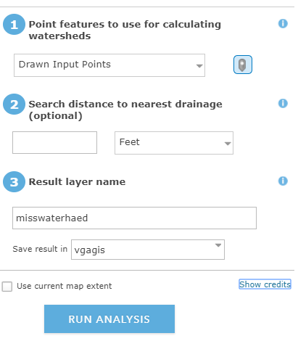
Create Watershed
World hydro layer
Why uncheck current map extent?
Watch out for tributaries

Slide 9
Interpolate
Continuous point data such temperature, precipitation, elevation
Point data
US Annual precipitation data csvb
Step 1: choose point layer
Step 2: Pick field to interpolate
Step 3: Keep defaults
Options--Choose study area, others default
Step 4: Name layer and check credits.

