Slide 1
Maps are More than Location
Dr. Georgeanne Hribar
Virginia Geographic Alliance
August 22, 2018

Slide 2

Core Principles
EVERYTHING occurs in time and space.
Maps form the basis for inquiry.
Inquiry unlocks meaning.
Interaction with maps engages students.
The use of maps requires critical thinking.
Map interpretation is an essential literacy skill.

Slide 3
Geographic Thinking
Making observations and connections
Asking questions
Gathering information from a variety of sources
Classifying information
Identifying cause and effect relationships
Building a geographic vocabulary

Slide 4

ODCAR – Consistent Process
Observe
Describe
Compare
Analyze
Reflect

Slide 5
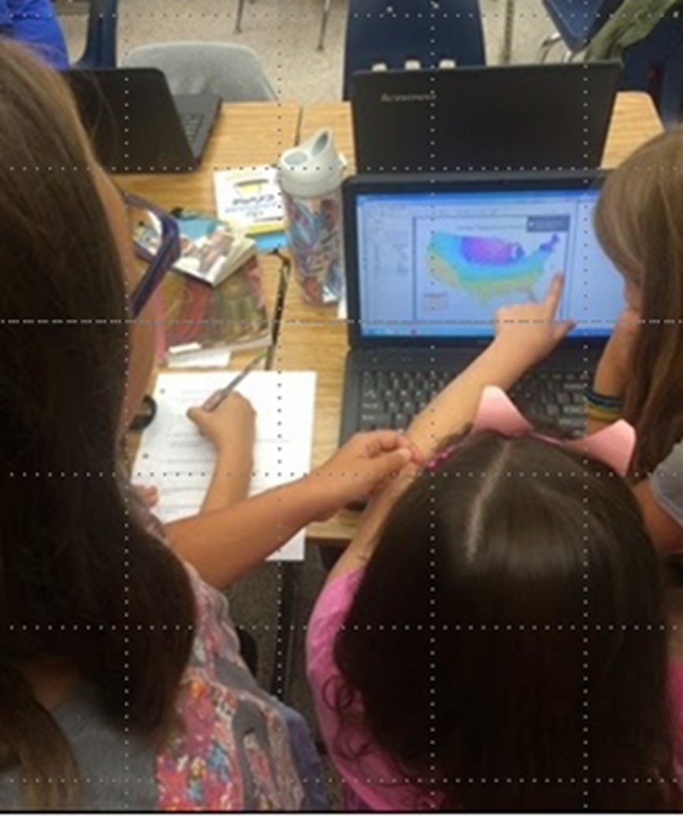
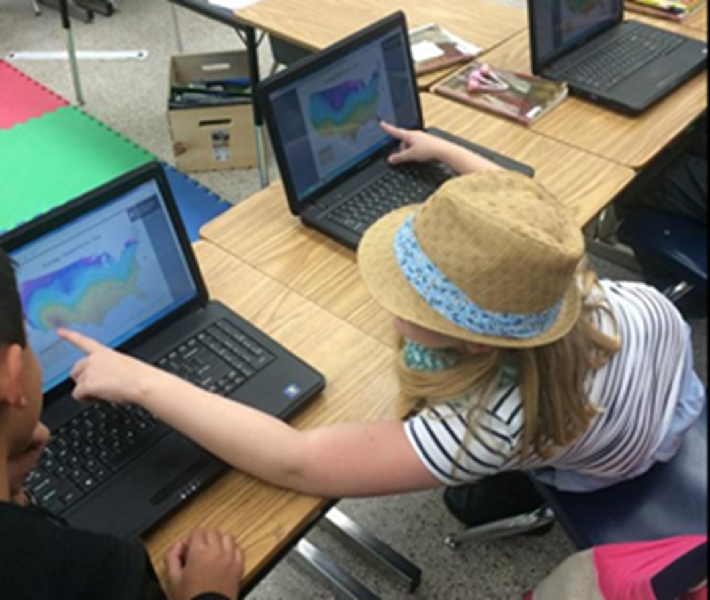
The Dynamic Link
Data at your finger tips
Explore relationships

Slide 6
Geographic Information System
What is a GIS?
What is AGO?
What software is required?
Where are the data stored?
When does data become information?

Slide 7
Problem solving based on
Concrete observations
Recognition of spatial patterns
Comparison of “what’s there?”
Analysis of map’s data
Create and test hypotheses
Propose possible explanations for “why there?”
To whom would this information be useful
Present findings

Slide 8
Uses of GIS
Visualize the Earth
Obtain content information
Solve problems
Create location-based narratives
Organize information
Make decisions

