Slide 1
GIS and Virginia Studies
Elementary
October 23, 2019
Georgeanne & Dennis Hribar, Ed.Ds
Christina Troxell, Mrs. .

Slide 2
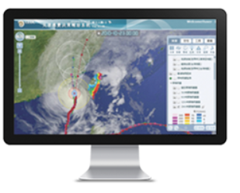
What is a Geographic Information System (GIS)?
A software system where the user inputs and interacts with a variety of spatial data to
Visualize
Question
Analyze
Interpret
Reveal relationships, patterns, and trends

Slide 3
ArcGIS Online
Cloud-based GIS
Hosts your maps
Hosts maps made by others
Hosts map layers
Provides basemaps
Users can
Add information to a map
Explore and represent data a variety of ways (filter, change symbols)
http://webapps-cdn.esri.com/Apps/StepByStep/

Slide 4
Guiding Principles
Everything occurs in time and space.
Maps are more than location.
Inquiry unlocks meaning.
He or she who interacts with the map learns the most.

Slide 5
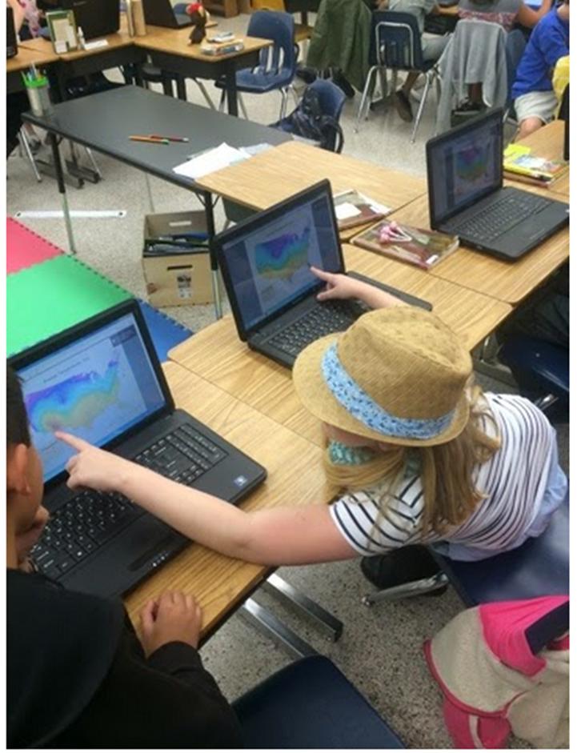
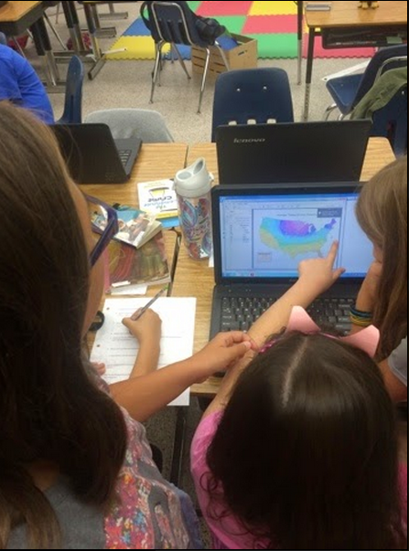
Photographs

Slide 6
Virginia GeoInquiries (beta)
A GeoInquiry is a scripted lesson designed for a 15 minute teacher guided map exploration.
Introduces students to the tools
Provides opportunity to acquire information
Supports critical thinking through map analysis
Develops spatial thinking essential for STEM
Today’s handouts at https://sites.wp.odu.edu/mapsrus
Features of MapsRUS

Slide 7
To access your VBSchools ARCGIS account, navigate to CLEVER. You can use bookmarks, or your school’s website.

Slide 8
Under Division Supported Resources, Click the ARCGIS icon.

Slide 9
Click the blue Virginia Beach City Public Schools button. If using a VBSchools device, you will be automatically logged in.

Slide 10
Why Login?
Publicly shared content can be accessed.
Subscription content available. Watch out for Premium Content.
Need to be logged in to save work.
Annotate a map
Create a Story Maps
Log in
Search for Virginia Regions_Elem WS
Remember the underscore between Regions and Elem

Slide 11
Virginia Regions
Examine the map
Observe the data
Look for patterns
Describe the distribution using quadrants
Compare the regions
Analyze the relationship between the regions
Reflect and draw conclusions or state generalizations

Slide 12
Steps of Interpreting Maps
Observe
Describe
Compare
Analyze
Reflect
Questions

Slide 13
Story Maps

