Slide 1
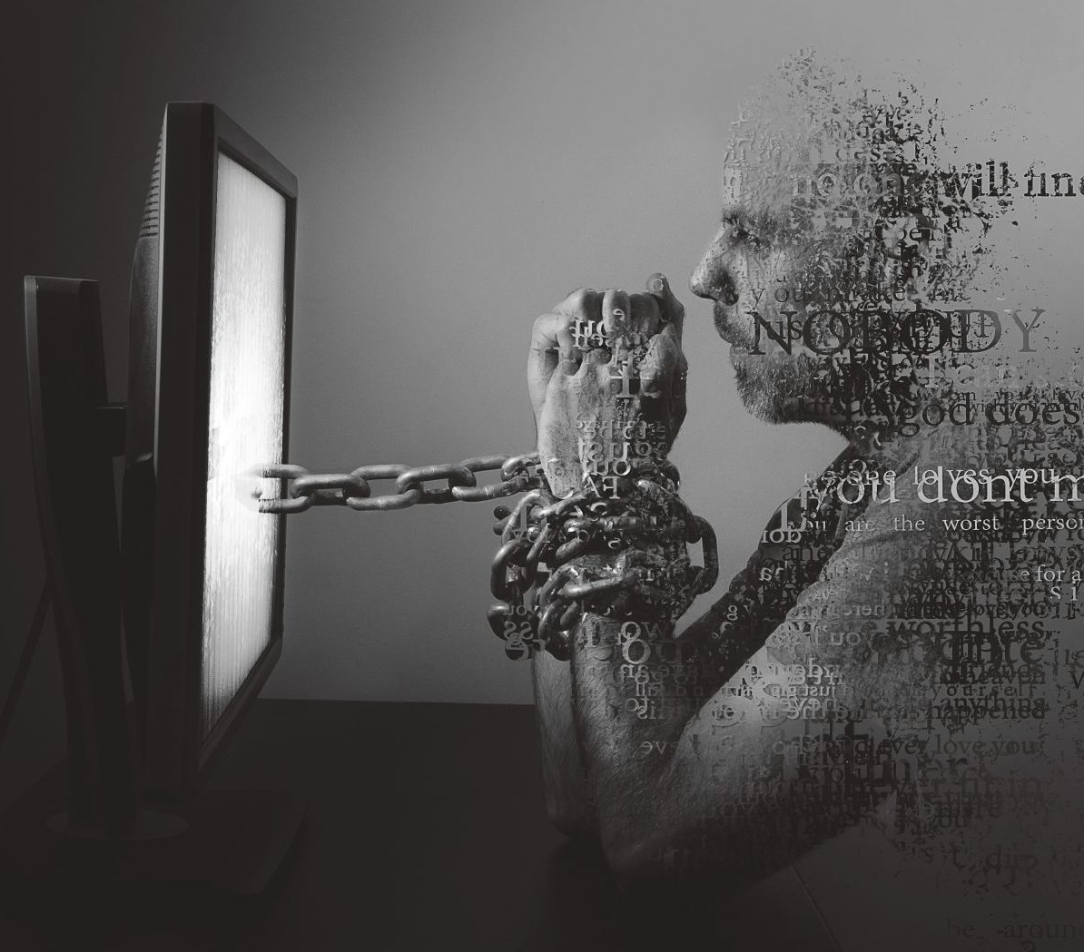

Cyberbullying and Online Harassment
BY: ALISSIA Metcalfe

Slide 2
What are the motives of the ones who are committing the crime?
Some motives behind cyberbullying include:
  Jealousy or Hate: Possible the bully is jealous and does not want to outwardly show their jealously, so they hide behind a computer.
  Power and Social Status: Using blackmail to bring someone of high status down from their position. Ex: Bryon Noems aka Kristi Noem’s husband
  Retaliation and Revenge: Possibly someone got the position over they cyberbully and now they are on social media writing bad things about the victims work ethics.
  Anonymity and Reduced Consequences: Gives the cyberbully committing the crime the ability to hide behind a fake identity and avoid facing the immediate

Slide 3
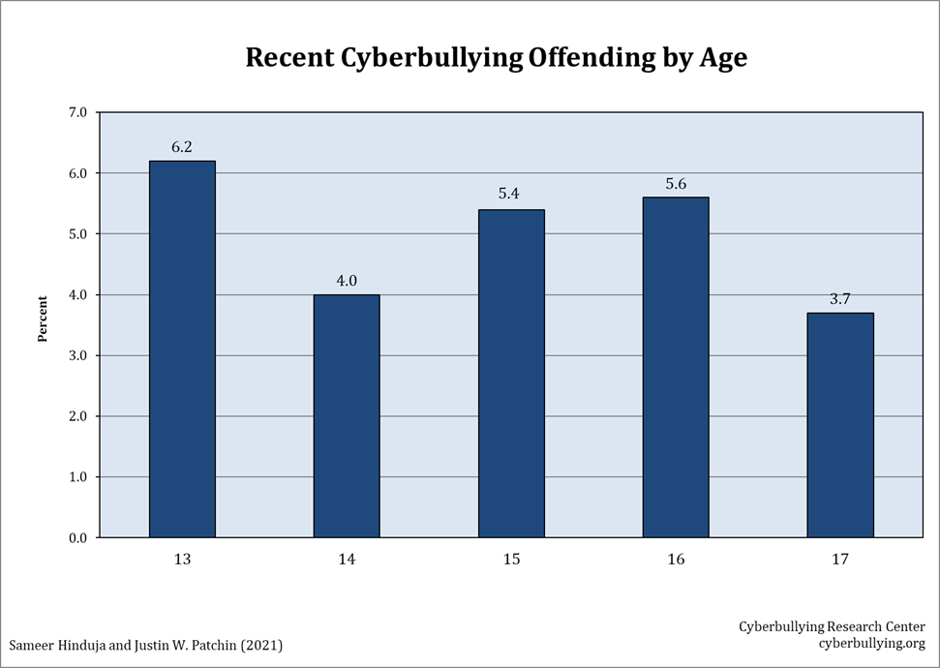
Age groups and percentages

Slide 4
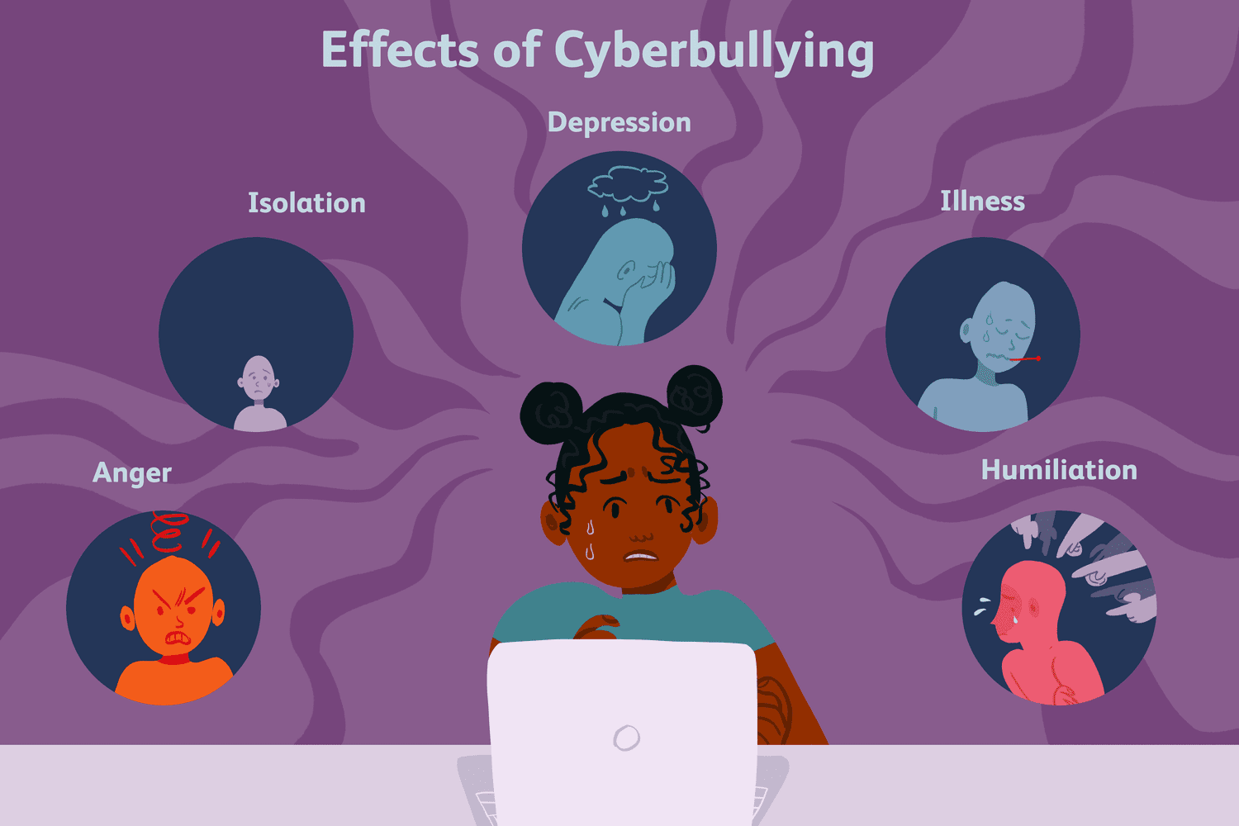
What are the psychological effects?
Victims of Cyberbullying face:
  Isolation: cyberbullying can lead to the feeling of being outcasted by society, different from everyone else leading to social isolation.
  Depression
  Changes in self esteem: victims may begin to view themselves as less than or begin to believe the things the cyberbullies are telling them which can lead to…
  And in some cases, suicide. 2008 Unites States v. Drew resulted in the loss of Sarah. Megan Meier
  https://www.youtube.com/watch?v=3wR1SWI0jls

Slide 5
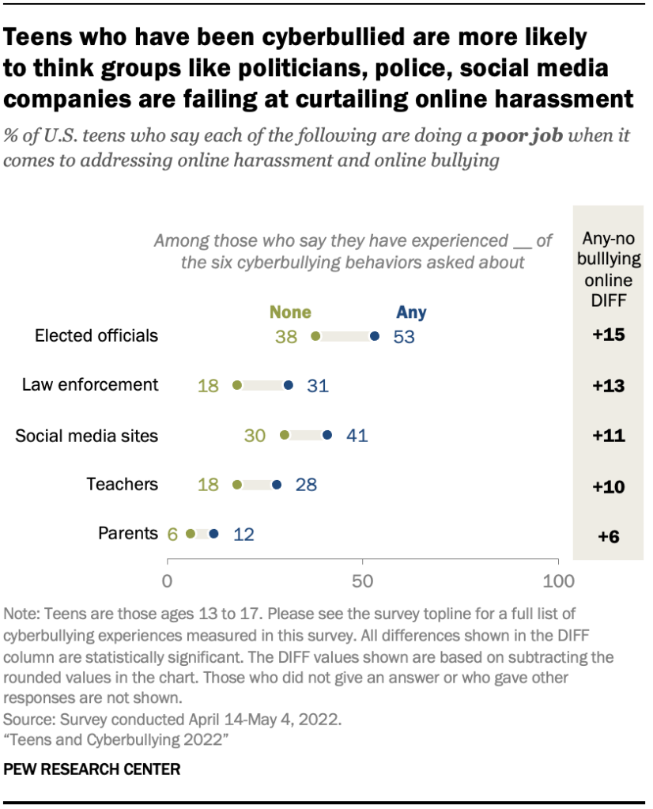
What is society’s take on cyberbullying?
As technology overtime has evolved and the popularity of social media platforms has grown. Society views cyberbullying as a major issue that causes emotional damage and major mental problems.
Some of society has voiced their opinion on how social media platforms are dealing with these issues, saying that platforms aren’t doing enough to protect their users from cyberbullying and not enough regulations in place to prevent them from being able to commit the crimes

Slide 6
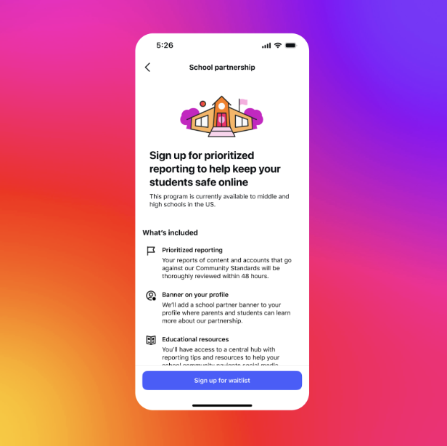
What are cybersecurity professionals doing about this?
AI-powered content filters and detection systems.
  These are being used on platforms like Instagram to filter out inappropriate language and emojis underneath comment sections of videos and pictures.
  Adding account security
  Using Multi-Factor Authentication (MFA) to prevent bullies from gaining access to victim’s profiles/ hacking into their profiles to upload malicious content
  Technical Support
  Having places on the platform where you can report malicious and inappropriate content/ comments.

Slide 7
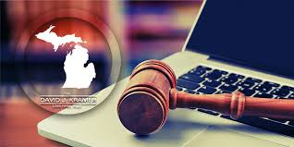
Laws and regulations in place and are they affective?
In the state of Virgina
H.B. 1871, signed by governor on July 1, 2023. “Bullying’ means any aggressive and unwanted behavior that is intended to harm, intimidate, or humiliate the victim…’Bullying’ includes cyber bullying. ‘Bullying does not include ordinary teasing, horseplay, argument, or peer conflict.”
Although above states law in the state of Virgina, other states do very. Some exclude criminal sanctions ( legal penalties) for cyberbullies. To include New Hampshire, Maine, New Mexico and Minnesota. Other states not requiring school sanctions, Michigan, New Hampshire and Alabama.
What do you think are the regulations set in place today effective or outdated?

Slide 8
Thank you!
References
https://cyberbullying.org/bullying-laws
https://www.pewresearch.org/internet/2022/12/15/teens-and-cyberbullying-2022/pi_2022-12-13_teens-cyberbullying_0-08a-png/
https://vc.bridgew.edu/cgi/viewcontent.cgi?referer=&httpsredir=1&article=1009&context=marc_pubs

