Slide 1
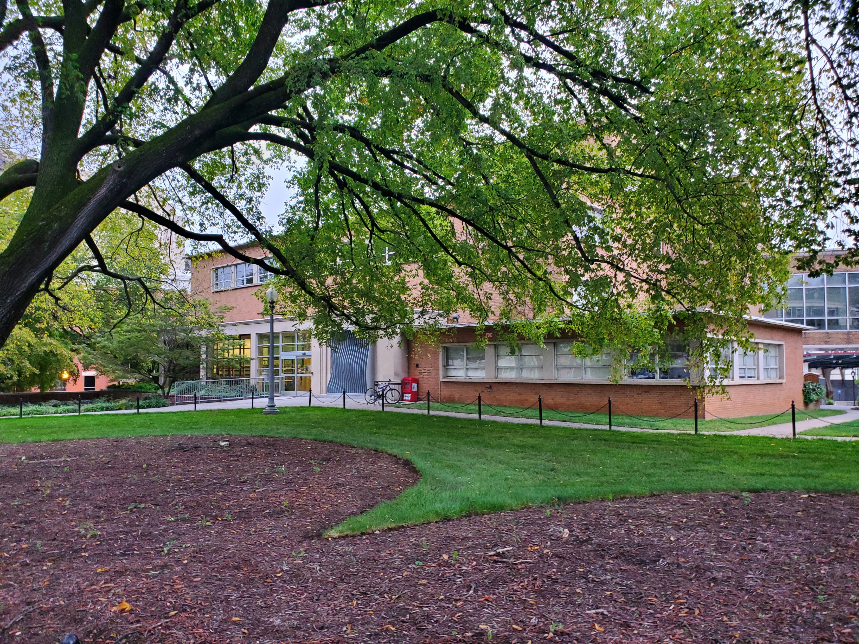
Library Visit #2
“Outward Appearances”
Ashlee Mullis
Old Dominion University
LIBS 608
Dr. Dawn Betts-Green

Slide 2
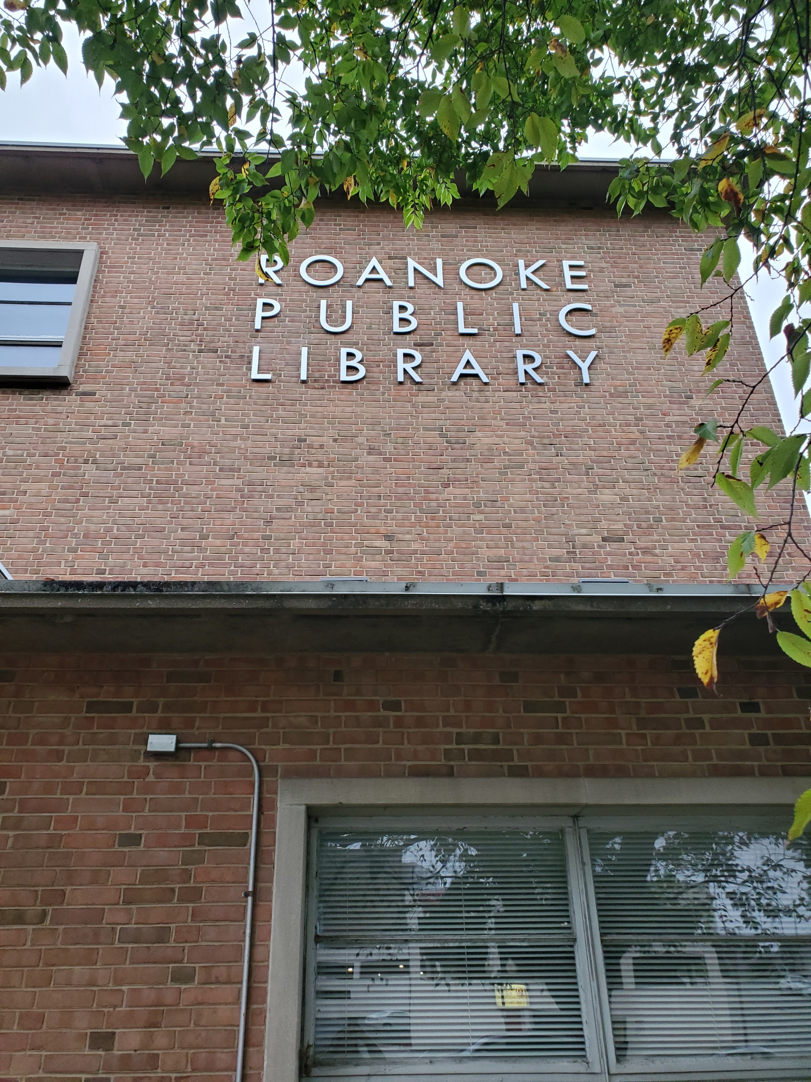
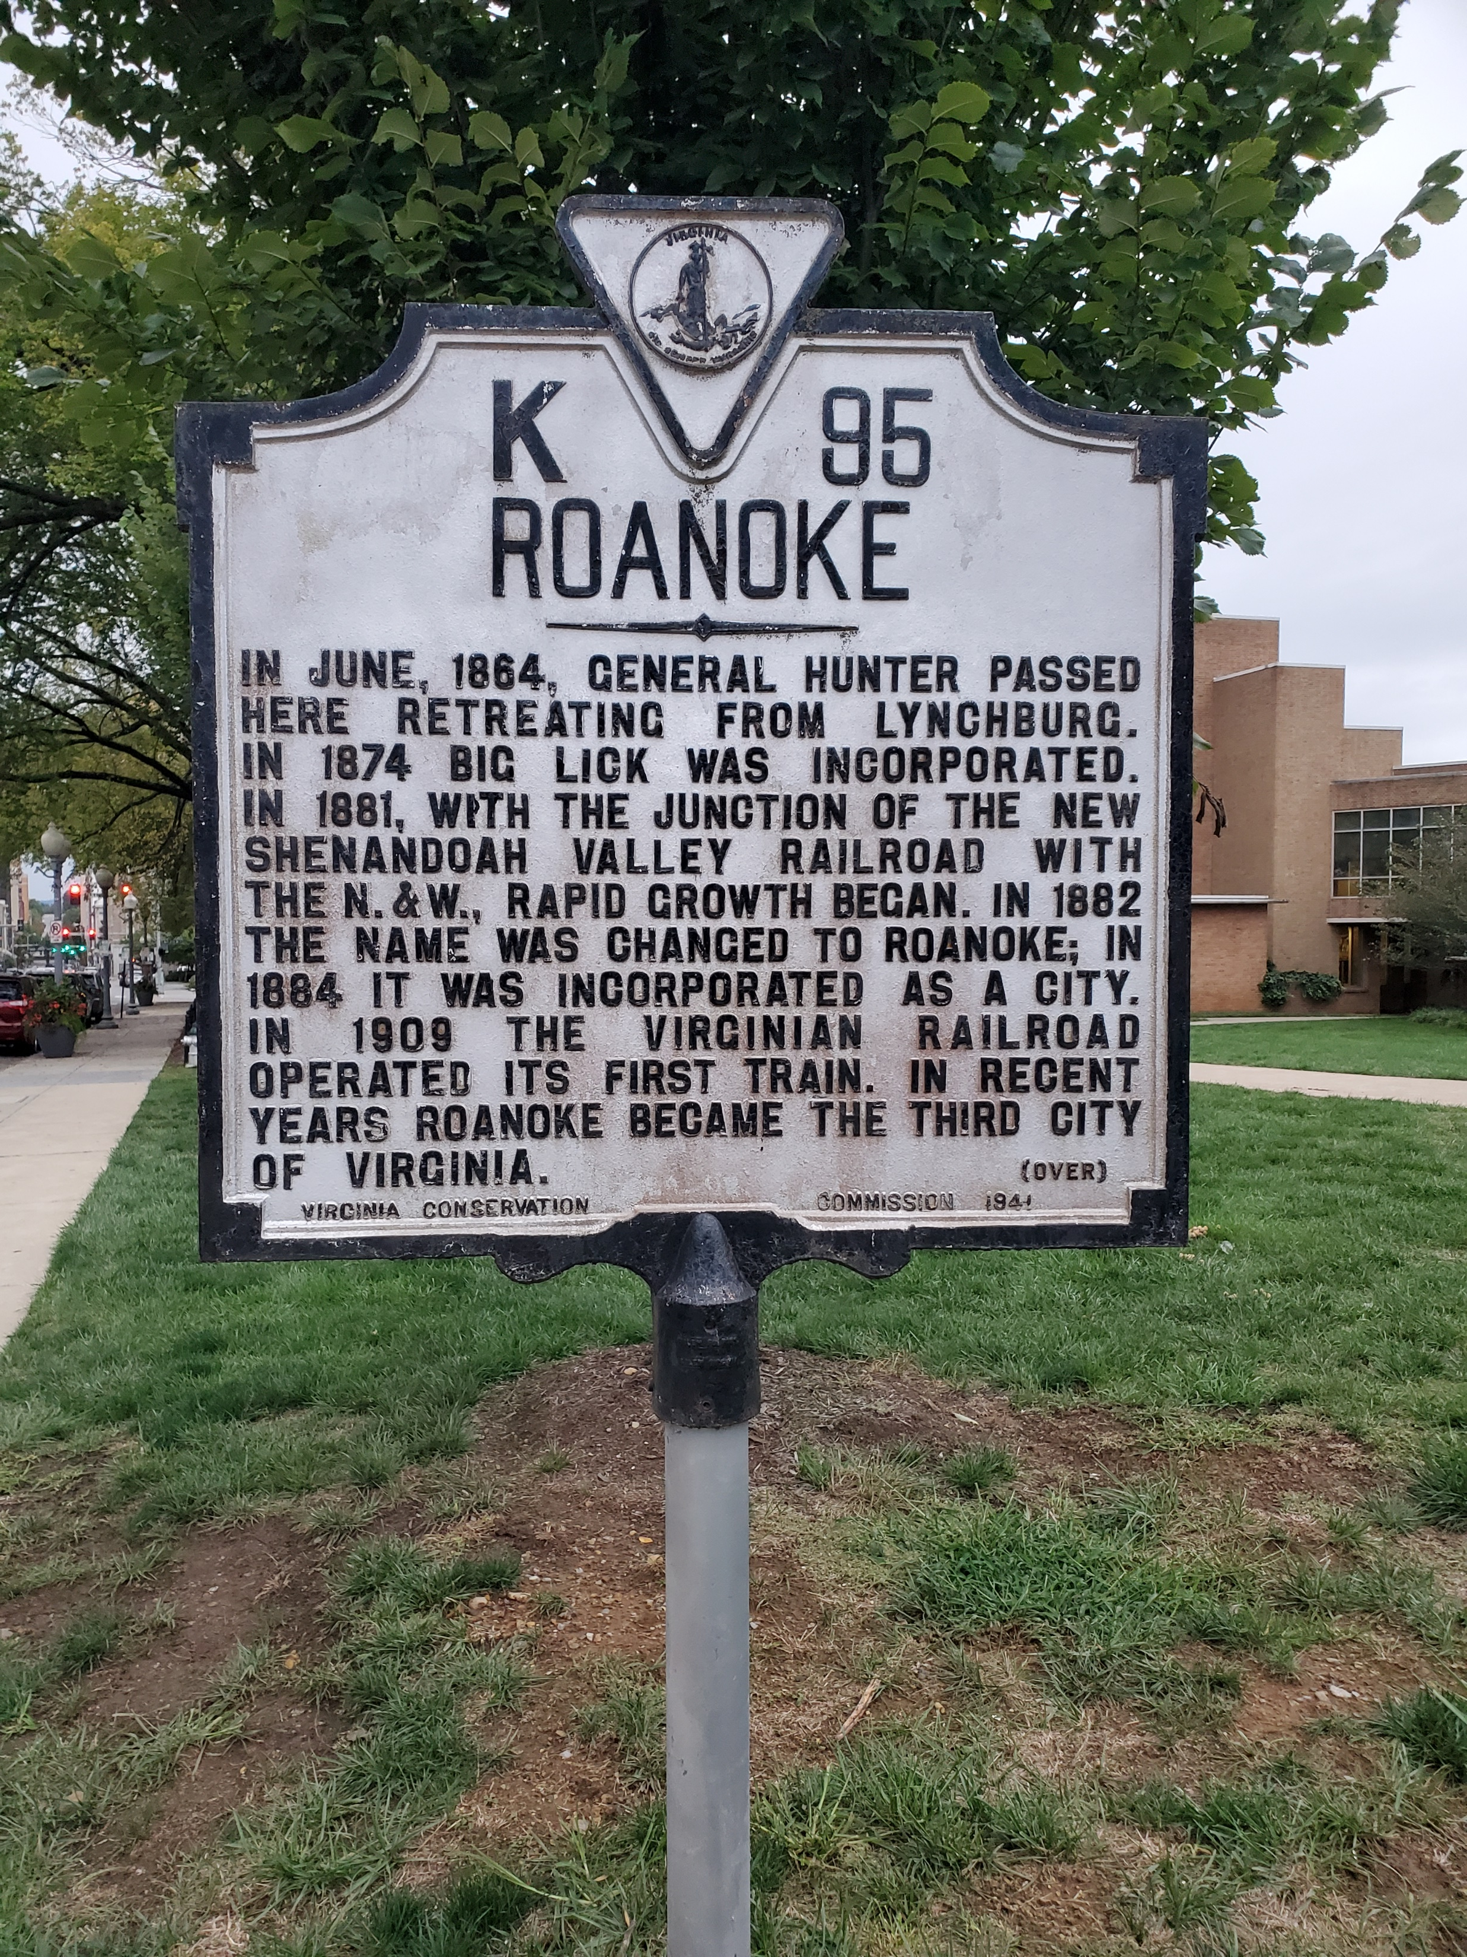
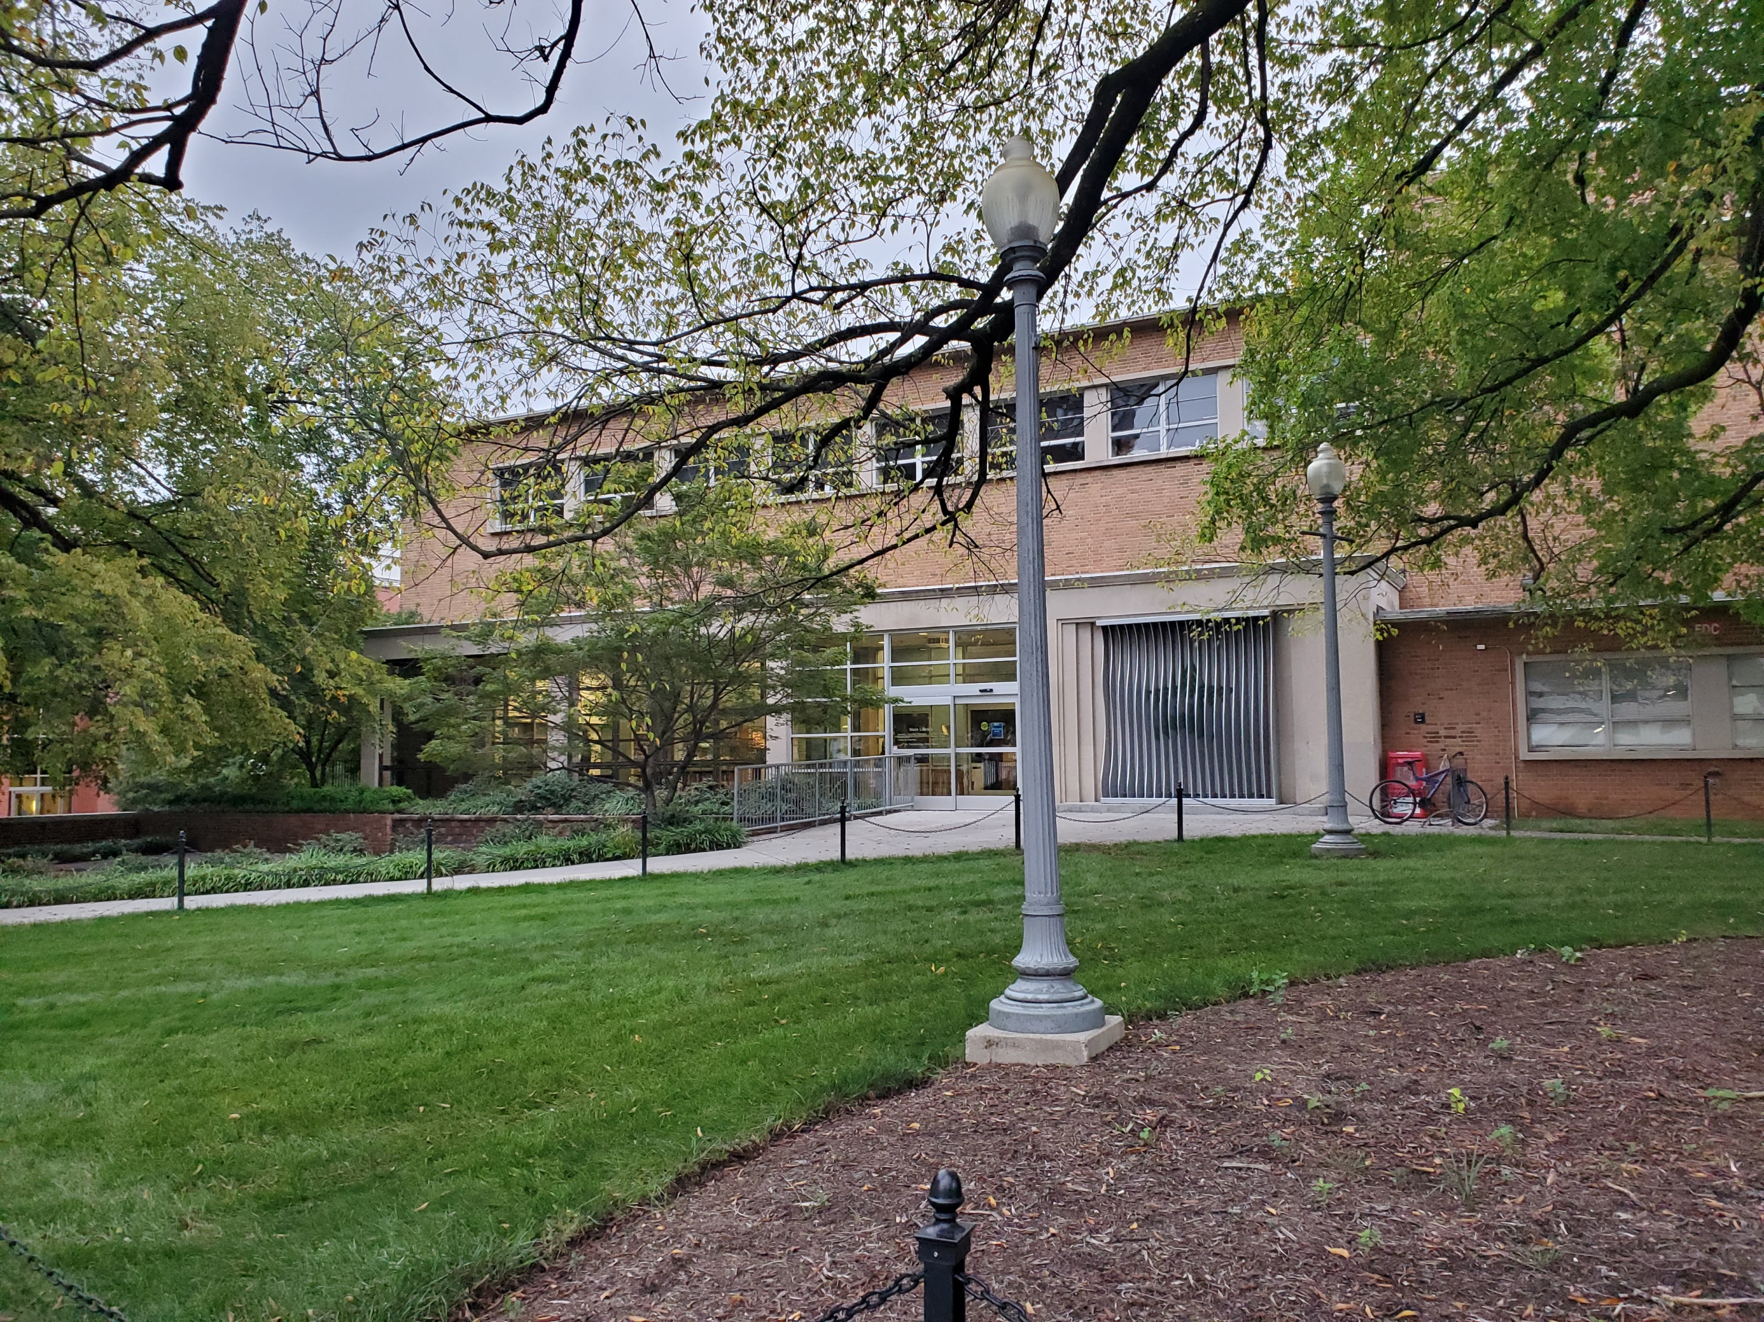
Roanoke Public Library
706 S Jefferson St.
Downtown Roanoke, VA

Slide 3
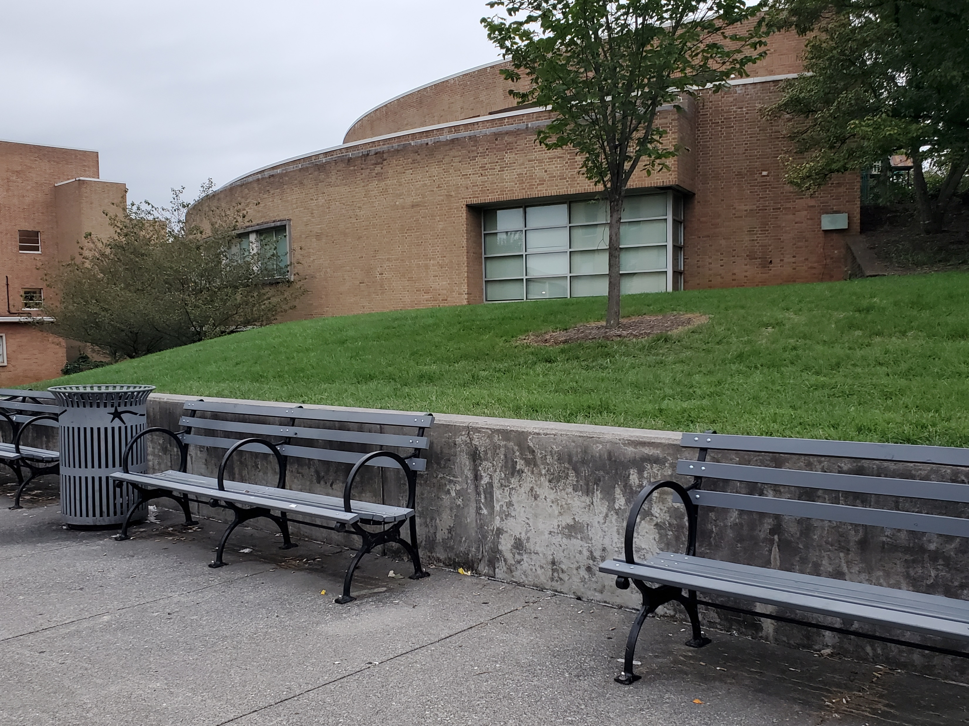
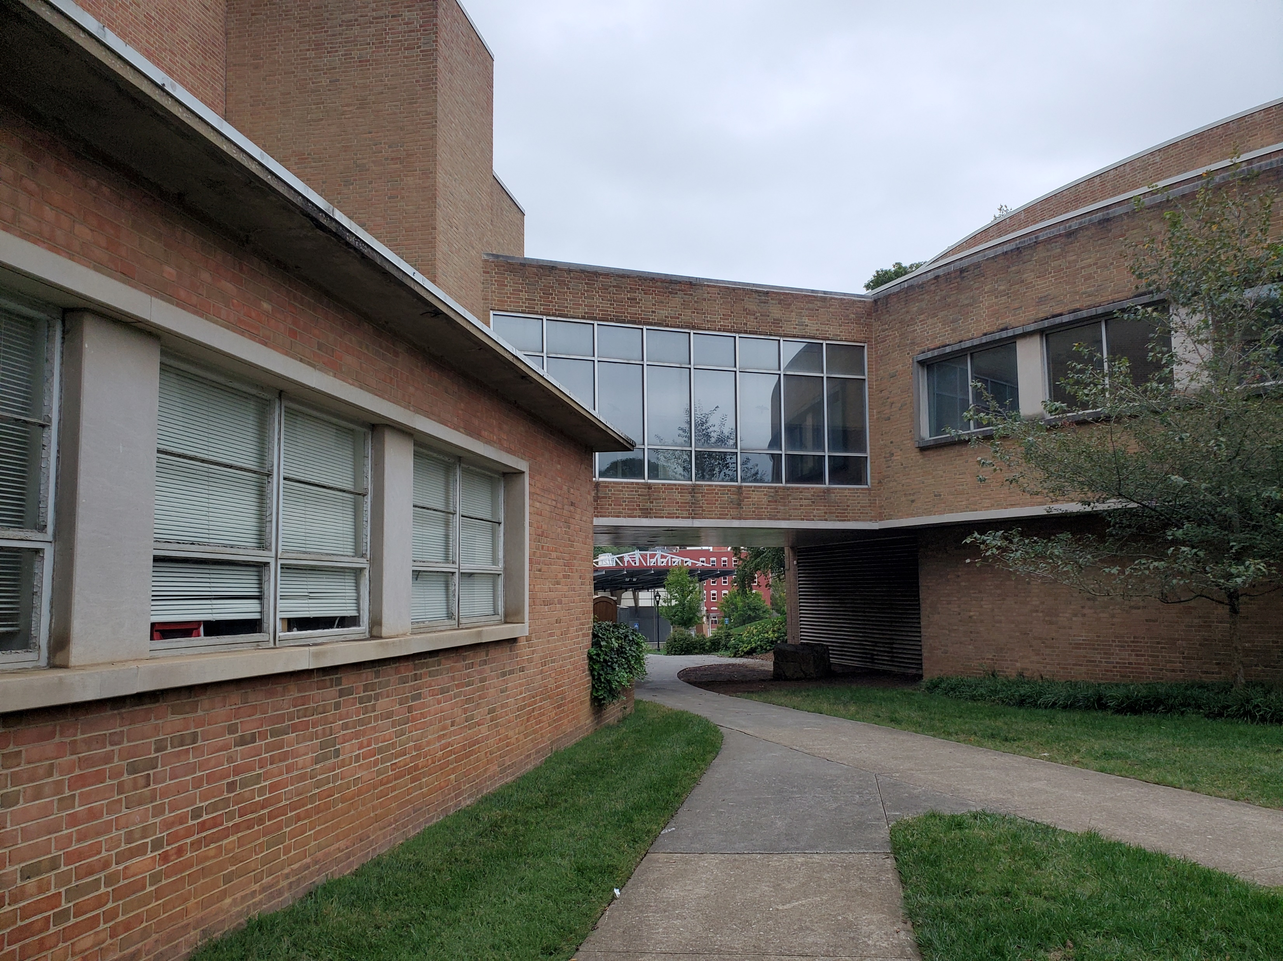
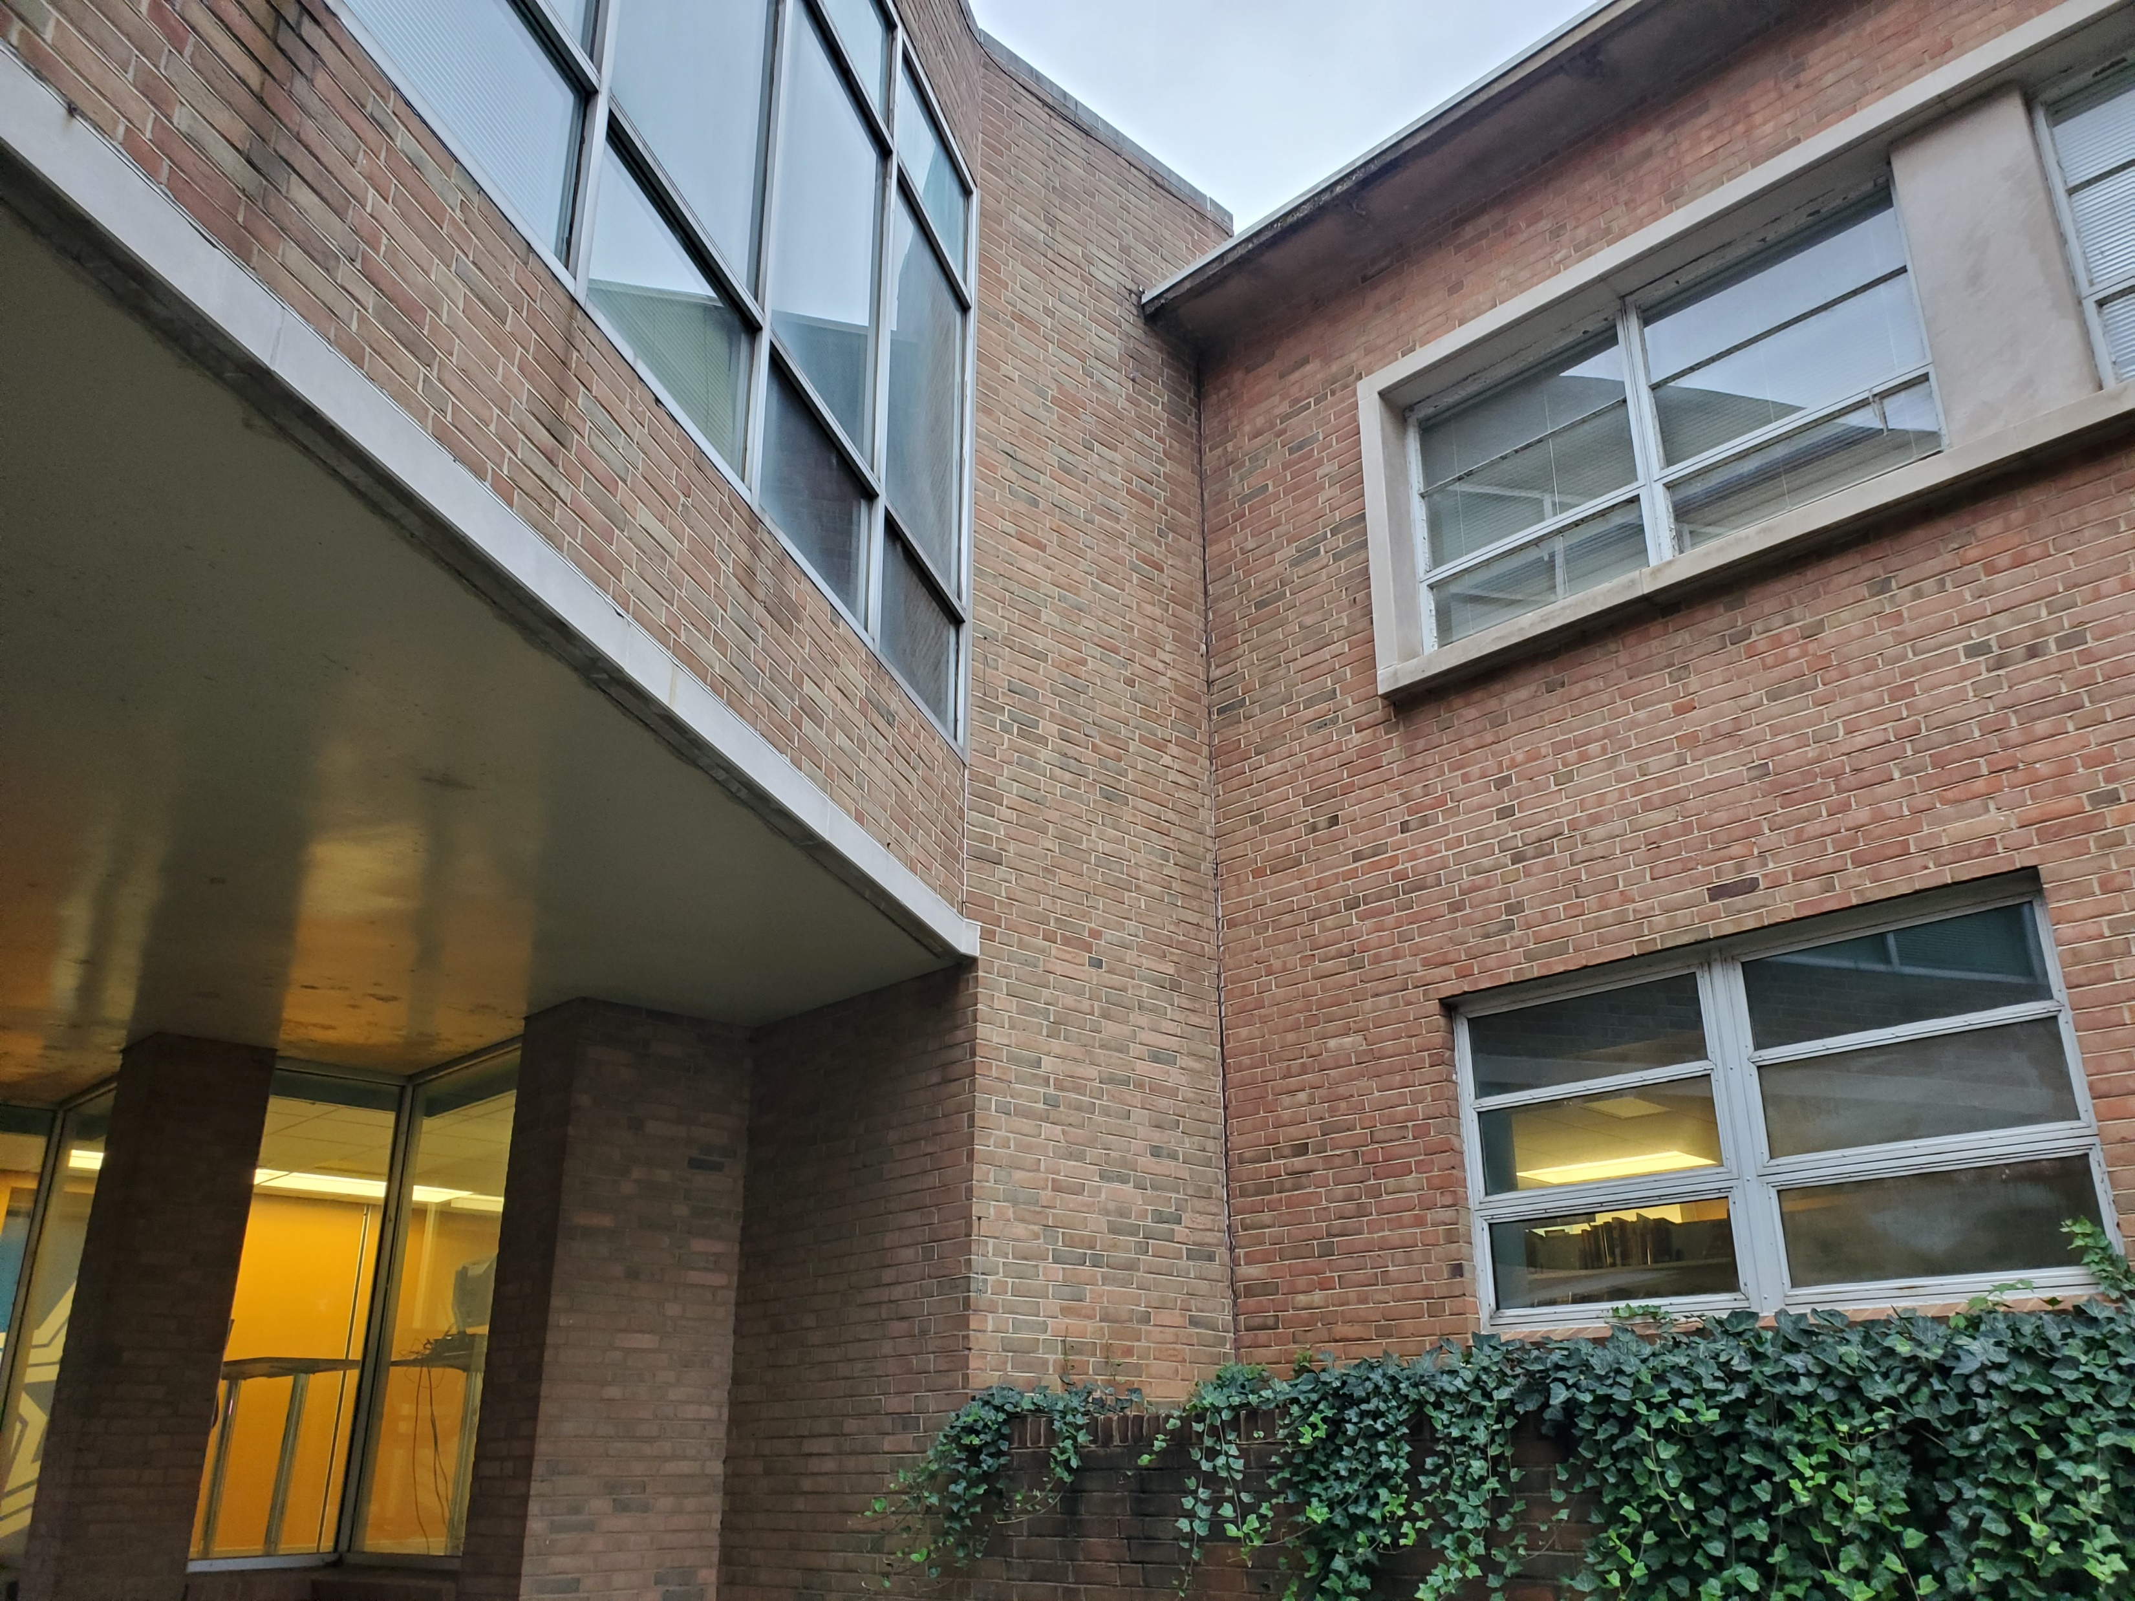
Building Style

Slide 4
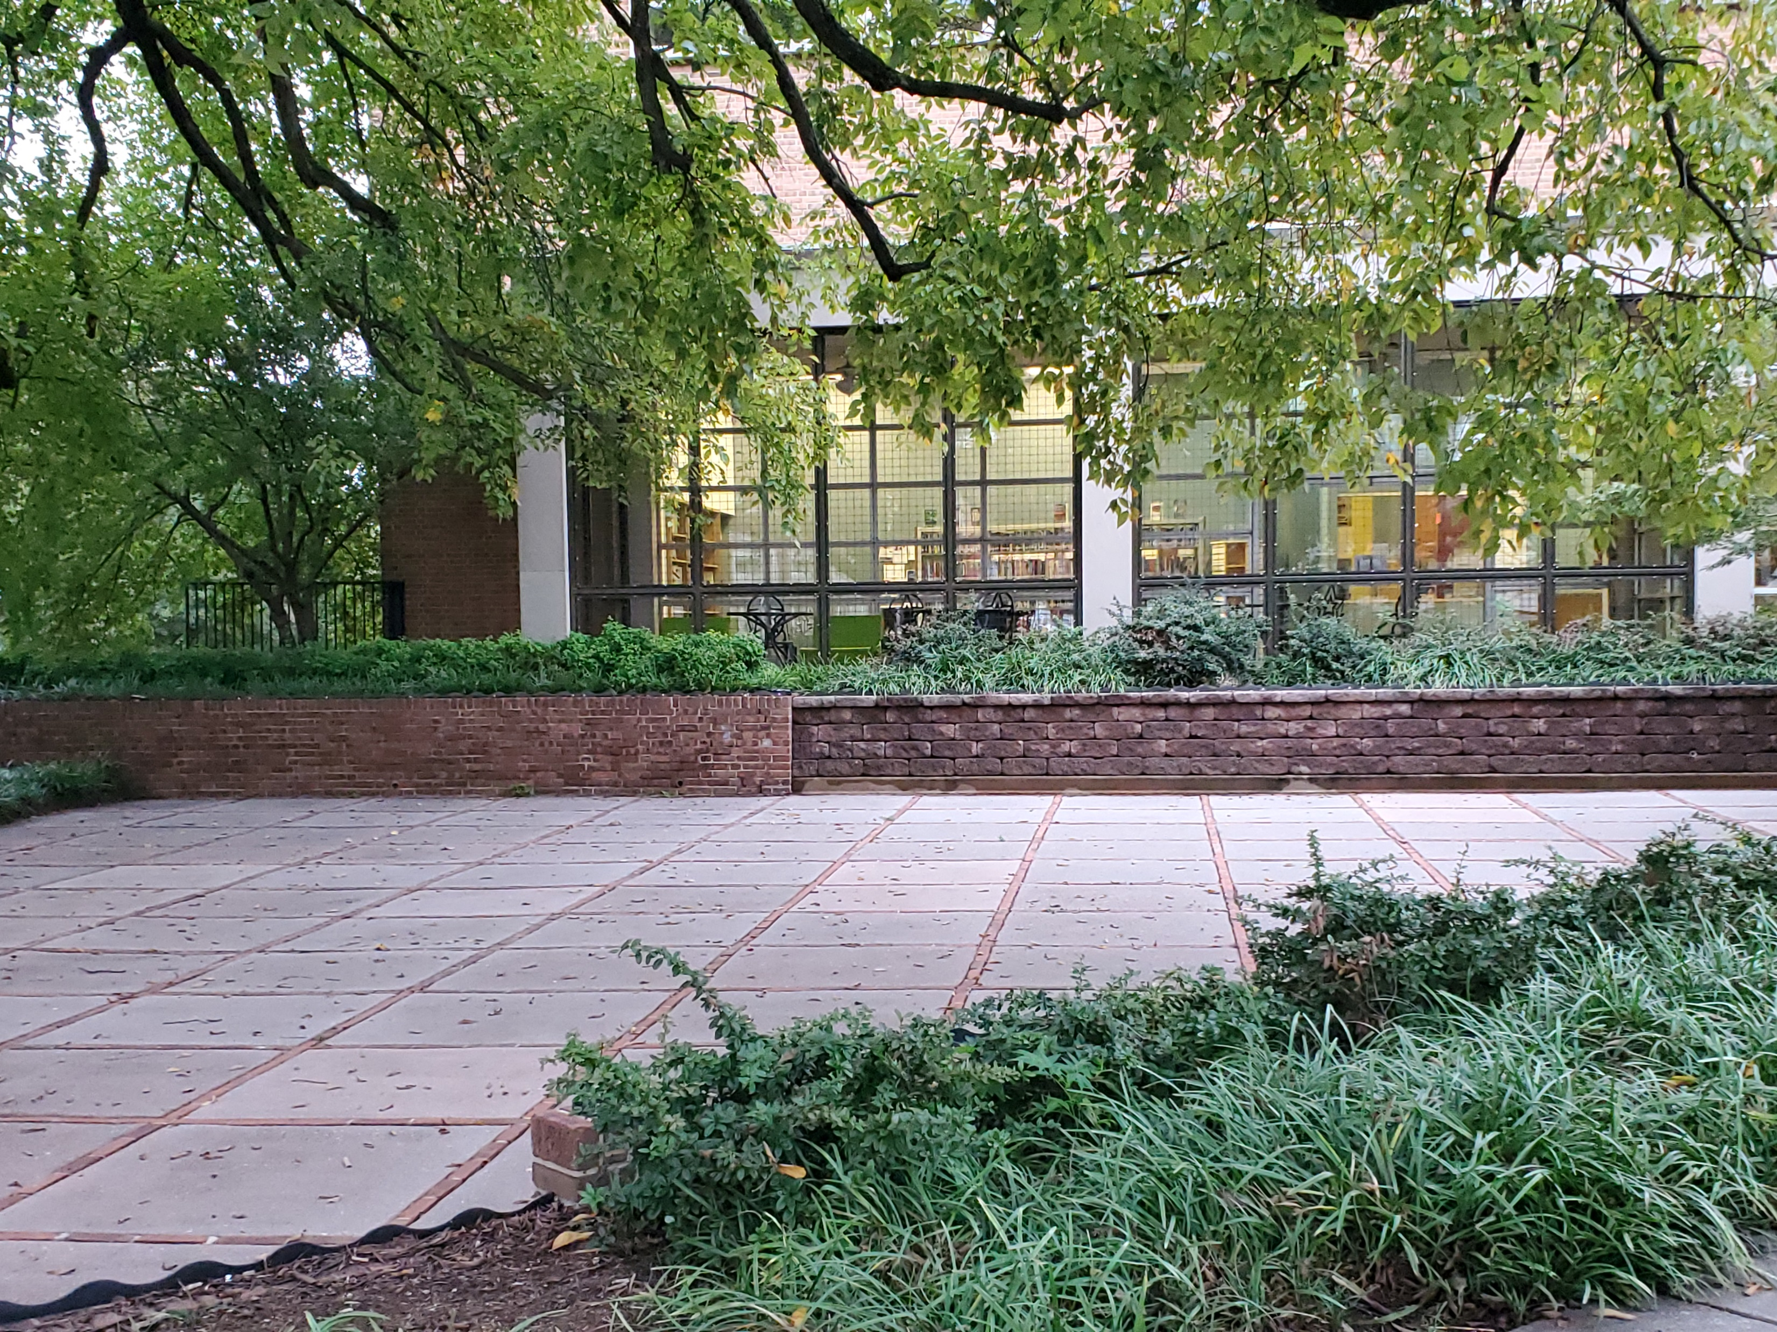
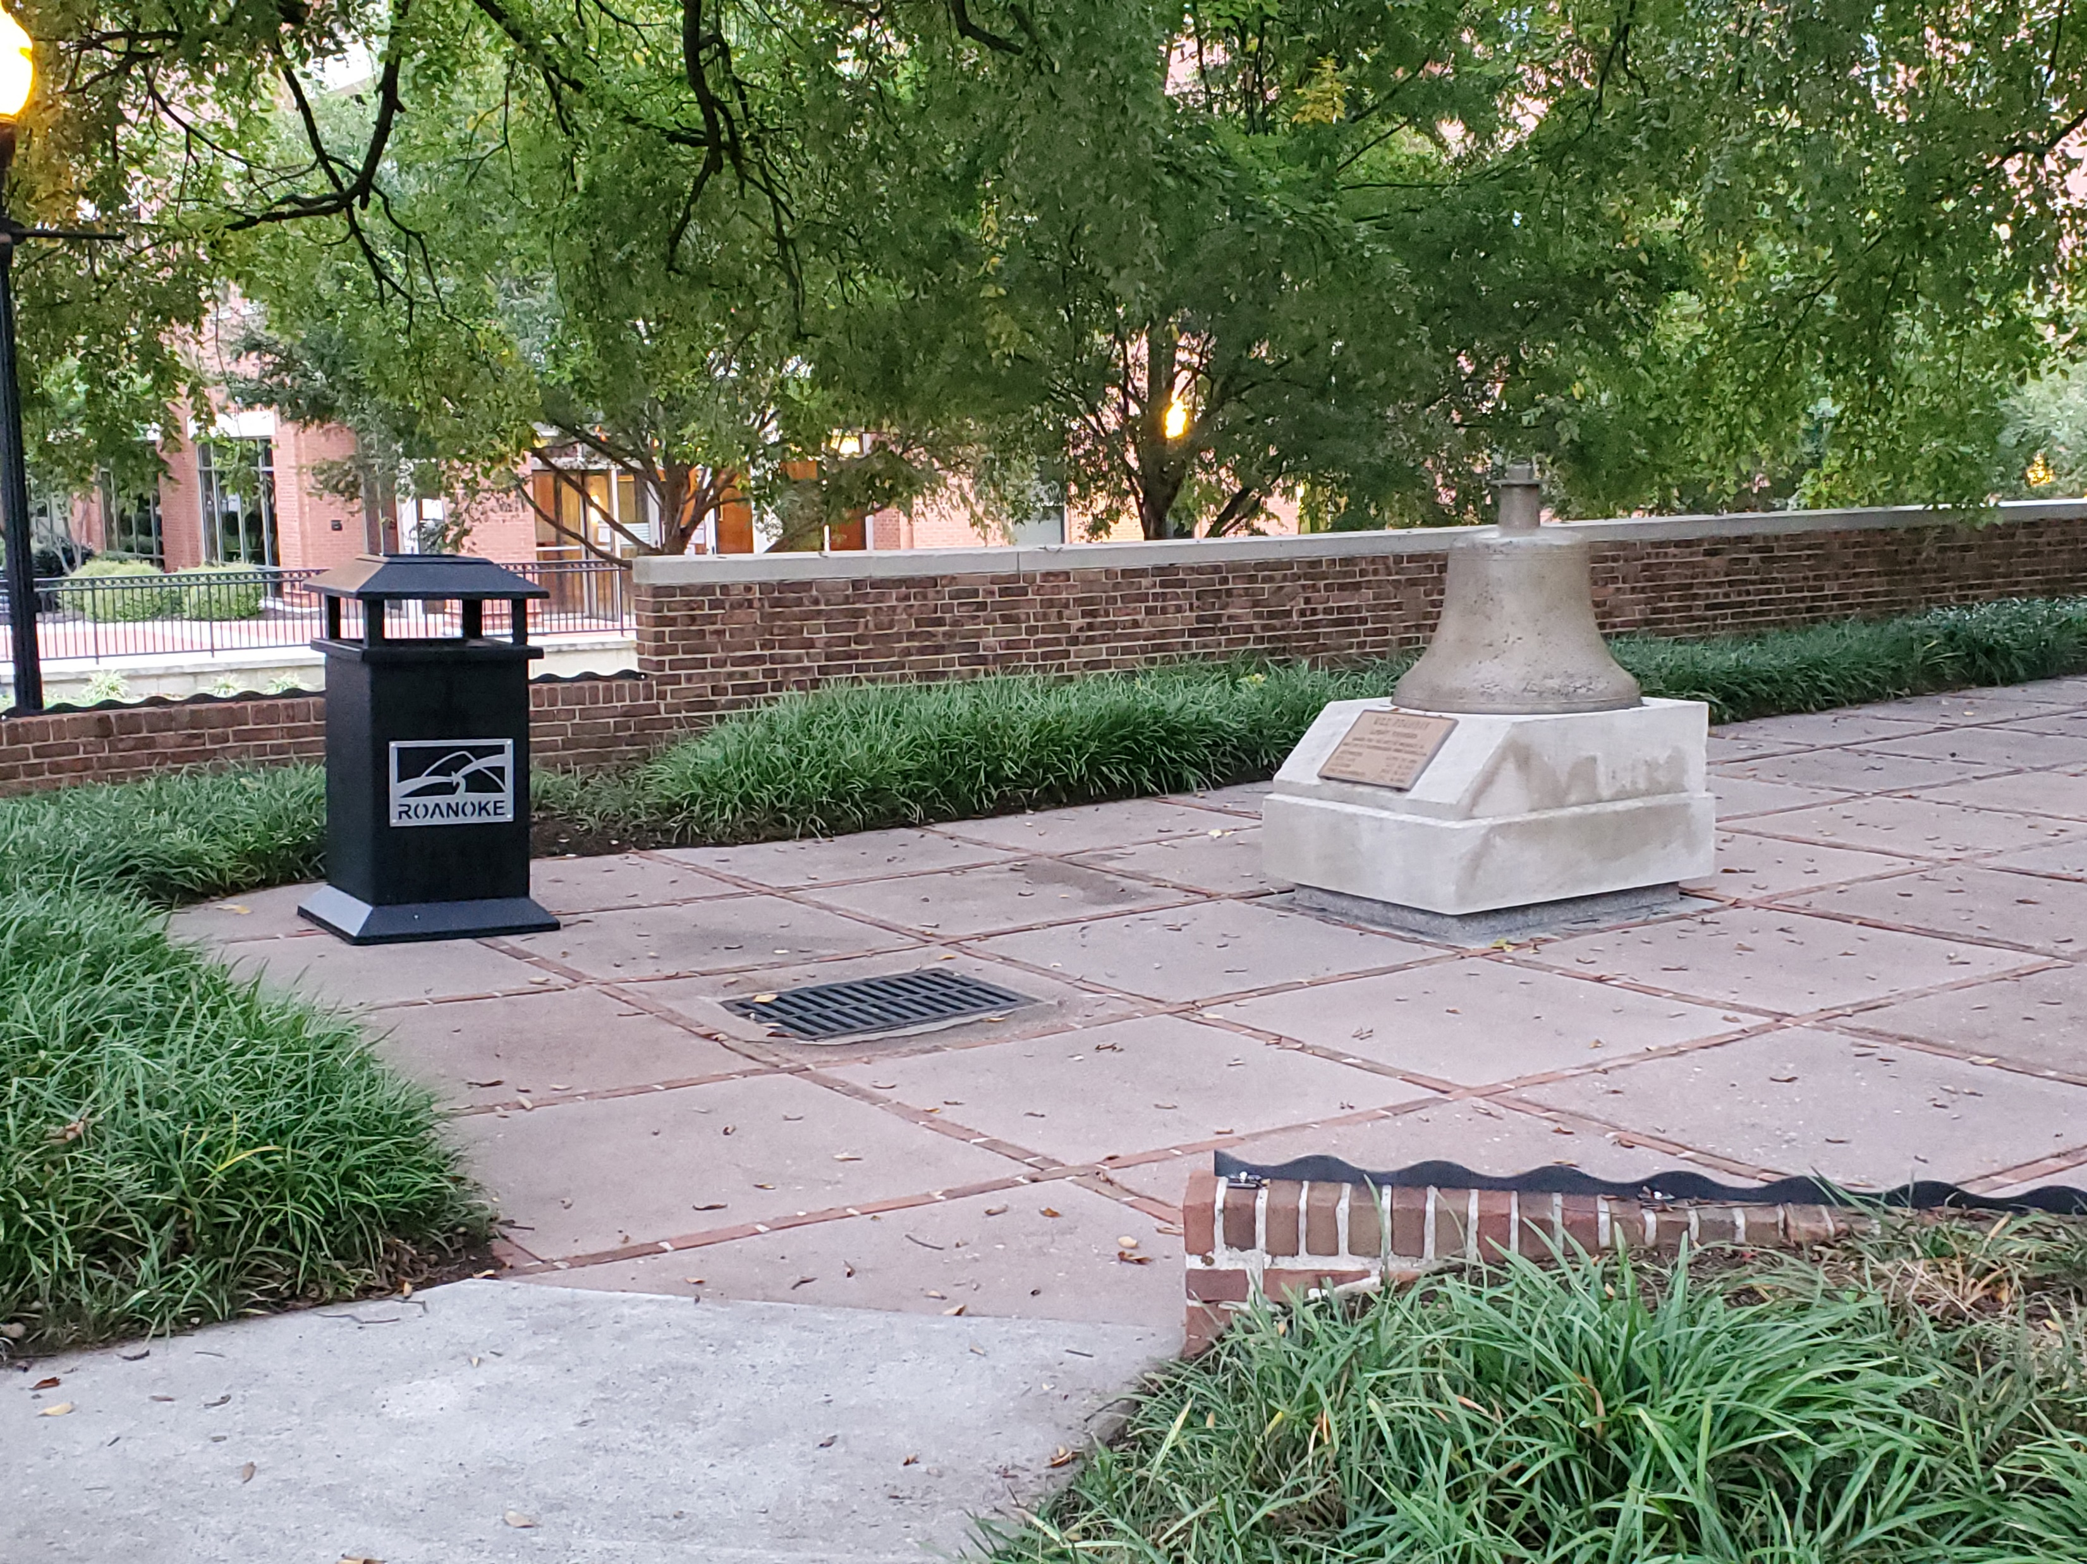
The Front Courtyard

Slide 5
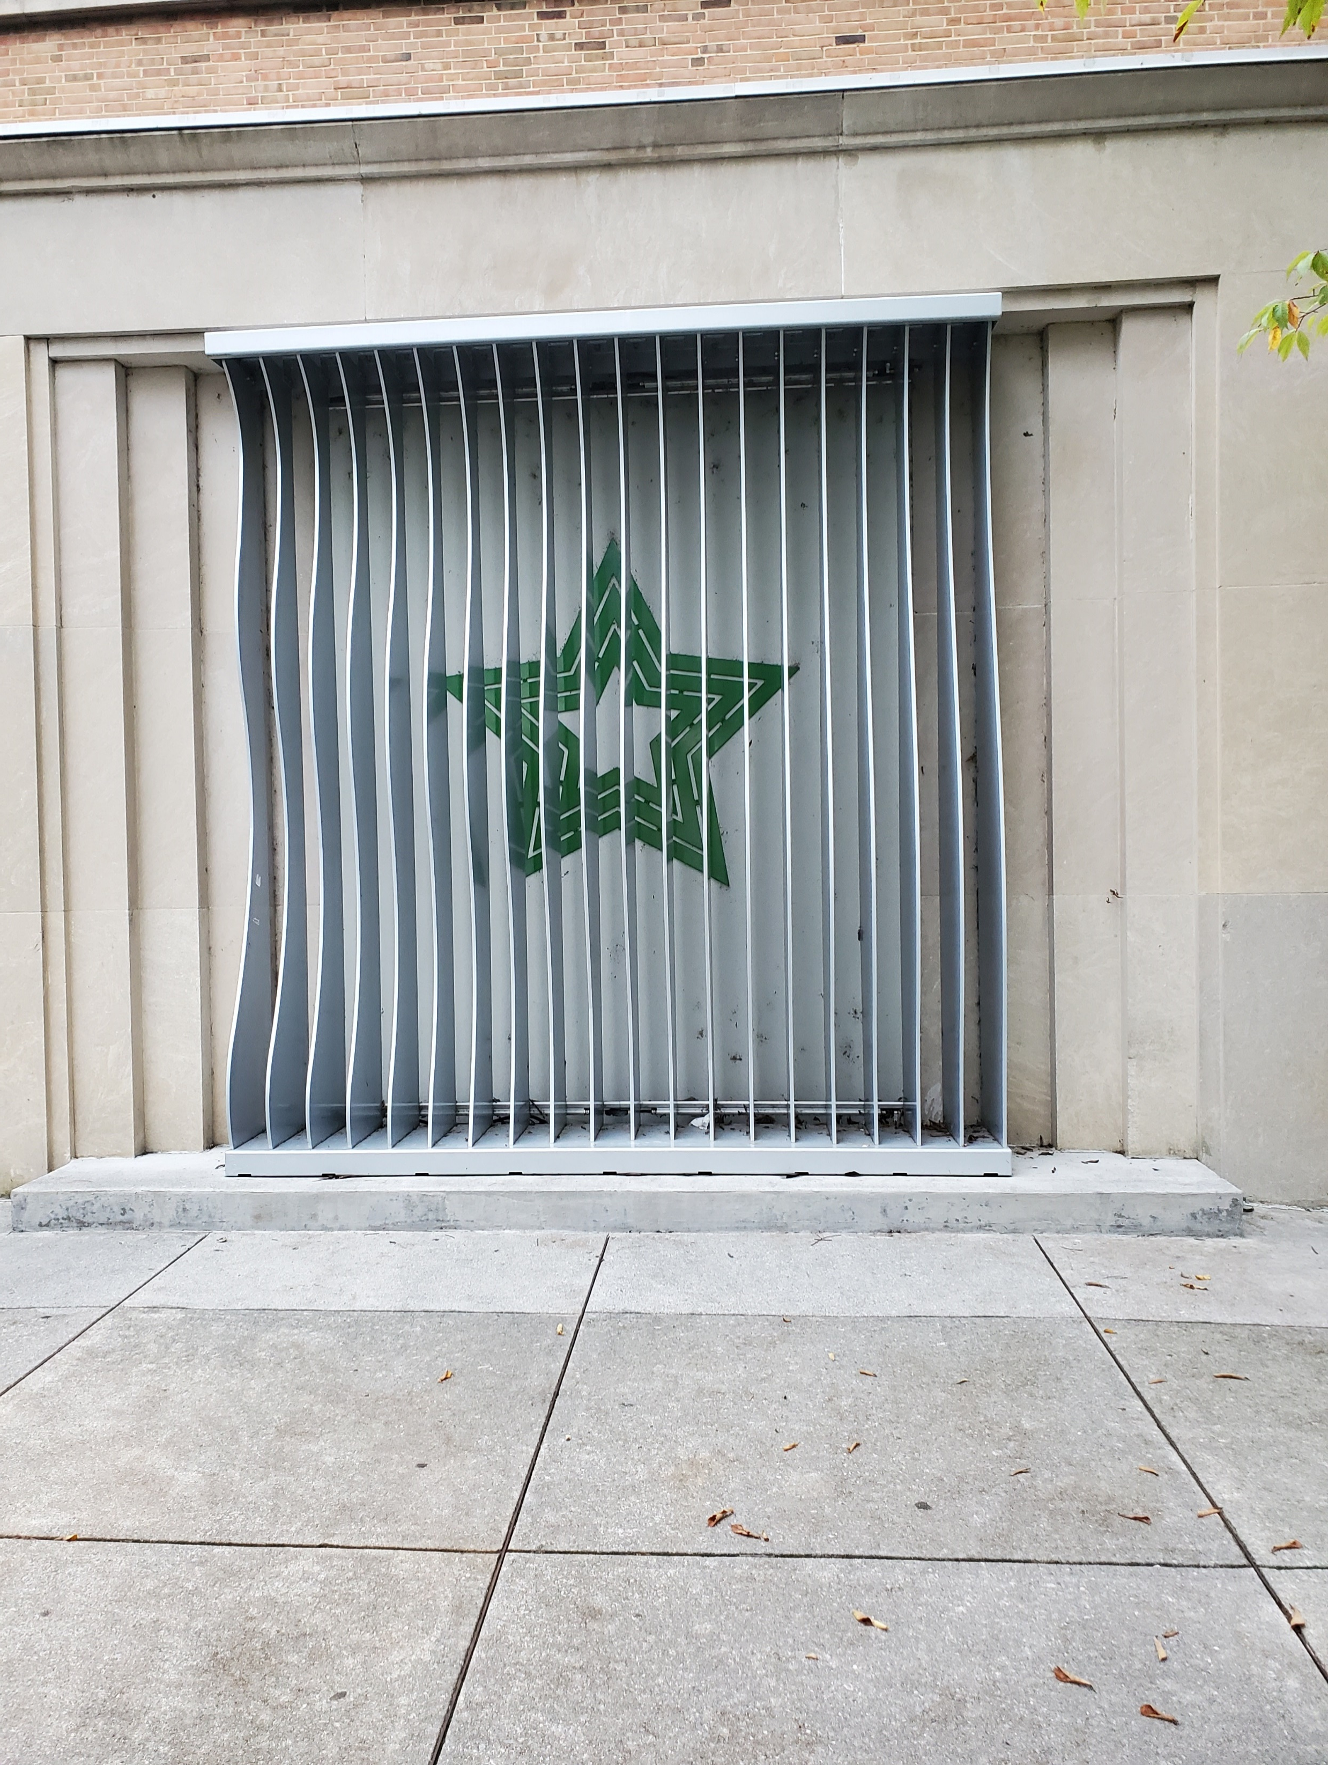
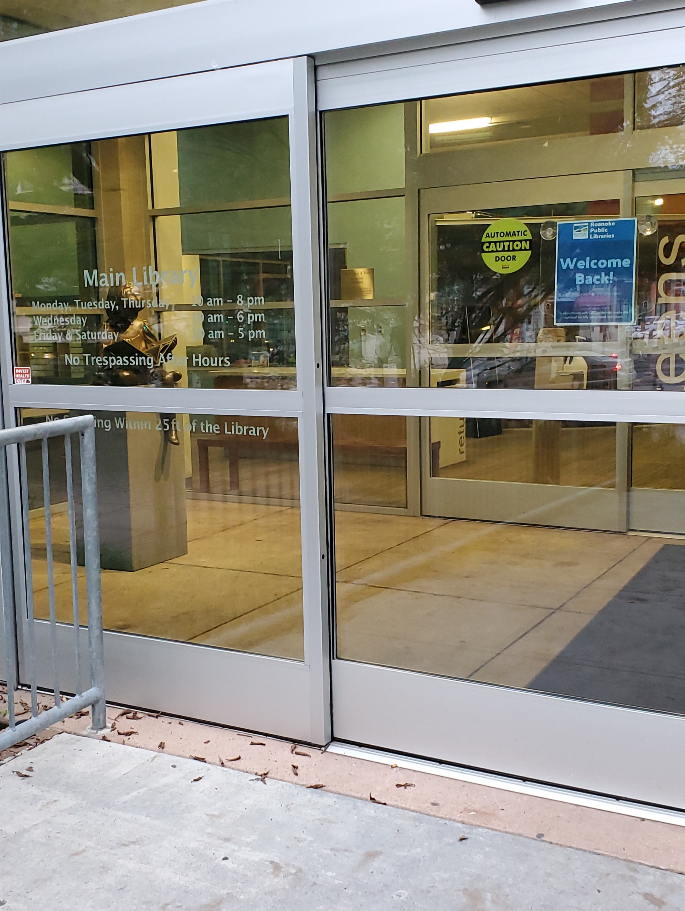
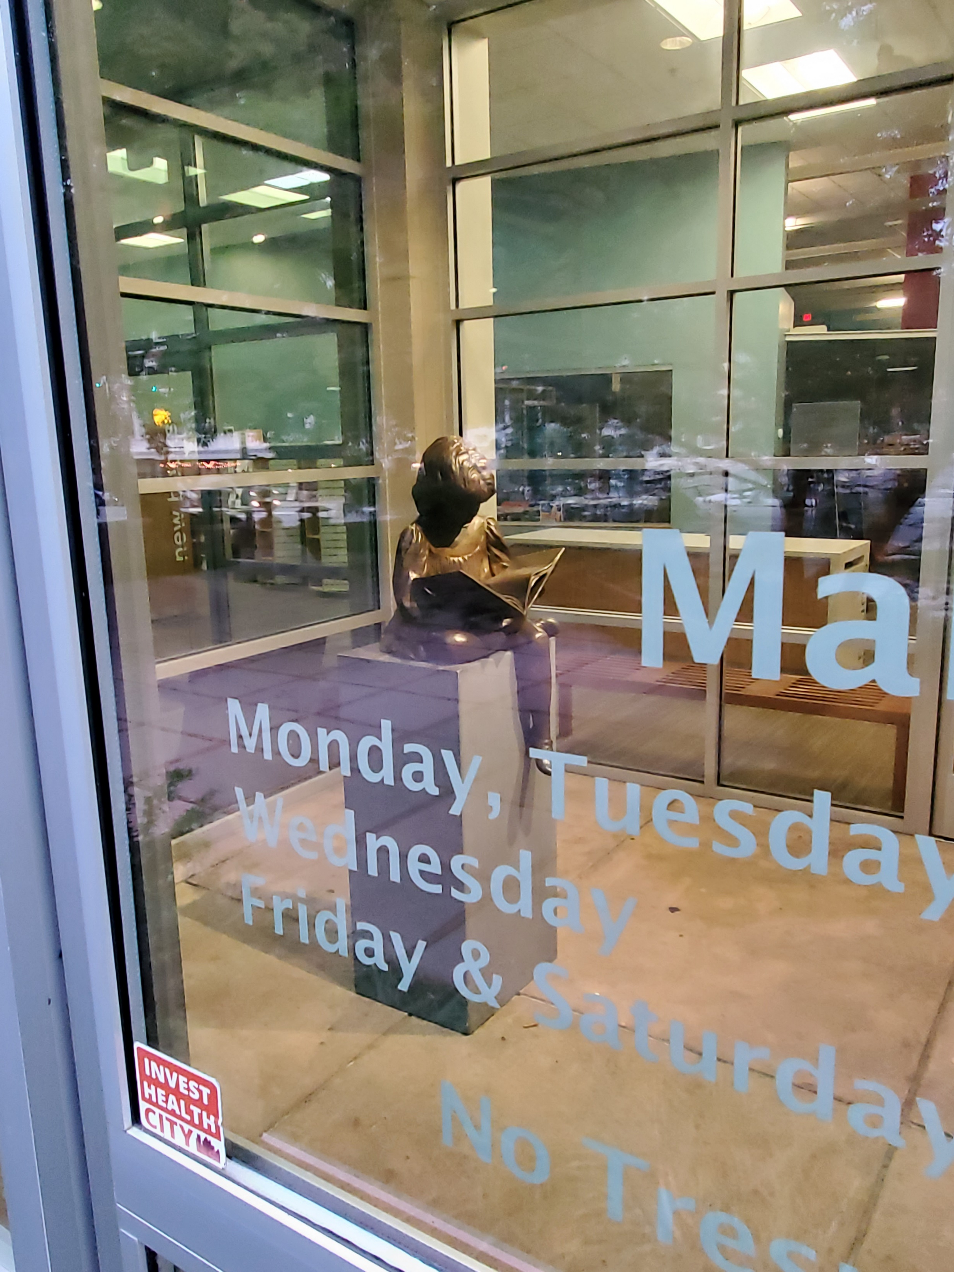
The Front Entrance

Slide 6
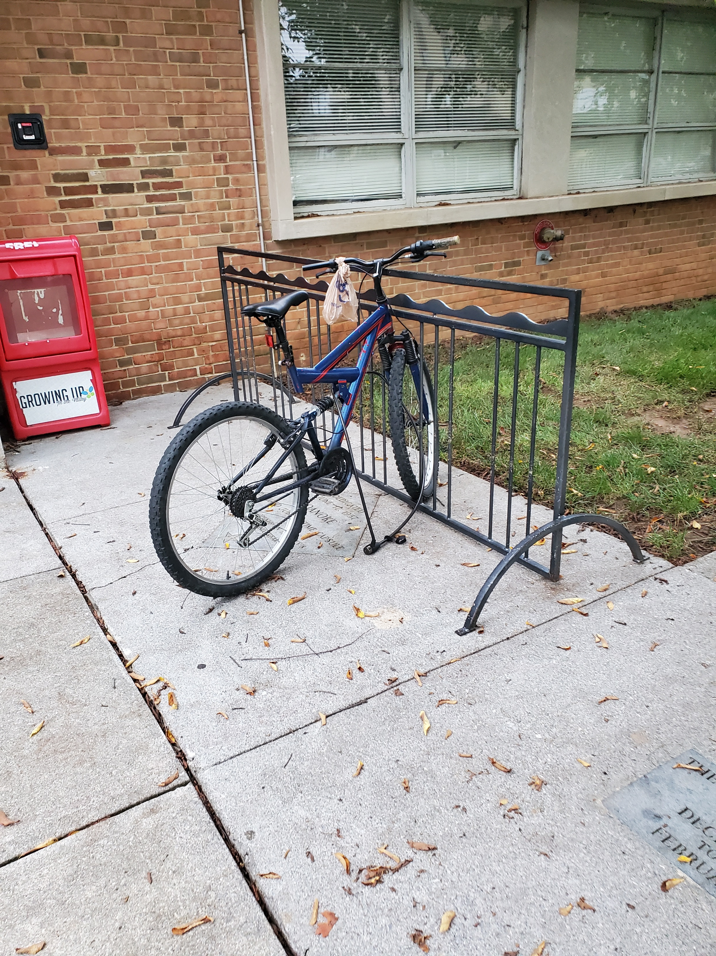
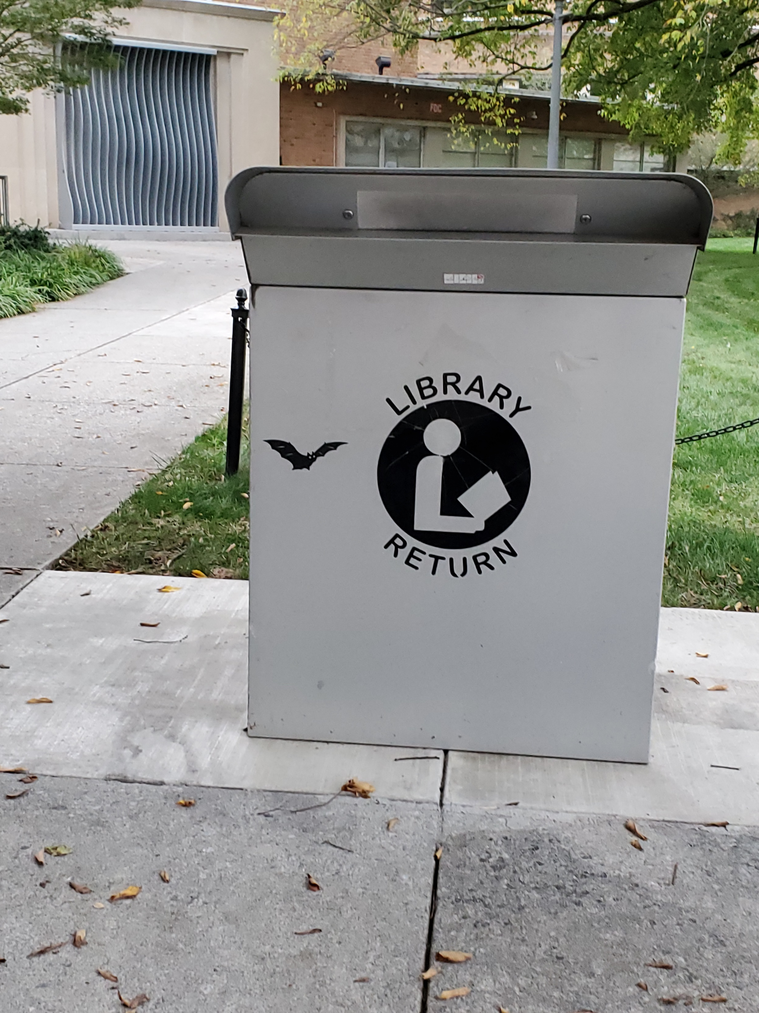
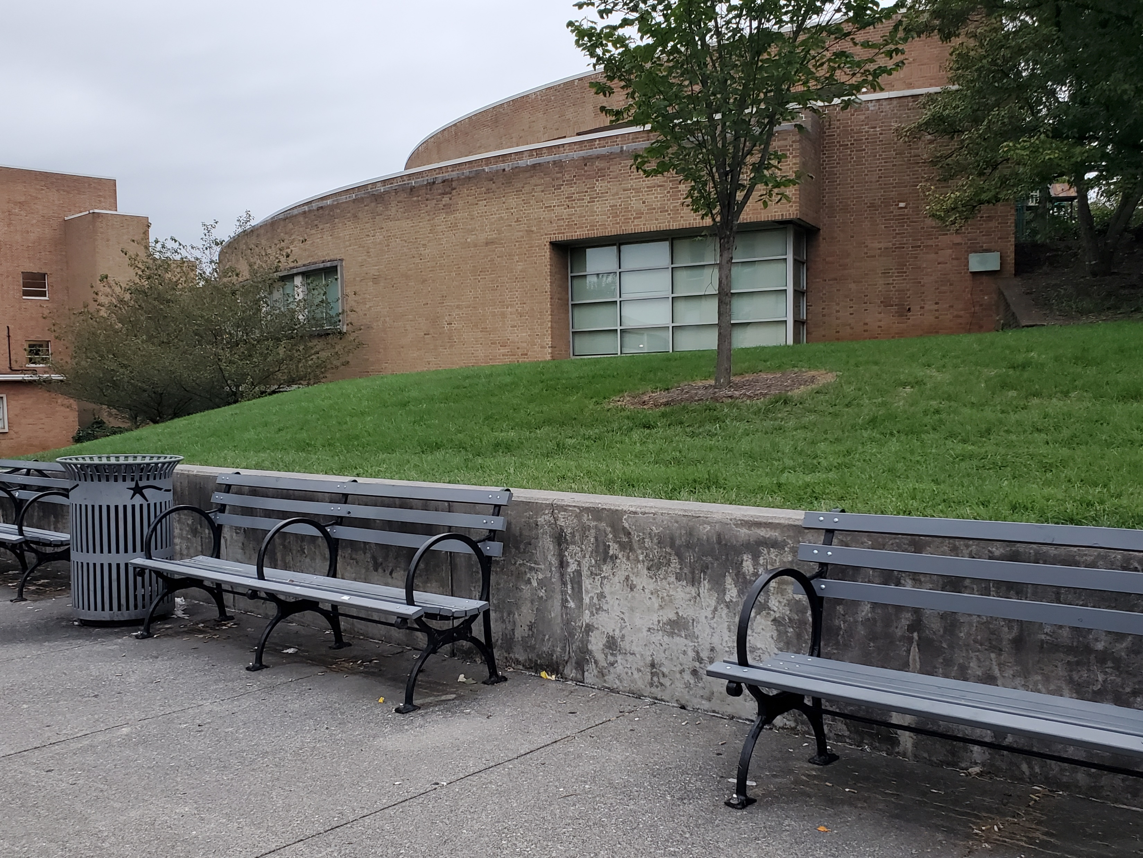
Services

Slide 7
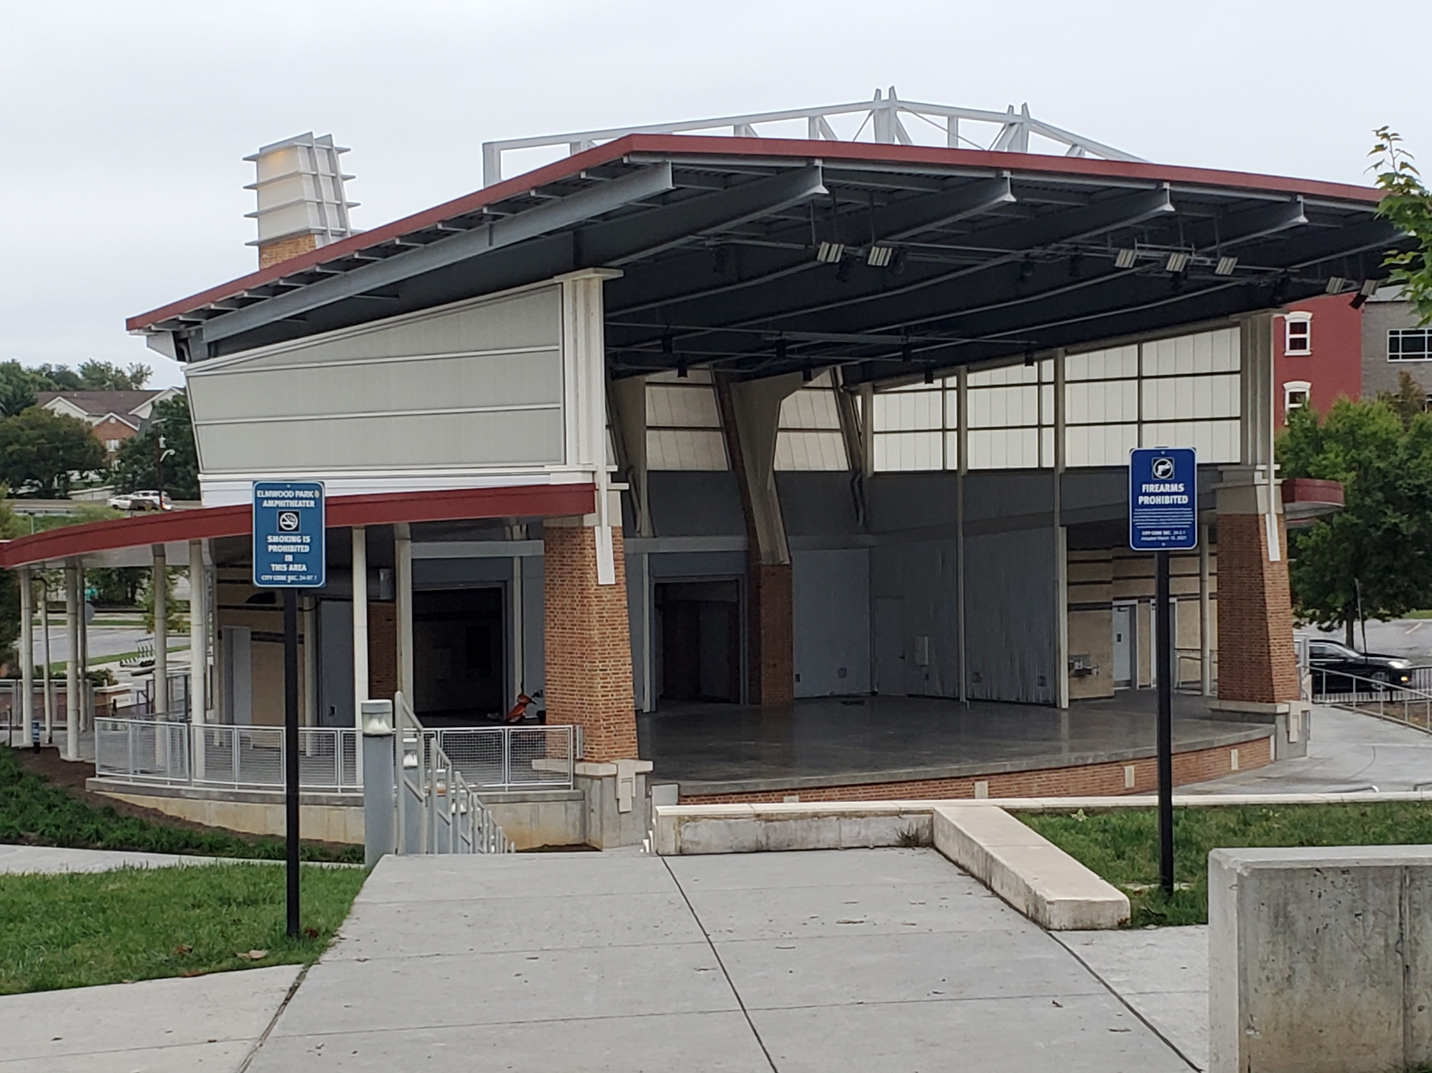
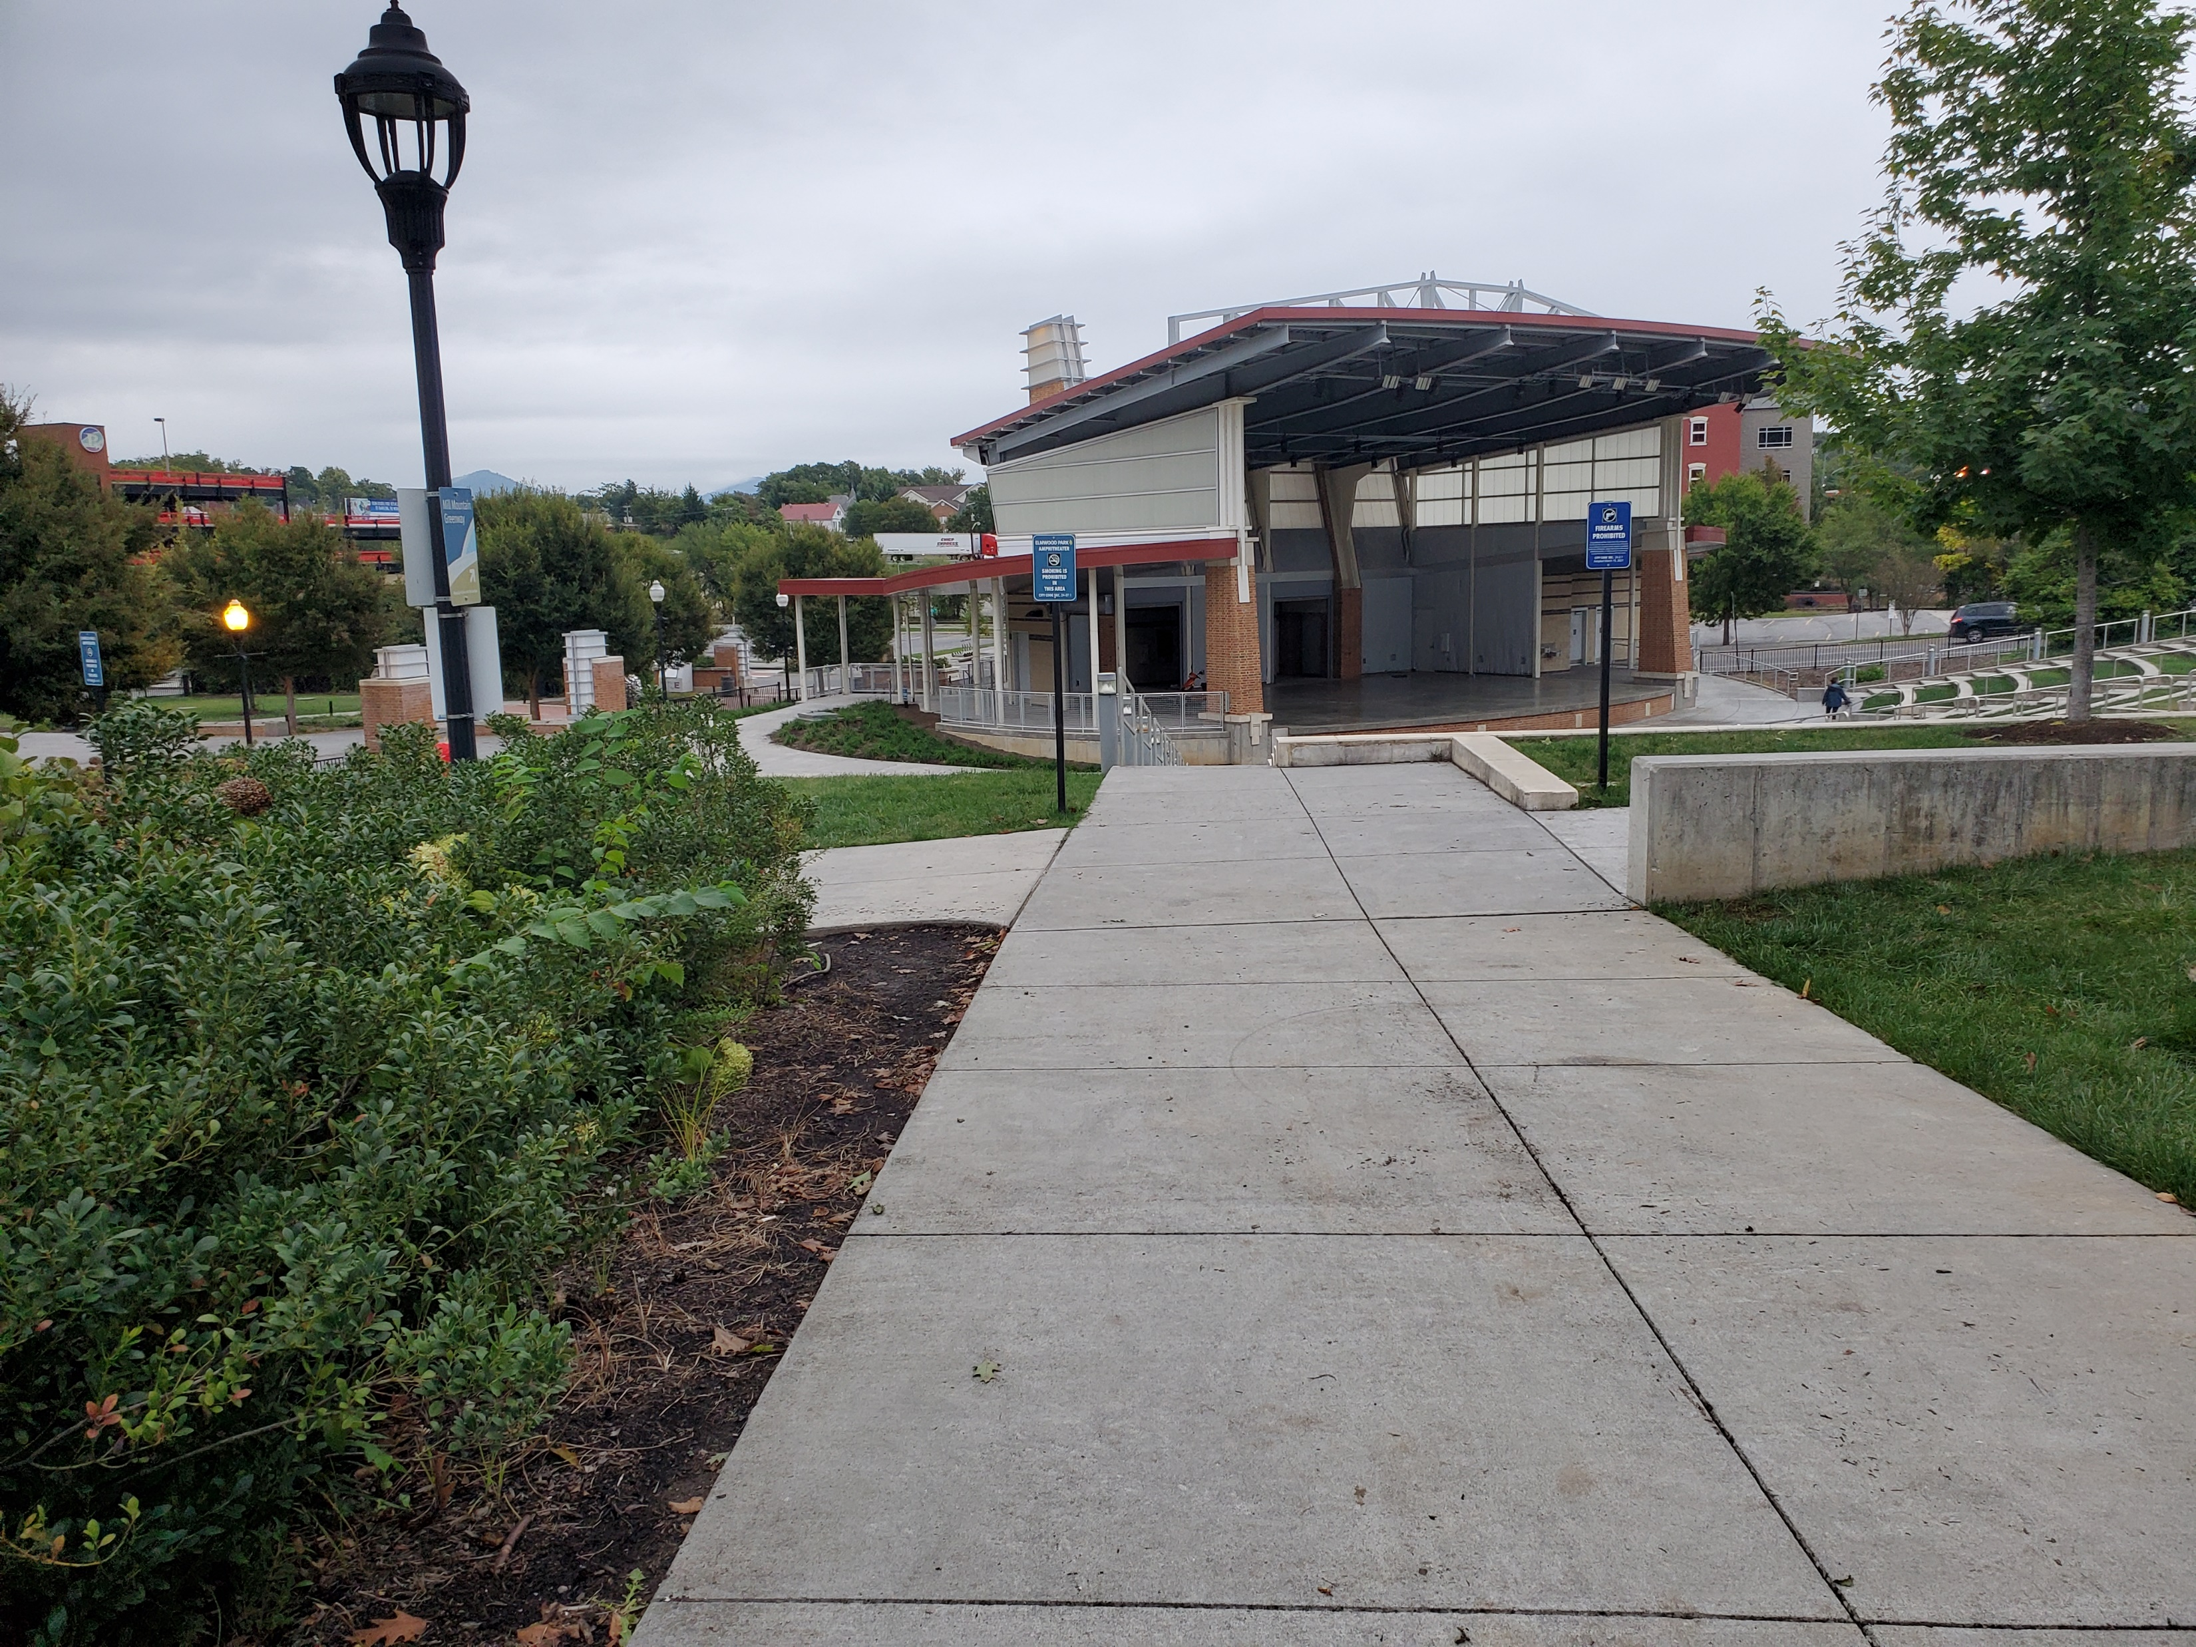
Amphitheater in Elmwood Park

Slide 8
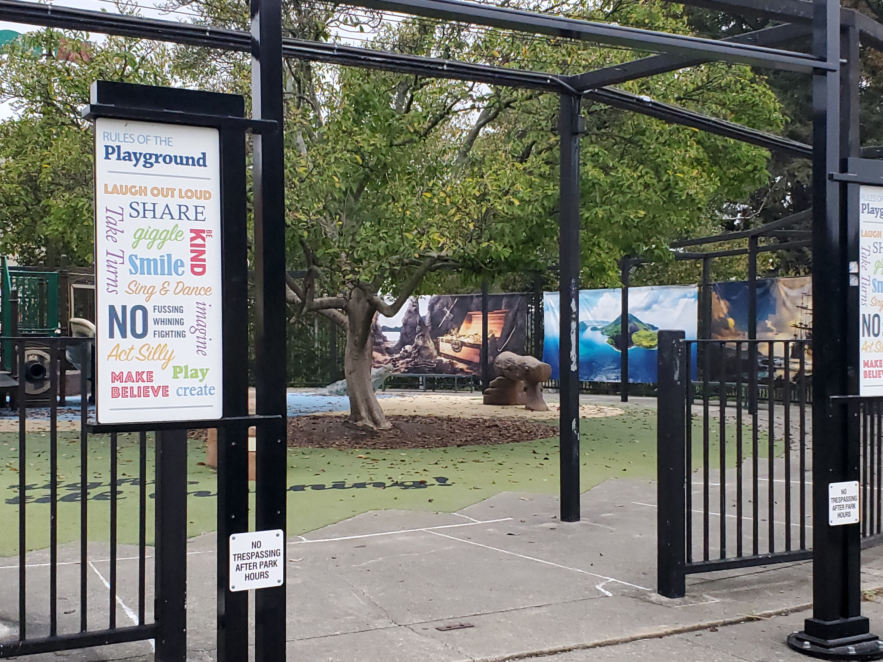
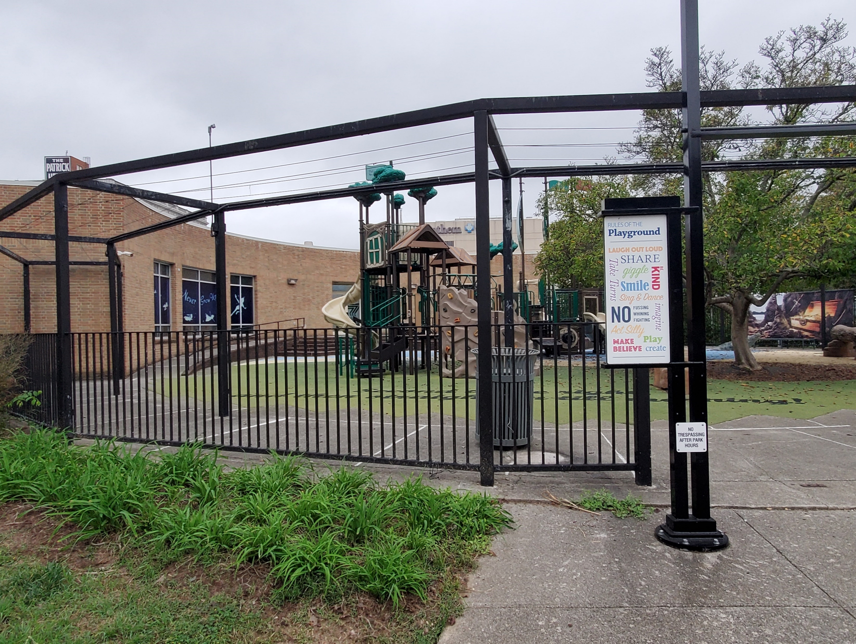
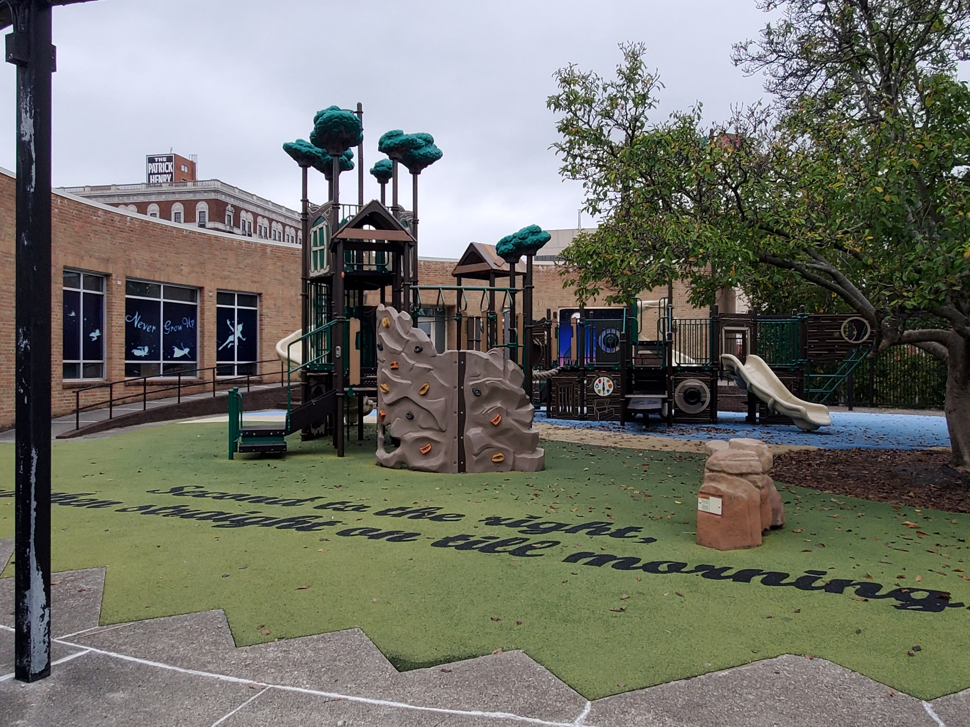
Playground

Slide 9
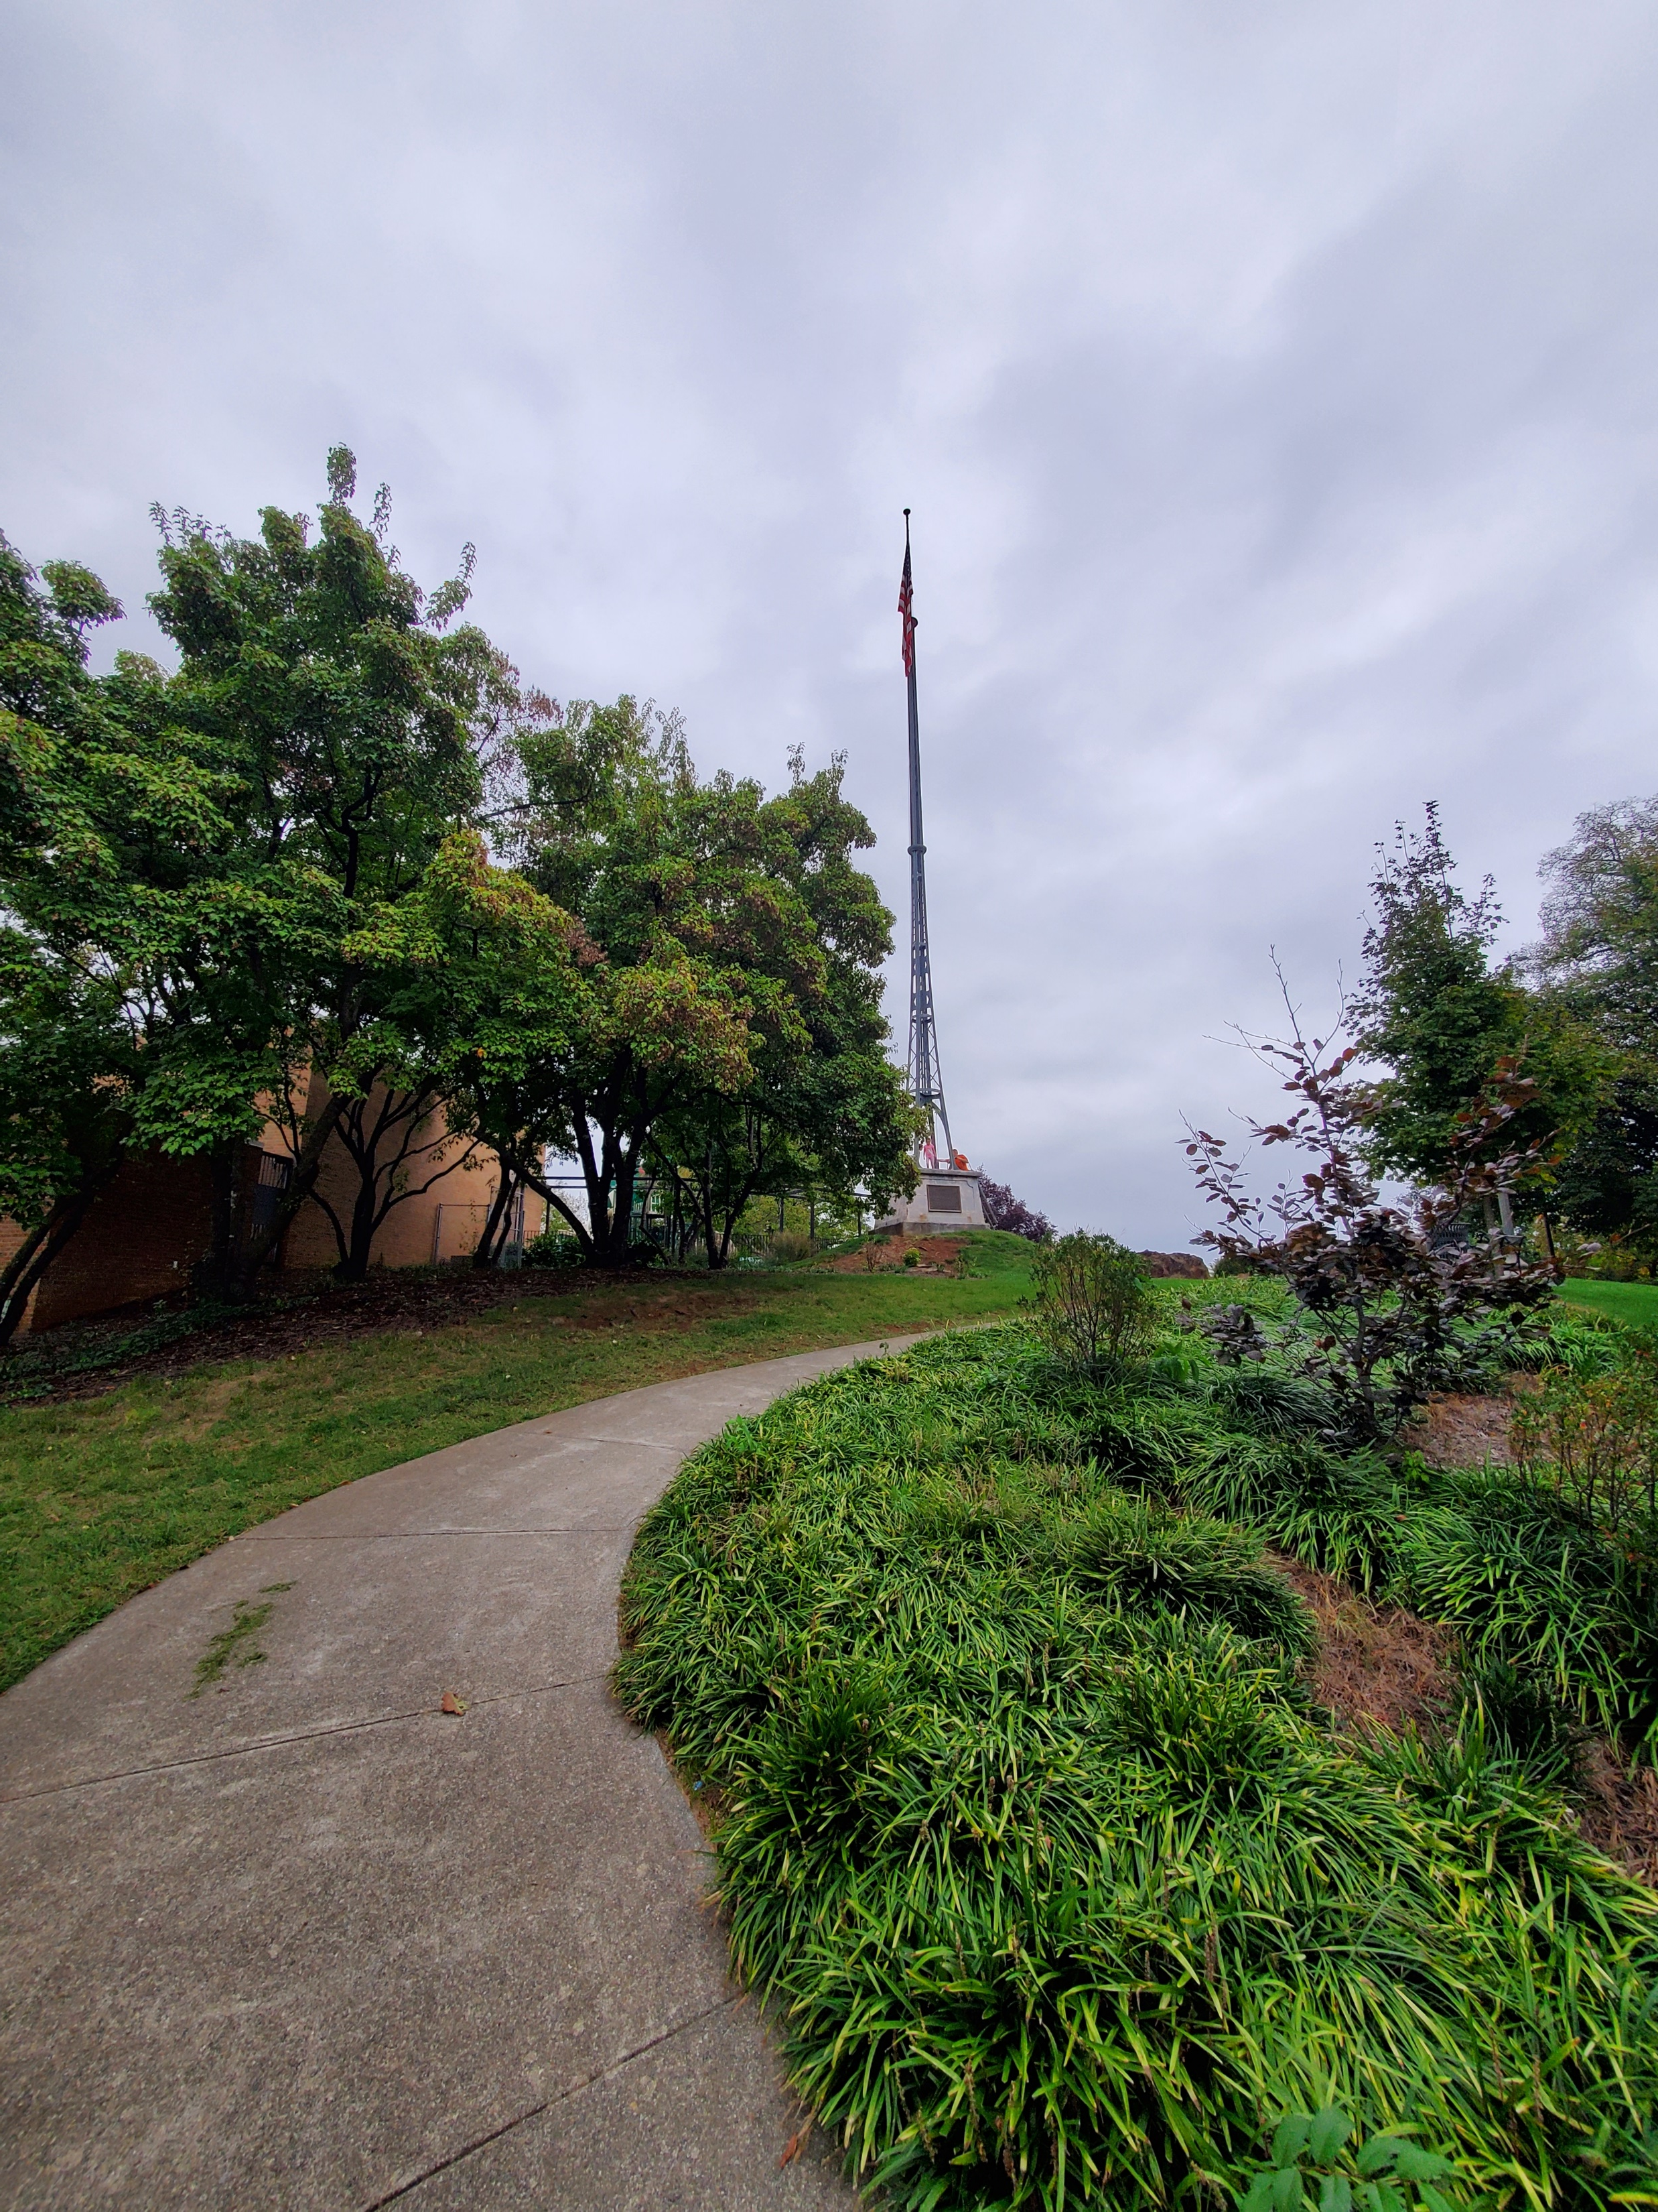
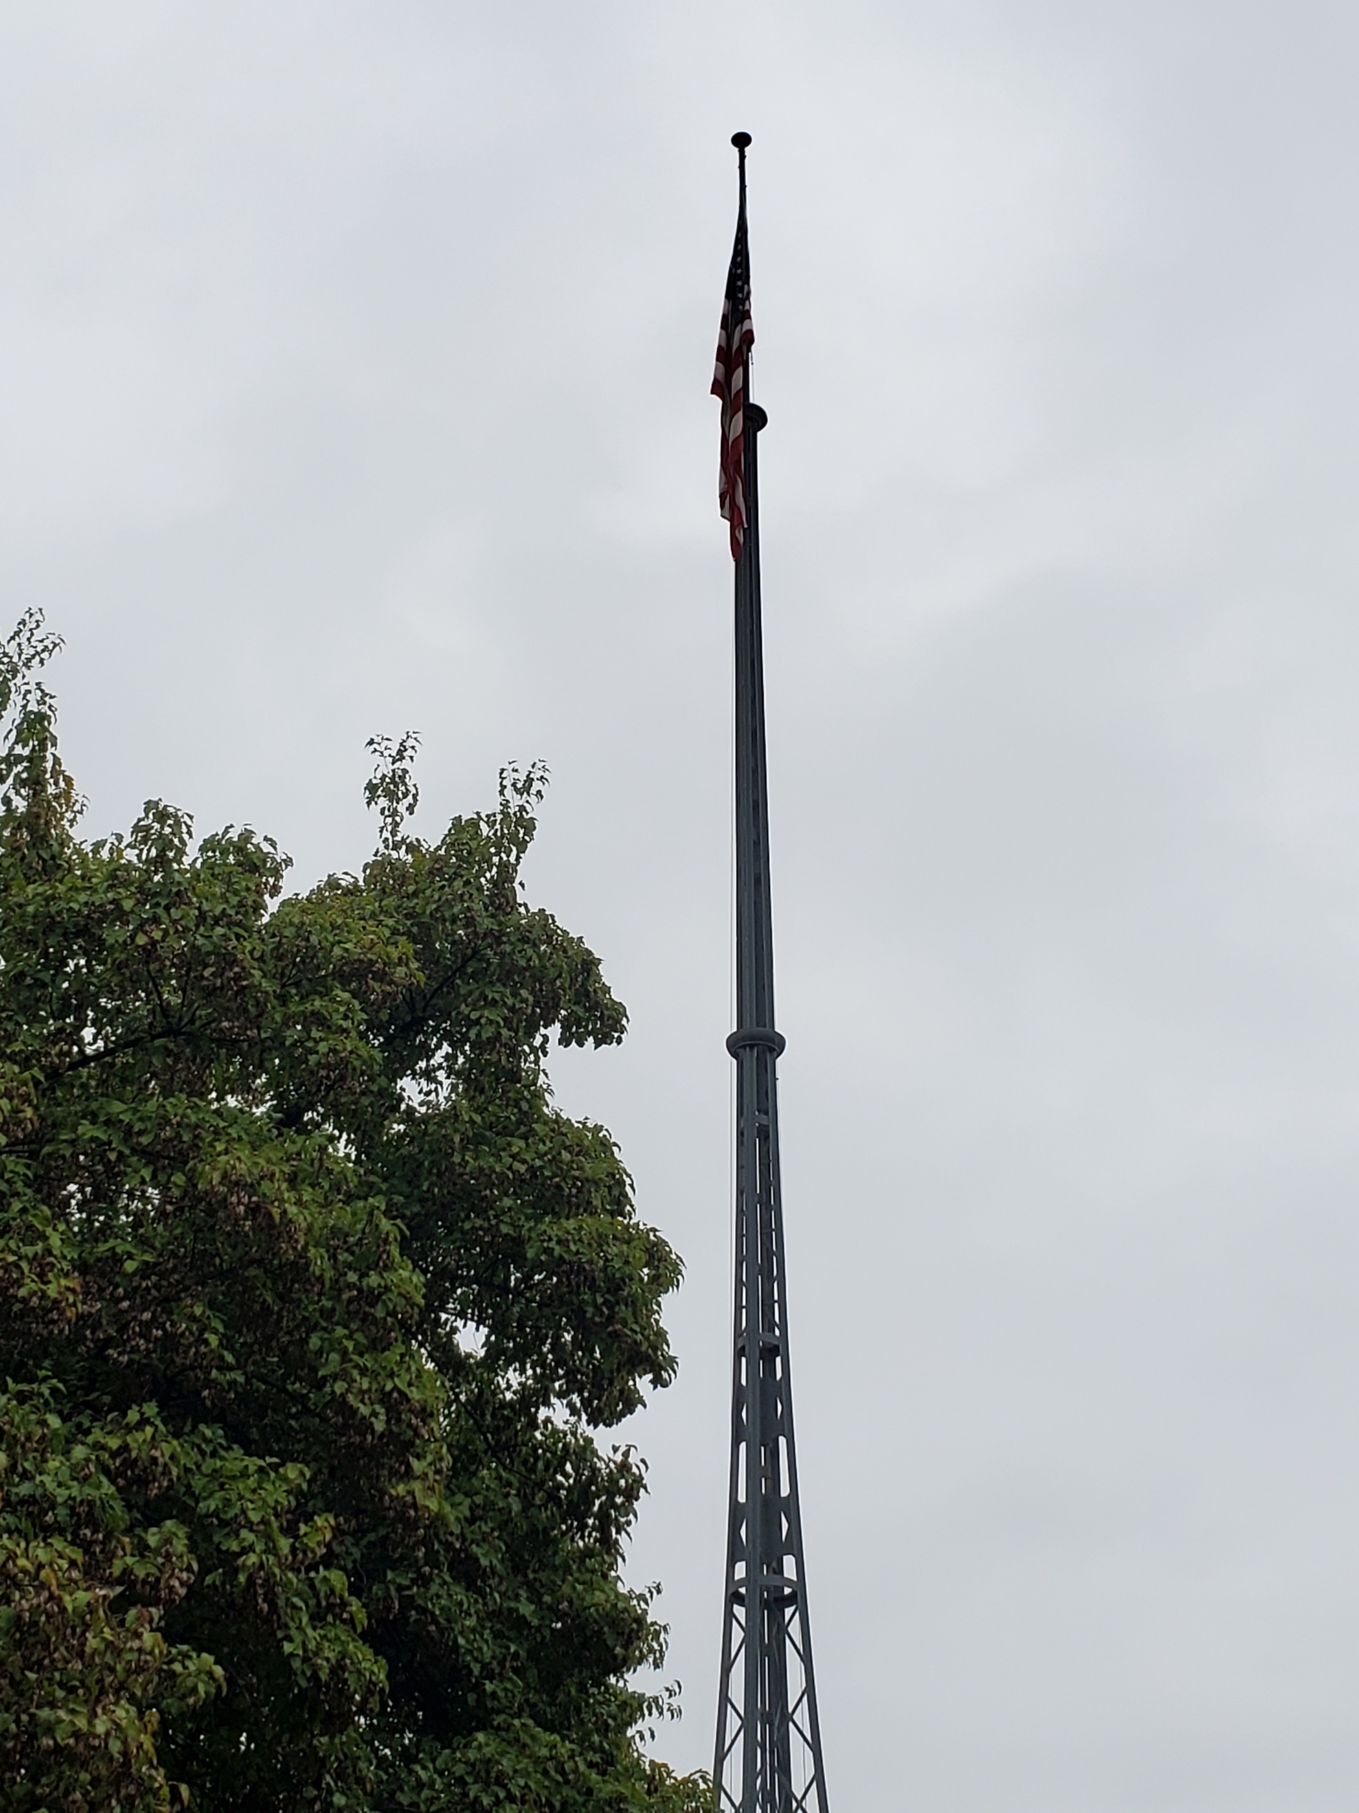
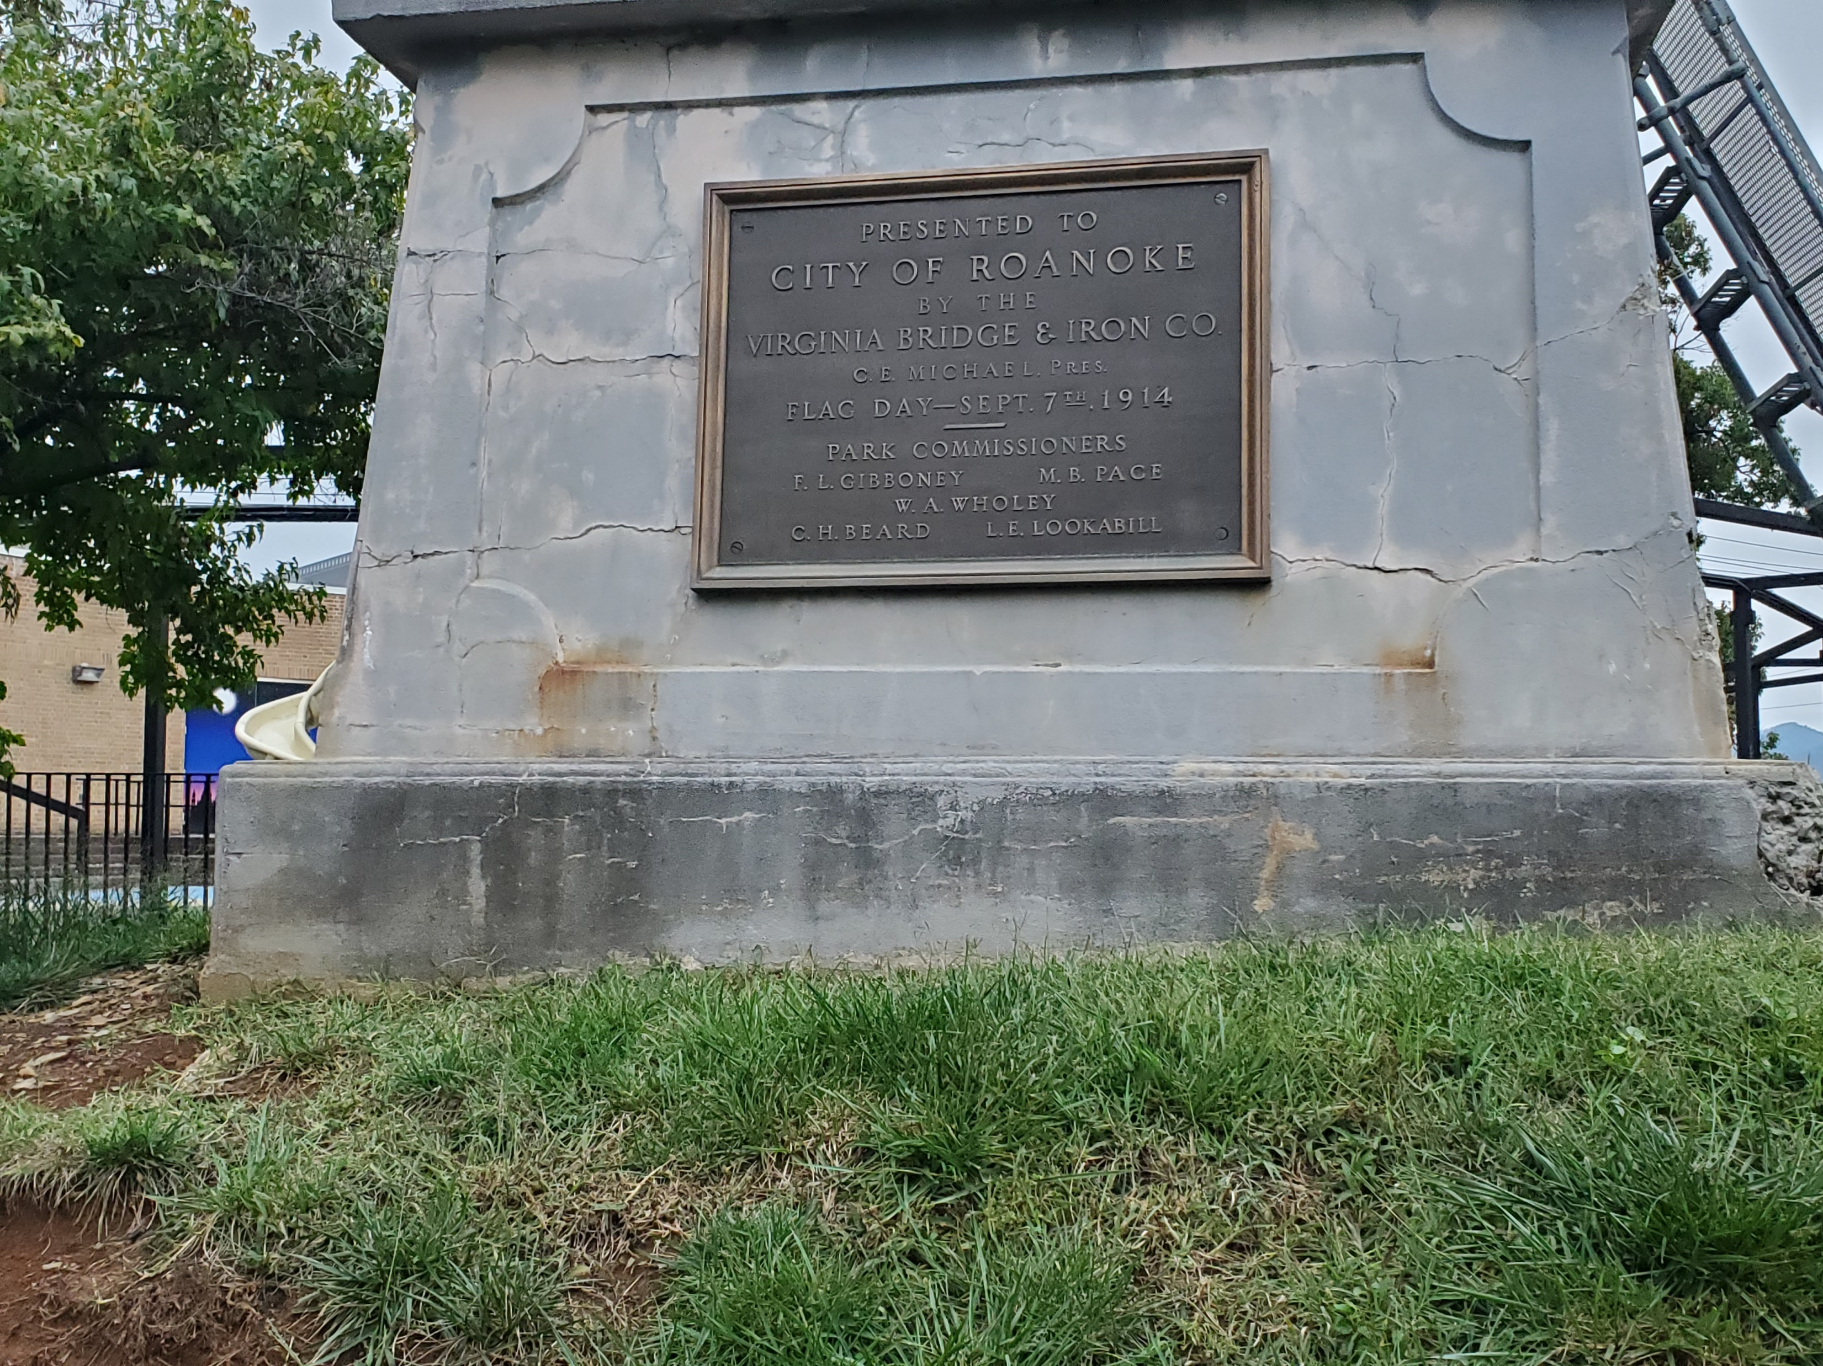
Flag Pole

Slide 10
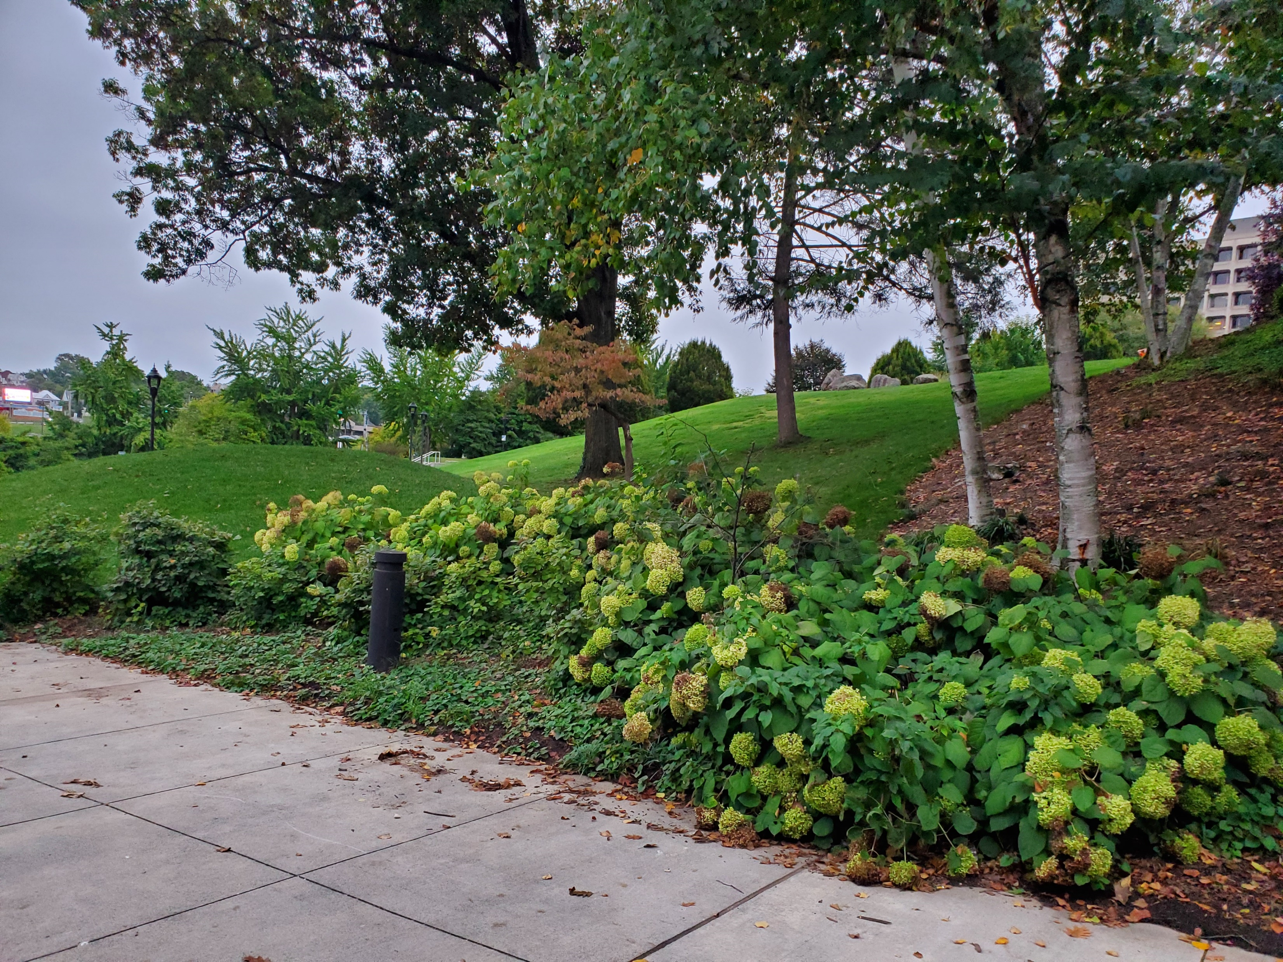
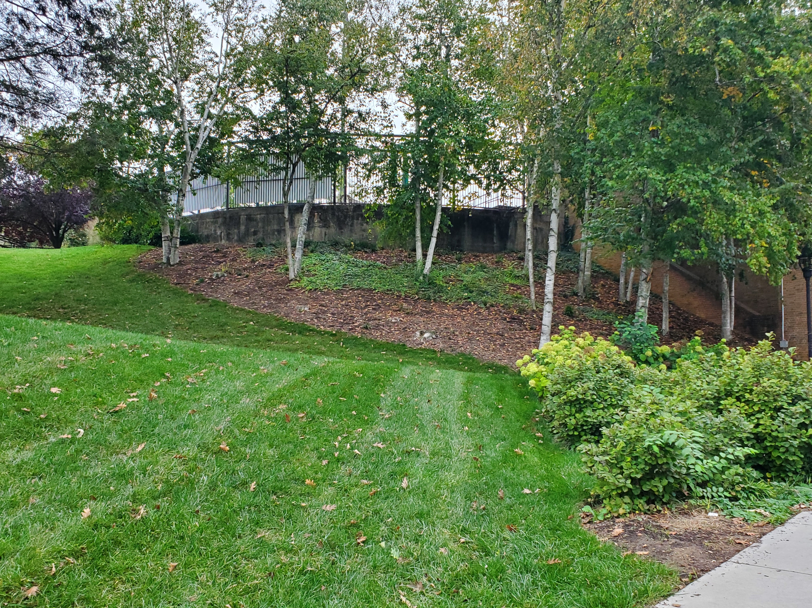
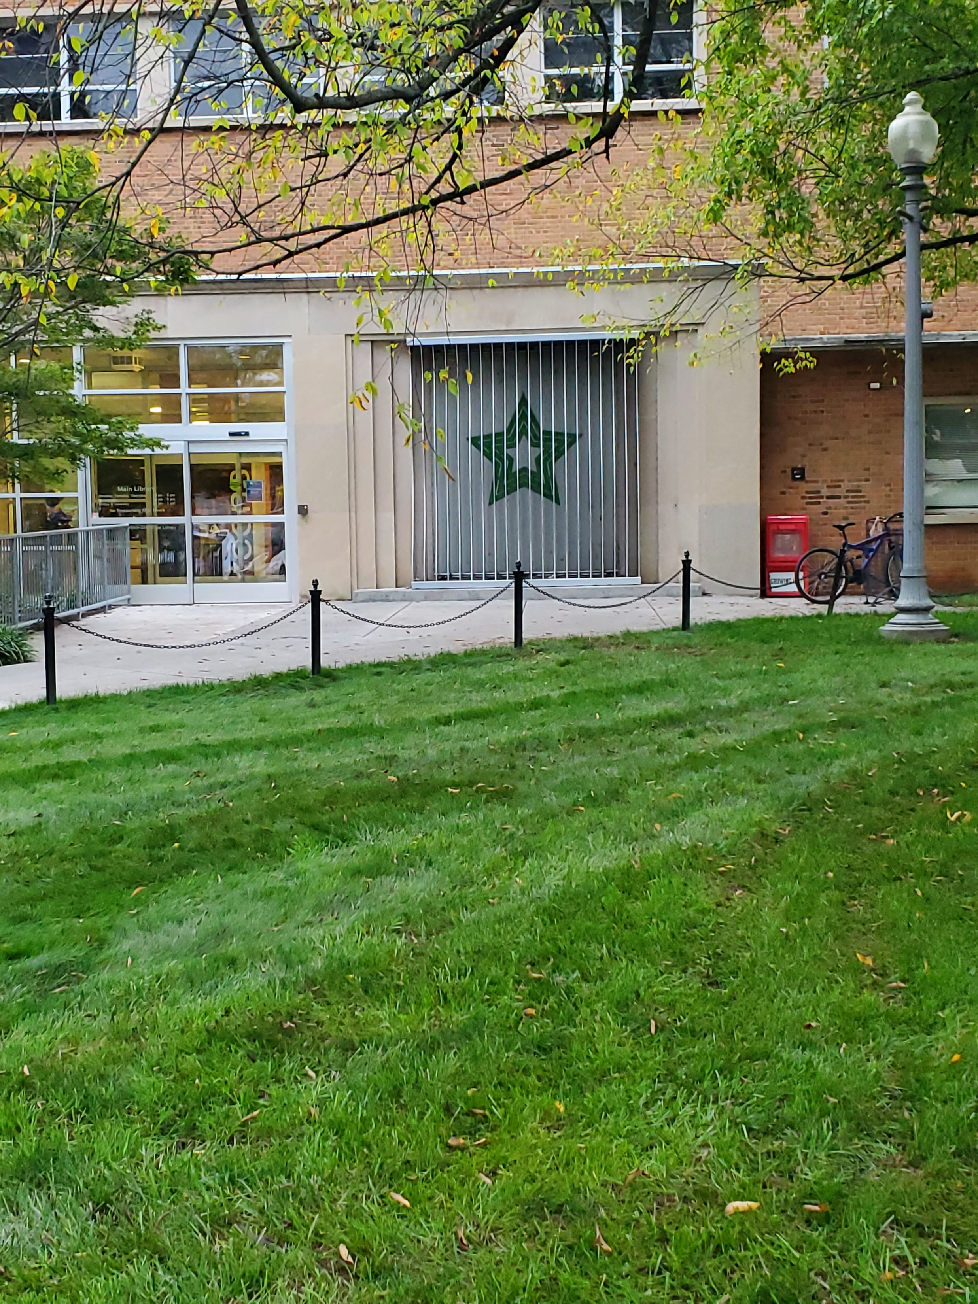
Landscape

Slide 11
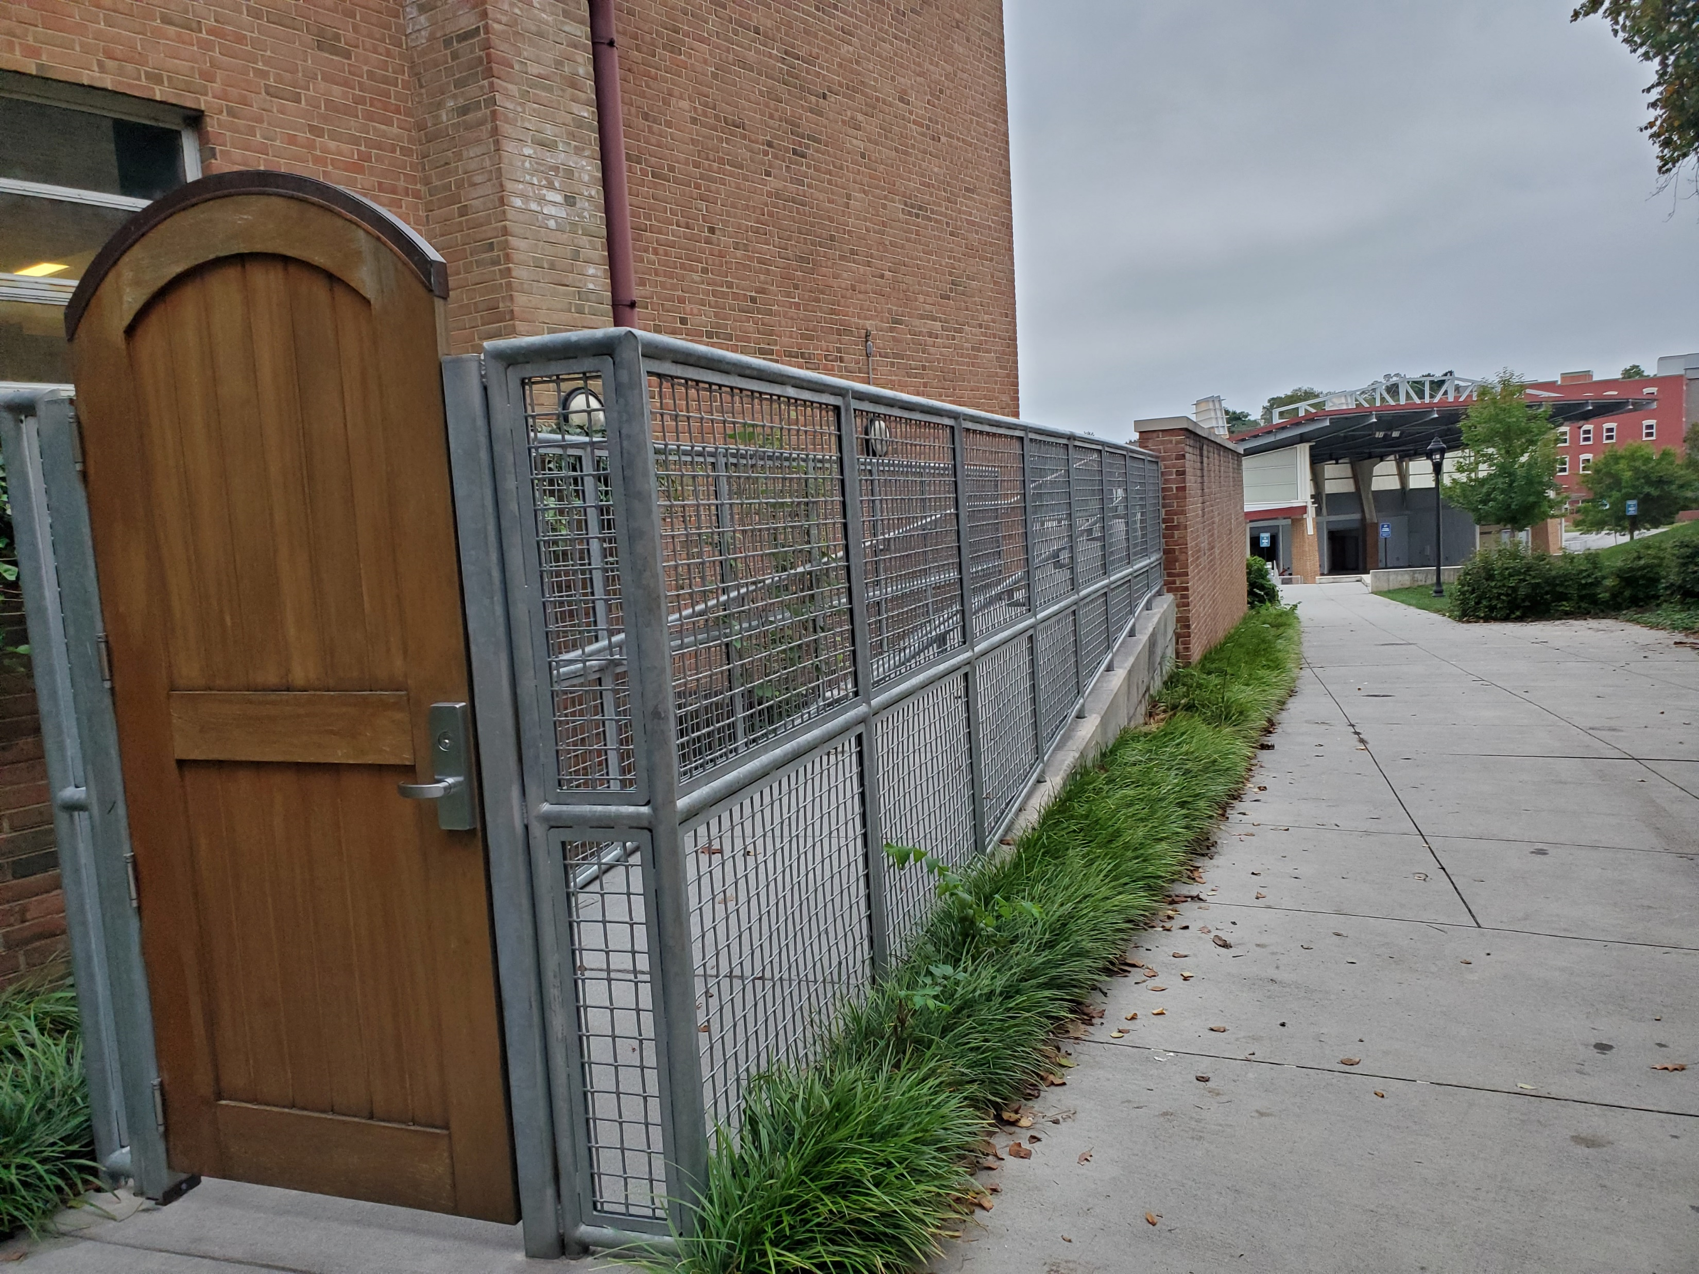
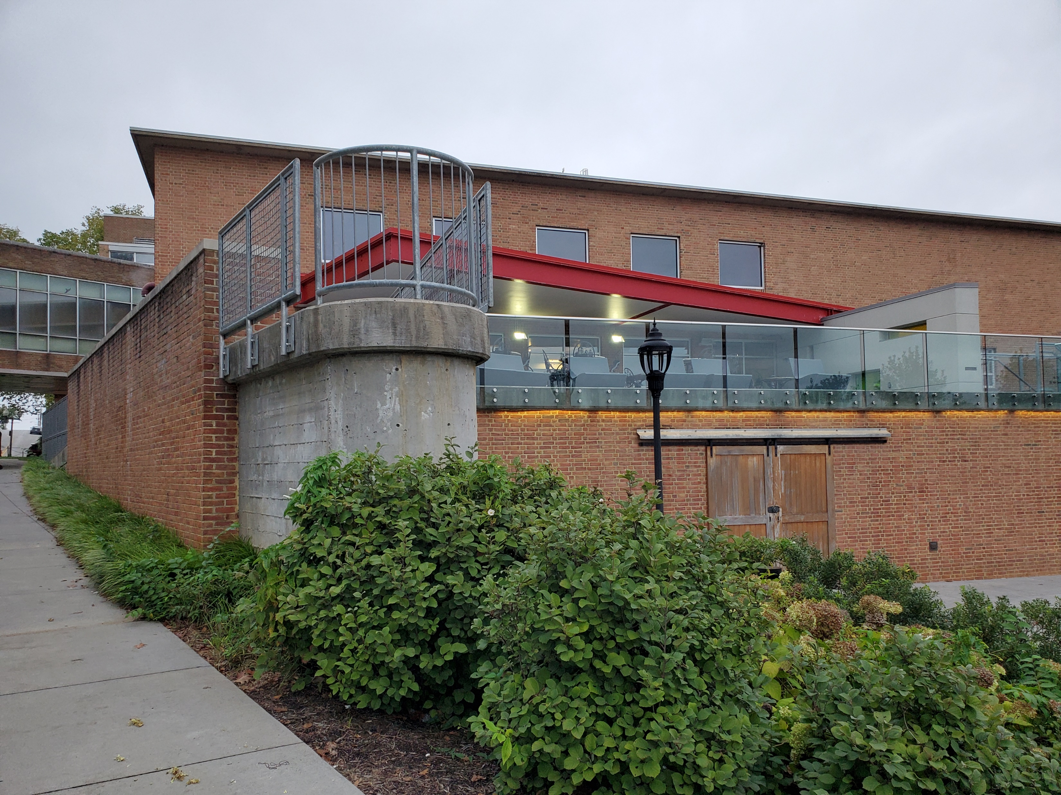
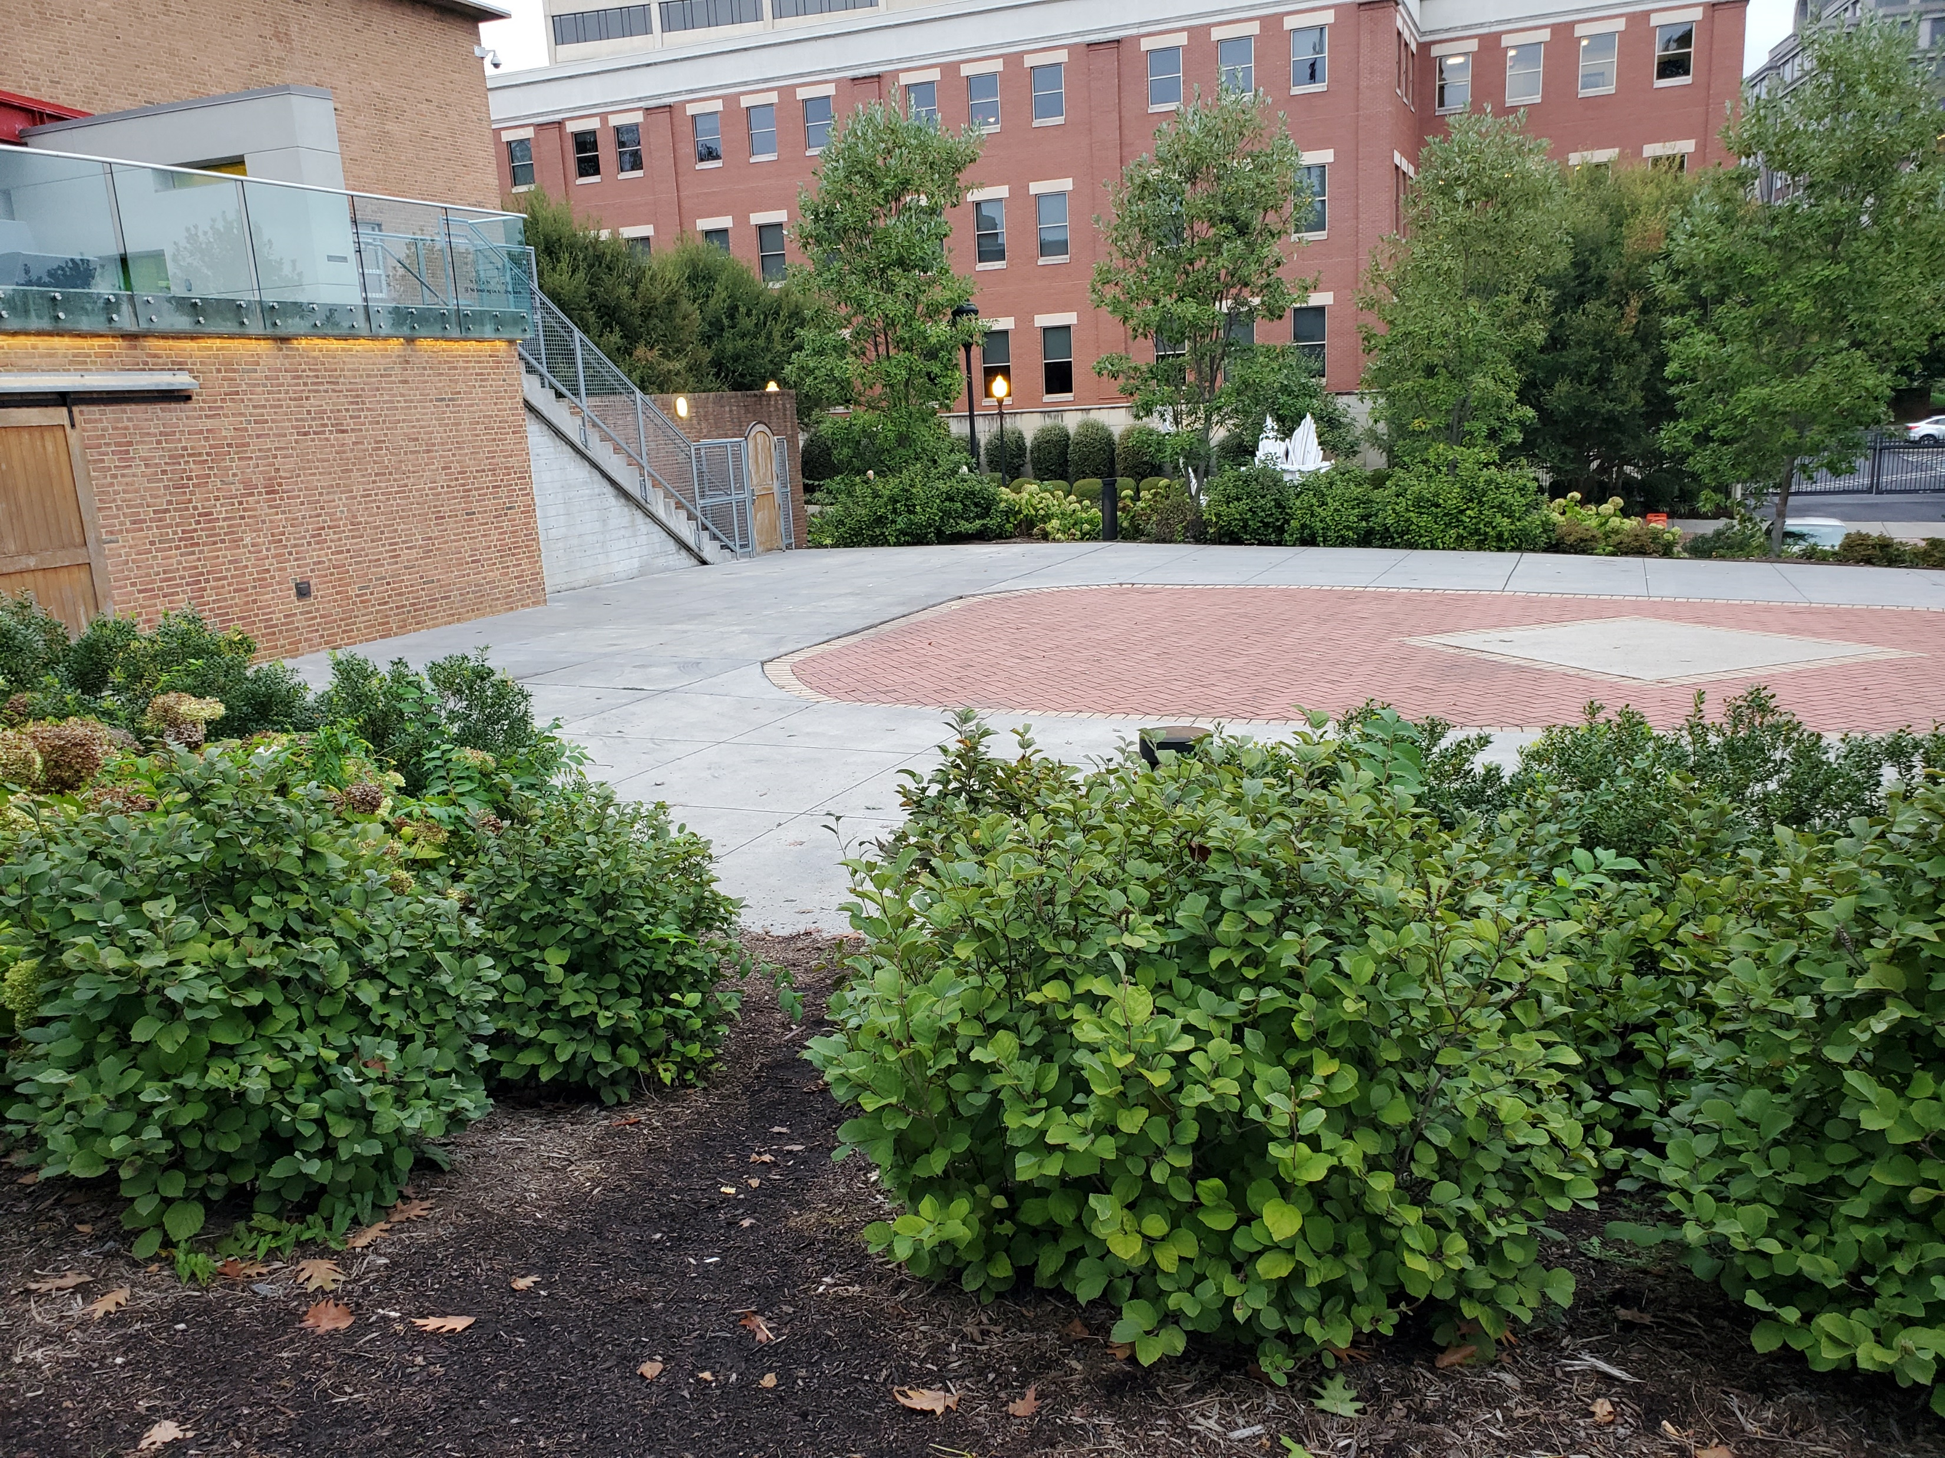
Back Seating Area

Slide 12
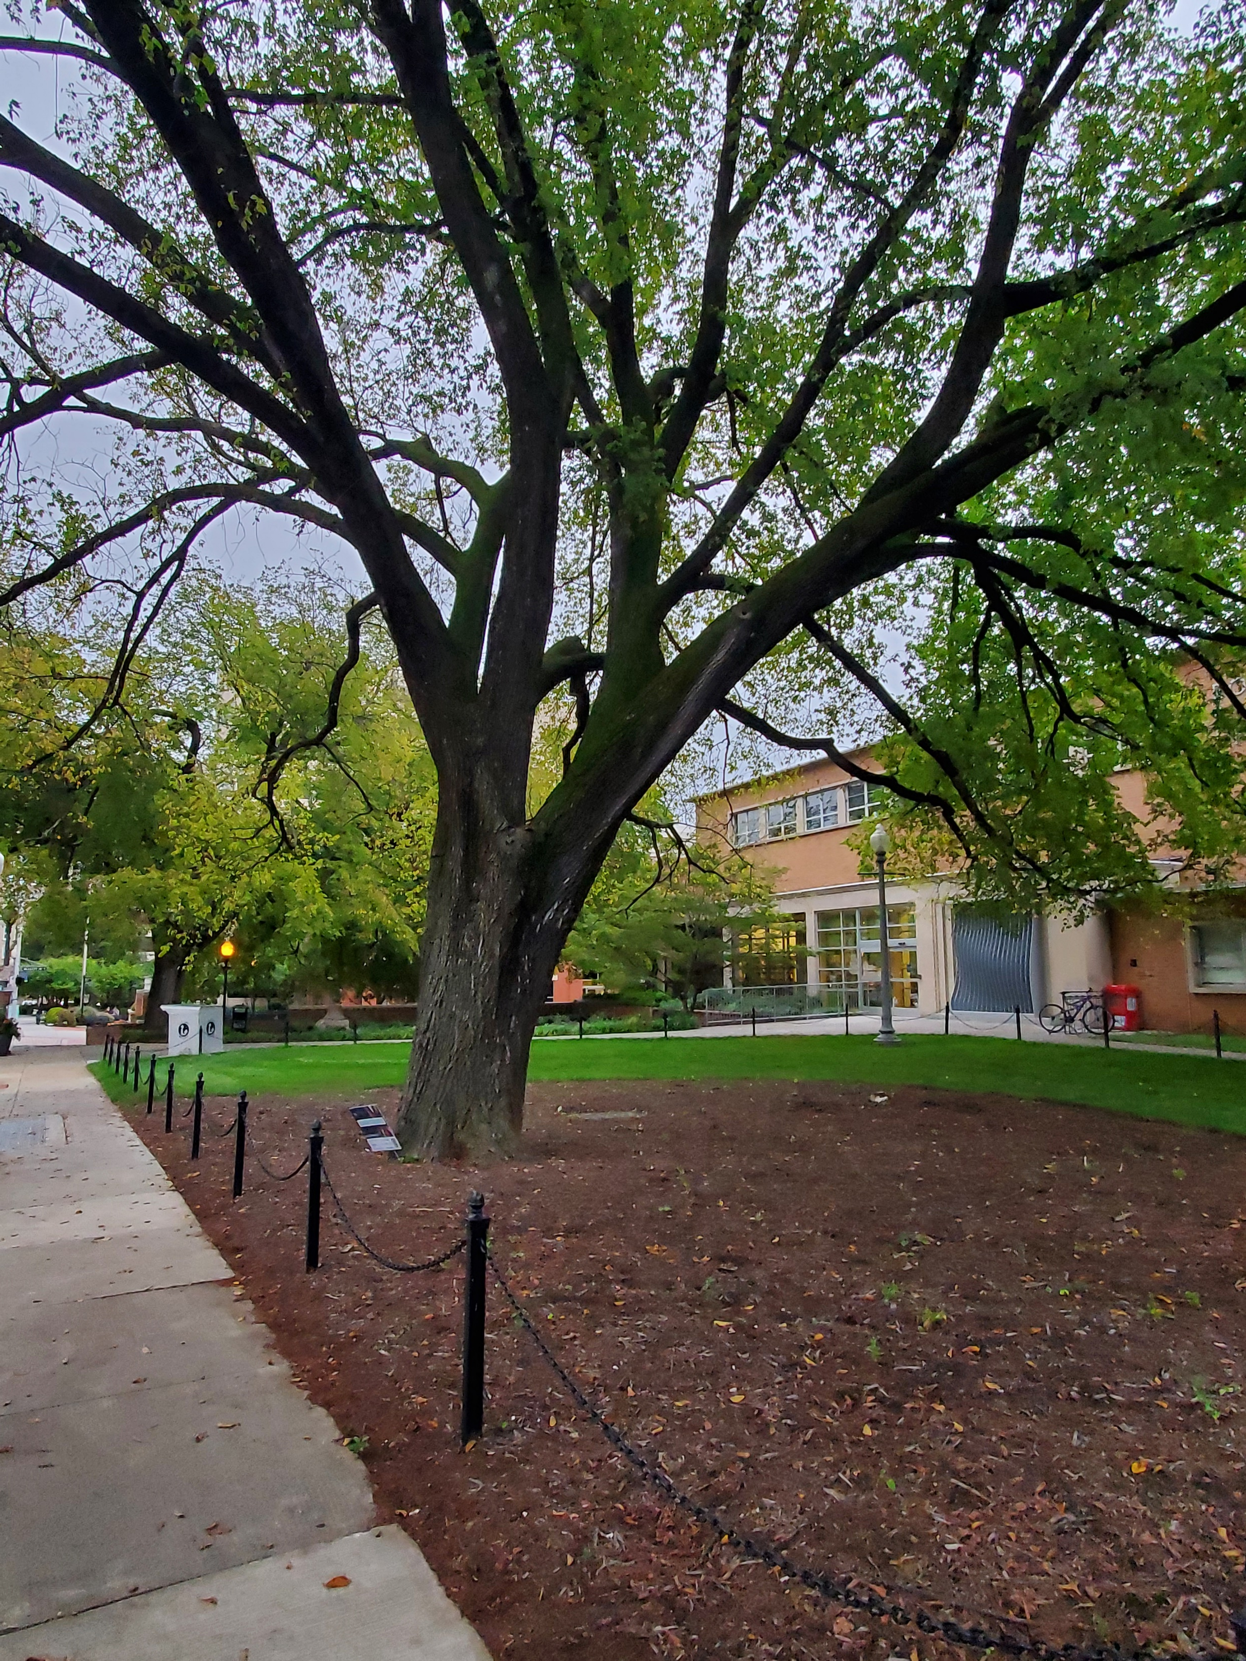
Conclusion

Slide 13
References
Elmwood Park. Downtown Roanoke. https://www.downtownroanoke.org/explore/elmwoodpark.
Lesneski, T. (August 3, 2016). Why outdoor spaces are essential for the 21st-century library. Demco Interiors. https://www.demcointeriors.com/blog/why-outdoor-spaces-are-essential-for-the-21st-century-library/.
Marrano, Gene. (October 19, 2014). Roanoke main branch library now has “wow factor.” The Roanoke Star. https://theroanokestar.com/2014/10/19/roanoke-main-branch-library-now-has-wow-factor/.
Mathews, Brian and Soistmann, Leigh Ann. (September 30, 2020). Encoding space: Shaping learning environments that unlock human potential. American Libraries. https://americanlibrariesmagazine.org/2020/09/01/encoding-space-library-design/.
Roanoke public library main. Emporis. https://www.emporis.com/buildings/336613/roanoke-public-library-main-roanoke-va-usa
Rubin, R. E. and Rubin, R. G. (2020). Foundations of library and information science (5th ed.).

