Slide 1
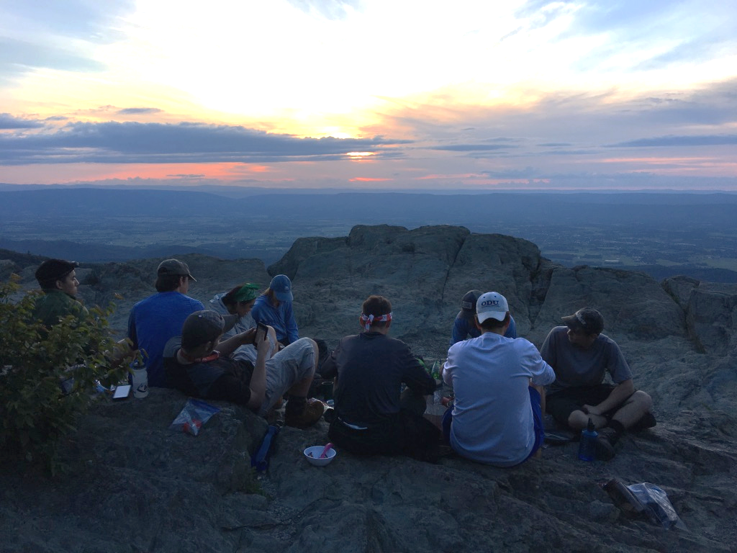
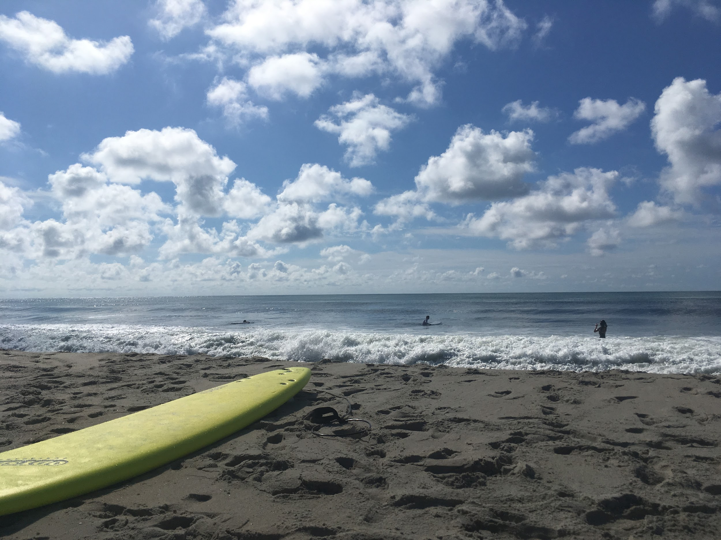
Promoting Resiliency and Flourishing Through Collegiate Outdoor Orientation Programming
Eleanor Crofford, Abigail Rossiter, Eddie Hill, Erik Edwards, Mike Willett, & Chris Zajchowski
Notes:
Intros
Thank co-authors
This research was informed by a culmination of 11 years of Dr. Hill’s work of the effects of 1st ASCENT trips on participants outlooks during their experience in the first year of college. This research study is specifically focused on the 1st Ascent trips at ODU from 2017 and 2019.

Slide 2
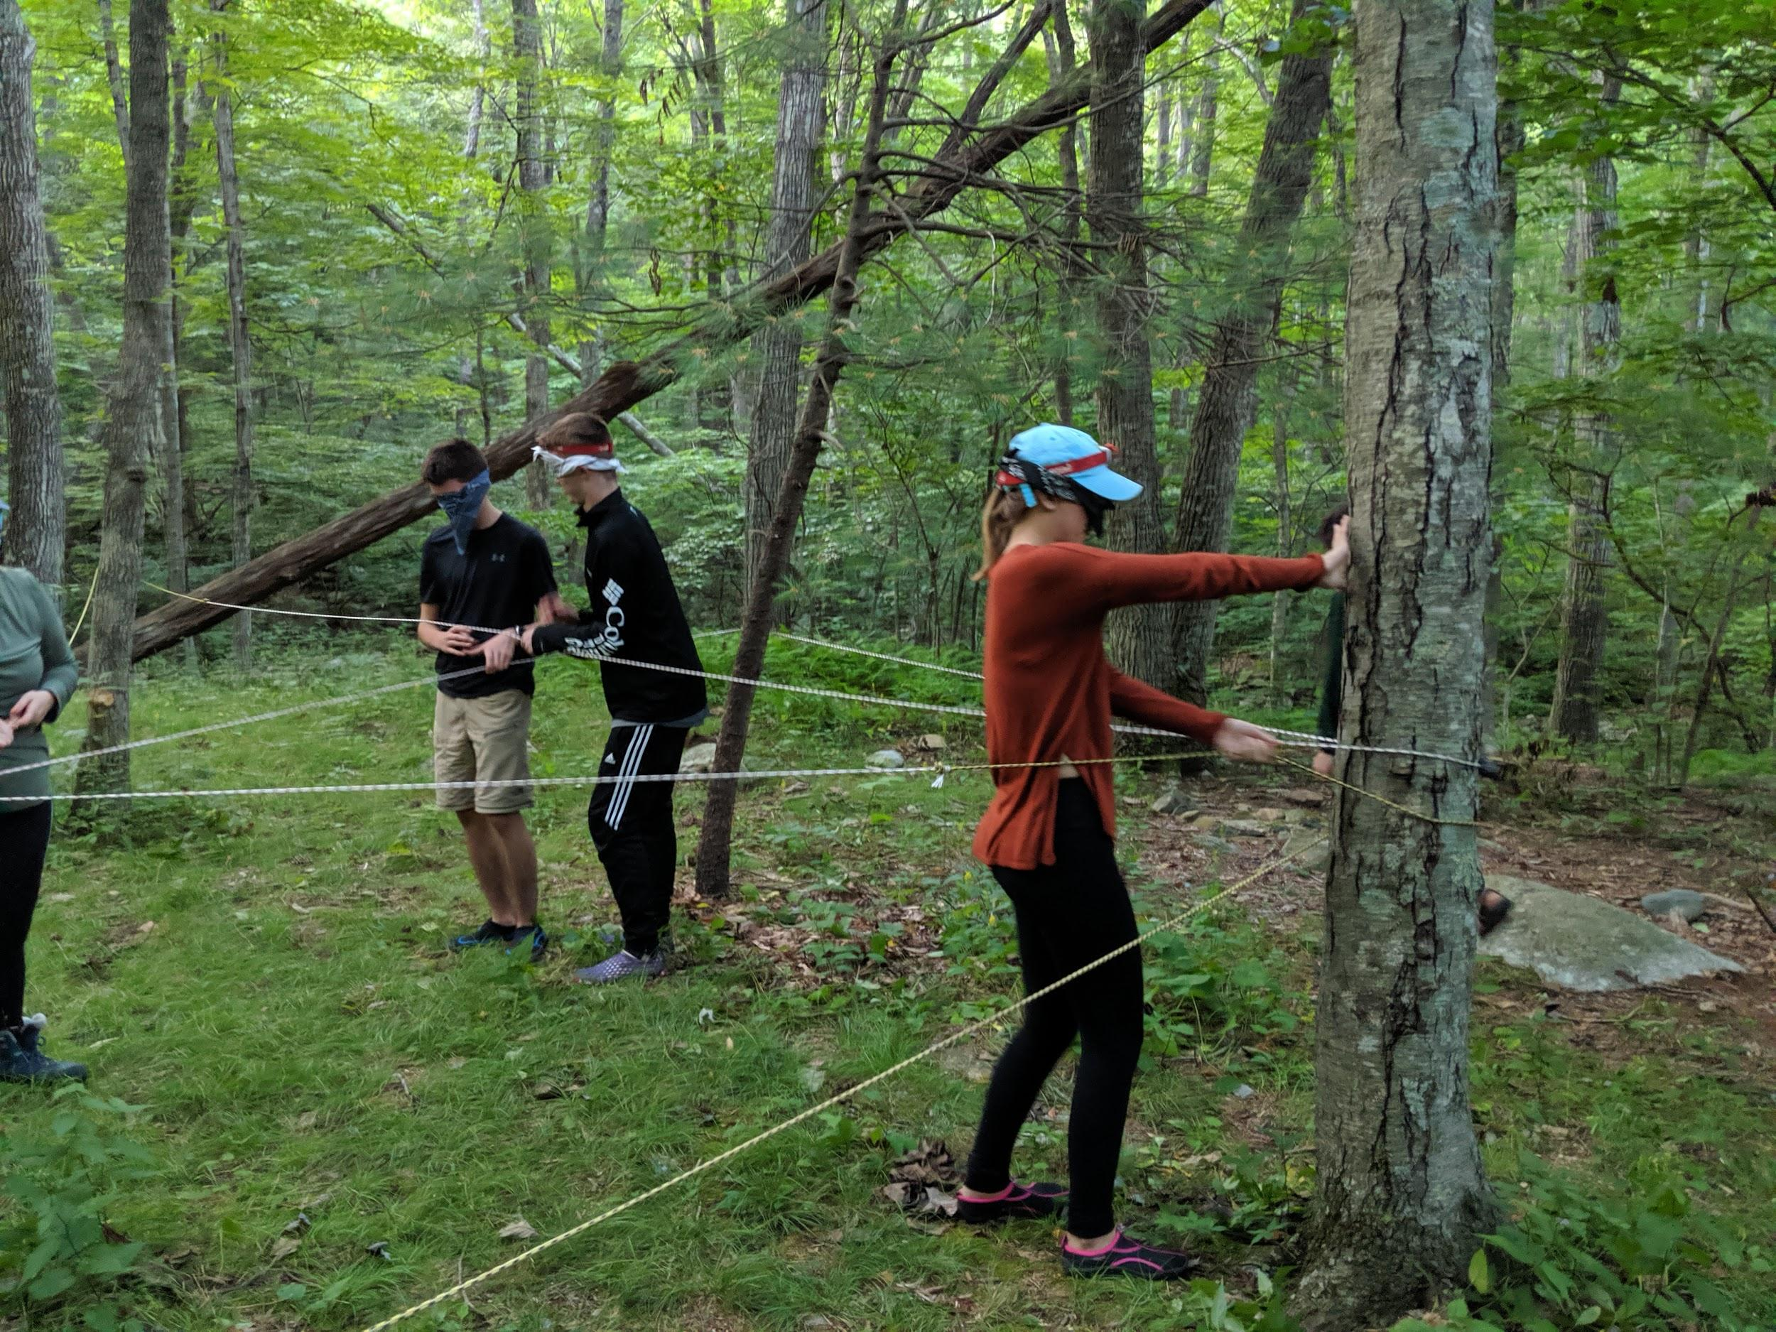
Introduction: Outdoor Orientation Programs
College programs that use wilderness and adventure experiences (Davis-Berman & Berman, 1996).
The first O.O.P. began at Dartmouth College in 1935
By 2014, there were >191 O.O.P’s at colleges and universities in the U.S. (Bell et al., 2014).
Focus on group initiatives (e.g., Gass & Seaman, 2012; Priest & Gass, 2005).
Introduction
Literature
Methods
Results
Discussion
Questions?
Notes:
Our research is based on Outdoor Orientation programs, or OOPs. OOPs involve exposing a small group of first year students to various outdoor activities such as climbing or surfing in an overnight setting. There is a long history of these programs, dating back to over 80 years ago at Dartmouth college. Since then, this first OOP at Dartmouth has grown to offer almost 20 different trip types to over 1100 students yearly. Although many colleges and universities have OOPs on a smaller scale, there are currently around 200 institutions offering OOPs in the United States. These programs all focus on group initiatives that foster life lessons that can help ease the transition of incoming students into college. An example of a group initiative during ODU’s OOP is pictured here.

Slide 3
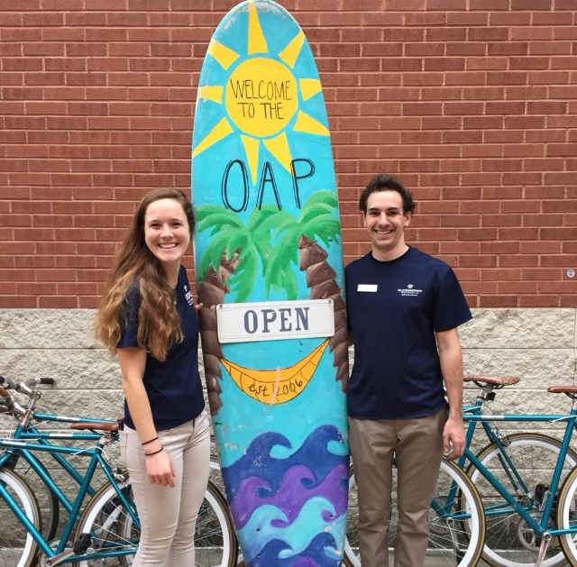
Introduction
Old Dominion University (ODU)
Located near the mouth of the Chesapeake Bay, in Norfolk, Virginia
24,000 students
Urban campus
Minority serving institution (M.S.I.)
ODU Outdoor Adventure Program
Established in 2006
O.D.U.’s O.O.P. program: First Ascent
Introduction
Literature
Methods
Results
Discussion
Questions?
Notes:
We are from Old Dominion University. We are a minority-serving, coastal, mid-sized campus located in Norfolk, VA.
We are part of ODU’s Outdoor Adventure Program. The program was established in 2006, and includes trips, rock wall, challenge course, and bike share programs. Our first iteration of an OOP was held in the summer of 2010, and was called TENTs (an acronym for -)
One of our alumns collected data regarding the TENTs program during an independent study in her undergraduate program. She found that it would be beneficial for students if the OOP were shorter in duration and more affordable. After adjusting to the needs of the population we are serving, we now call our OOP “First Ascent”

Slide 4
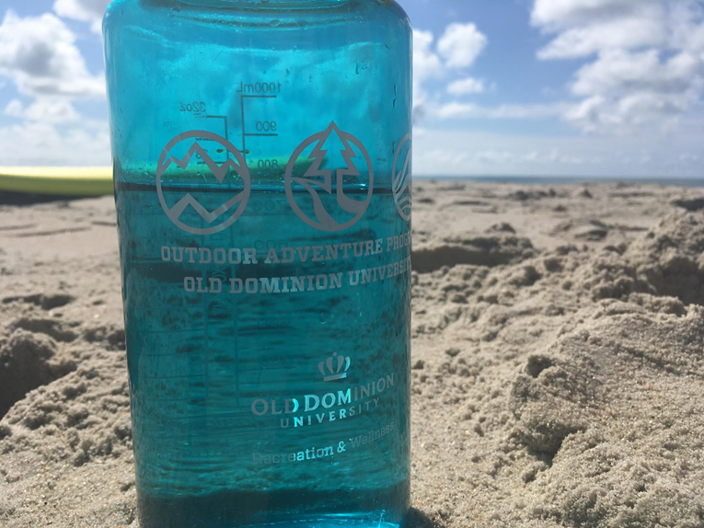
First Ascent Goals
“The goal of the First Ascent Program is to engage every student as completely as possible and ensure that they feel like they are part of the university community.”
Ease the stress associated with the transition to college
Helping students to develop connections
Feel welcome in the university community
Understand more about university life
Develop confidence in themselves and their abilities
Introduction
Literature
Methods
Results
Discussion
Questions?
Notes:
Our 1st Ascent program has five main objectives to help first year students feel welcomed to university life as they take on their new role as a college student.
We hope that students improve upon these five goals following participation in our OOP. One of these goals is to ease the stress associated with the transition to college. As students deal with stress in transitioning to college life, they must learn how to adapt, which brings us to our literature review.

Slide 5
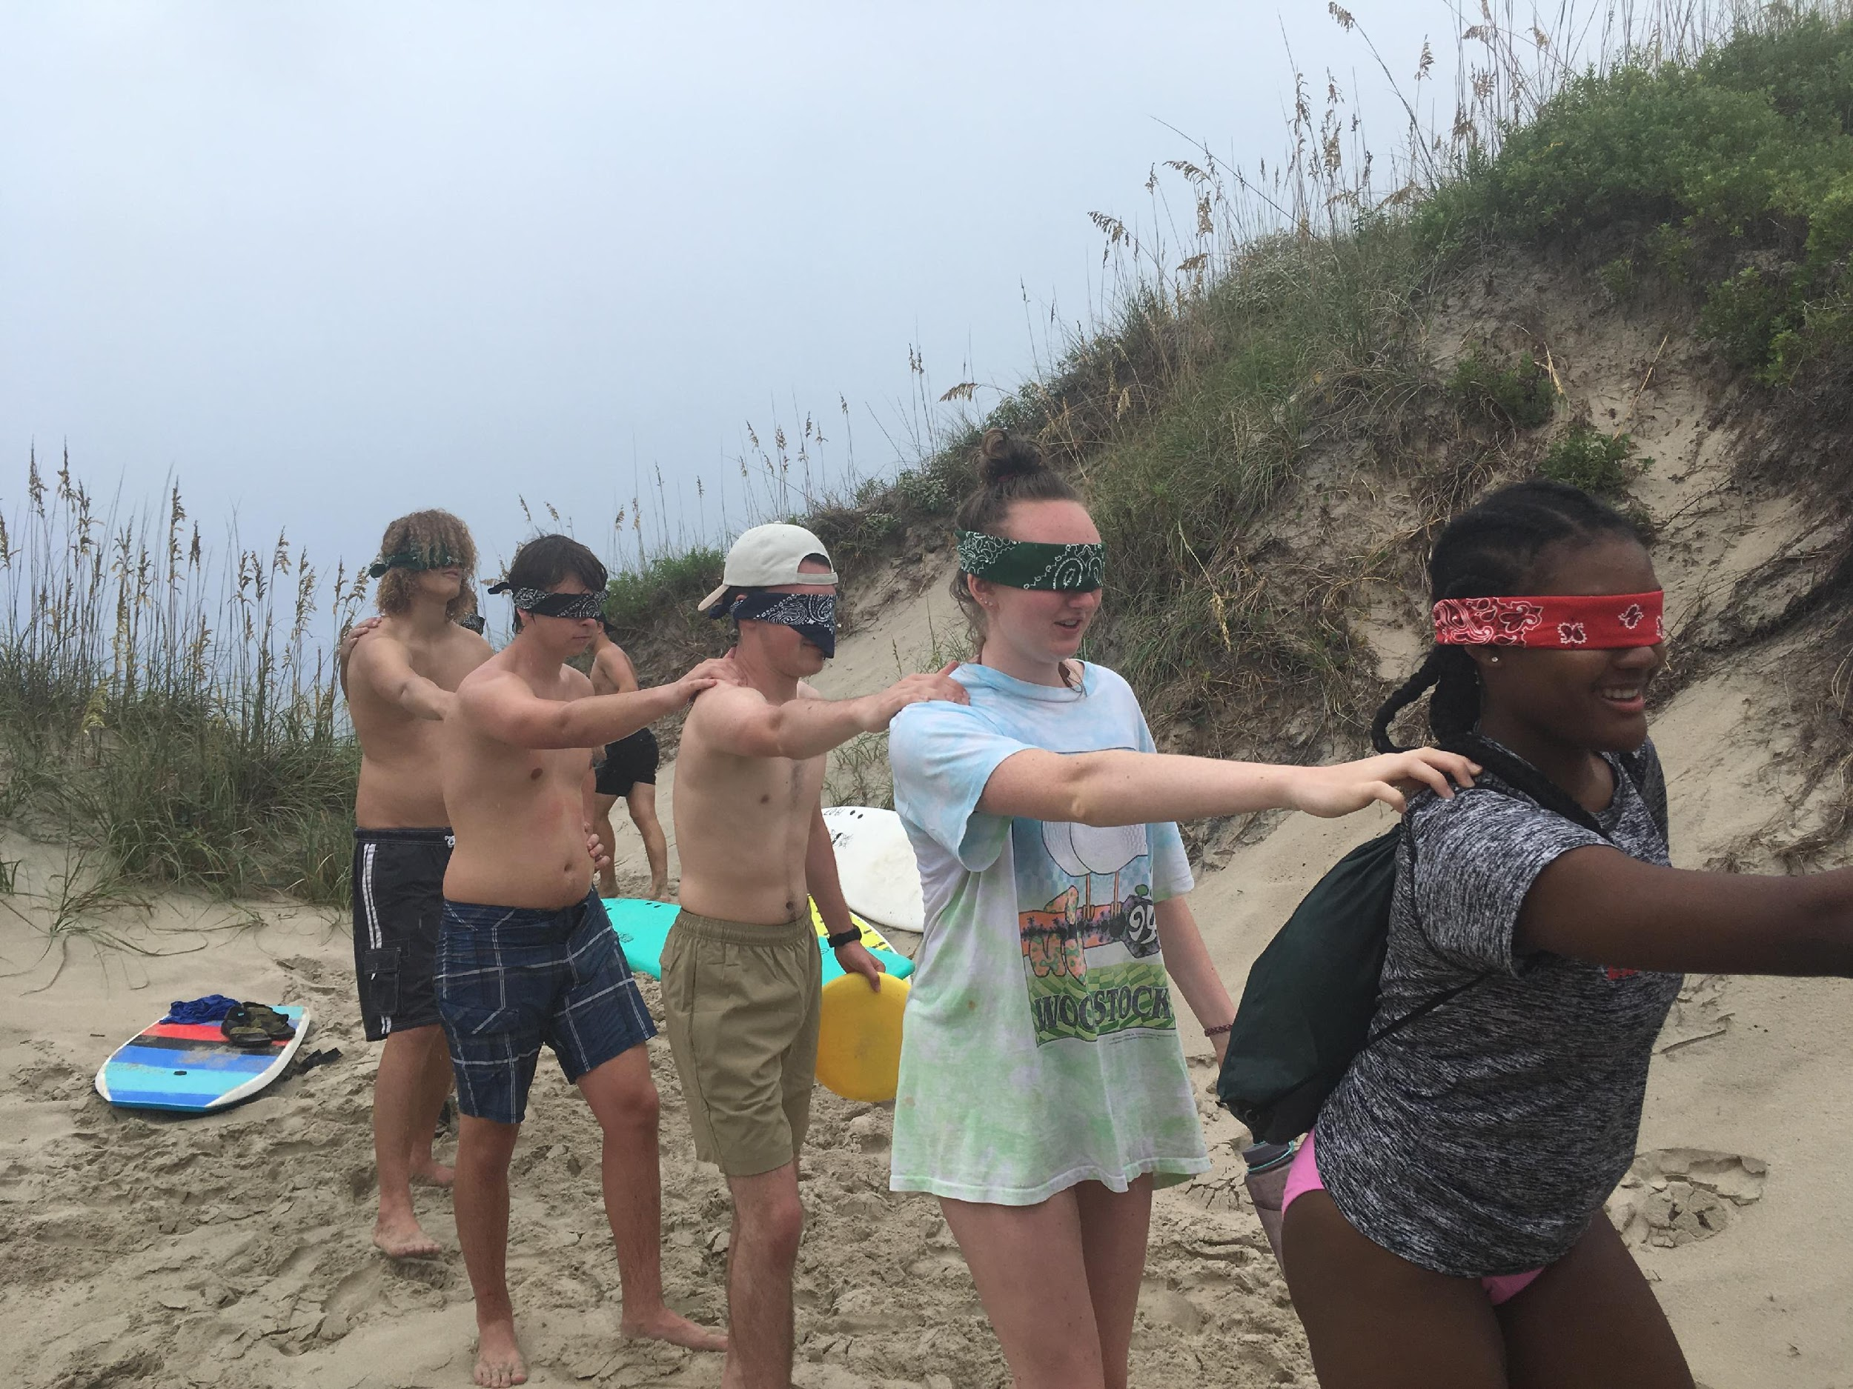
Resilience
“Resilience, simply stated, is one’s ability to deal with and adapt to stress or adverse circumstances (Wagnild & Young, 1993). By definition then, one’s degree of resilience is developed, at least in part, when one is exposed to stressful situations” (Shellman & Hill, 2017).
Introduction
Literature
Methods
Results
Discussion
Questions?
Notes:
When students adapt to a new environment or circumstance, they are being resilient. There are numerous definitions for resiliency, but simply stated, resiliency is defined as one’s ability to deal with and adapt to stress or adverse circumstances. Students who are not able to develop necessary processes to manage new stressors often leave higher education, thus first-year orientation programs such as first ascent aim to alleviate the stress associated with this difficult transition period.

Slide 6
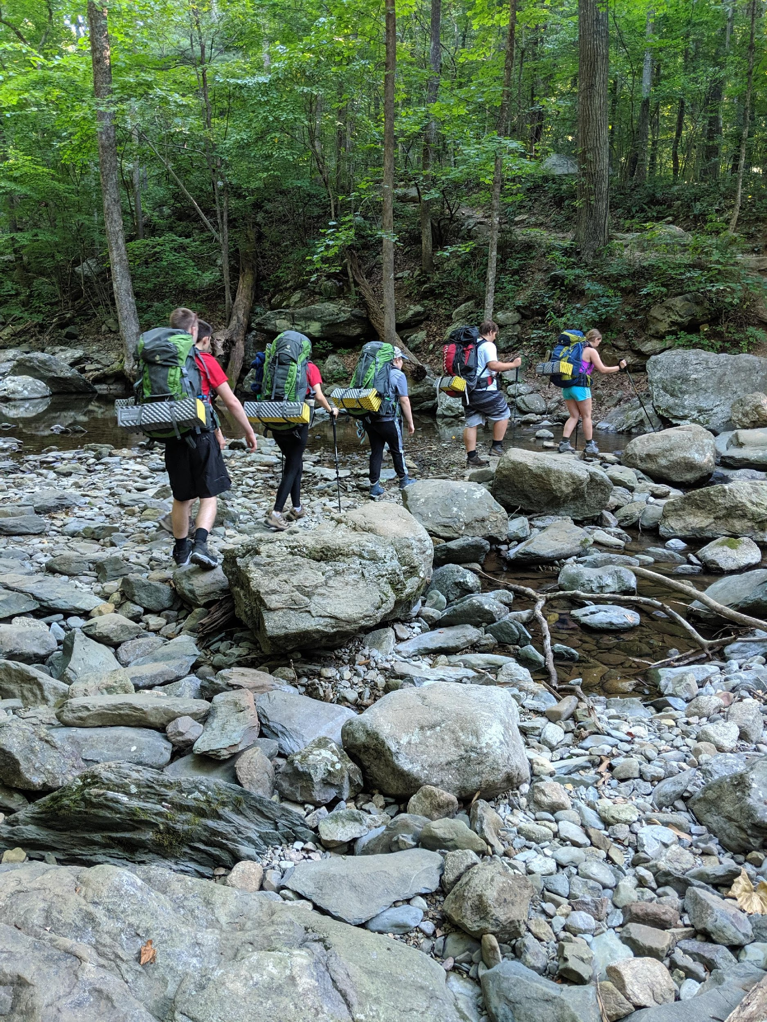
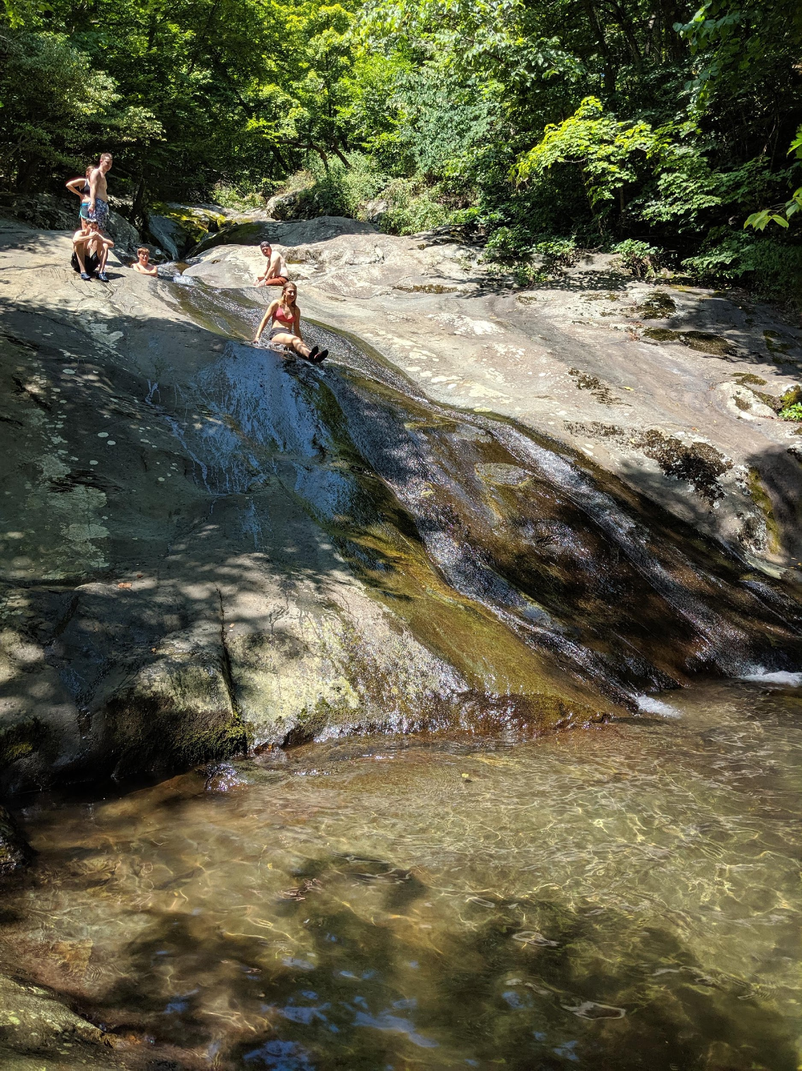
Flourishing
“Not only are flourishing individuals free of mental illness, they also are filled with emotional vitality and they are functioning positively in the private and social realms of their lives. Far from being supermen or superwomen, flourishing individuals are truly living rather than merely existing” (Keyes, 2003).
Introduction
Literature
Methods
Results
Discussion
Questions?
Notes:
Another factor vital to the success of first year college students nationwide is well-being, or flourishing. Not only do we want students to have the ability to bounce back from stressors associated with a transition to college, we want them to thrive. Flourishing is a way that we define this, and focuses on the emotional energy that determines how students function in personal and social facets of their lives. As stated by Keyes in Flourishing: Positive Psychology and the Life Well-Lived, far from being supermen or superwomen, flourishing individuals are truly living rather than merely existing.

Slide 7
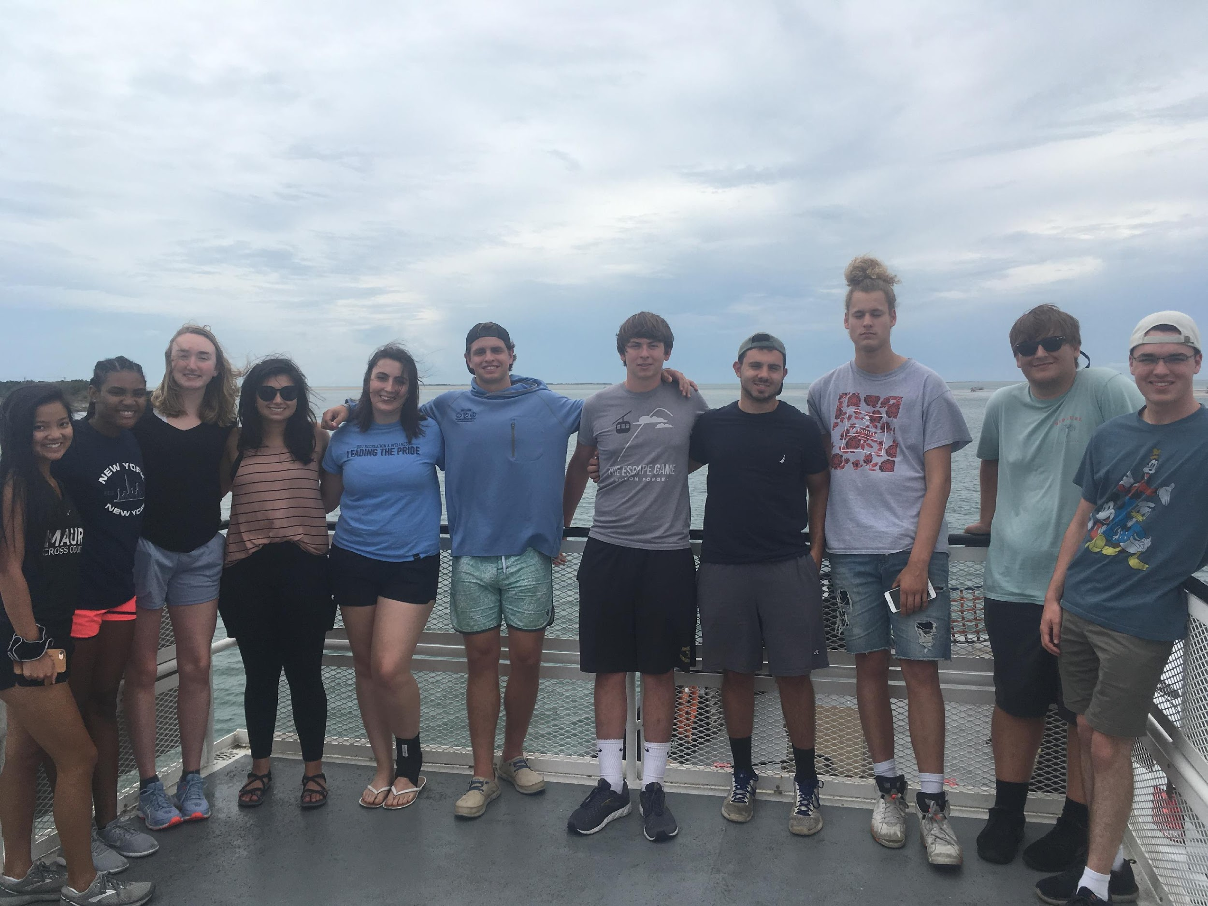
Setting
Four-day programs (Friday through Monday)
Student led; faculty mentor
Two program types
Backpacking and climbing trip in Shenandoah National Park, VA
Surfing and biking trip to Ocracoke Island, Cape Hatteras National Seashore, NC
Introduction
Literature
Methods
Results
Discussion
Questions?
Notes:
ODU’s First Ascent program offers three trips and two trip types each summer.
-Two of our annual trips are located on Ocracoke island in the Outer Banks of North Carolina. Ocracoke island is one of the East Coast’s top watersport recreation destinations, but is still secluded from the rest of the OBX. A ferry ride is the only way onto the island, where tourists can visit small, historic villages separated by miles of undeveloped, protected beaches. For these trips, we stay on the island’s campground, teach students how to surf, and bike to the village.
-Our other First Ascent trip located in the beautiful Shenandoah National Park. Located in the Blue Ridge Mountains of Virginia, Shenandoah national park is 200,000 acres of wilderness terrain, contains over 500 miles of trails, and includes a 100 mile stretch of the Appalachian trail. For these trips, we climb at Little Stony Man and backpack along the waterfalls of Whiteoak Canyon train and the AT.
Our First Ascent program is unique because it is student led with three student trip leaders, with the inclusion of a faculty mentor. We recruit our faculty from a diverse range of disciplines across campus, and have included our very own Dr. Hill and Dr. Z on these trips. Students meet at the university on the first day, and after trip preparation and introduction activities, make the journey to the destination of the trip. Along with participating in outdoor activities, each day is themed with different lessons in the forms of discussions and activities, which include Challenges Ahead, Asking for Help, and Self-leadership. Students reflect on the trip when they return to the university.

Slide 8
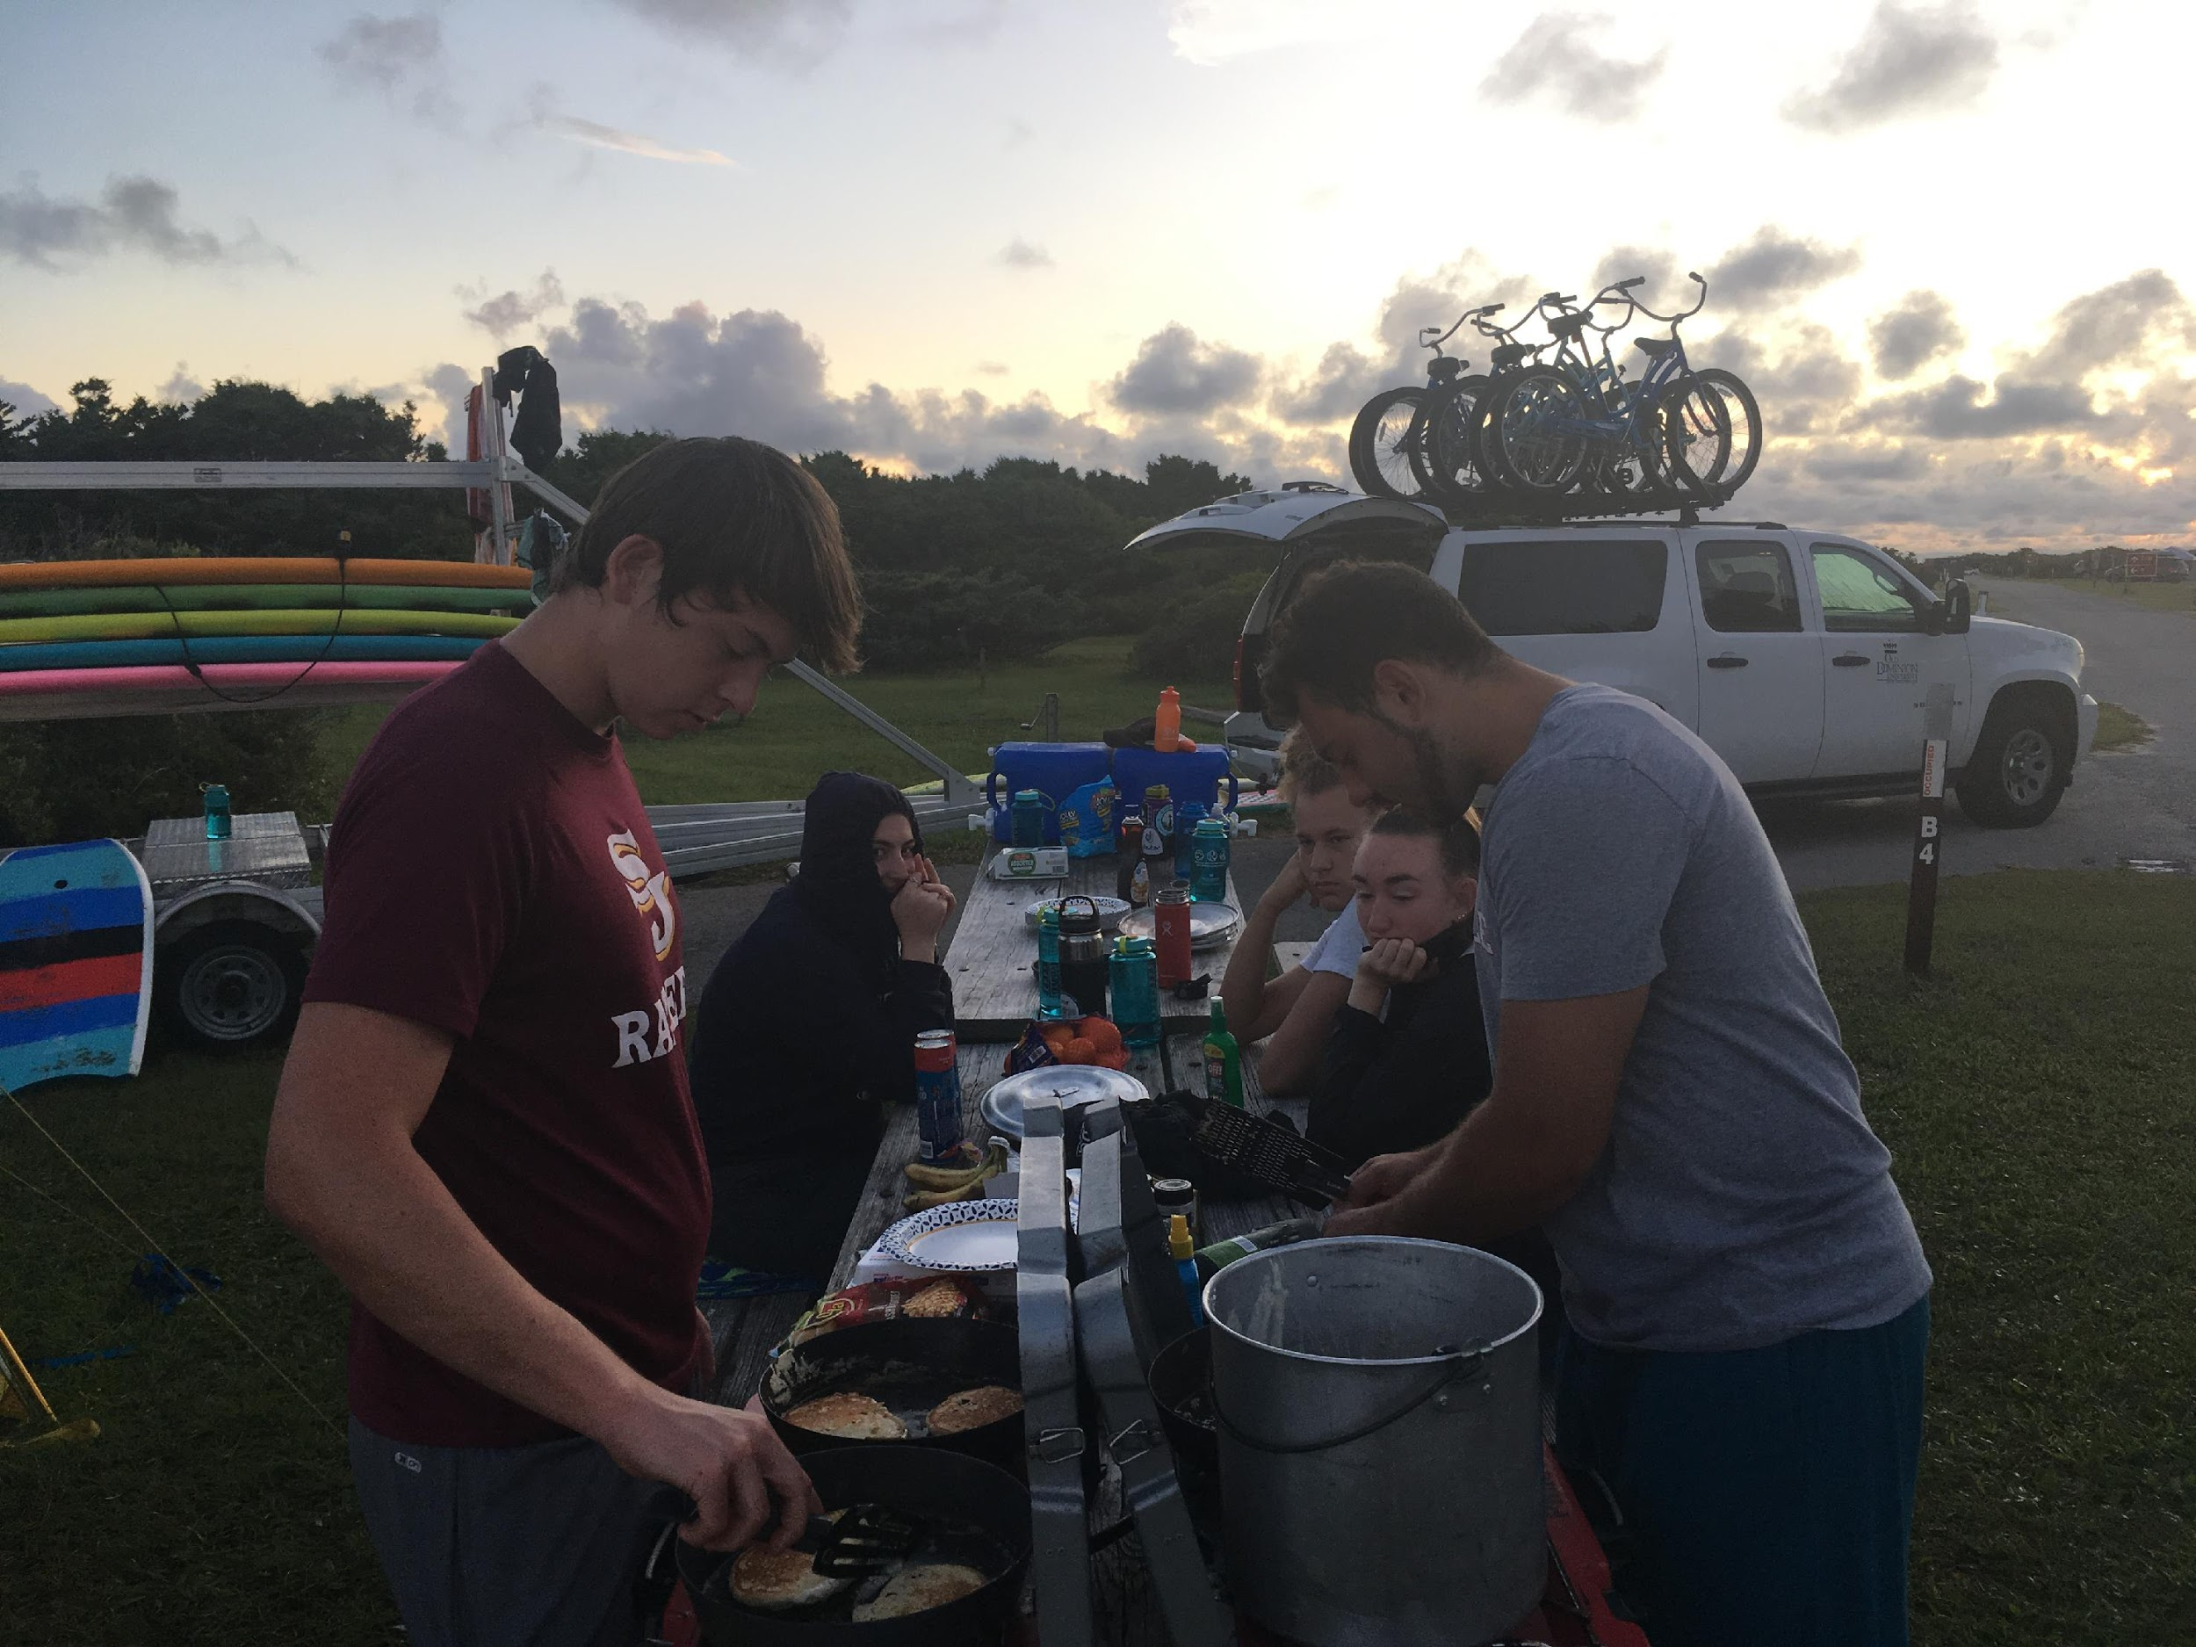
Methods
Pre-trip, post-trip, and follow-up surveys
2017 & 2019 (6 trips; 27 participants)
Mixed Methods approach
Quantitative analysis: Paired t-test
Qualitative analysis: Thematic analysis
Introduction
Literature
Methods
Results
Discussion
Questions?
Notes:
Mixed Methods - quantitative and a thematic analysis of qualitative data
with Pre, Post and Follow-Up survey (mention survey scale types? )
Limitations included no follow-up survey for previous 2019. 2018 ahd no data due to change in leadership of program

Slide 9
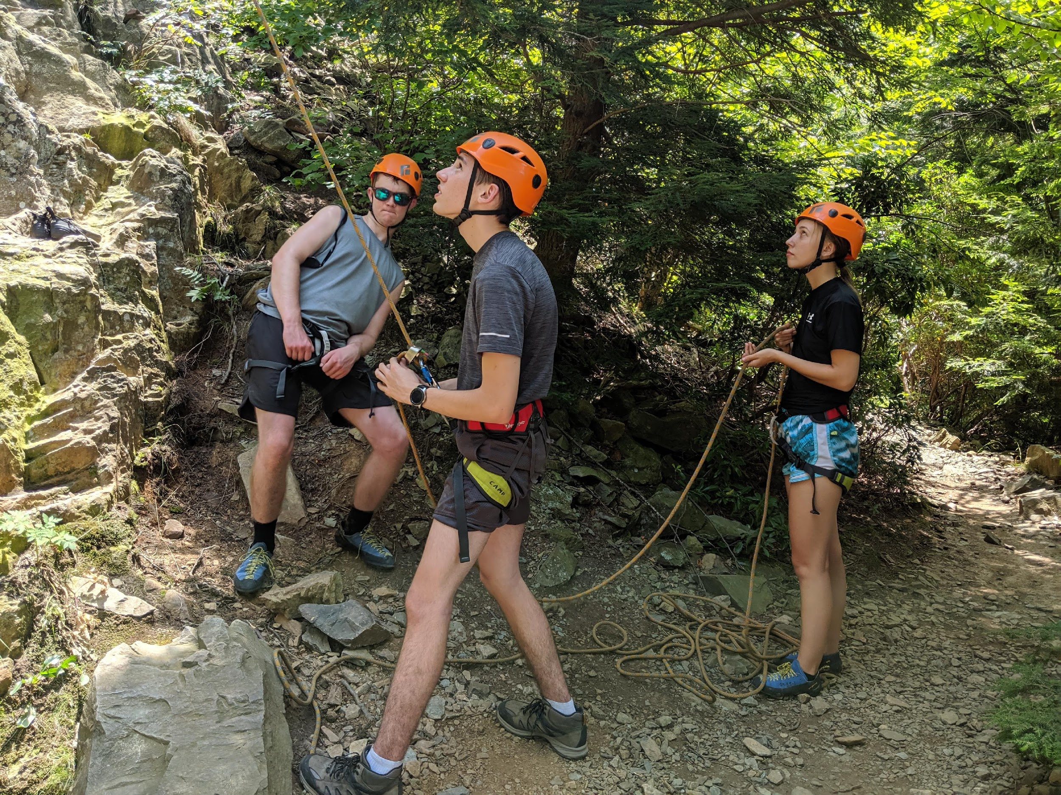
Research Questions
1. Does participation in First Ascent increase participants’ perceived level of resilience?
2. Does participation in First Ascent increase participants’ perceived level of flourishing?
3. How are the First Ascent goals being met?
Introduction
Literature
Methods
Results
Discussion
Questions?
Notes:
Purpose of Study: To identify the effects of an outdoor orientation program on participants’ level of resilience and flourishing, but we are inquiring the following…
1. Does participation in First Ascent affect participants’ perceived level of resilience?
2. Does participation in First Ascent affect participants’ perceived level of flourishing?
3. How are the First Ascent goals being met? - refer back to goals - open ended questions around the goals
Referinf back to out goal #1. ”ease of transition”; was that goal being met utilizing the open ended questions?

Slide 10
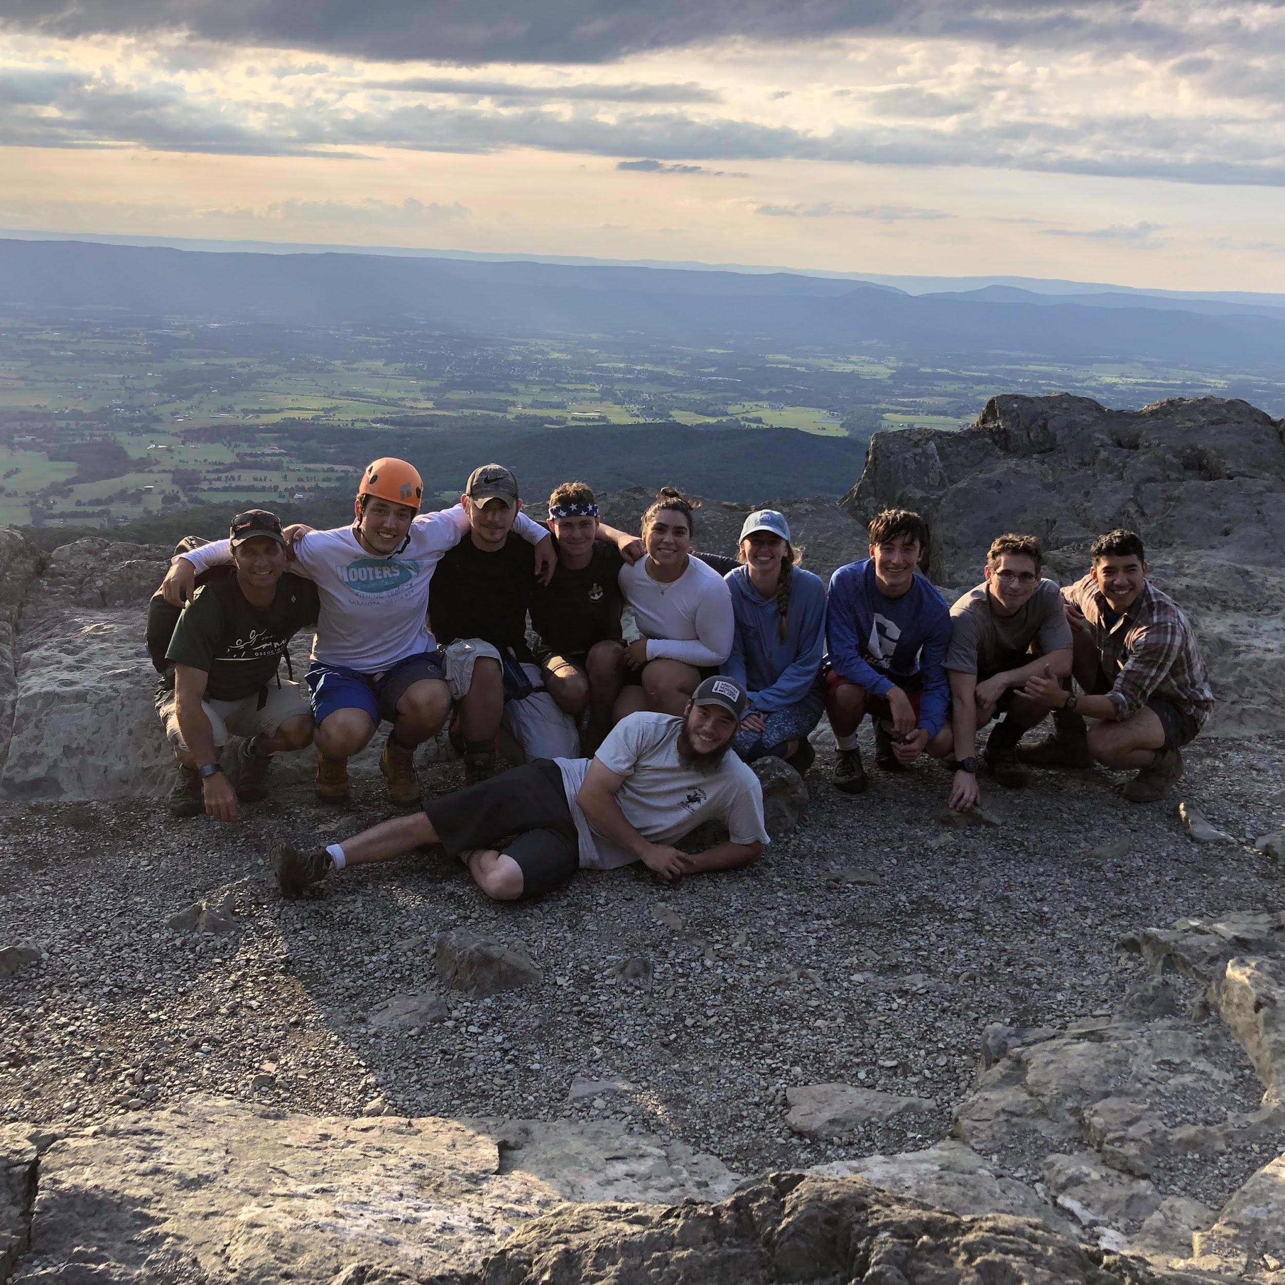
Study participants for 2017 and 2019
Sample: n = 27
Gender:
Males: 21
Females: 6
Age: 18-39
Average = 19
Race:
White/Caucasian: 22
Black or African American: 2
Hispanic/Latino: 2
Asian/Pacific Islander: 1
Marital Status:
100% Single
Trip Type:
Surfing: 17 attendees
Climbing: 10 attendees
Introduction
Literature
Methods
Results
Discussion
Questions?
Notes:
We had 27 subjects for this study, with a few more actual participants on the trips, but due their age, had to be dismissed for analysis.
interesting – indicative of AORE issues that while we are Minority Service Institute, we see very little minority participation.

Slide 11
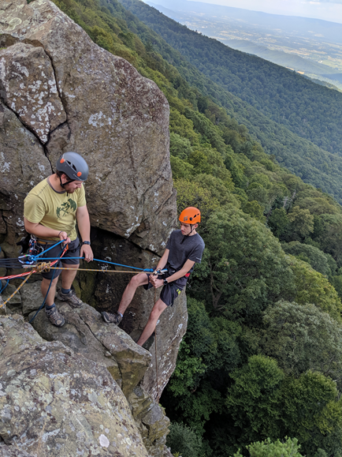
Instrumentation- Resiliency
Brief Resilience Scale (BRS; Smith et al., 2008)
6 items; 5-point Likert-scale
Overall measure of resilience
Cronbach’s alpha .90
“I usually come through difficult times with little trouble.”
Introduction
Literature
Methods
Results
Discussion
Questions?
Notes:
Reference photo- “little Stoney man.”
One year did a 25-question, found brief resilience scale- a lot shorter- similar psychometric properties- (reliability and validity are both equal)
Breif Resilience Scale has similar psychometric properties – same reliability but shorter with 6 questions instead. So, why not use?

Slide 12
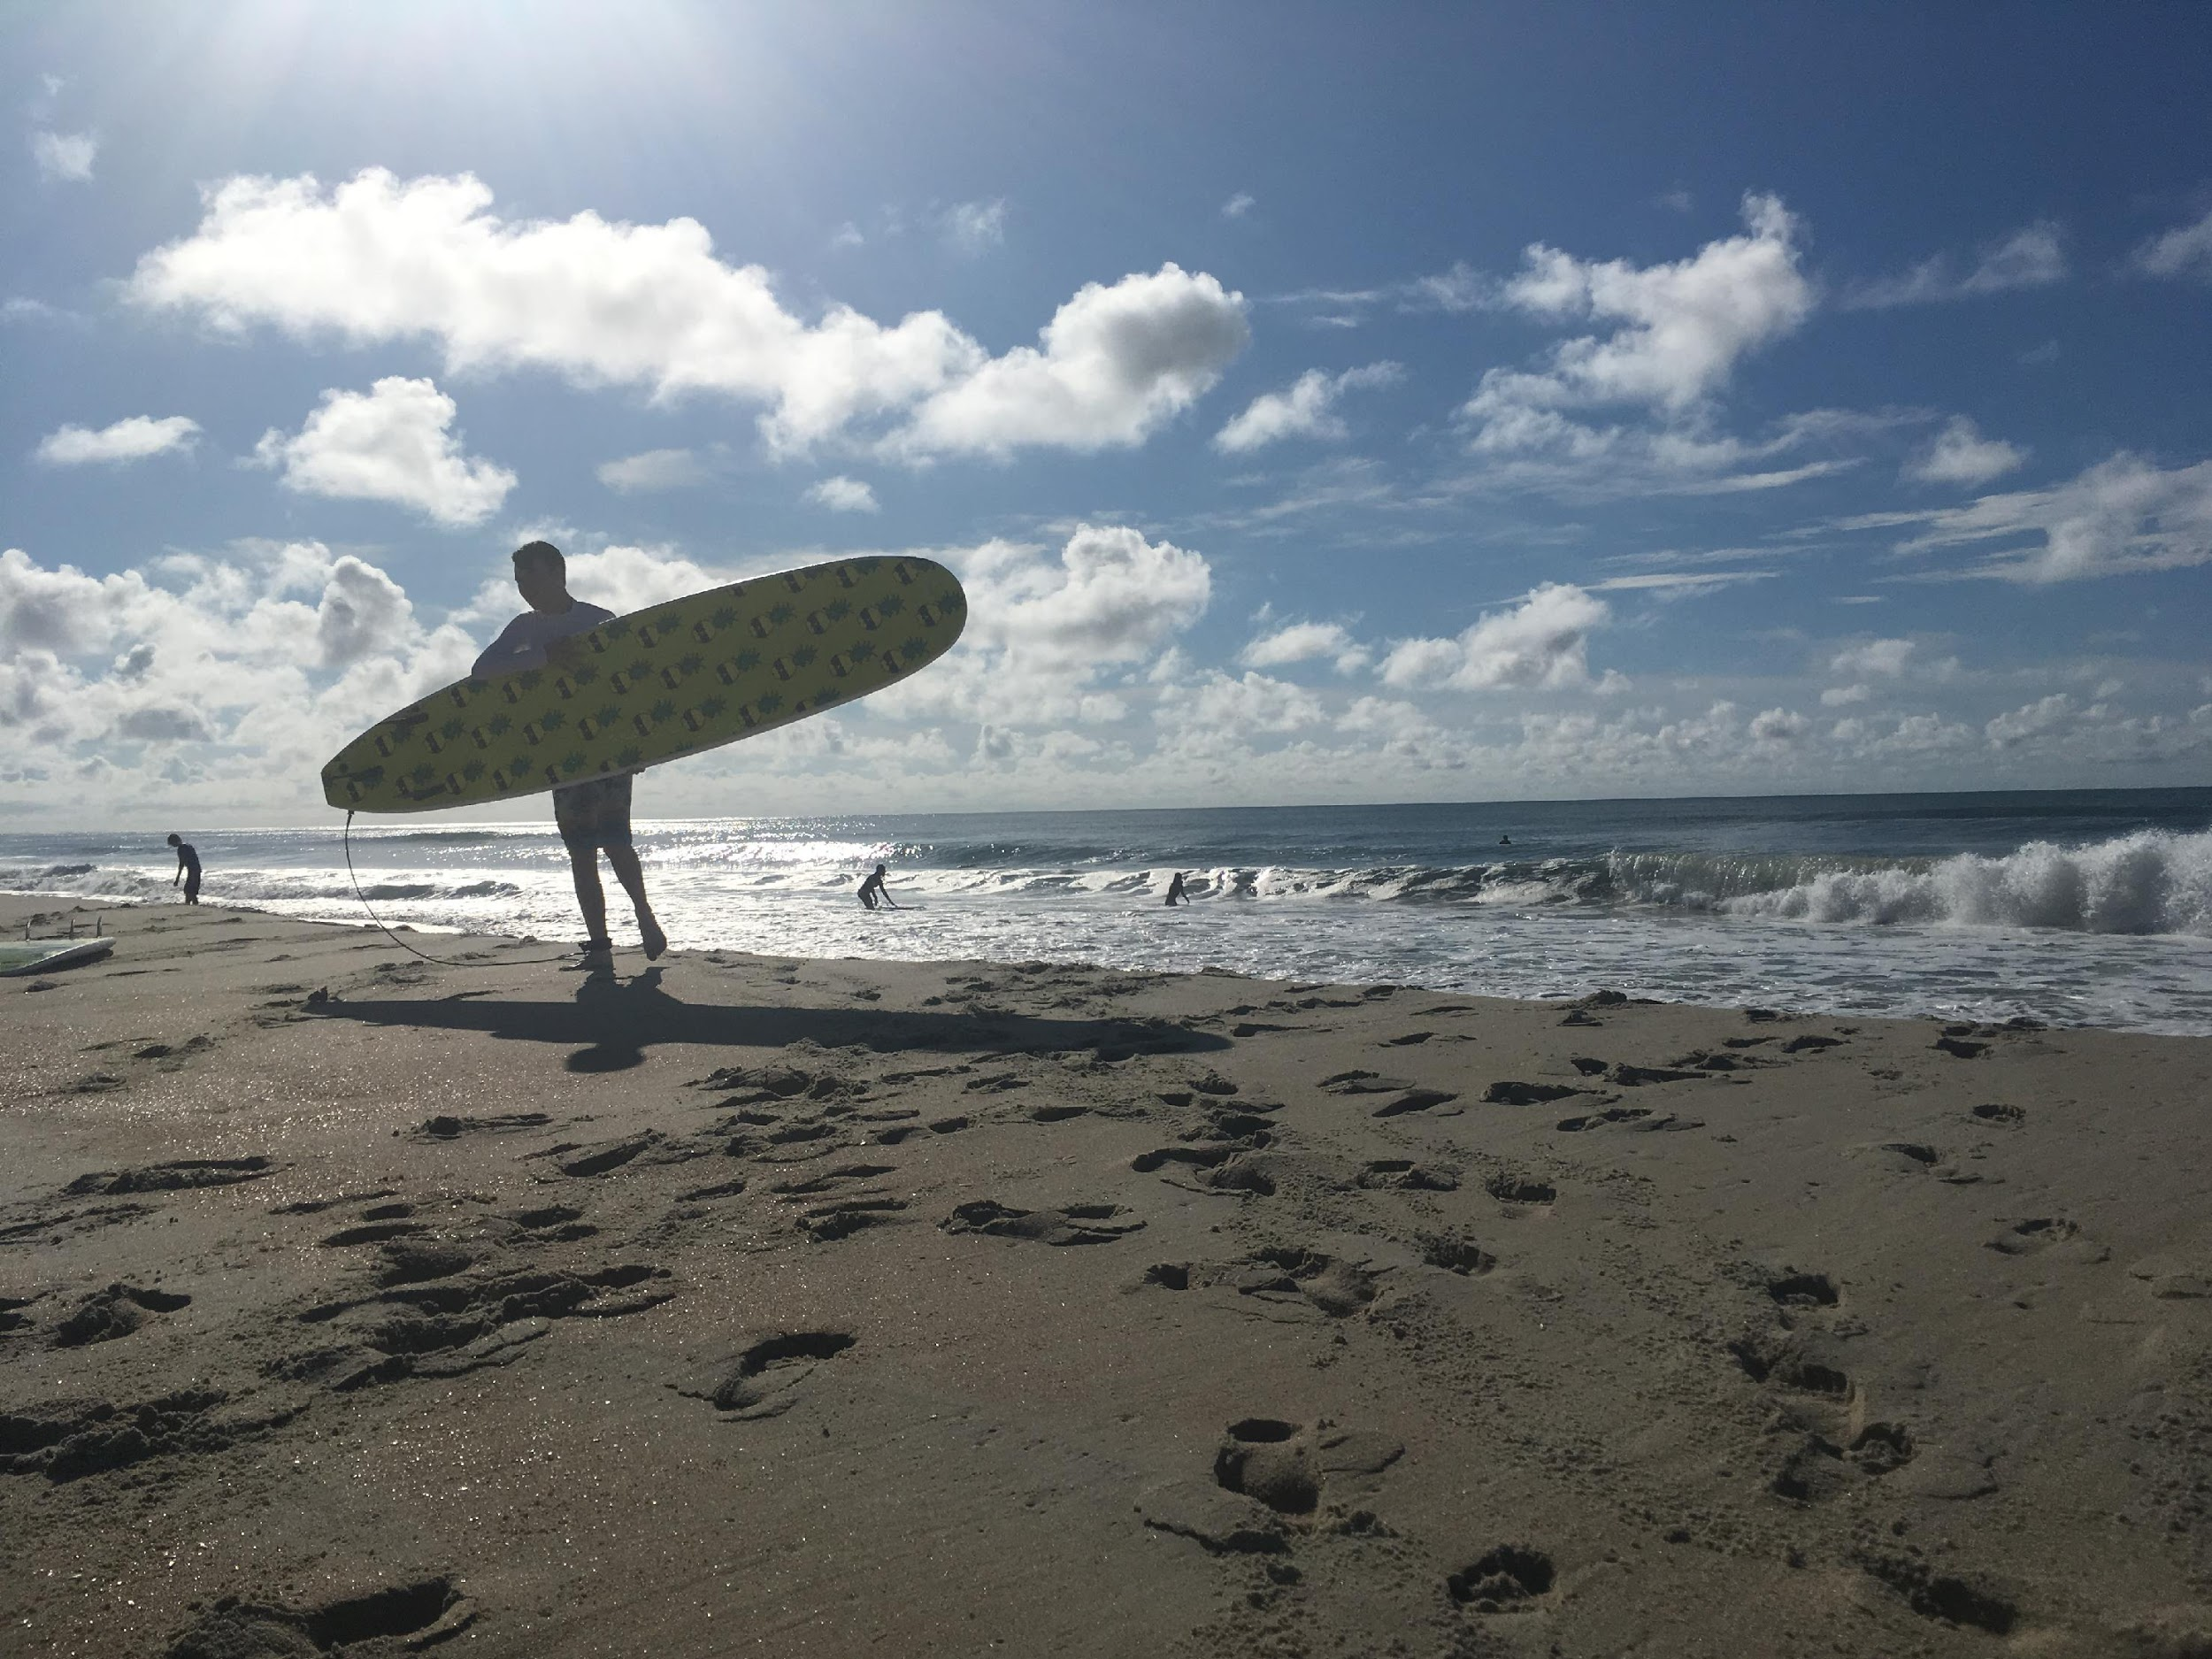
Instrumentation- Flourishing
Mental Health Continuum Short Form (MHC-SF, Keyes, 2009).
14-items, 6-point Likert scale: never to everyday.
Overall measure of flourishing
Cronbach’s alpha .98
“How often in the past week did you feel that your life has a sense of direction or meaning to it.”
Introduction
Literature
Methods
Results
Discussion
Questions?
Notes:
We used the Mental Health Short Form survey which again, has a great reliability rating to ask questions like, “How often in the past week did you feel that your life has a sense of direction or meaning to it.” This helped us analyze the..
Three domains of well-being:
Psychological
Emotional
Social

Slide 13
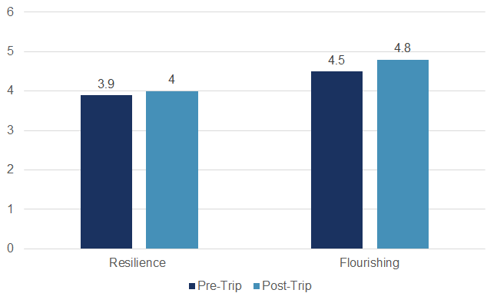
Results: Does participation in First Ascent increase
perceived level of flourishing and/or resilience?
Flourishing
t(27) = 4.653 p = .01
Cronbach’s alpha = .98
Resiliency
t(27) = 1.923 p = .06
Cronbach’s alpha = .90
Introduction
Literature
Methods
Results
Discussion
Questions?
Notes:
Paired samples t-test we found statistical significance of flourishing factors in students pre to post trip. AND we are close to approaching that significance with resilience at .06 and hope that with more data collection from future summers will close that gap. CONBRACH’s Alpha means strong reliability

Slide 14
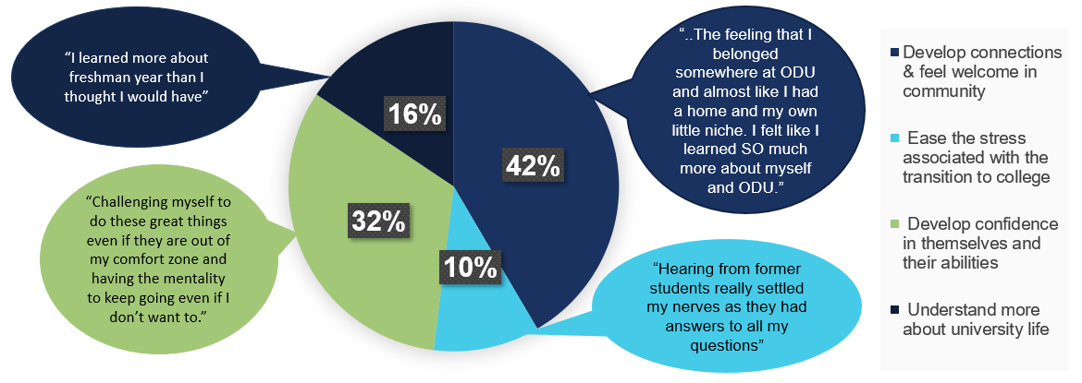
Qualitative Data: Post Trip Surveys
Introduction
Literature
Methods
Results
Discussion
Questions?
Notes:
I’m excited to share with you this unique portion of our research from 2019. By analyzing qualitative data from our post-trip surveys from this year, we’ve been able to answer our third research question: how are first ascent goals being met? The graphic above displays instances in which we found quotes that support each of the objectives in the purpose of FA.
Our first goal was to ease the stress associated with the transition to college. We found that 10% of analyzed quotes directly hit on this point.
Our second goal was “helping students to develop connections.” Our third goal was to “feel welcome in the university community”. There was some overlap in the quote content and these objectives. When students are getting connected, they are feeling welcome. 42% of the analyzed quotes hit on both of these objectives.
Our fourth goal was to understand more about university life. 16% of the analyzed quotes hit on this factor.
Finally, our fifth goal was to have students develop confidence in themselves and their abilities. 32% of the analyzed quotes referenced outcomes from this goal.
A note about our post-surveys- We are not directly asking students “how has goal number 3 of first ascent impacted you, rather, we ask general questions about what they learned from the trip. From analyzing results from these generalized questions, we gain better insight into how FA goals are being met.

Slide 15
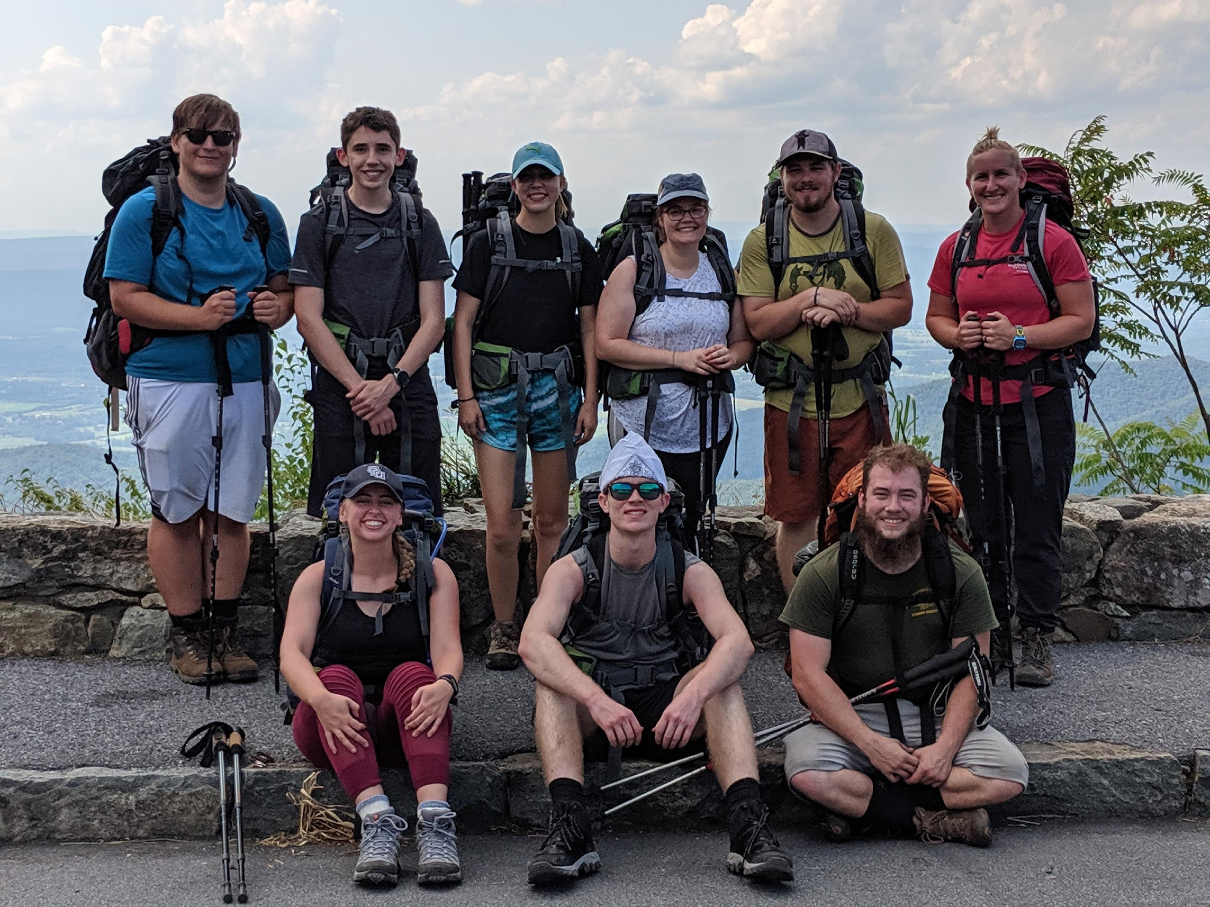
Discussion, Recommendations and Implications
Results of Flourishing and Resilience
Consistent with previous work in less time (Shellman & Hill, 2017)
More responses in follow-up data
Change data collection time intervals
Limitations
Small sample size
Limited follow-up data
Introduction
Literature
Methods
Results
Discussion
Questions?
Notes:
the 12 week follow up data turned out to be (approx 35% response rate) which we coaxed from them at a reunion of participants and student leaders that we hosted and provided pizza.
Why do we see flourishing more at the end of trip?
How the results correlate with similar research by other institutions?
Does this have broader implications across a university setting?
Where is there room for improvement in data analysis and/or programming?

Slide 16
Discussion, Recommendations and Implications
Combination of First Ascent goals
Identification of OOP as High Impact Practices as defined by the AAC&U
First year seminars and experiences
Learning communities
Service learning
Undergraduate research
ePortfolio
Personal testimony
Introduction
Literature
Methods
Results
Discussion
Questions?
Notes:
As previously stated when discussing our qualitative analysis, we should consider refining the goals of first ascent to 4 objectives instead of 5. Helping students develop connections and feel welcome in the university community go hand-in-hand, and the many qualitative quotes reflected both these objective simultaneously.
Another interesting connection we made from our study was comparing Outdoor Orientation programs to High Impact Practices. The Association of American Colleges and Universities is an organization that sets guidelines for High Impact practices, which is defined as educational programs and experiences that research has shown to increase student success. There is no mention of Outdoor Orientation Programs specifically within these guidelines. While our data is limited, the culmination of our research and other literature on the topics of OOPs is enough to support adding OOPs to the list of High Impact Practices for institutions.
Finally, I want to share my story with you. I participated in the First Ascent program the summer before my freshman year. This trip had a lot of firsts for me: my first time I was on a trip with a group of strangers, my first time camping, my first time rock climbing, my first time backpacking. I faced many challenges, from the physical challenge of stepping over the edge of a cliff to rappel down a rock face, to the mental challenge opening up to a group of people I had just met. At the time I had no idea how impactful this trip would be on my college life… in fact, I would argue that I wouldn’t be who I am today if I hadn’t gone on this trip.
Tying this all back to the objectives in our FA goals, the most impactful objective on me was my development of confidence in myself and my abilities. Coming in as a freshman, I was very shy and I kept to myself. Stepping over the edge during a rappel, reaching the top of a climb, and overcoming the challenge of sharing my input with a group of people during a group discussion are all factors that led to an increased sense of confidence in myself. Although my sense of confidence grew through facing personal challenges, I couldn’t have done it without the support I had from student trip leaders, my peers, and faculty mentor.
Inspired by this experience, I decided to complete the semester-long apprenticeship to become a trip leader. The next summer, along with the following two summers, I was a leader for the same first ascent trip I participated in as a freshman. This past year, I lead a surfing first ascent as well. It is an honor to lead participants through an experience that was truly life-changing for me. As a trip leader, I am eager to see a participant reach new heights, whether that be through overcoming the physical challenge of rock climbing or the challenge of making a life transformation. Through being a student trip leader, I have become more outgoing and have discovered my passion for working with people to reach their goals. I know that if I were to show my freshman self who I am now, I would not be able to fathom my personal evolution.
I would consider my first ascent experience a High Impact Practice, because it truly did impact my success in college. Not only am I a student, but I’ve learned to overcome challenges such as balancing a full course load with a part-time job. I’ve not only learned how to adapt to new challenges, but I’ve learned to thrive. My well-being has never been higher than when I surround myself with a community of people who support my personal growth. I’ve found that through working with the OAP, but I know many of my FA peers and past participants have found that through other facets of university life. Being on both sides of this program- as a participant and as a leader, I feel that I have a great understanding of how impactful this program is on the students it serves.

Slide 17
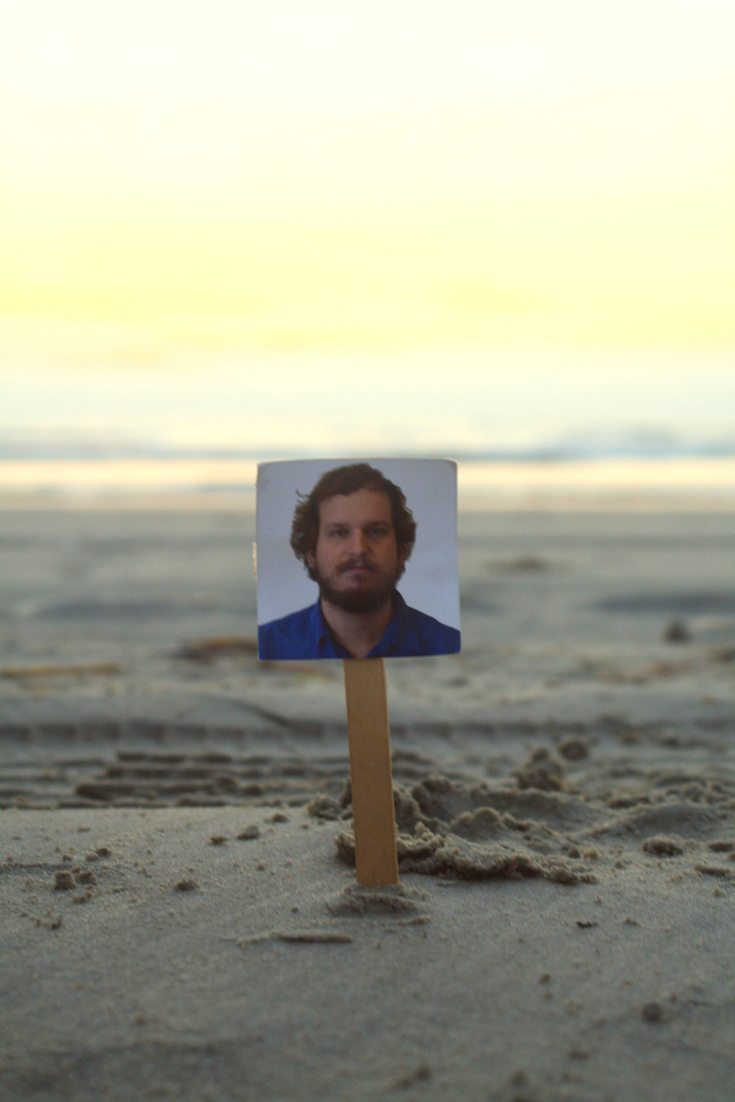
Thank you Co-Authors!
“Mike on a stick”
Erik “Dusty” Edwards
Introduction
Literature
Methods
Results
Discussion
Questions?
Notes:
Again, we would just like to show our appreciation to our co-authors! We have Dr. Hill and Dr. Z, two awesome FA mentors and supporting professors. We have one of our favorite bosses, Michael Willett, pictured here as “Mike on a Stick”- btw Mike on a stick was on my freshman FA trip. And then we have Erik “Dusty” Edwards, our favorite trips coordinator.

Slide 18
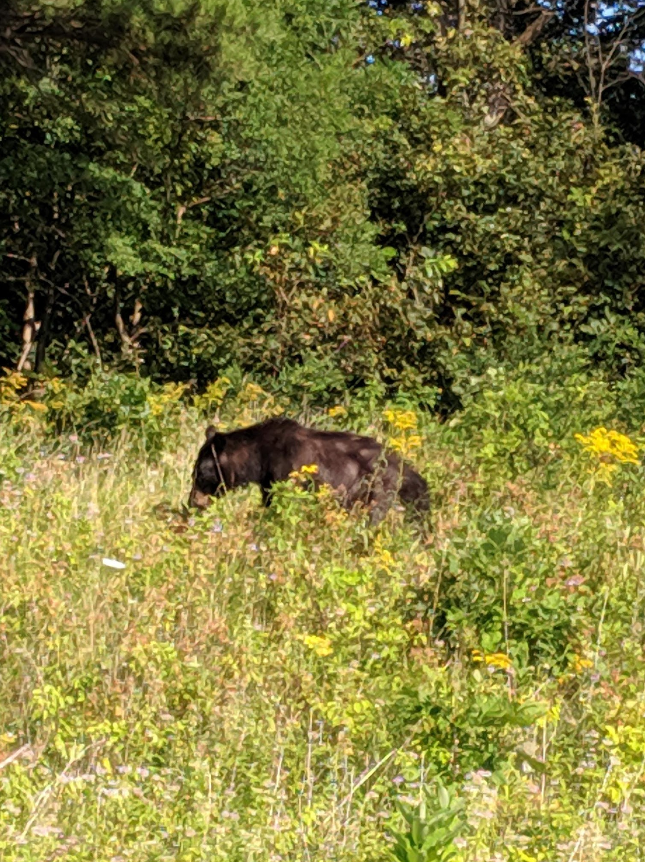
Questions or Thoughts?
Eleanor Crofford
ecrof002@odu.edu
Old Dominion
University
Abby Rossiter
aross006@odu.edu
Old Dominion
University
Introduction
Literature
Methods
Results
Discussion
Questions?

