Slide 1
An Exterior Exploration
Amy Vernon
Library Visit #2
Old Dominion University
LIBS 608
Dr. Dawn Betts-Green

Slide 2
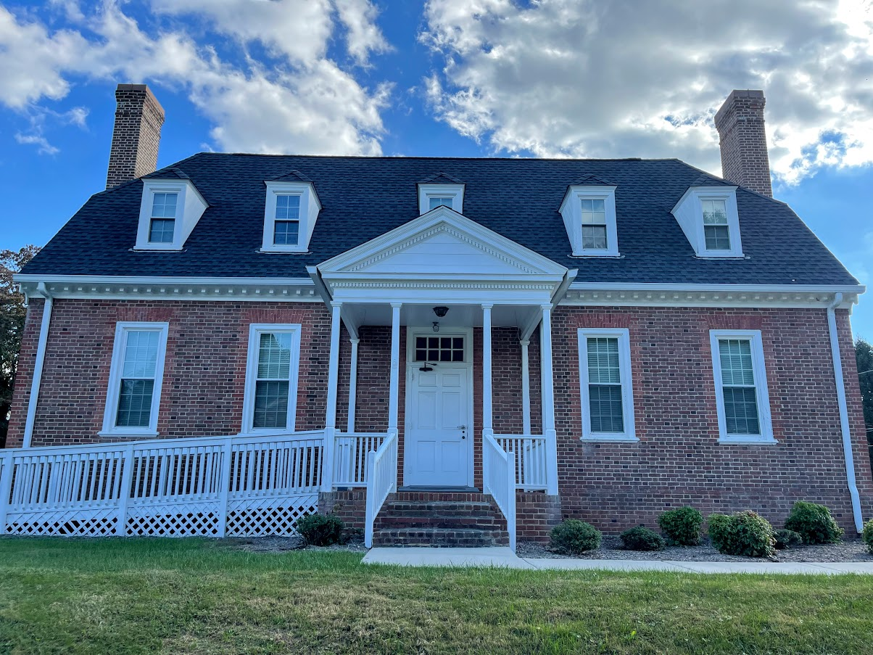
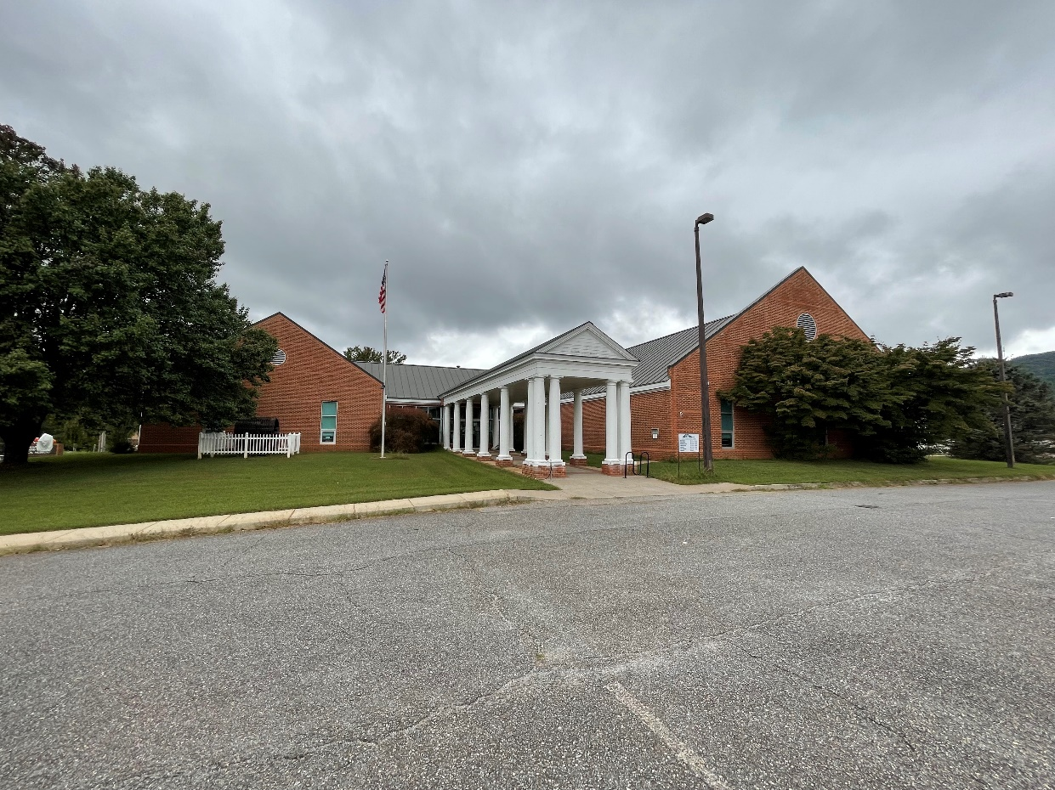
Patrick County Branch Library 116 West Blue Ridge Street Stuart, Virginia
THEN
NOW

Slide 3
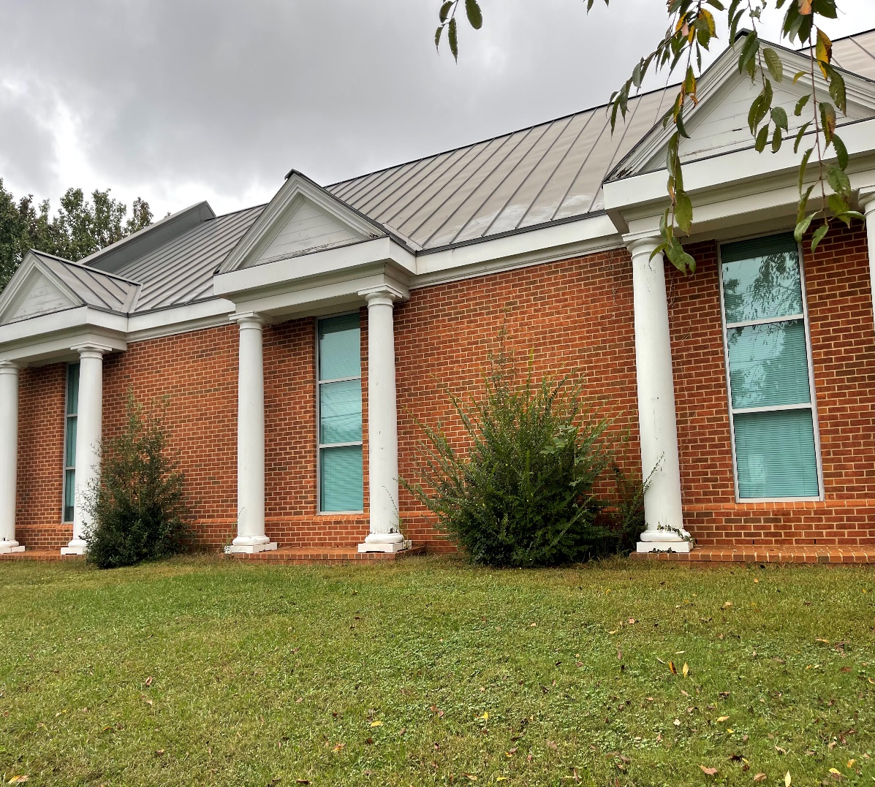
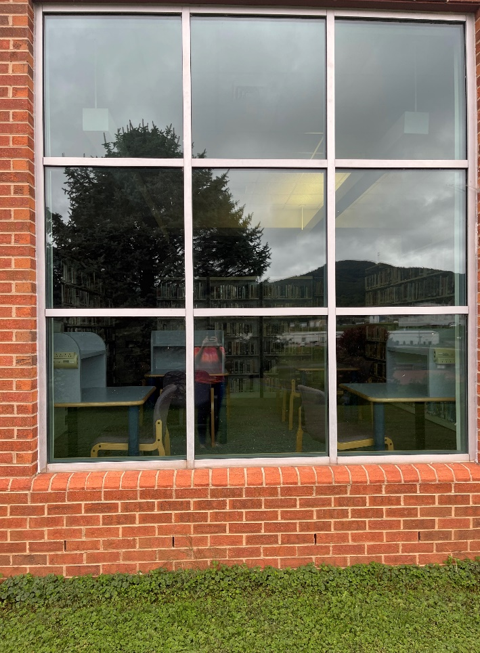
The Building

Slide 4
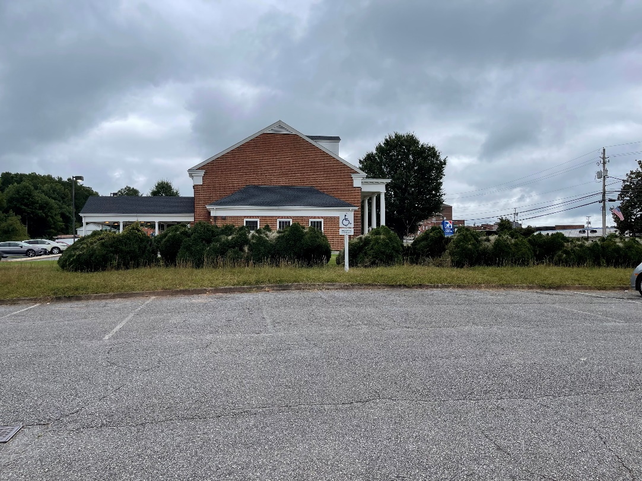
Location

Slide 5
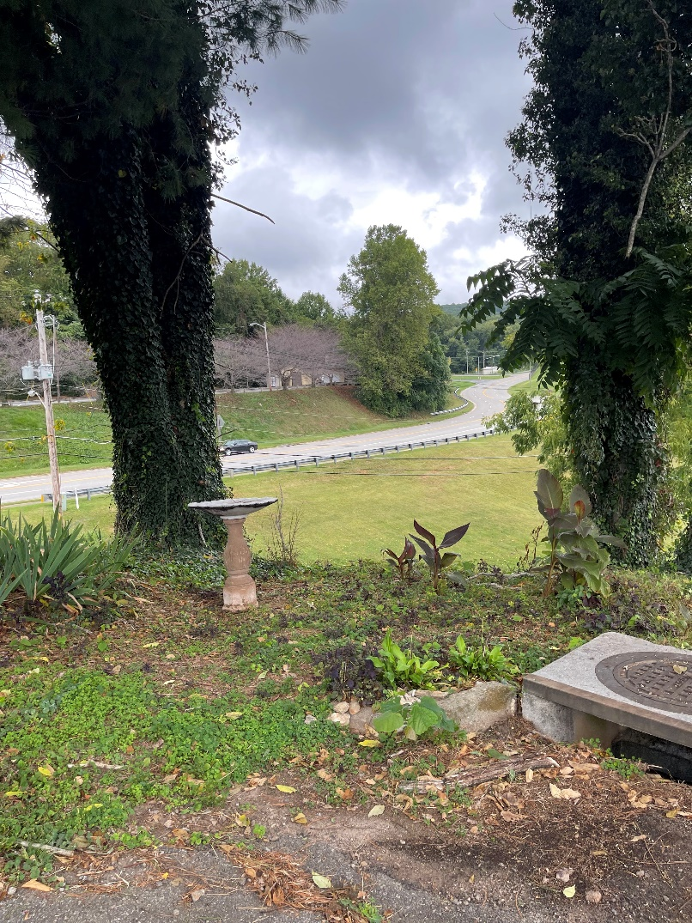
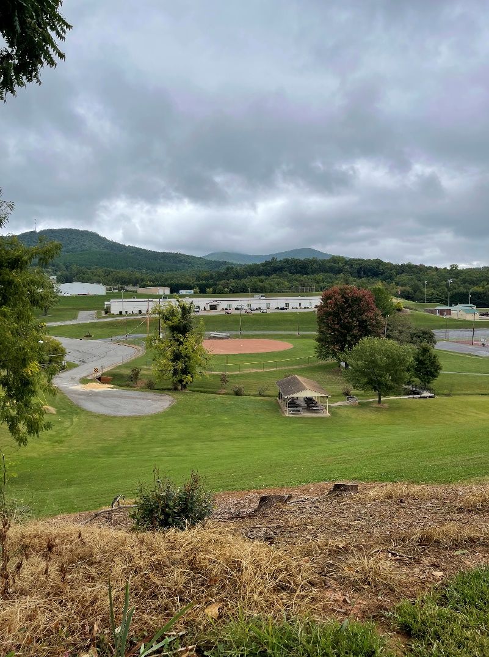
Location

Slide 6
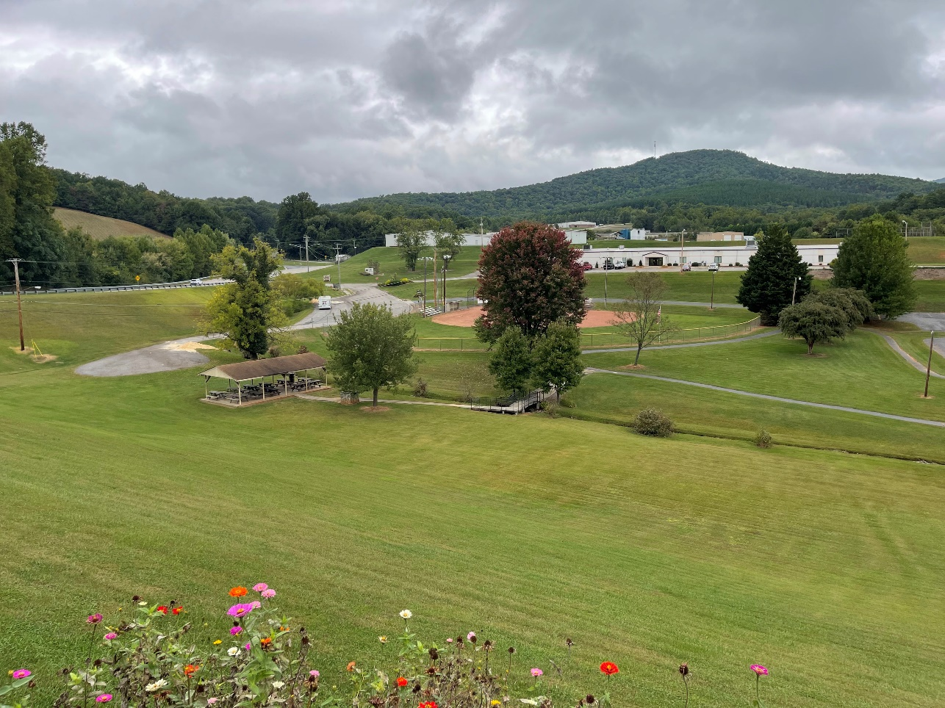
Recreation Area Dehart Park, Pool, & Trail

Slide 7
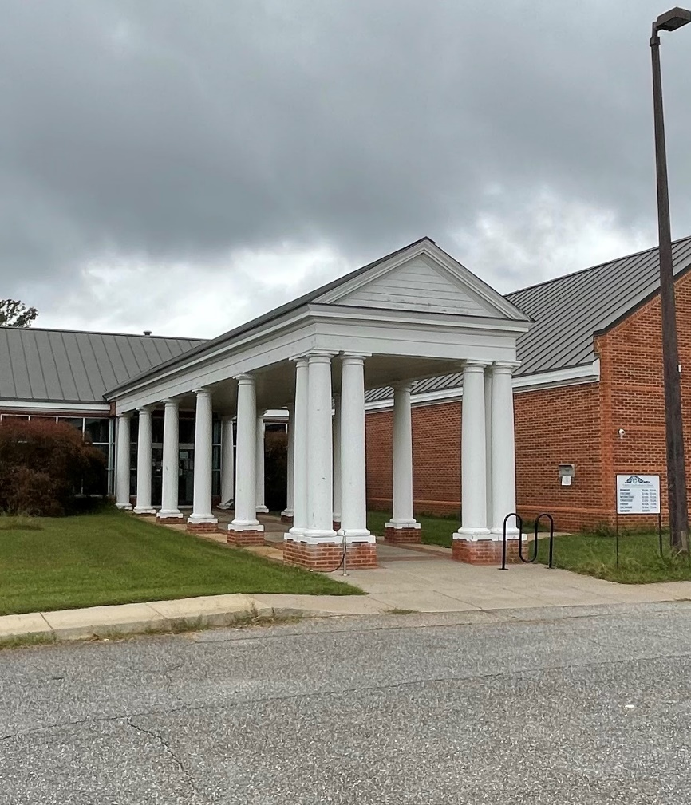
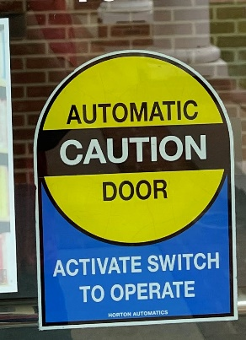
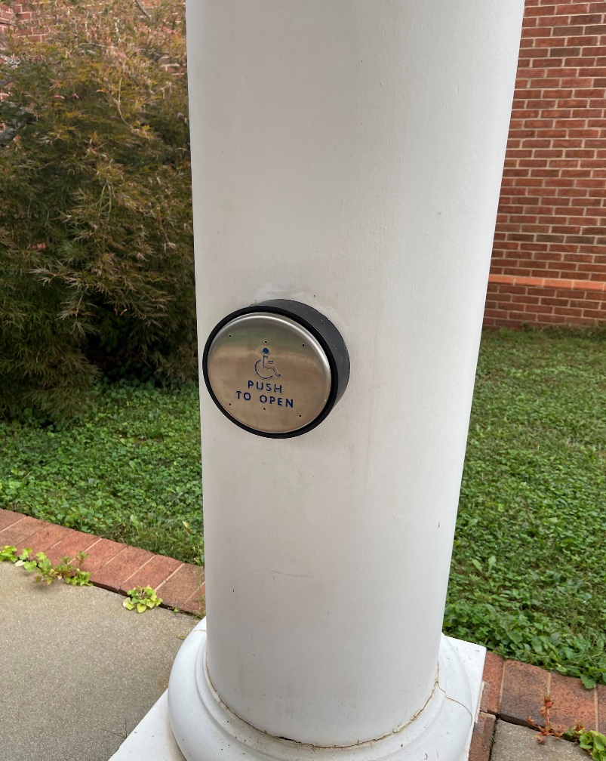
Accessibility

Slide 8
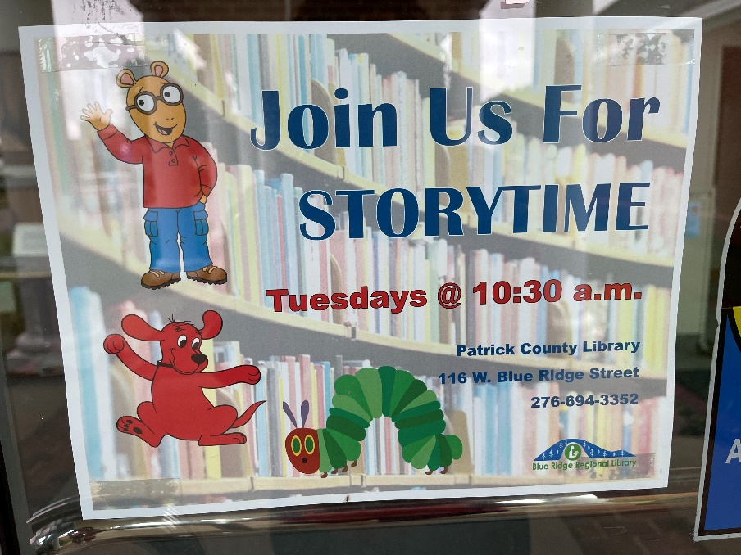
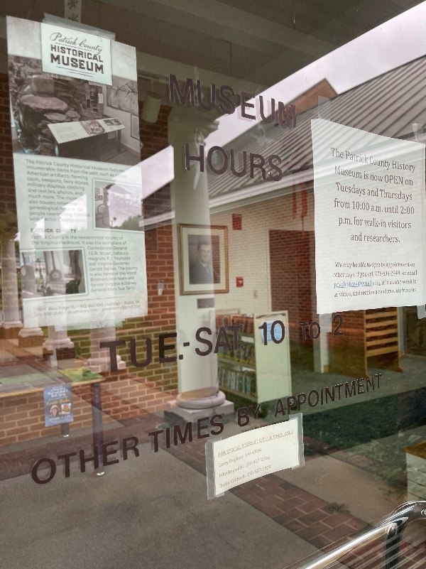
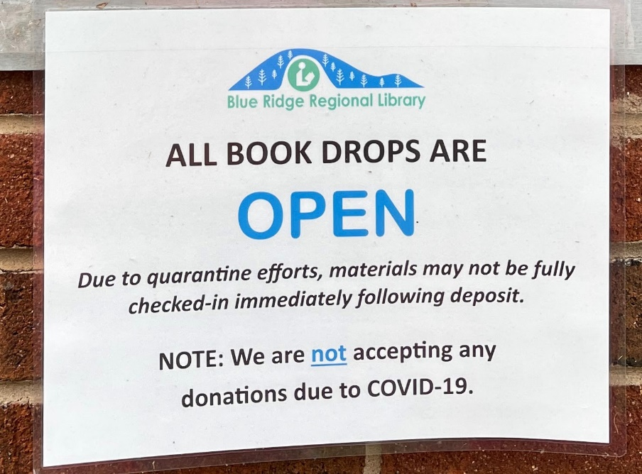
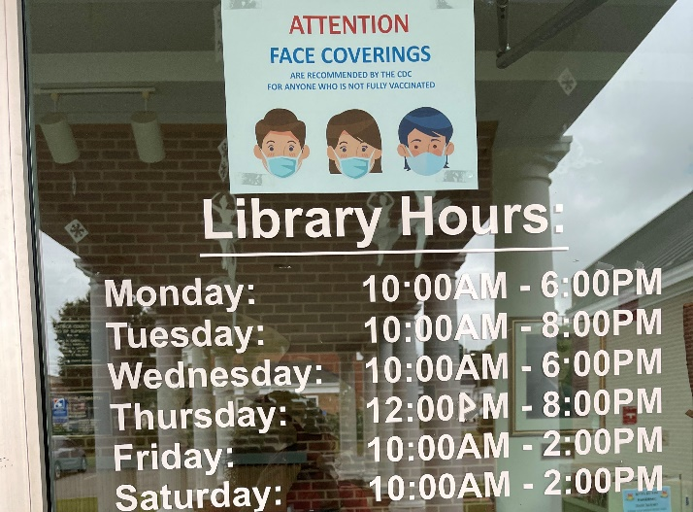
Signage

Slide 9
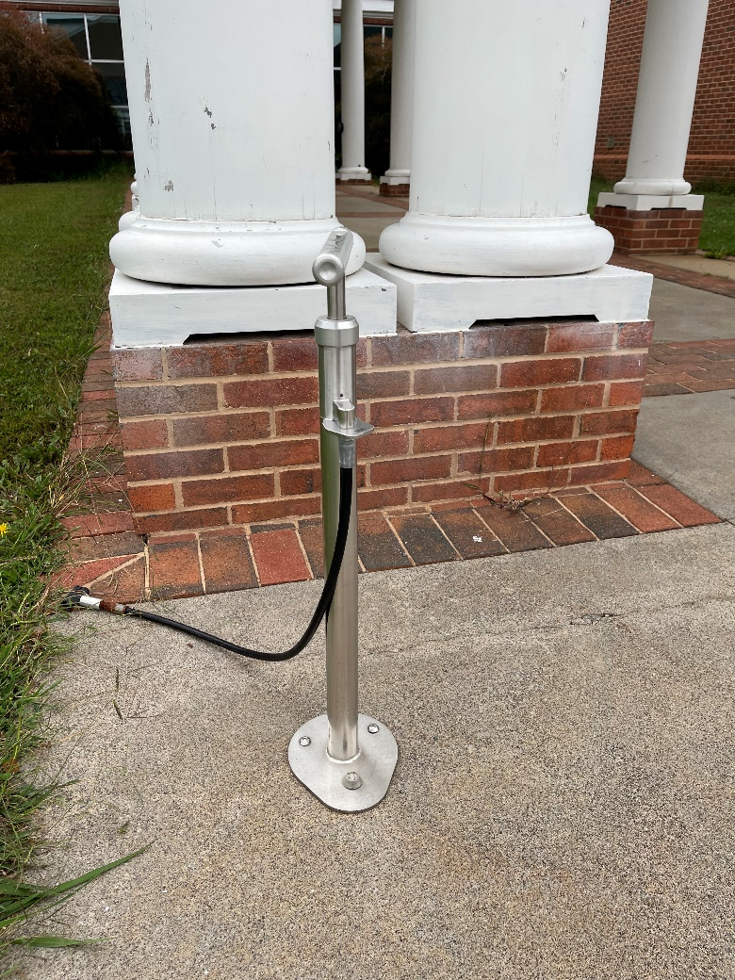
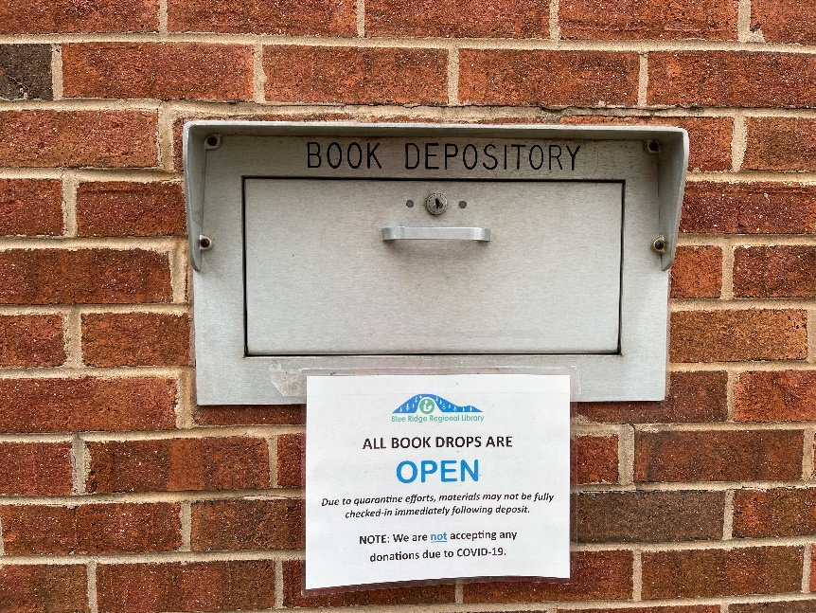
Exterior Services

Slide 10
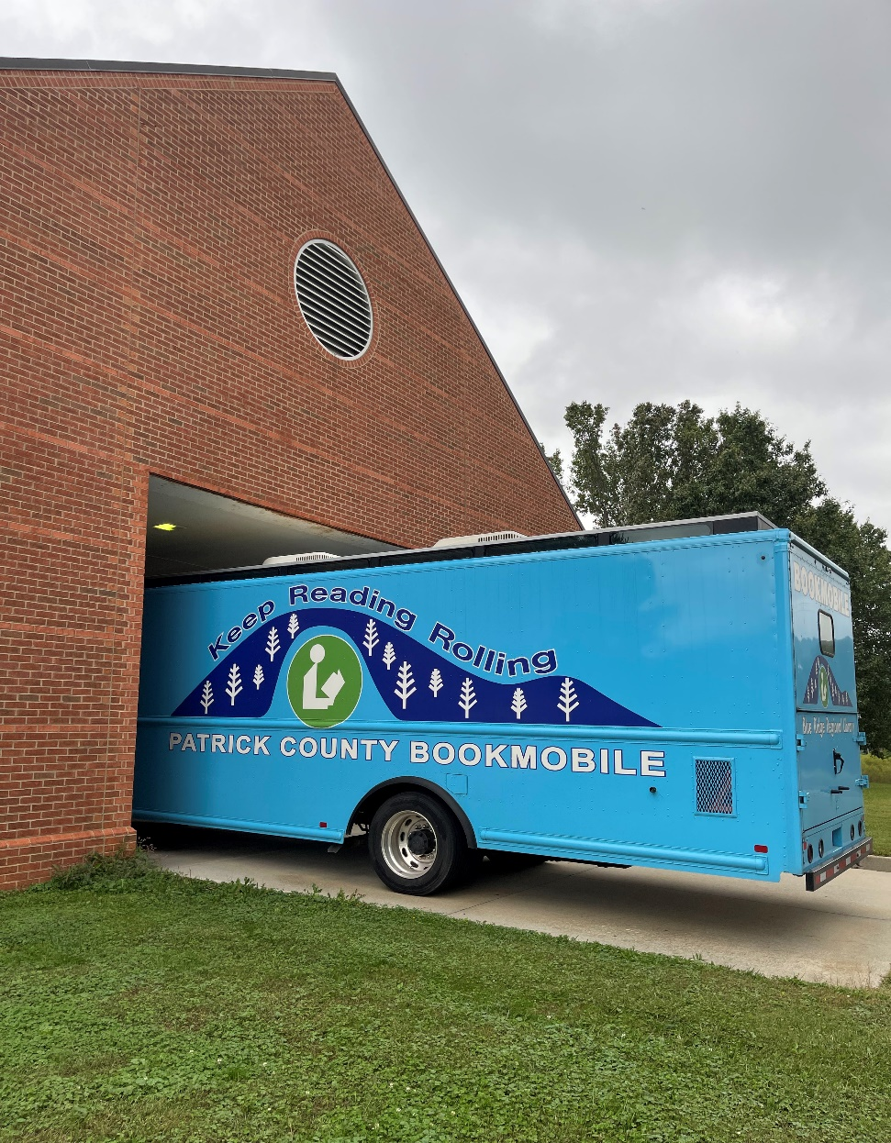
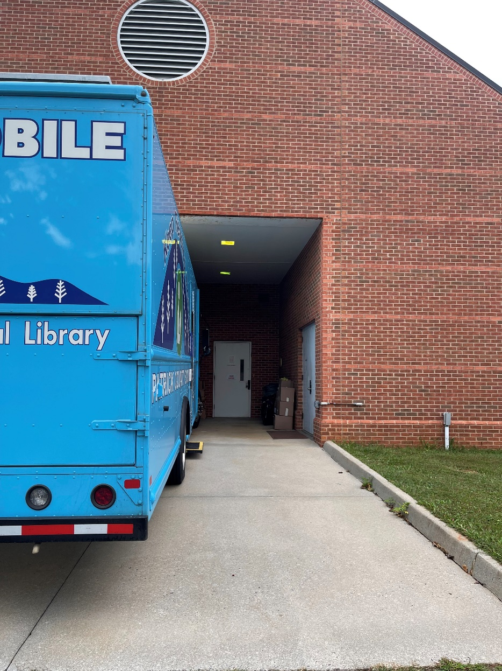
Books on Wheels

Slide 11
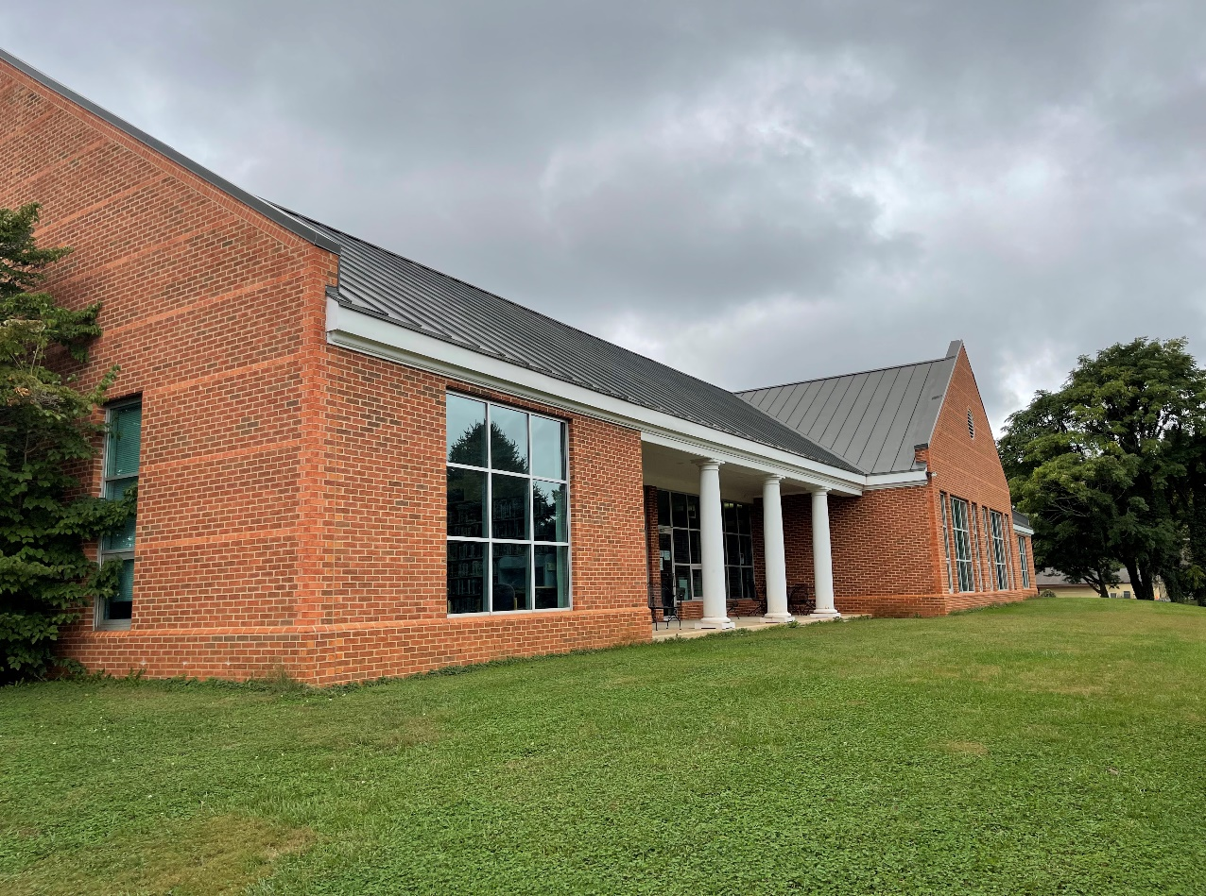
Outdoor Enjoyment

Slide 12
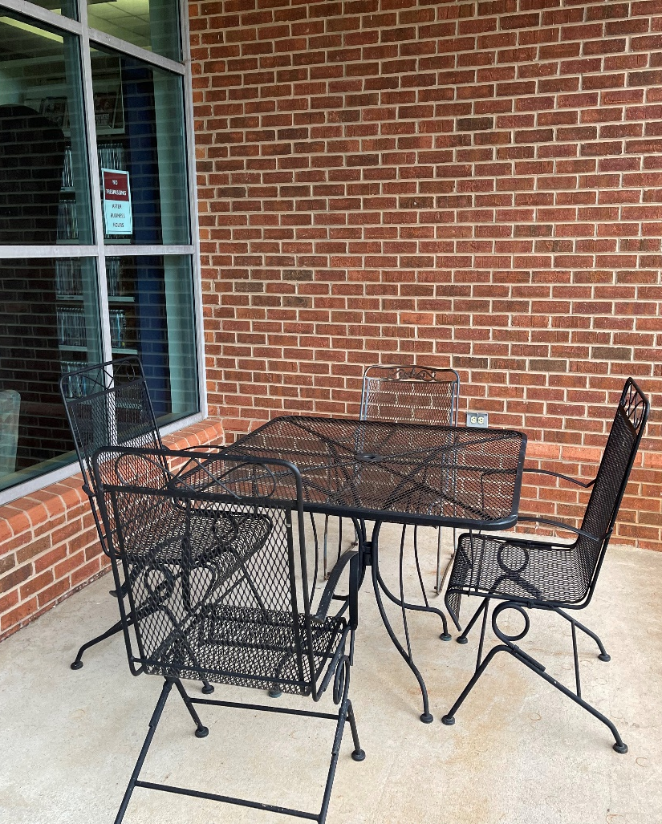
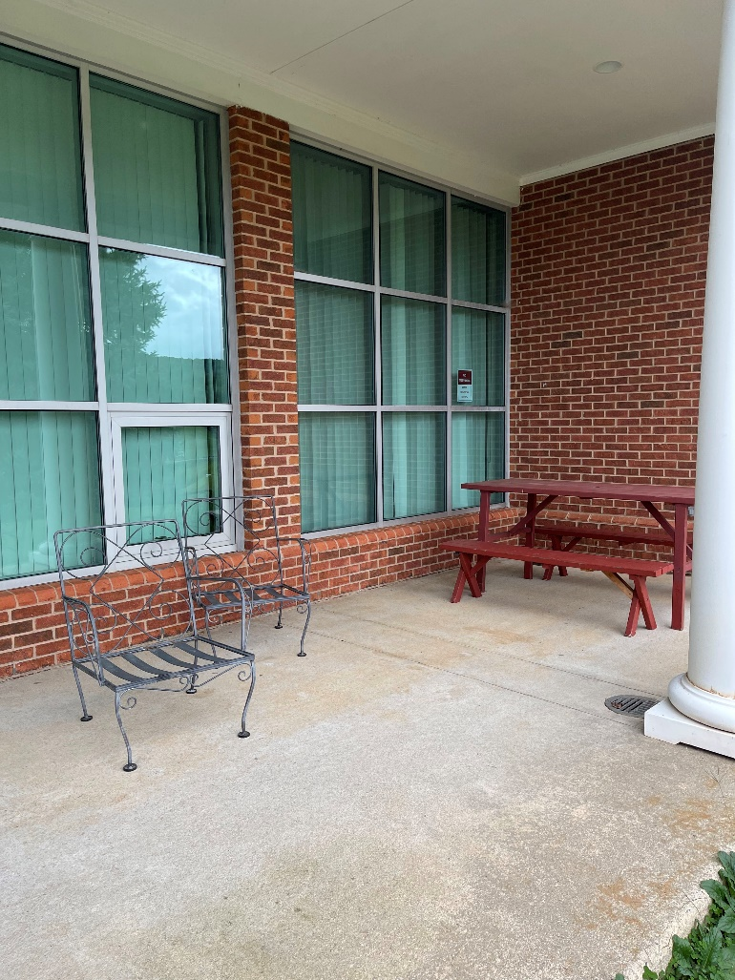
More Outdoor Enjoyment

Slide 13
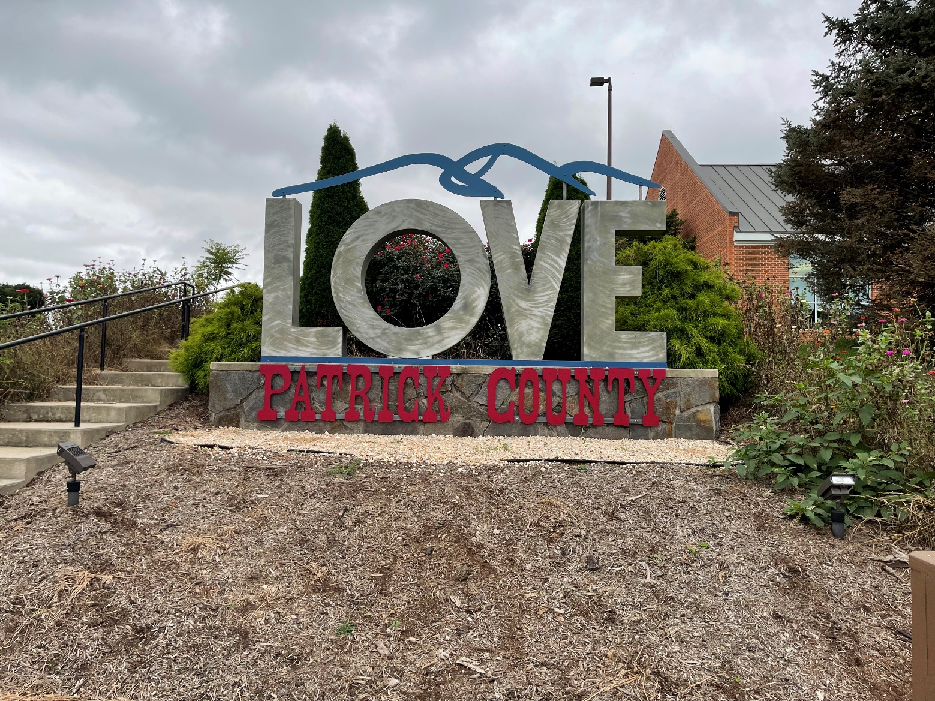
Virginia is for Library Lovers

Slide 14
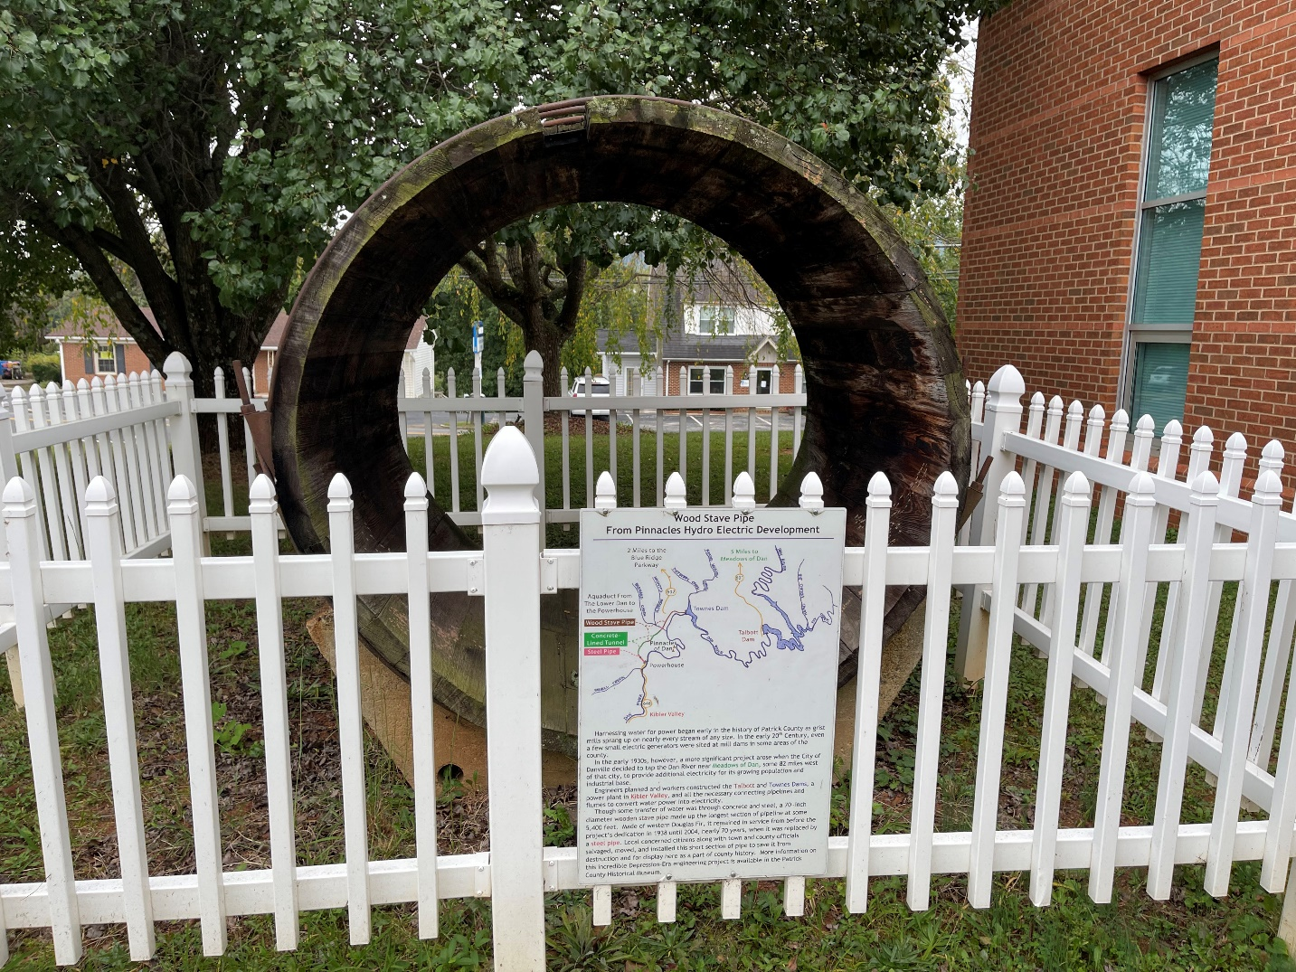
Special Features

Slide 16
Lesneski, T. (August 3, 2016). Why outdoor spaces are essential for the 21st-century library. Demco Interiors. https://www.demcointeriors.com/blog/why-outdoor-spaces-are-essential-for-the-21st-century-library/ Mathews, Brian and Soistmann, Leigh Ann. (September 30, 2020). Encoding space: Shaping learning environments that unlock human potential. American Libraries. https://americanlibrariesmagazine.org/2020/09/01/encoding-space-library-design/. Rubin, R. E. and Rubin, R. G. (2020). Foundations of library and information science (5th ed.). Blue ridge regional library. (2012). Patrick county branch library. Retrieved October 14, 2021,from https://www.brrl.lib.va.us/branch.php?id=4. Patrick County Virginia history. (2021). Patrick county historical society and museum. Retrieved October 14, 2021, from https://patcovahistory.org/. Trattner, D. (n.d.). Colonial architecture. HGTV. https://www.hgtv.com/design/decorating/design-101/colonial-architecture
Citations:

