Slide 1
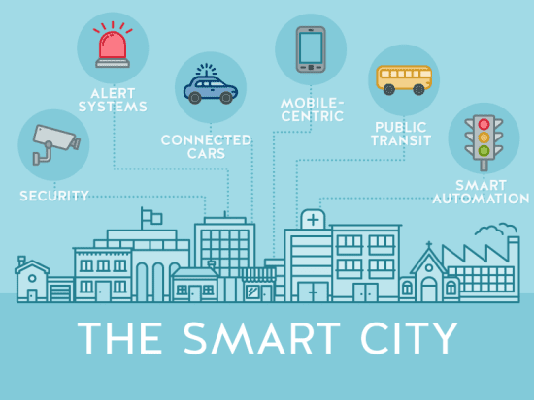
Cybersecurity in Smart Cities

Slide 2
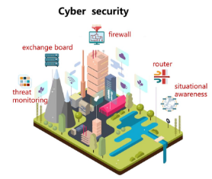
Defining Smart Cities
What is a Smart City?
Smart cities incorporate technology and data into daily life. It upgrades transportation, energy, and public safety by connecting to systems that interact with each other.
Key Features of Smart Cities
IoT devices are found on sensors of streetlights, data streaming on buses, and tracks energy use minute by minute. Data analytics combine this information as a guide, and with interconnected infrastructures, cities function efficiently and become sustainable for people

Slide 3
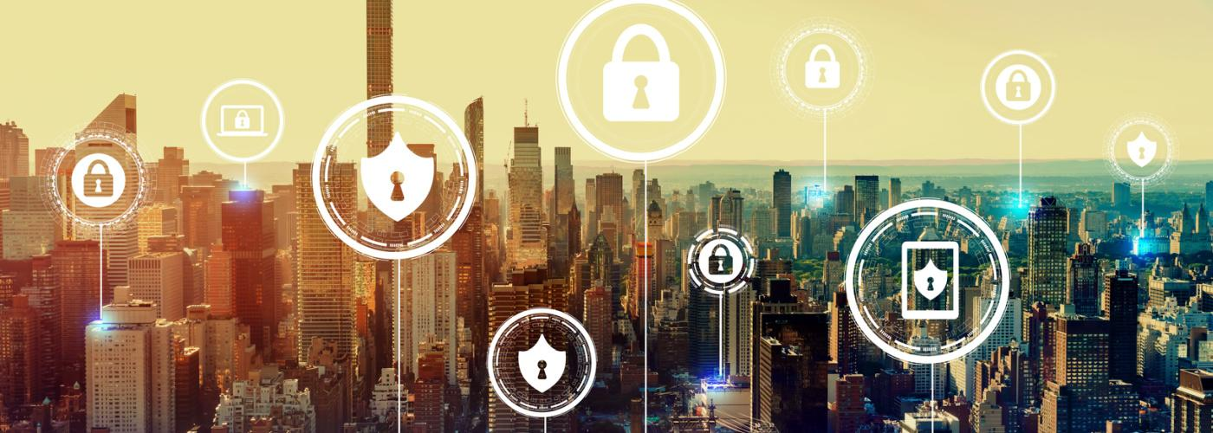
Cybersecurity in the Urban Landscape
02
The Growing Threat in Smart Cities
Why Cybersecurity Matters in Smart Cities
As smart cities infrastructure expands, weak spots continue to increase they cybersecurity risks. Since everyone and everything is connected, this allows hackers to find more ways into systems.
Cybersecurity keeps data, systems, and people safe. A single breach can shut things down, it’s expensive, threatens safety, and shakes people’s trust in the system.

Slide 4
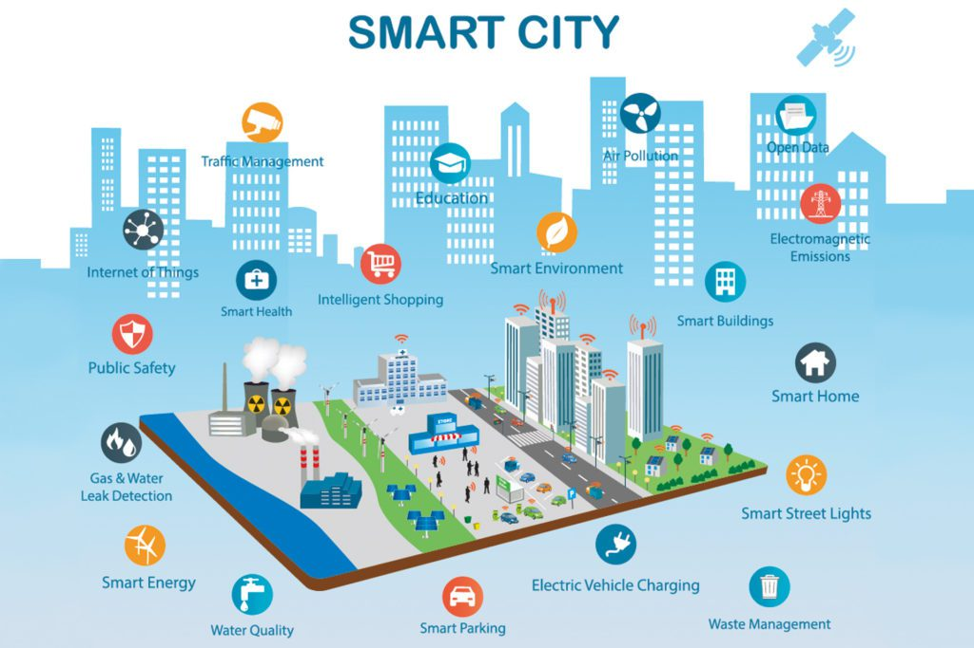
Technologies That Power Smart Cities
Internet of Things (IoT)
IoT sensors gather and send data out to allow system monitoring and control. Having security and data privacy for these devices can be a challenge.
Data Analytics and Cloud Computing
Data analytics use information to find patterns we can use to make better plans for the cities. Cloud computing allows us to store and share this data better. Still, data breaches or sudden service outages can happen.

Slide 5
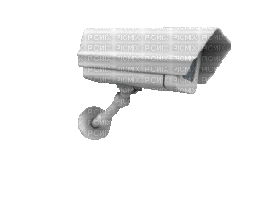
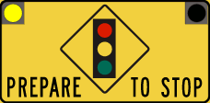
The Vulnerabilities in Smart Cities
Examples of Vulnerabilities
Weak Points
Hackers often target weak spots like insecure IoT devices, outdated software, and network vulnerabilities. When they break through, they can take control of a system and do damage.
An example of this would be traffic lights getting hacked, surveillance cameras being hijacked, or power grids being attacked. They show just how much damage a single vulnerability can cause.

Slide 6
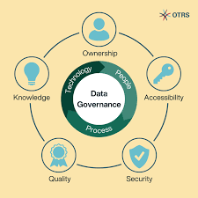
Privacy Concerns and Data Governance
Citizen Data Collection and Usage
Importance of Data Governance and Regulation
Smart cities systems can collect large amounts of data about people. This creates real privacy concerns like data leaks, constant surveillance, or someone abusing someone's personal information.
Data regulation is important to maintain privacy and enforce strict policies for managing data. People want to know what’s happening with their information. That’s the only way to build integrity and trust for the smart cities systems.

Slide 7
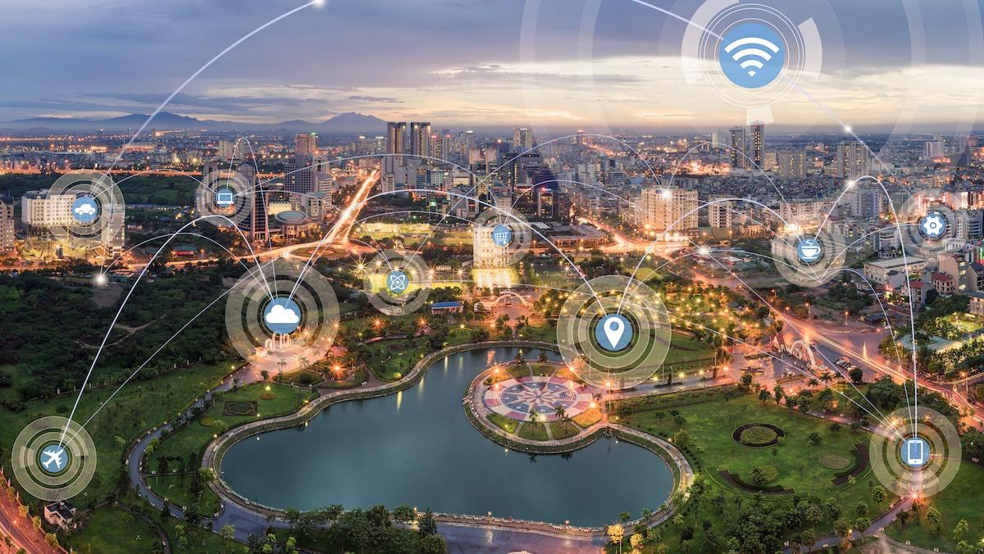
Ethical Considerations
The Ethics of Smart City Technologies
AI-driven decisions and personal data collection and use in smart cities raise some ethical concerns. Bias and discrimination can happen and go unnoticed. This can lead to figuring out who is responsible if the system makes a mistake.
Ensuring Fairness and Transparency
To create fair systems, we need to make sure the algorithms are not bias. We must be open about how smart city data is processed because it helps build trust with the public.

Slide 8
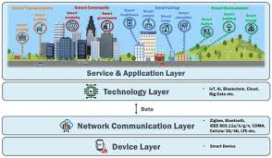
Cybersecurity Framework in Smart Cities
Importance of Cybersecurity Strategies
A good security strategy keeps smart cities safe and brings all the technologies together. It can also help build strong and organized teams and policies, which work side by side.
Elements of a Security Framework
Enforcing security protocols, having clear response plans to incidents, and ensuring everyone knows what to do is very important for cybersecurity. Having regular audits and updates prepares cities for future threats.

Slide 9

Information Sharing in Smart Cities
Strengthening Collective Security
Information Sharing is Important
Information sharing between all devices and institutions is important to make a smart city efficient and secure. Shared resources can improve threat intelligence and coordinated responses.
Collaboration enhances overall security and promotes a culture of cybersecurity awareness.

Slide 10
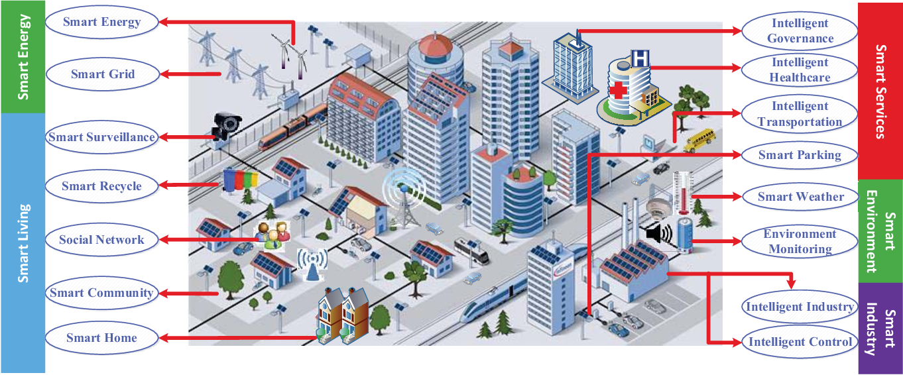
Addressing Future Challenges in Smart Cities
Addressing Evolving Threats
Staying Ahead of Cyber Threats
Being prepared for new types of cyber threats that target smart city systems is vital. We need constant innovation and to always be ready for the next threat.
Making cybersecurity part of the culture and keeping the conversation going about cyber threats to the smart cities can help us stay one step ahead. Make sure to share what you learn and stay current.

Slide 11
Thank You

