Slide 1
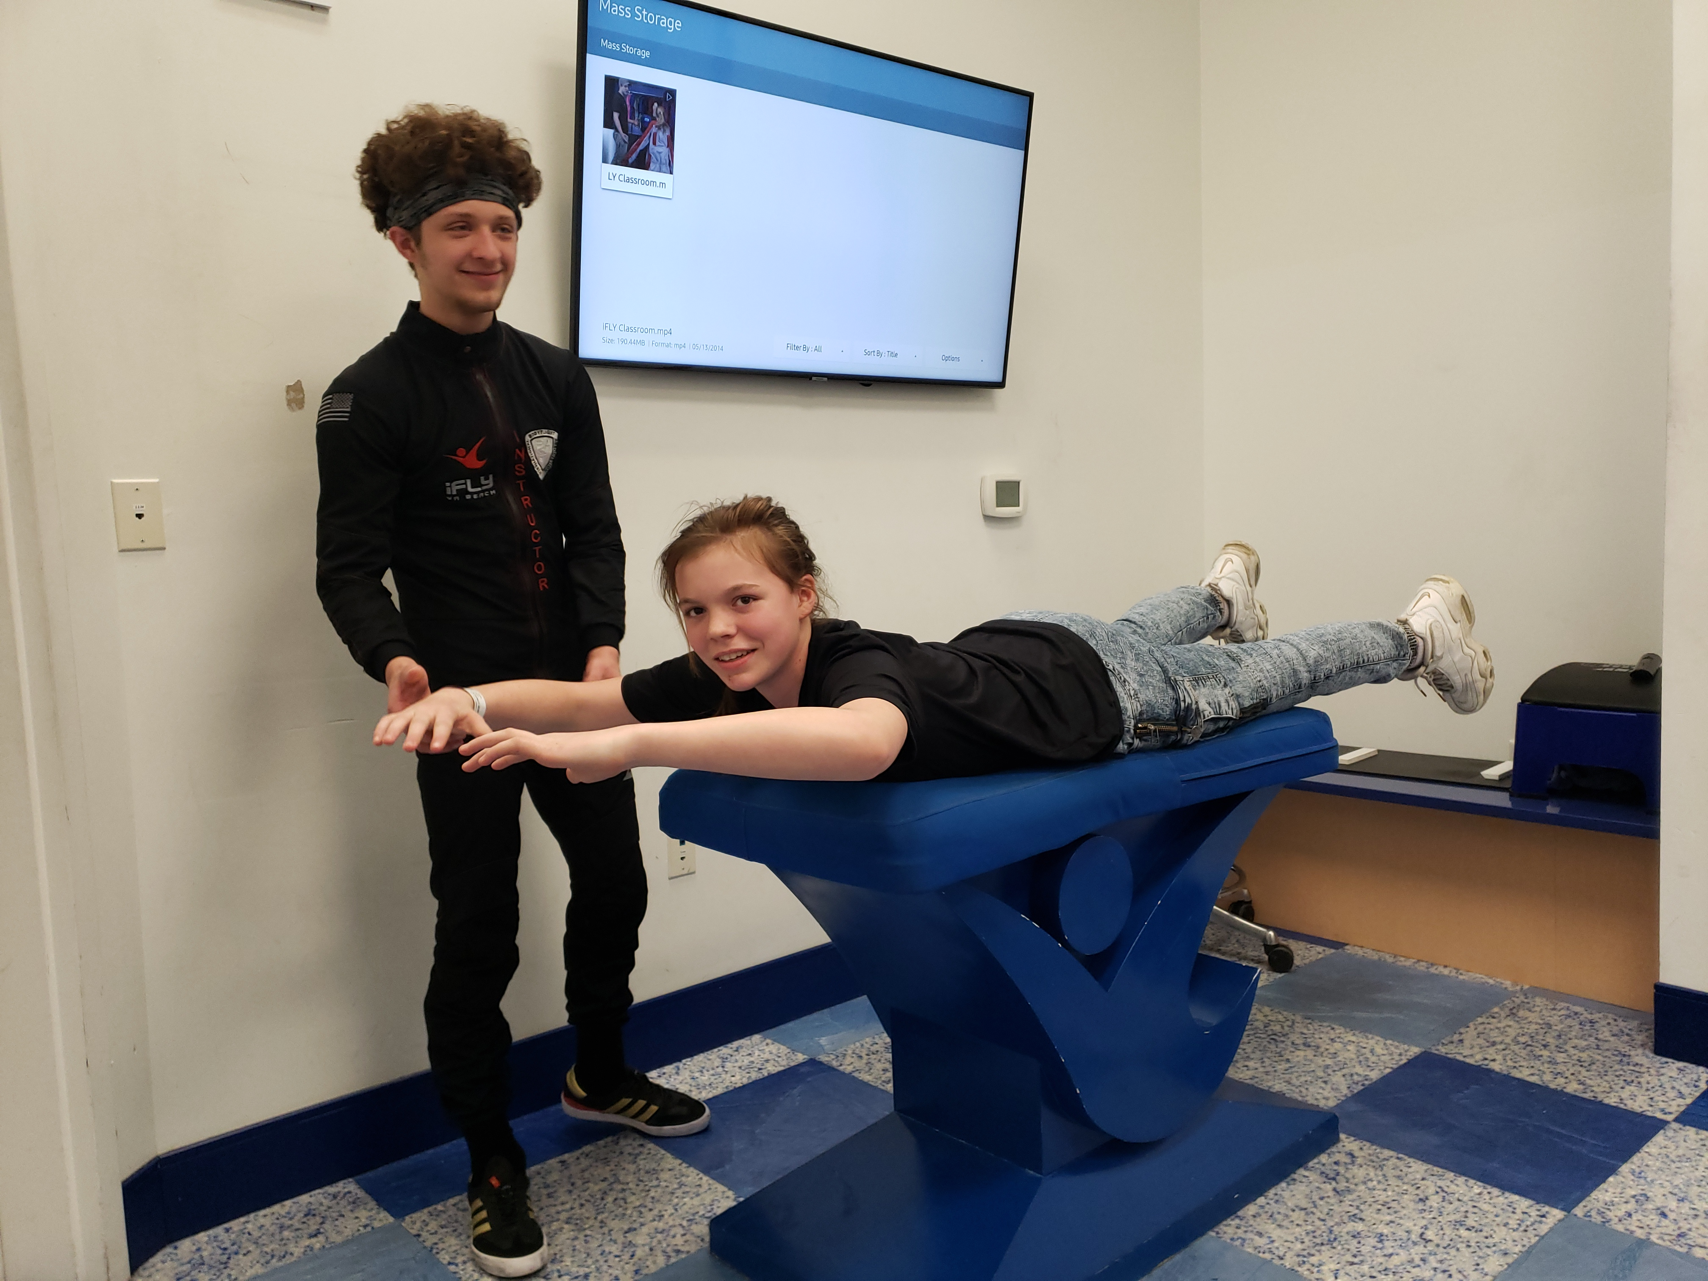
How would you learn to skydive?
First you might go to an indoor Sky diving arena and learn how to hold yourself and get acclimated to feeling of flying.

Slide 2
And then you would graduate to Tandem SkyDiving

Slide 3
Finally you would be able to take the plunge all by yourself!

