Slide 1
Certificates Showing a Road Map to Protection and Leadership

Slide 2
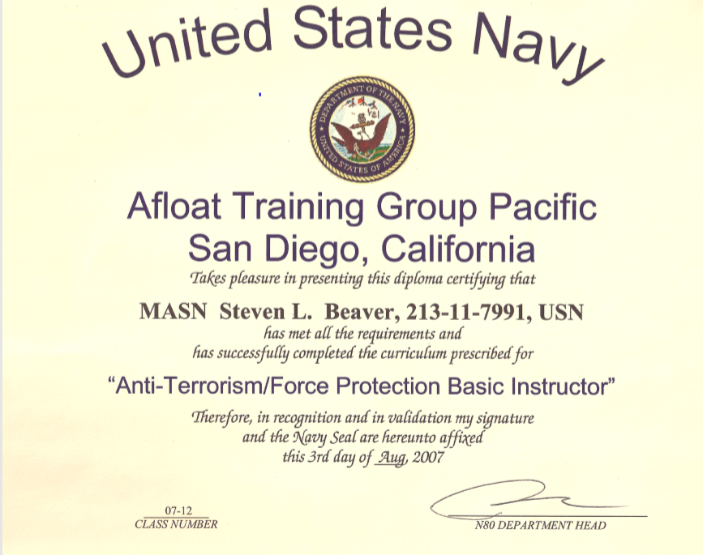
Certificates Showing a Road Map to Protection and Leadership

Slide 3
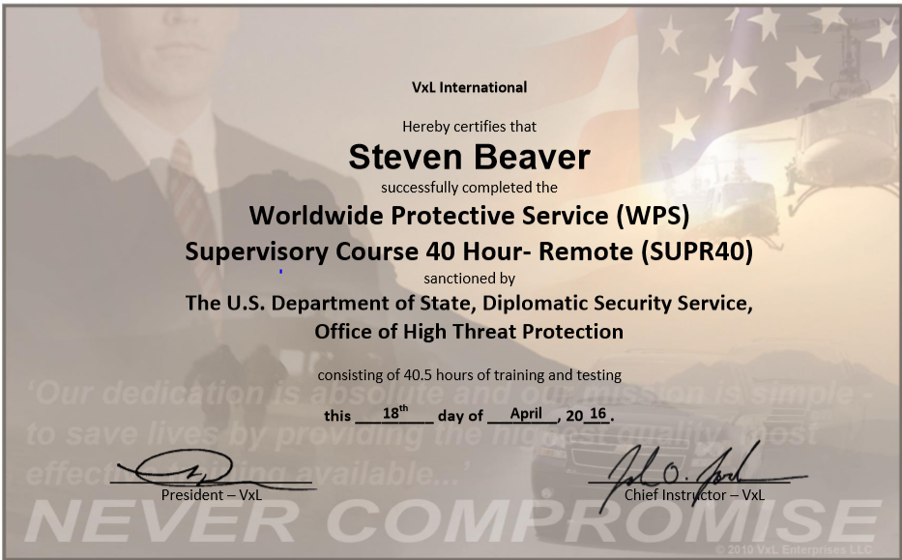
Certificates Showing a Road Map to Protection and Leadership

Slide 4
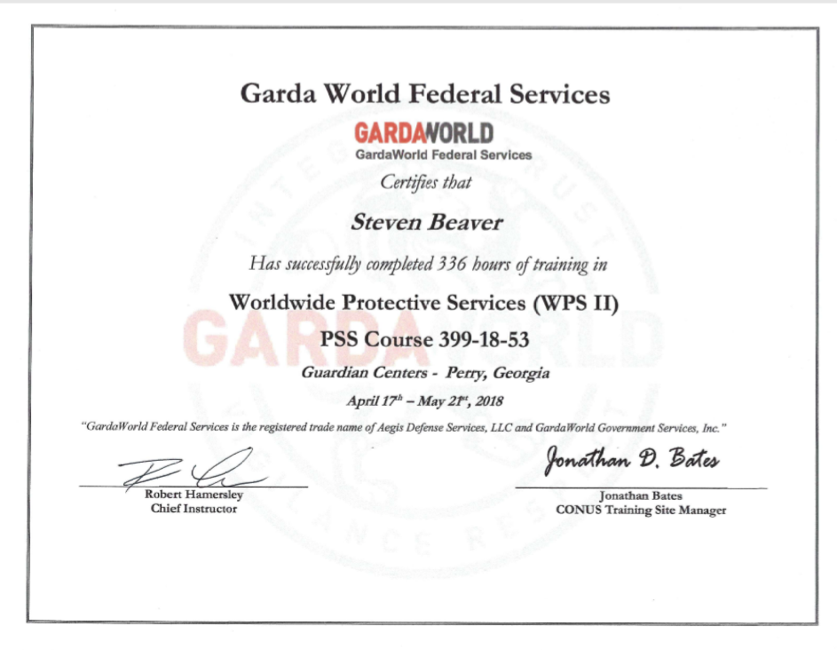
Certificates Showing a Road Map to Protection and Leadership

Slide 5
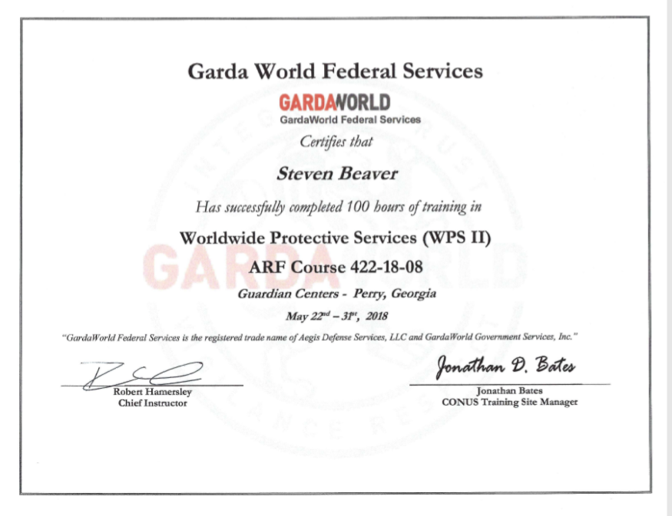
Certificates Showing a Road Map to Protection and Leadership

