Slide 1
What is a virus and how does it spread?

Slide 2
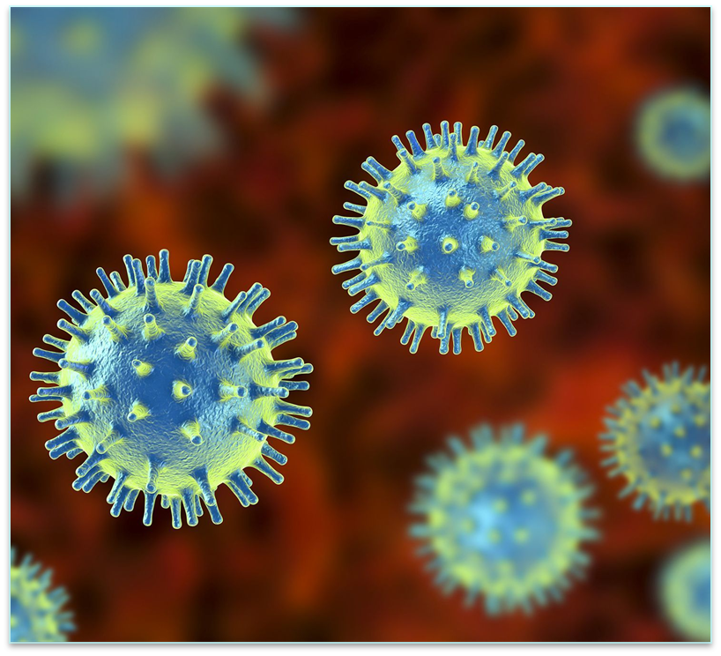
What is a virus?
A virus is a microscopic agent that replicates inside of a host cell.
AKA a virus is a very tiny germ that makes cells sick
More than 100,000,000 viruses can fit on the tip of your pen
What are some examples of viruses?
Covid-19
Flu
Cold
https://www.nationalgeographic.org/encyclopedia/viruses/
Group 1

Slide 3
Structure of a Virus
Structure of a virus varies
Something all viruses contain is a capsid where its viral DNA or RNA is contained
These come in many different shapes
Another structure us a capsid that is enveloped with part of the host cells membrane to better hide during infection
Is a virus living?
NO!
Viruses aren’t considering living because they cannot reproduce without a host cell.
Group 1

Slide 4
How does a virus spread?
Viruses spread many ways
A virus can infect you by entering any opening in your body such as your mouth, nose, and cuts.
Infected food
Touching your mouth and nose
Breathing in air around someone who’s sick
not washing your hands
Molly

Slide 5
Getting into the cell
Membrane Based Fusion
Specifically for enveloped viruses
Or viruses that have their genetic information enclosed by a membrane that has come from or is like the host cell
Hitching a ride through the cell membrane
Hijack the natural process of the cell to have the virus be accepted through endocytosis
After the Virus has been packaged it fuses with the membrane that let it inside the cell
Byron

Slide 6
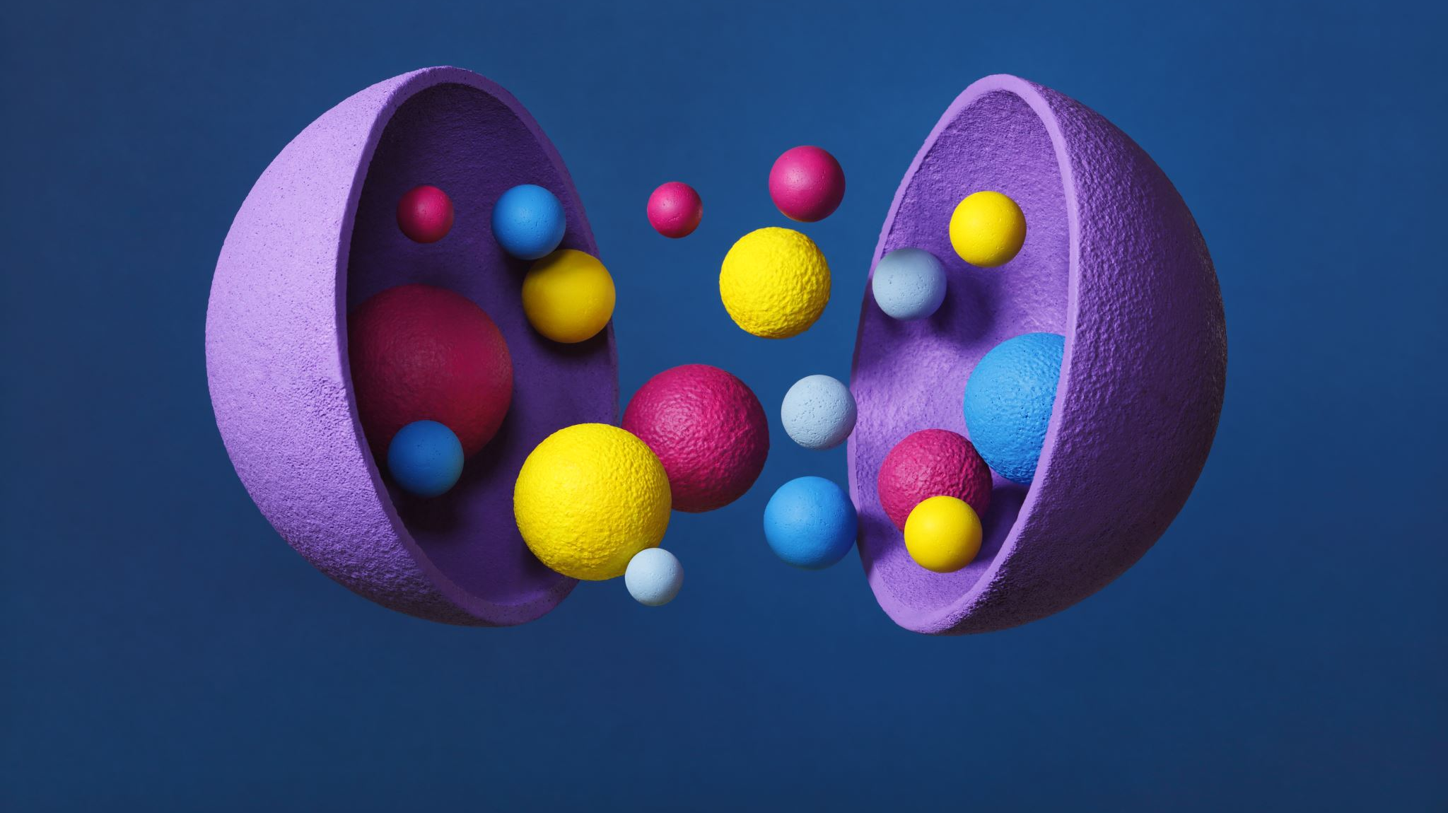
The DNA and RNA from the virus then enters the host cell and invade the nucleus

Slide 7
Virus implants DNA & RNA
e

Slide 8
What is dna and rna?
Madelyn Jones
DNA IS GENETIC MATERIAL THAT TRANSFERS TO OTHER CELLS
RNA IS THE STORED BLUEPRINT TO THE GENETIC MATERIAL
[THOUGHTCO]

Slide 9
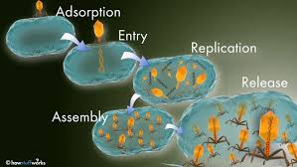
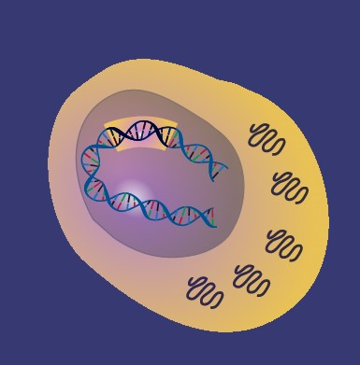
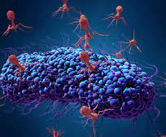
DNA REPLICATING IN THE CELL
After the virus has entered the host cell it will start to replicate its genetic information.
Then the virus will make new copies of the virus inside the host.
Rick Seal

Slide 10
The virus infects the cell to infect millions of other cells
Virus attacks a healthy cell
The Infected cell explodes, releasing thousands of new virus particles
Copies infect other healthy cells
Karlie Pritchard

Slide 11
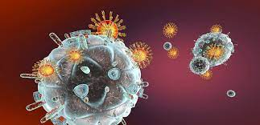
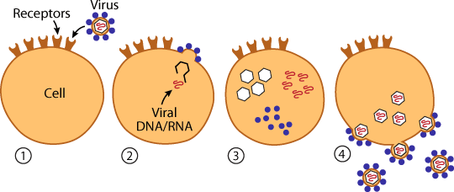
Copies of the virus and how they're created
Karlie Pritchard

Slide 12
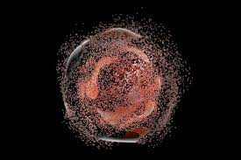
Infected cells are damaged or die
Courtney Haney
Faith Lawrence
Most viral infections result in death of the host cell
2 kinds of death: apoptosis and necrosis
Viral replication can cause biochemical and structural changes in cell
Can change cell functions
Some viruses do not cause any apparent changes to the cell
Notes:
Necrosis is the death of body tissues. It occurs when there is little blood flow to the tissue and cannot be reversed. It's also known as "premature" cell death.
Apoptosis is the elimination of cells without releasing harmful substances. It plays a crucial role in developing and maintaining the health of the body by eliminating old cells, unnecessary cells, and unhealthy ones. It's also known as "programmed" cell death.

Slide 13
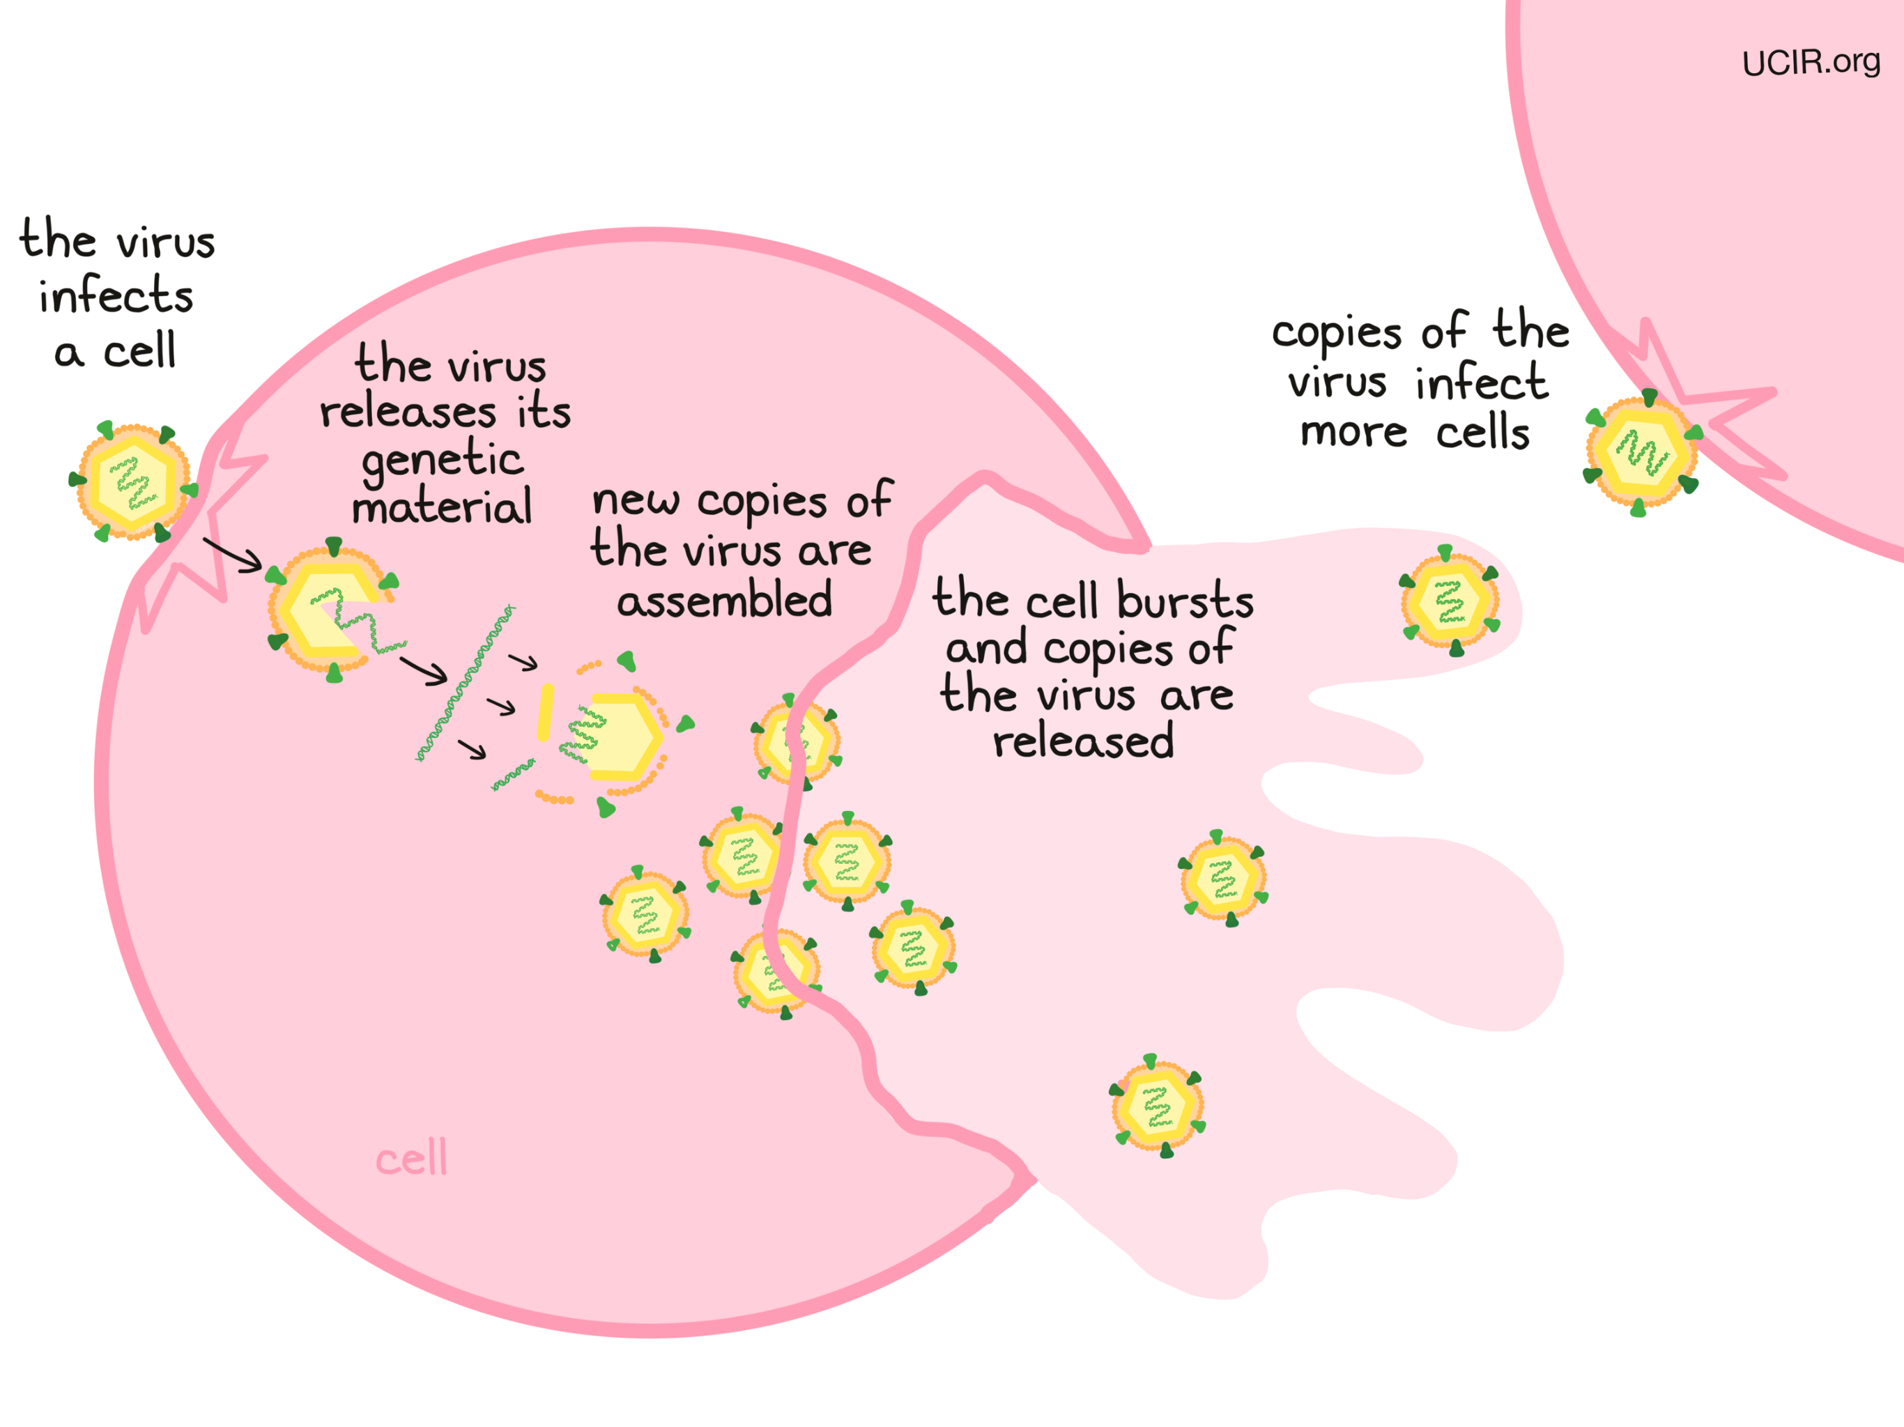

Slide 14
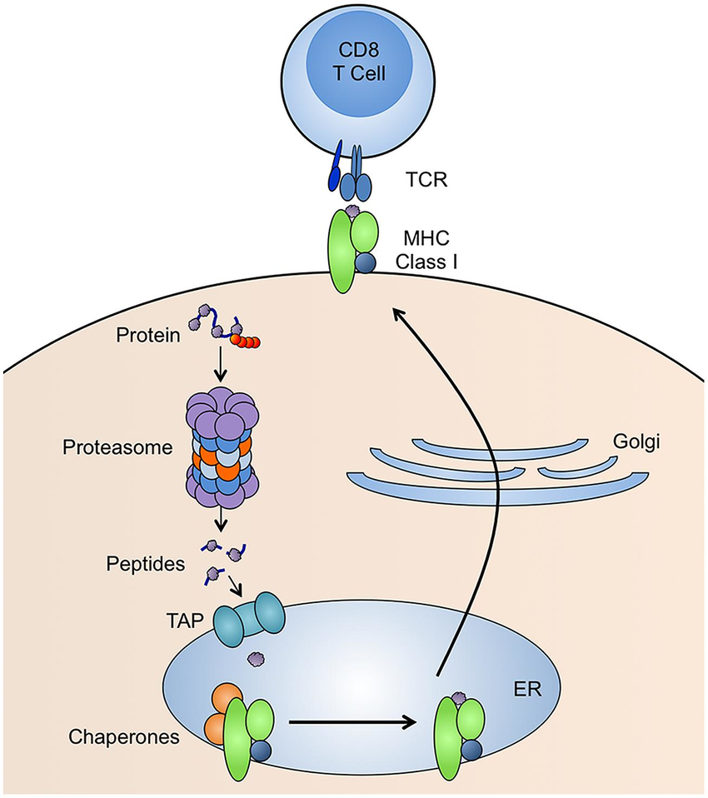
How a Virus is detected: MHC Class I
Once a virus has invaded a host, the immune system cannot "see" the virus and has no idea that the body has been invaded.
Class I major histocompatibility complex proteins (MHC class I) is employed
MHC class I displays protein pieces from inside the cells upon its surface
Unfortunately, some viruses have stopped MHC Class I
Lydia
(McCarthy et al. 2015)

Slide 15
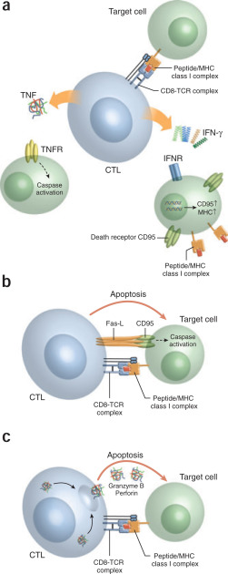
HOW A VIRUS IS DETECTED: Cytotoxic T-Cell
Cytotoxic T cells circulate the body killing cells infected with viruses with toxic mediators.
T cell receptors proteins recognize antigenic peptide
When the receptor detects a peptide from a virus, the virus is detected
T Cells release cytotoxic factors killing infected cells
(Andersen et al. 2006)
Lydia

Slide 16
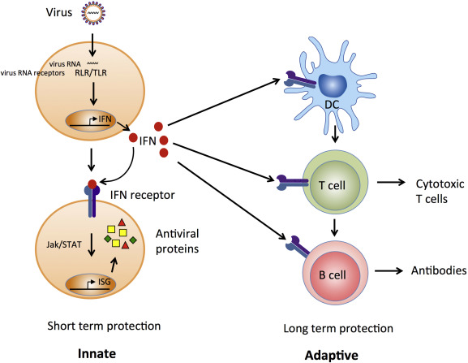
Innate immune response: Interferons
Once infected cell produce interferons.
These are small proteins that prevent further replication of viruses.
They act as signaling molecules warning nearby cells of viral presence.
Neighboring cells:
start producing anti-viral proteins which prevents viral replication
Increase number of MHC class I molecules
(Robertsen, 2018)
Javen

Slide 17
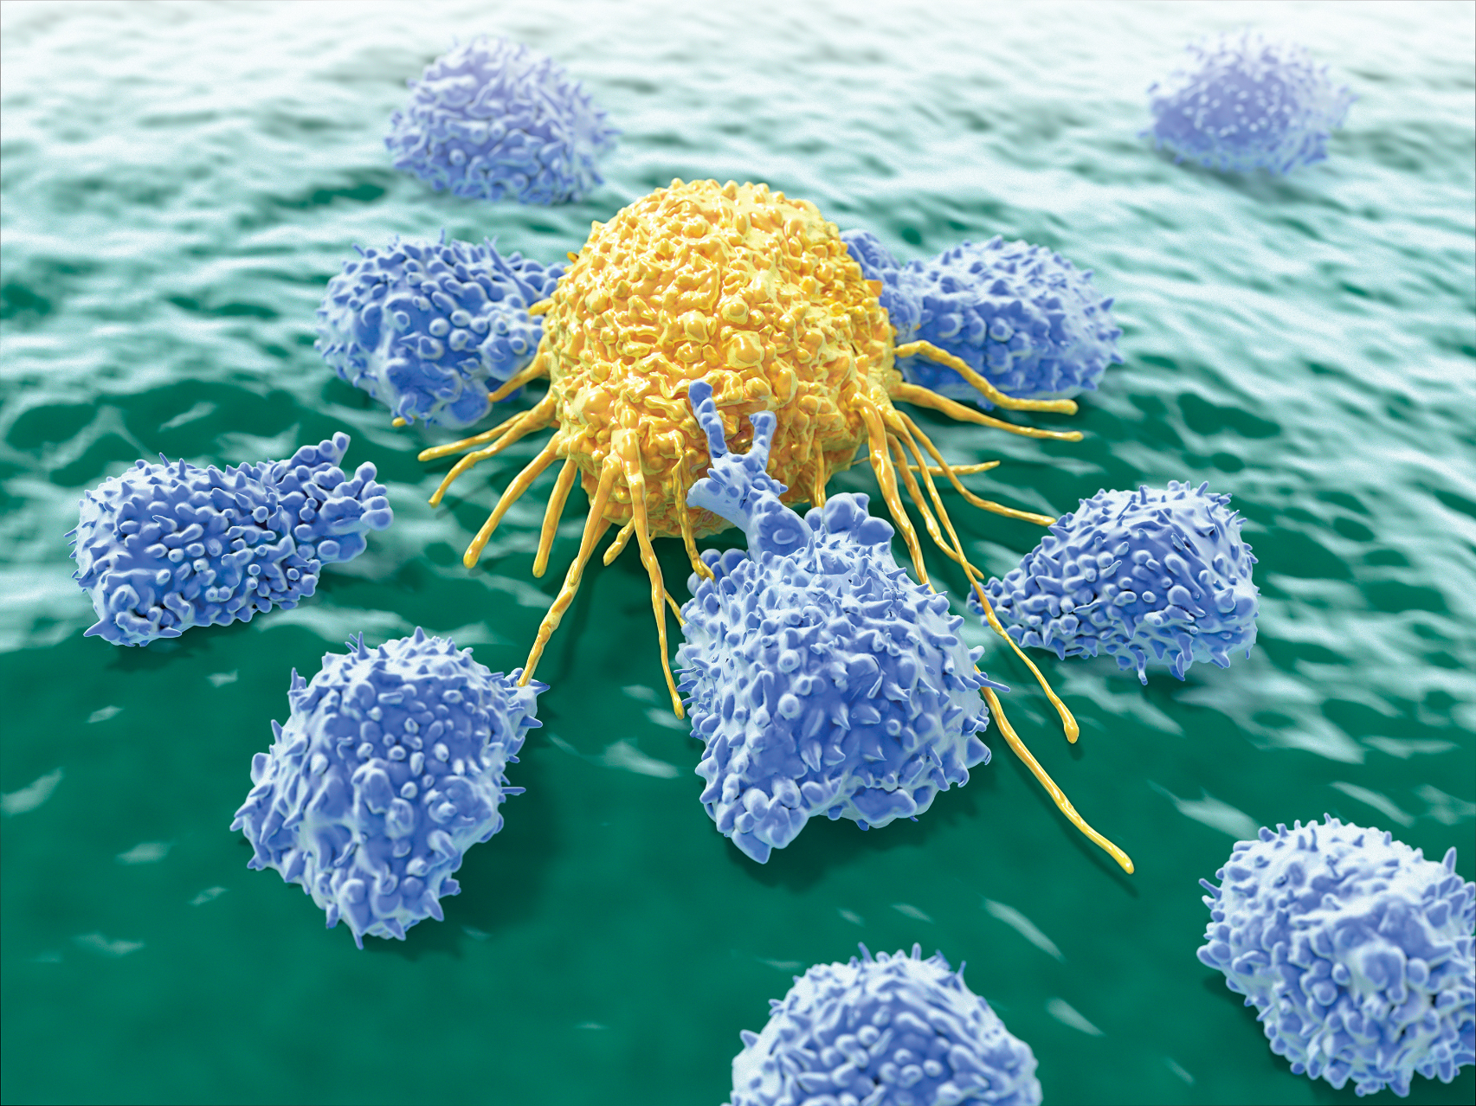
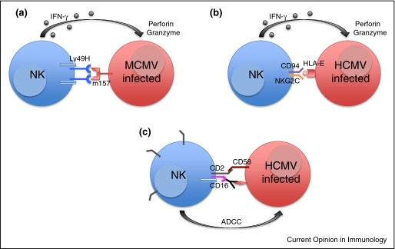
Natural Killer (NK) Cells
Part of the Innate Immune Response.
Recognize the virus on MHC class I molecules.
They will release toxic substances, which kill infected cells.
Viruses could prevent the production of MHC Class I molecules
NK Cells will recognize the lack of MHC Class I molecules
(Levy, 2019)
(Lam et. Al 2017)
Jacob

Slide 18
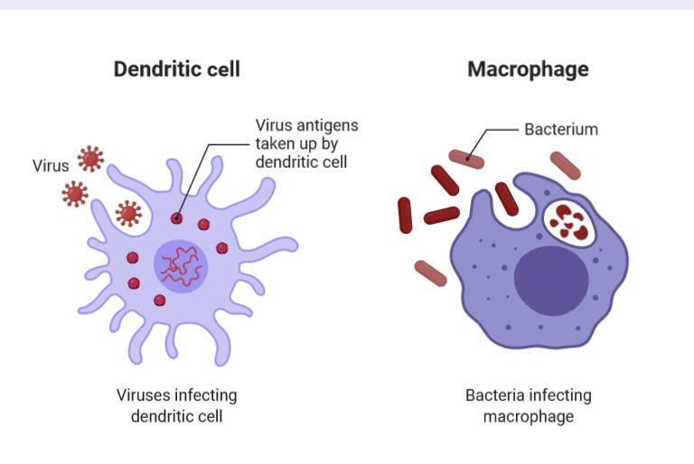
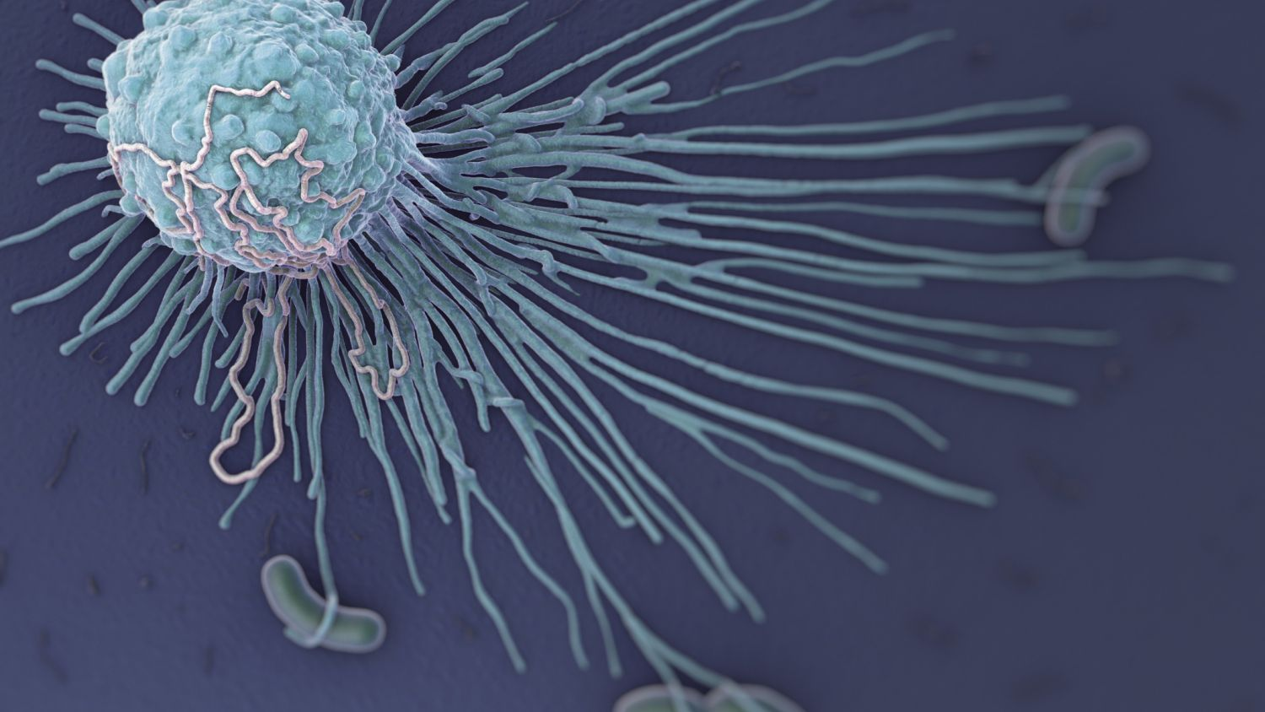
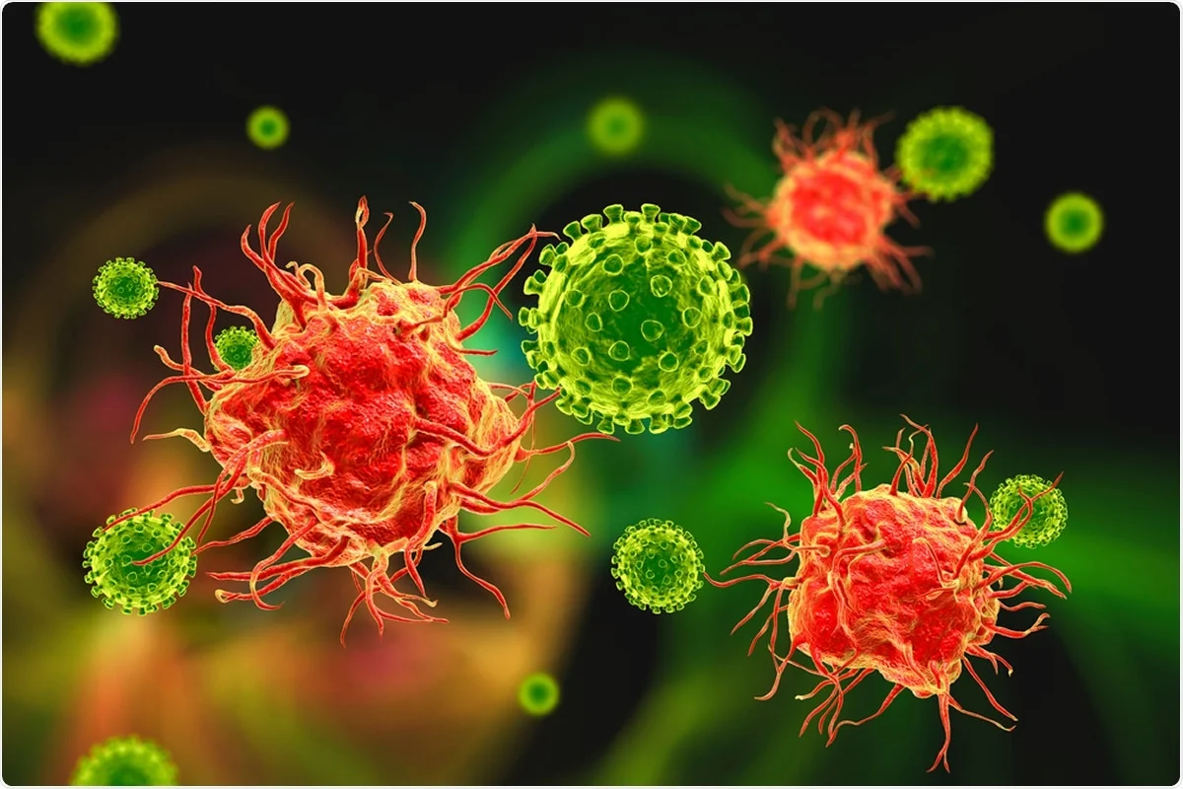
Antigen-presenting cells
Allow the virus to be recognized by cells used in the immune response system.
Macrophages – Ingests free floating viruses, breaks the virus down, and releases the material as waste. (They will also signal the adaptive immune response, when it recognizes a virus)
Dendritic cells – Allows the virus to be detected by T-Cells (Used to kill infected cells).
Jacob

Slide 19
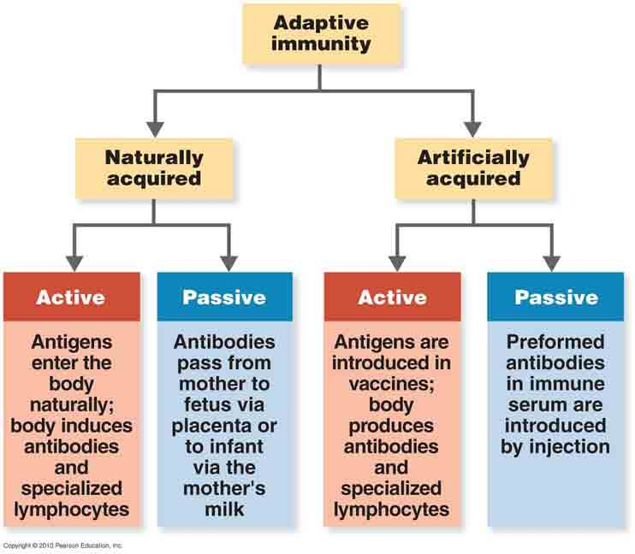
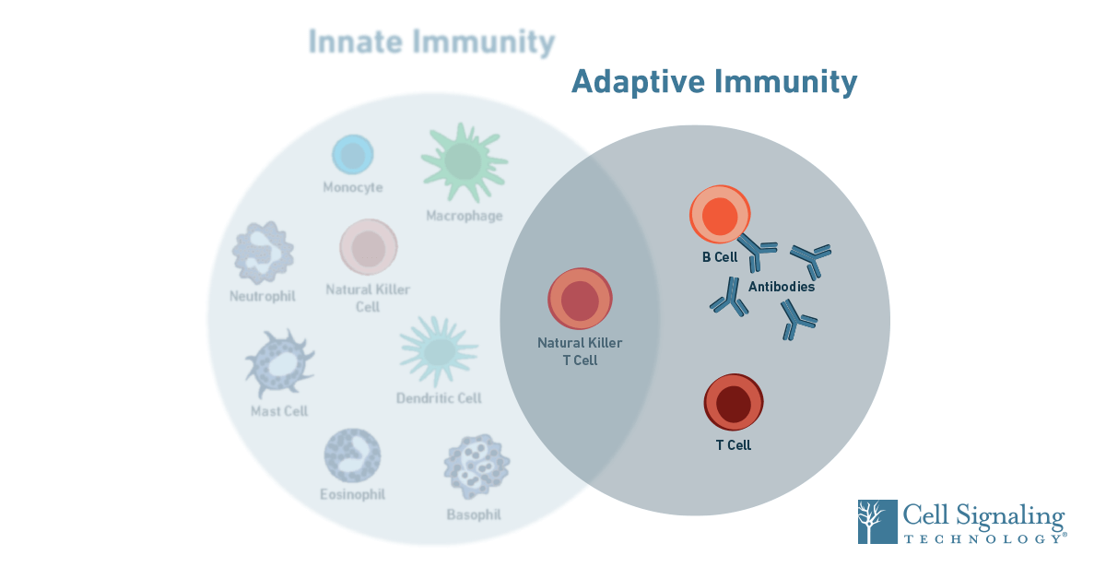
Adaptive Immune response
It is a more complex response compared to an innate immune response
Long lasting protection
The function is to eliminate/destroy invading pathogens, so it is important that this response is triggered by foreign molecules rather than the host
Able to distinguish between host and pathogen
Failure of distinction leads to autoimmune diseases
Javen

Slide 20
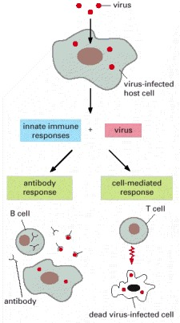
Cell mediated immunity
Does not depend on antibodies
Focuses more on intracellular pathogens
Driven by the lymphocytes: mature T cells, macrophages, and the release of cytokines in response to an antigen
Antigen presenting cells that have membrane bound MHC class I proteins that are used to recognize cells that have foreign antigens
The binding is necessary for maturation from naive T cell into helper/killer T cells
Step 1: T cells respond to the antigens from pathogens by binding to the epitopes on the protein
Step 2: antigens can be displayed on the membrane bound MHC class I protein on infected cells which also binds to T cells
Step 3: The T cells becomes activated and forms clones
Step 4: Helper t cells with the CD4 protein - activates other T cells and B cells and Cytotoxic T cells - produce cytokines that kill the cell via apoptosis
Ravali

Slide 21
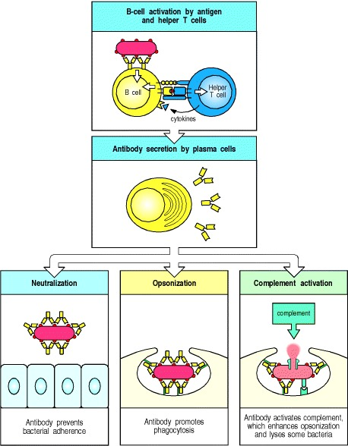
Humoral (anti-body mediated) Immunity
Antibody immunity
Focuses on extracellular pathogens
B Cells - produce antibodies
Antigen presenting cells that have membrane bound MHC class II proteins that are used to identify pathogens after a phagocyte engulfs a molecule
Memory cells which are stored in the lymphatic system from previous exposure also helps fight by producing antibodies if the body has been exposed before
Ravali

Slide 22
Reference slide
Dr. Biology. (2011, February 16). Viruses. ASU - Ask A Biologist. Retrieved October 12, 2021 from https://askabiologist.asu.edu/virus
Virus Structures. (2021, March 6). https://bio.libretexts.org/@go/page/6606
•Cohen, Fredric S. “How Viruses Invade Cells.” Biophysical journal vol. 110,5 (2016): 1028-32. doi:10.1016/j.bpj.2016.02.006
https://www.thoughtco.com/dna-versus-rna-608191
https://onlinelibrary.wiley.com/doi/10.1111/j.1365-2796.2010.02222.x
https://courses.lumenlearning.com/biology2xmaster/chapter/virus-infections-and-hosts/
https://www.immunology.org/public-information/bitesized-immunology/pathogens-and-disease/immune-responses-viruses
https://www.sciencedirect.com/science/article/pii/S0022202X1532621X#f0030
https://www.researchgate.net/figure/MHC-class-I-antigen-presentation-pathway-Proteins-with-ubiquitin-tags-red-spheres-are_fig2_272512098
https://www.sciencedirect.com/science/article/pii/S0145305X17300769
https://www.nationalgeographic.org/encyclopedia/viruses/
https://www.sciencedirect.com/science/article/abs/pii/S0952791516301510
https://www.ncbi.nlm.nih.gov/books/NBK21070/
https://www.ncbi.nlm.nih.gov/books/NBK10762/
https://www.ncbi.nlm.nih.gov/books/NBK10752/
https://www.technologynetworks.com/immunology/articles/humoral-vs-cell-mediated-immunity-344829
https://app.biorender.com/biorender-templates/t-5f7c7d573b9a9000abcfa12e-different-types-of-antigen-presenting-cells

