Slide 1
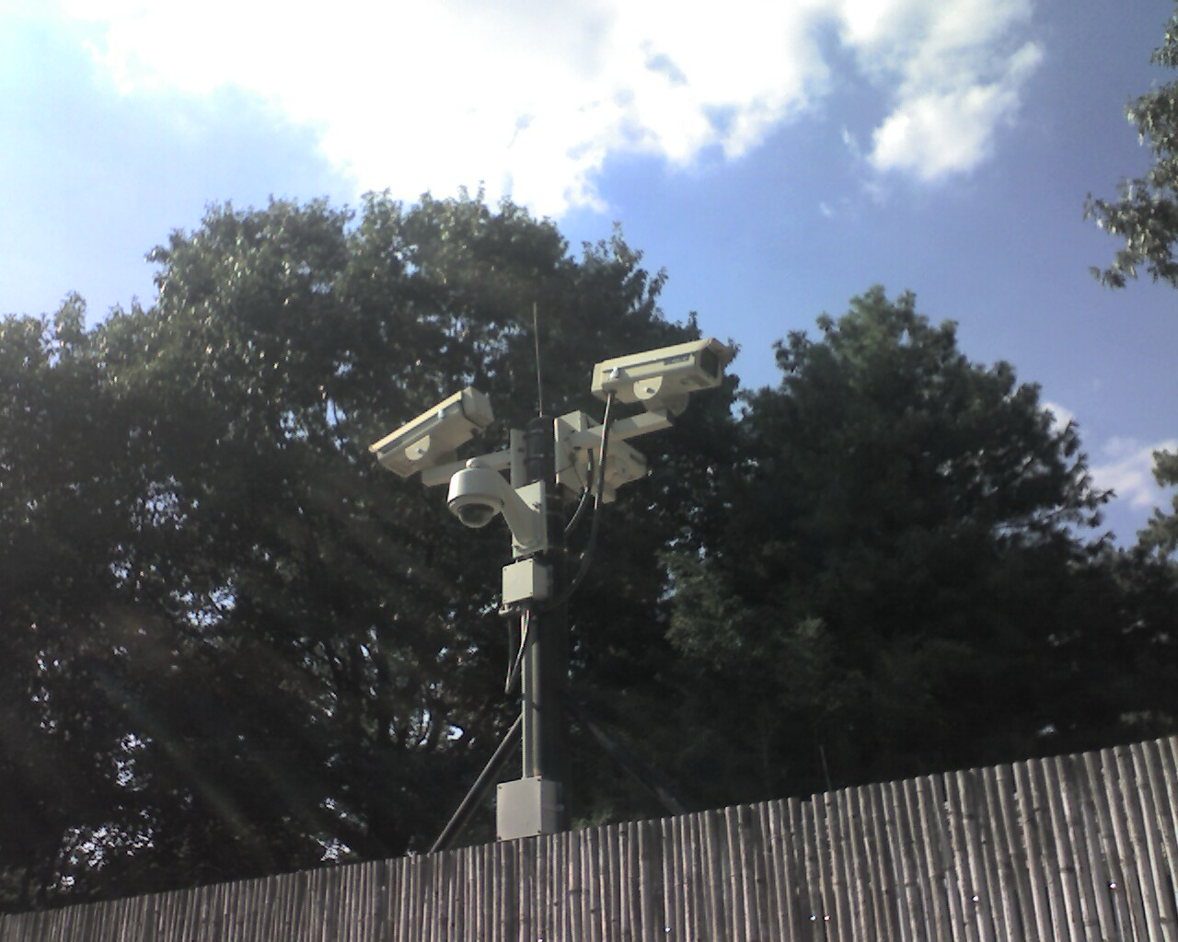
How would your behavior change if you knew you were being watched every second you stepped outside your home?
How does China’s surveillance system impact its citizens and influence their daily lives?
I chose this topic because China's surveillance system goes beyond public safety. It has a major effect on tracking citizens' travels, keeping an eye on their habits, and even influencing their thoughts and actions. In everyday life, this degree of control brings up major concerns about freedom, privacy, and human rights.

Slide 2
Surveillance and Privacy loss
China's surveillance technology crosses over citizens' privacy by keeping an eye on nearly every part of your daily life.
- Citizens are constantly watched, which changes how they act, speak, and even think in public and private settings.
“The government uses over 500 million CCTV cameras, many equipped with facial recognition, to monitor public spaces” (Mozur, 2019).
“Private conversations and online activity are tracked through apps like WeChat, which shares user data with authorities” (Liang, 2018).

Slide 3
Behavioral Monitoring Through Social Control
China's social credit system uses data gathered from monitoring to recognize and discourage behavior in order force conformity.
“Citizens can lose travel rights or job opportunities for low scores, which may result from unpaid bills or criticizing the government” (Creemers, 2018).
“Those with high scores receive perks like fast-track services and better housing options:” (Kobie, 2019).
- Surveillance isn’t just about watching — it’s used to shape people’s lives, decisions, and social status.

Slide 4
The Impact on Mental Health and Freedom
Constant surveillance reduces personal freedom and has psychological effects.
“Studies show that surveillance creates fear, anxiety, and changes in behavior, especially among young people and minoritie” (Zuboff, 2019).
“Citizens avoid discussing sensitive topics or participating in protests, fearing consequences” (Bradsher, 2020).
Surveillance doesn’t just affect what people do — it affects how they feel, limiting freedom of expression and thought.

Slide 5
Conclusion
China's use of monitoring goes much beyond safety, it affects people's privacy, shapes how they behave through social control, and restricts their daily freedom.

Slide 6
References
Calzada, I.
"Citizens’ Data Privacy in China: The State of the Art of the Personal Information Protection Law (PIPL)." Smart Cities, vol. 5, no. 3, 2022, p. 57. MDPI, https://doi.org/10.3390/smartcities5030057.
"Greitens."
PRC Leader, https://www.prcleader.org/greitens.
Mozur, Paul, Muyi Xiao, and John Liu.
"One Nation, Under Surveillance." Scholastic Upfront, 19 Sept. 2022, https://upfront.scholastic.com/issues/2022-23/091922/one-nation-under-surveillance.html.
"Surveillance cameras" by Jay Tamboli is licensed under CC BY-NC 2.0.
Tang, Zhe.
"China Is Suffocating Citizens with Increasing Surveillance." Bitter Winter, 31 Aug. 2019, https://bitterwinter.org/china-is-suffocating-citizens-with-increasing-surveillance/.
"Power to PIPL: A Rundown of China's New Personal Information Protection Law."
Zasio, https://zasio.com/power-to-pipl-rundown-chinas-new-personal-information-protection-law/.

