Slide 1
Cybersecurity and Social Engineering
Bryce Staples

Slide 2
What is Social Engineering?
Social engineering is the use of manipulation to trick people into revealing confidential information.
It focuses more on human behavior rather than computer systems
Common goals of cyberattacks are to steal information, financial data, or personal information.

Slide 3
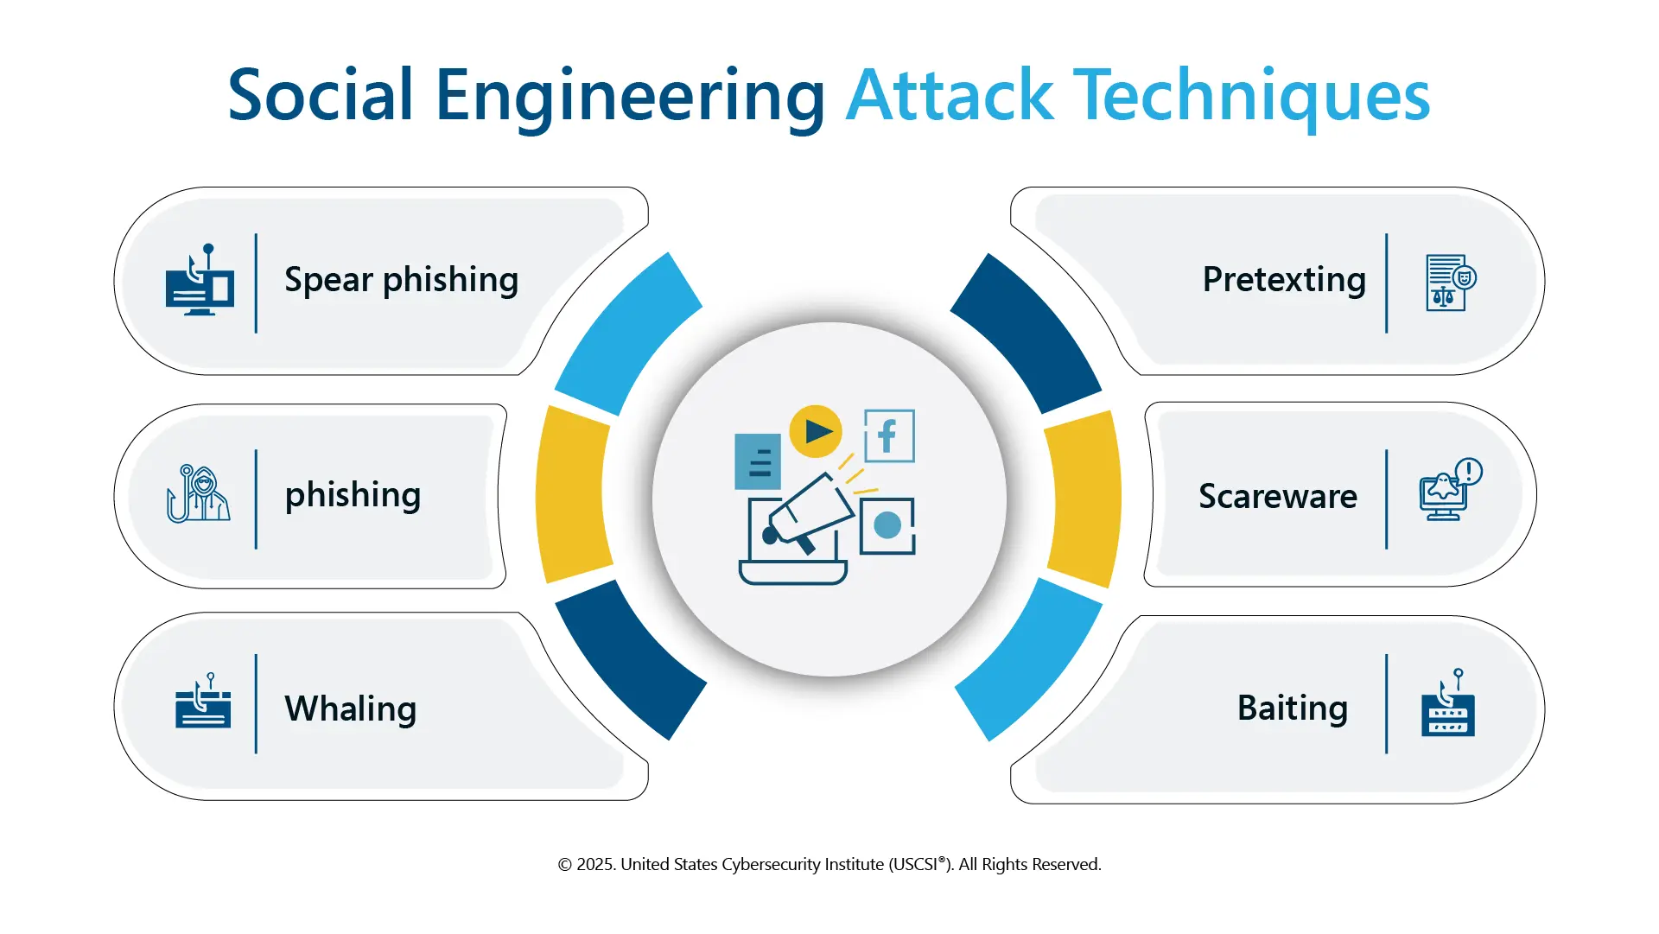
Social Engineering Tactics
Social engineering attacks use different tactics to trick someone into giving away their personal information, such as:
Phishing – fake emails or websites to steal information
Pretexting – pretending to be someone (IT or bank)
Baiting – tempting individuals with free downloads or prizes
Vishing – scams through phone calls
These types of attacks primarily rely on interaction with the victim
What are Social Engineering Attacks and How to Protect Against Them?

Slide 4
Psychological Underpinnings
Social engineering attacks are effective because they take advantage of basic human behavior.
Trust: attackers pretend to be people from legitimate organizations
Fear: messages warn of negative consequences, for example, losing access to an account
Urgency: pressure is used to make quick decisions without thinking
These psychological tactics make scams more believable and harder to detect.

Slide 5
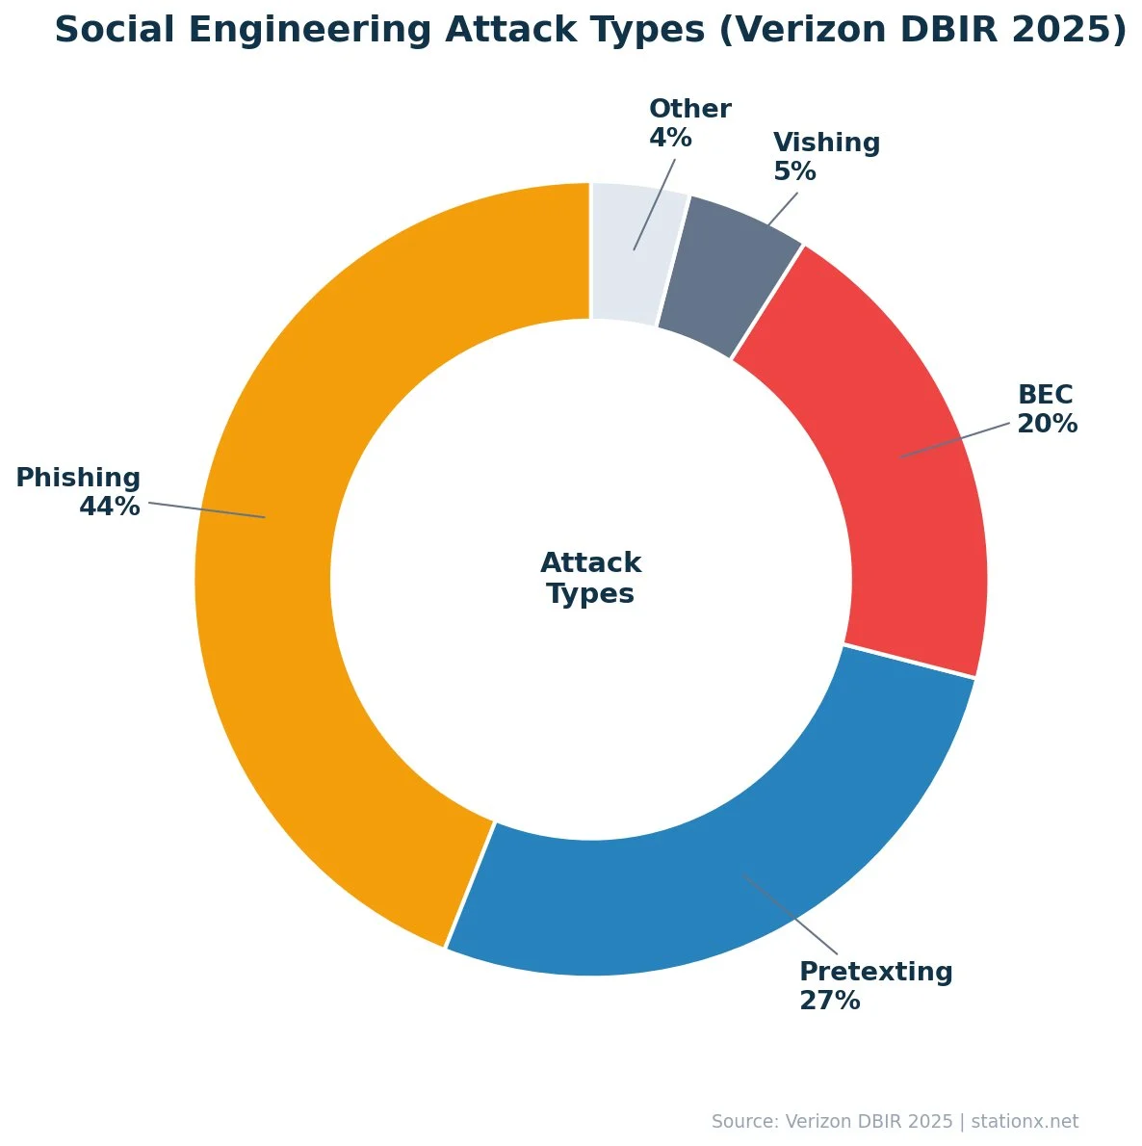
Real-World Example of a Social Engineering Attack
A common real-world example of a social engineering attack is a phishing email.
A student may receive an email that looks to be from their school, asking them to verify their account information. The message often creates urgency by stating that their account will be locked if they do not respond quickly.
The email could include a link that looks real, but it leads to a fake website created to steal login credentials.
Once the student enters their information, the attackers can gain access to their account.
Social Engineering Statistics [2026]: 100+ Facts & Trends

Slide 6
How to Reduce the Risk of Social Engineering Attacks
Social engineering attacks can be prevented by being more aware and cautious when you’re online.
Avoid clicking on suspicious links or messages
Always verify requests for sensitive information
Use stronger passwords that are not easily guessed and enable two-factor authentication
Limit the amount of personal information shared online
Being aware of these tactics is the most effective way to keep your personal information protected

Slide 7
References
House, N. (2026, April 27). Social Engineering Statistics [2026]: 100+ Facts & Trends. StationX. https://app.stationx.net/articles/social-engineering-statistics
United States Cybersecurity Institute (USCSI®). (n.d.). What are Social Engineering Attacks and How to Protect Against Them? https://www.uscsinstitute.org/cybersecurity-insights/blog/what-are-social-engineering-attacks-and-how-to-protect-against-them. https://www.uscsinstitute.org/cybersecurity-insights/blog/what-are-social-engineering-attacks-and-how-to-protect-against-them

