Slide 1
CYSE 201S Cybersecurity
Cyberbullying and Online Harassment

Slide 2
Cyberbullying and Online Harassment
The role of cybersecurity in addressing cyberbullying and online harassment is to protect people from it, and right now, it's to explain cyberbullying and online harassment so we can start putting in place rules and laws to mitigate their impact on people.
Notes:
Like people need to start about what is Cyberbullying, and is online harassment. What is it. And what effects does it have Like Doxing, Trolling can causes stress, anxiety fear. And what you can do to stop yourself from it like changing privacy settings, don’t share personal information, block people you don’t want to talk to.

Slide 3
Impacts of Cyberbullying and Online Harassment
Discuss the social
Fake information spreads fast online.
Things that happened online can affect their personal life
People may lose trust in others, leading them to seek support in their social lives.
Discuss the psychological
Things that happened online can affect their personal feeling.
It can cause a victim to think like a bully, creating a loop.
Discuss the legal aspects.
Criminal actions can occur if the area where the crime is taking place has laws to prevent them.
Lawsuits if false statements harm reputation
Restraining orders to protect victims
Notes:
Psychological Mental health problems, victimization thinking that they are the problem, make people think that there is no wrong, information online go fast, losses support in real life.
Legal: Criminal actions any places now have laws that attacks these people cyberbullying online, And civil lawsuits for false statements that harm reputation for the that got attacked. Restraining orders to protect victims against these attacks.
Social, Happens anywhere at anytime, Can see who is doing it because of anonymity, School and participation in life can be affected. They can be

Slide 4
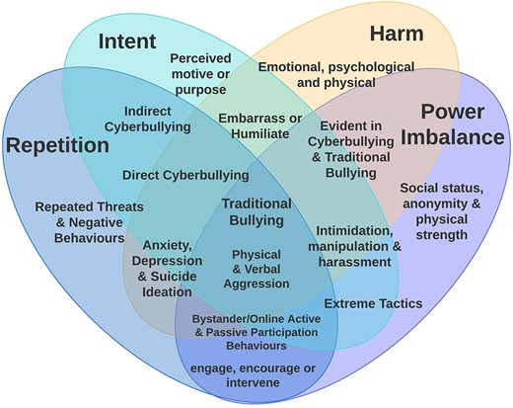
Figure 4. The four core elements of cyberbullying (Intent, Harm, Repetition, and Power Imbalance) with overlapping intersections. Reprinted from (Ray et al., 2024)

Slide 5
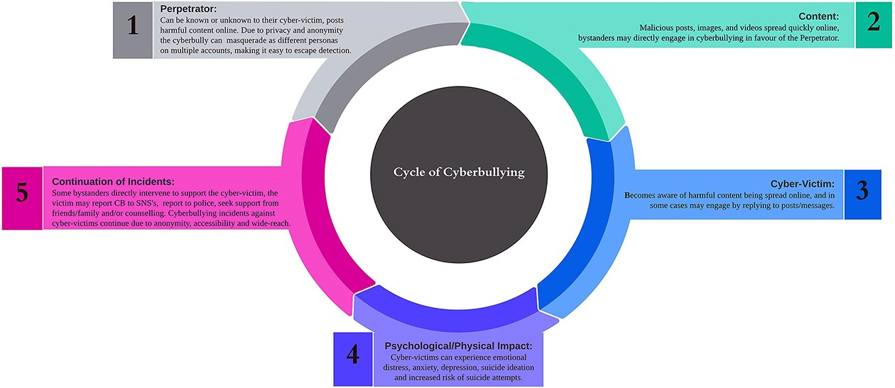
Figure 6. An example of cycle process of cyberbullying on social media. Reprinted from (Ray et al., 2024)
Notes:
Test

Slide 6
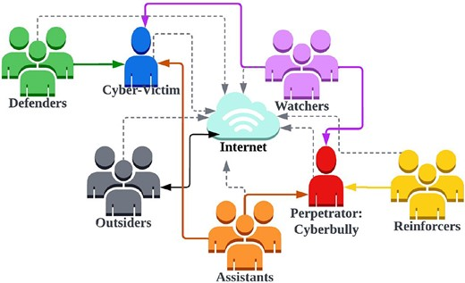
Everyone play a part in cyberbullying
If you see cyberbullying, then you are now in this graph in some way.
You can be a defender who stops the attack
You can be a watcher who does nothing about it
You can be a reinforcer that encourages cyberbullying
You can be an assistant who engages with the bully
Everyone who sees cyberbullying is now playing a part in the cyberbullying. Everyone has played each role in the graph at some point in their online life. Maybe they were kids and didn’t know better, or maybe people don’t care how they act on the internet. I think understanding this will make people better understand what cyberbullying is.
Figure 7. Cyberbullying active and passive participation. Reprinted from (Ray et al., 2024)

Slide 7
References
Ray, G., McDermott, C. D., & Nicho, M. (2024b). Cyberbullying on Social Media: Definitions, Prevalence, and Impact Challenges. Journal of Cybersecurity, 10(1). https://doi.org/10.1093/cybsec/tyae026

