Slide 1
The Quest
D’Angelo Stines

Slide 2
Jim Heath
With Jim being a Sports information Director, amongst many other things he is in charge of team press conferences. He plays more of a behind the scenes role in them being that he sets them up and is not an active interviewer. This is something that he does that really peaks my interest because it is up to him to get the individuals that we as viewers want to hear from.

Slide 3
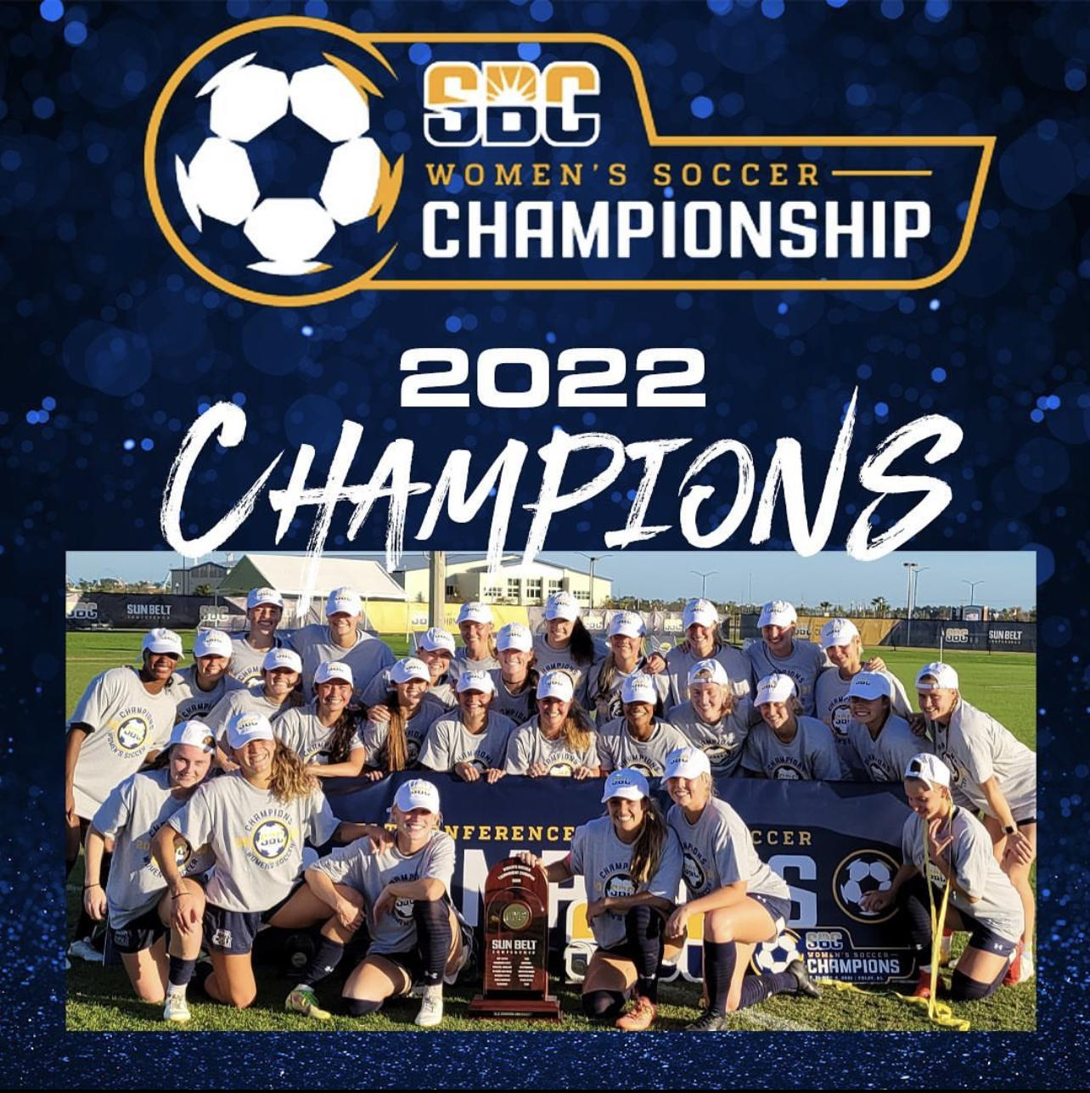
The Proposal
Being that we have a women’s soccer POWERHOUSE right on our campus that in my eyes doesn’t nearly get the recognition and attention they deserve, my proposal is to have an open press conference for local reporters and fans to attend. The reasoning behind the fans being there is to get to hear about all that goes into being back to back conference champs and how they felt to win the first ever ODU Sun Belt championship. Following the press conference fans will be able to interact and meet with the players. This will be a great opportunity for the team to get exposure within the community and hopefully boost the overall support they get.

Slide 4
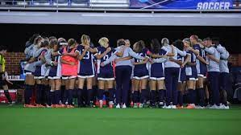
Goals
Tactics
Recognition of a phenomenal sports team
Increase overall fanbase
Publicity
Location: ODU Soccer Complex
Promotion: Social Media posts on ODU sports pages and Womens soccer pages
People: ODU students, alumni, media outlets, and new/old fans

