Slide 1
Protecting Clients/Users Accounts & Passwords
DaRon Briggs

Slide 2
FIDO Alliance Authentication
Avoid relying passwords
Biometrics.
Two-factor verification/authentication (2FA)
PIN numbers

Slide 3
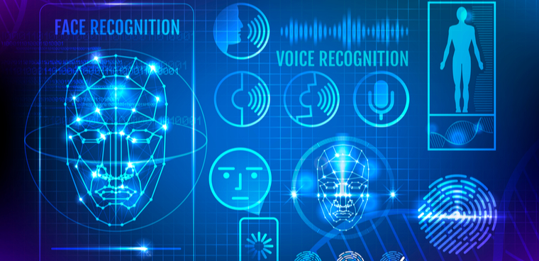
FIDO Alliance Authentication : Biometrics
Iris Scanning
Fingerprint Scanning
Facial Recognition
Voice Recognition

Slide 4
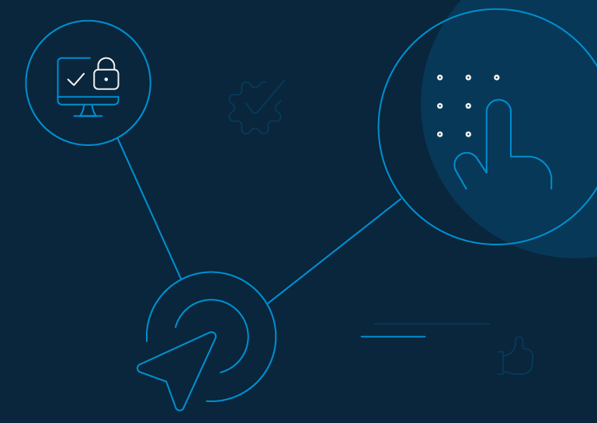
FIDO Alliance Authentication: PIN
Receive Set of Numbers
Reset So Often (Monthly)
Can be used alone
Can very in length

Slide 5
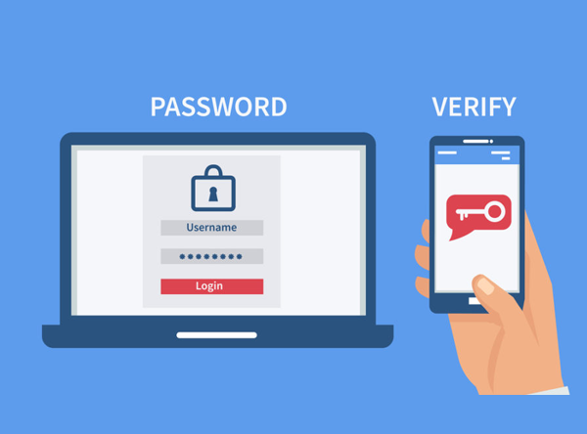
FIDO Alliance Authentication:2FA
Used with Username/Password
Something you have (Phone)
Something you are (Biometrics)
Something you know (PIN)

Slide 6
Staying up to Date
Organization’s servers
Software (Organization and User)
Routine security checks

Slide 7
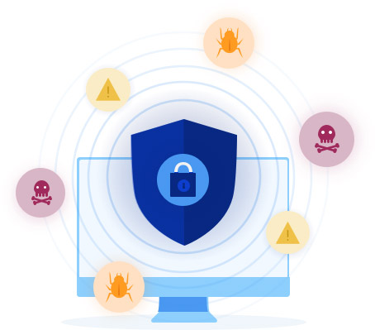
Keeping accounts updated/SAFE
Regularly updating passwords
Notifications when logging in
Exit not in use applications
Install antimalware and anti-ransom

Slide 8
Tips and Advice
No 100% safe protection
Looks luscious?

Slide 9
Resources
FIDO Authentication. (2019, June 26). Retrieved November 10, 2020, from https://fidoalliance.org/fido-authentication/
Rosenblatt, S., & Capriani, J. (2015, June 15). Two-factor authentication: What you need to know (FAQ). Retrieved November 10, 2020, from https://www.cnet.com/news/two-factor-authentication-what-you-need-to-know-faq/
Johansen, A. (2019, September 5). How to help protect against 5 types of phishing scams. Retrieved November 12, 2020, from https://us.norton.com/internetsecurity-online-scams-how-to-protect-against-phishing-scams.html
6 Ways to Protect Yourself From Hackers. (n.d.). Retrieved November 11, 2020, from https://www.chubb.com/us-en/individuals-families/resources/6-ways-to-protect-yourself-from-hackers.html
Gerstner, L. (2016, November). How to Thwart Identity Thieves. Retrieved November 12, 2020 from http://web.a.ebscohost.com/ehost/detail/detail?vid=10&sid=8a969181-53a1-45b8-b14c-bb7123044dab%40sdc-v-sessmgr02&bdata=JnNjb3BlPXNpdGU%3d#db=a9h&AN=118059869

Slide 10
END OF PRESENTATION

