Slide 1
Grocery Store Checkout: Business Process
DaRon Briggs
IDS 493
REMIX #4

Slide 2
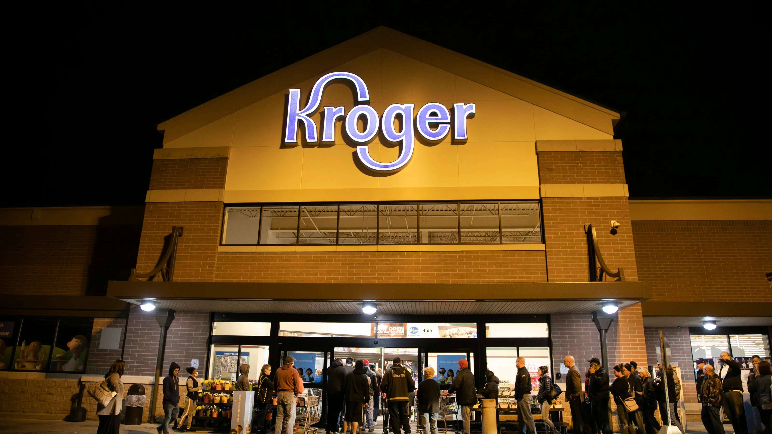

Slide 4
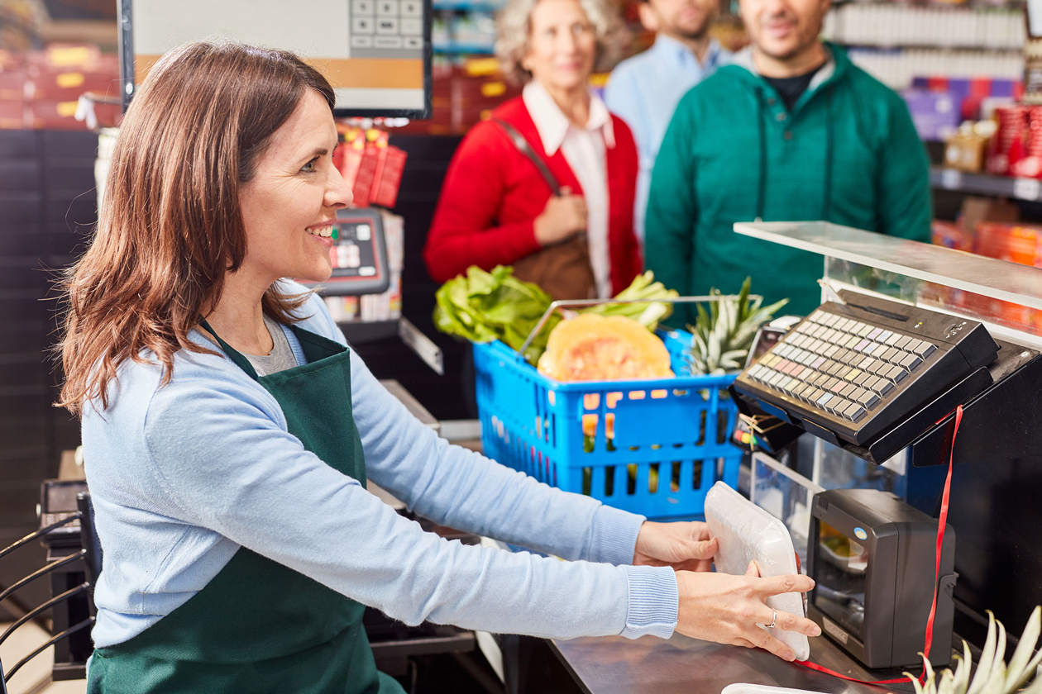

Slide 5
SCANNED SUCCESSFULLY?

Slide 6
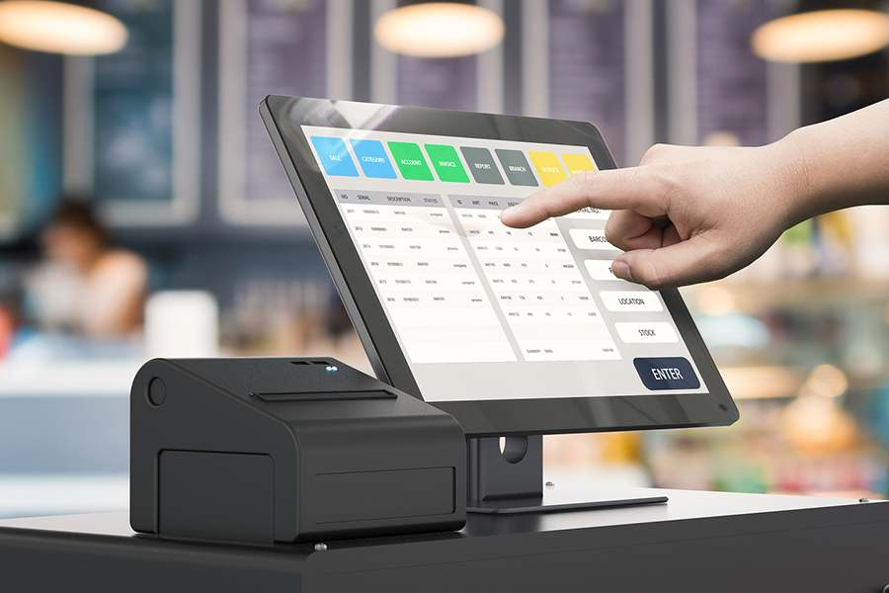

Slide 8
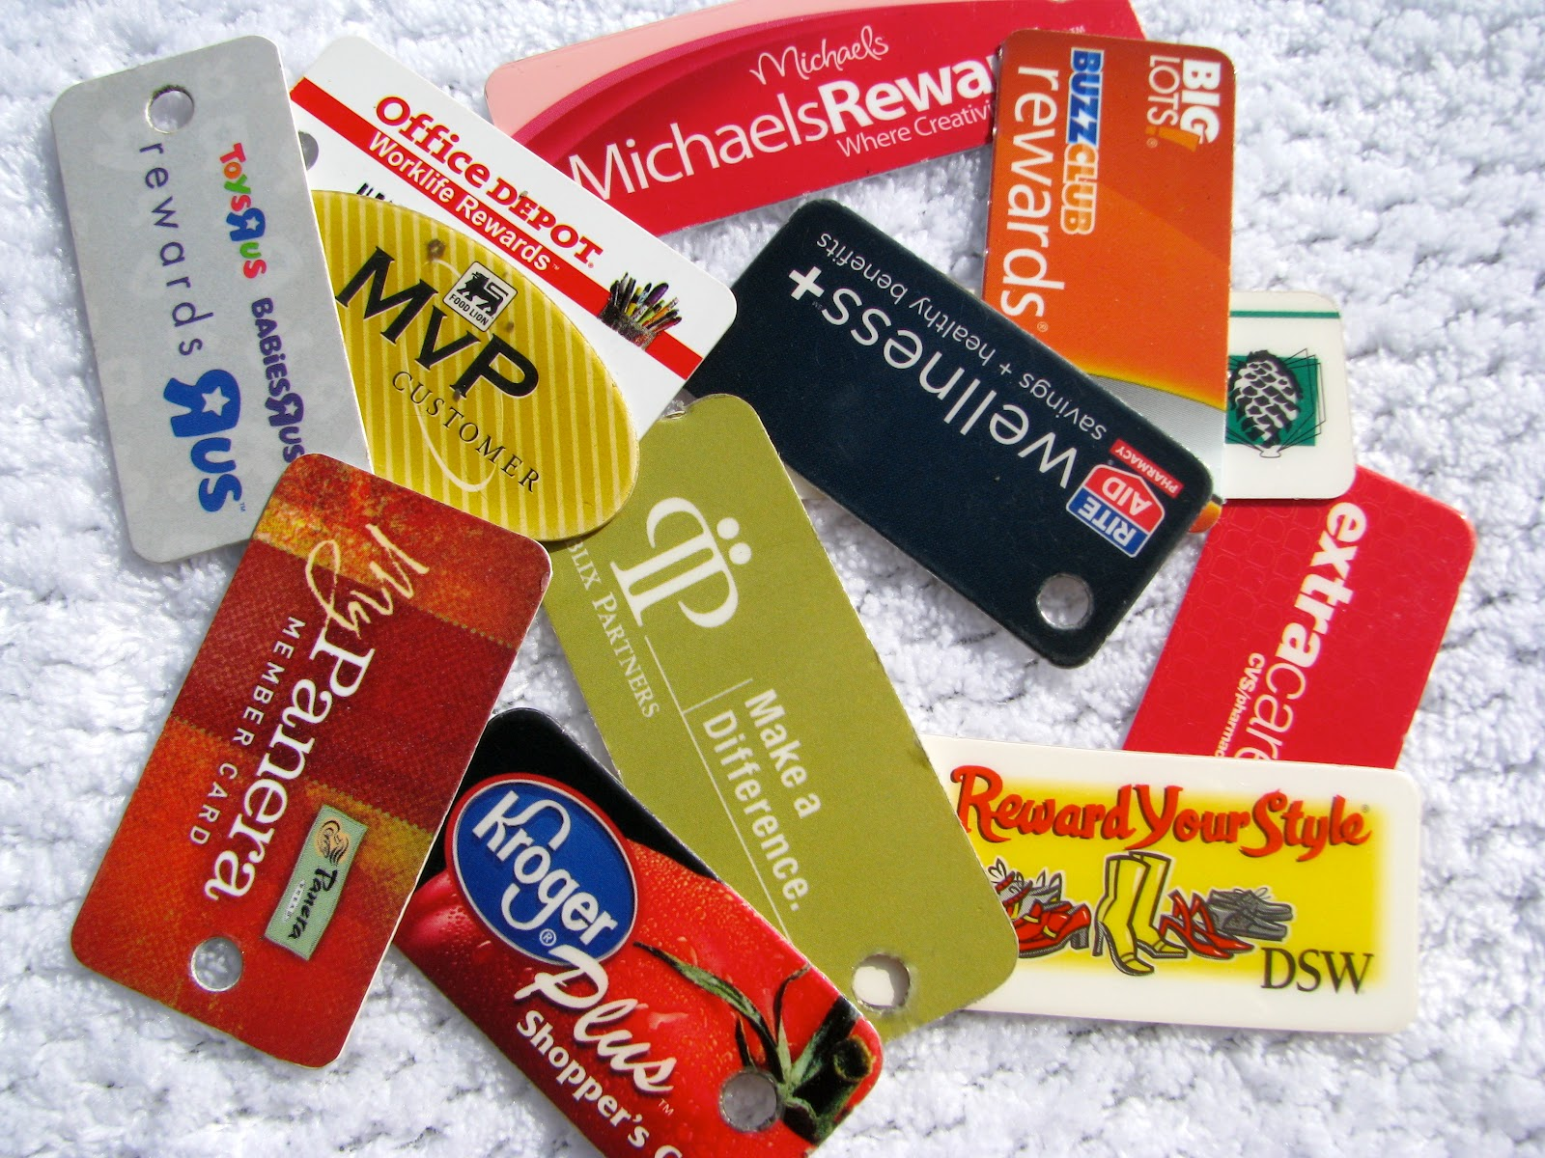

Slide 9
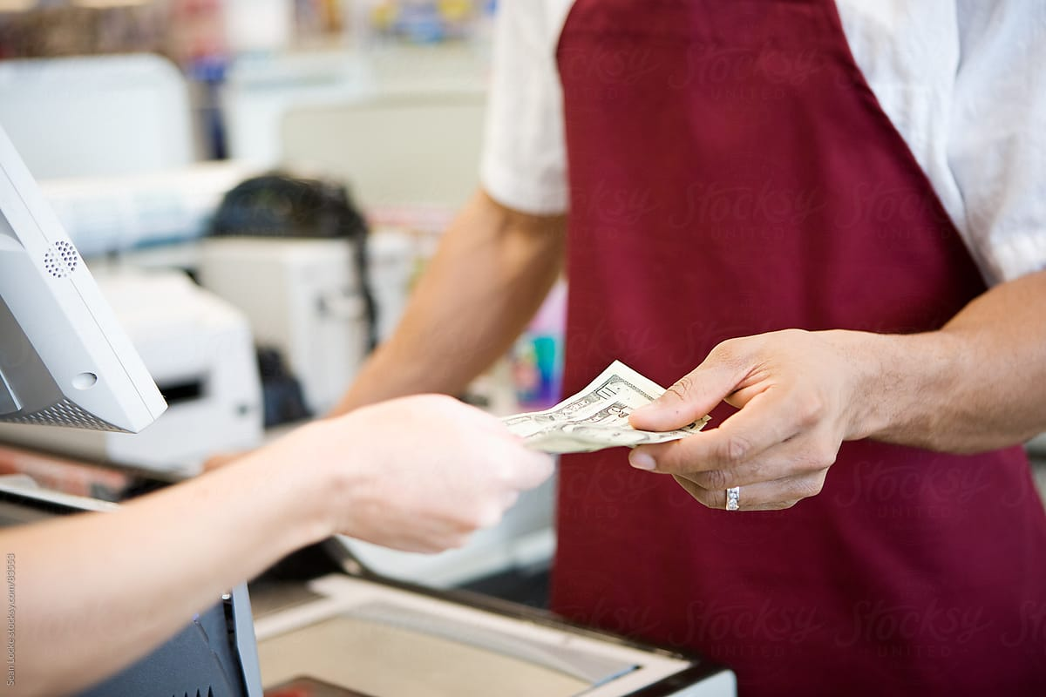

Slide 10
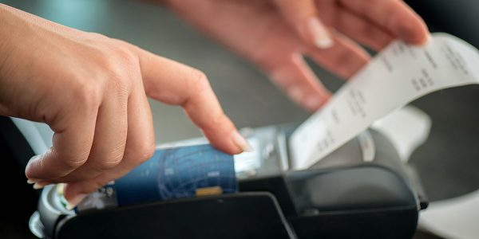

Slide 12
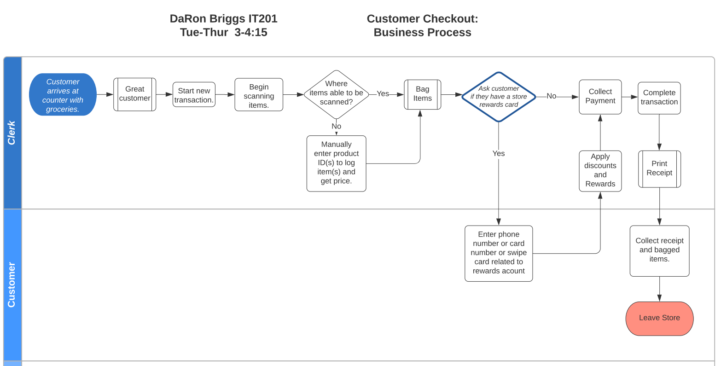

Slide 13
END

