Slide 1
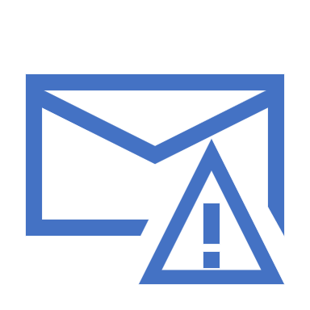
Avoiding Phishing Scams
DaRon Briggs
Remix #5
IDS 493

Slide 2
Phishing Language
Common Words You’ll seen used in phishing attacks
Urgent
Immediately
Locked Out
ASAP
Click Here

Slide 3
Check For Grammar errors.
Words are often misspelled in phishing attacks.
Often time scammers don’t speak English as their first language or are rushing when writing the scam.
Sometimes phrases are out o place or sentence structures don’t make logical sense.

Slide 4
Don’t Click
Be cautious of viewing emails you were not expecting.
Don’t click on links if they seem suspicious, instead hover over the link to view if the link is valid.

Slide 5
Verify the Sender
Check to see if the sender’s email address (or phone number in some cases) is suspicious.
Verify the address is an actual address.
If you weren’t expecting an email from the sender, approach with caution.

Slide 6
Personal Information
Scammers will often ask for personal information such as your Social Security Number or Password over email.
Valid Organizations will often times never ask for this information out of the blue or will at least use a standard encryption method to protect your personal information.

