Slide 1
VISUAL ARGUMENT
Created By: Devon Callis

Slide 2
WHAT IS VISUAL RHETORIC?
Visual Rhetoric can consist of many elements, however, the four that matter are purpose, message, audience, and the voice.
A visual argument engages viewers and persuade them to accept the message and idea of an image, sculpture, video, etc.

Slide 3
Same Sex Marriage
What is so different from the 1960s with interracial marriages and the 2000s with same sex marriage?
What does it indicate about people who have an issue with interracial relationships?

Slide 4
VITAMIN WATER
What is the message of this image?
Why have NBA star Kobe Bryant on the front?
Is vitamin water promoting for a specific audience?

Slide 5
BITS OF TRUTH
What exact words have power?
When should someone avoid using these words to young adolescents?
If I said something useful and nice would they still cry?

Slide 6
ARGUMENT OR PERSUASION
Whether or not a photograph is full of shapes and colors, or black and white, their purpose is either argumentative or persuasive.
Argumentative visuals usually use logic to “incite a person to take action or change”
Meanwhile, persuasion is based on appealing to emotions and feelings.

Slide 7
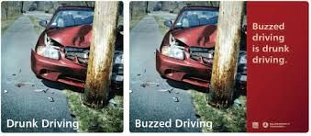
THE DIFFERENCE
How is an argumentative image so different from one that is persuading viewers?
The picture to the right is arguing that people to not drink and drive, even if they’re “buzzed.” By showing the image of recked car is persuading them to avoid driving drunk or buzzed.

Slide 8
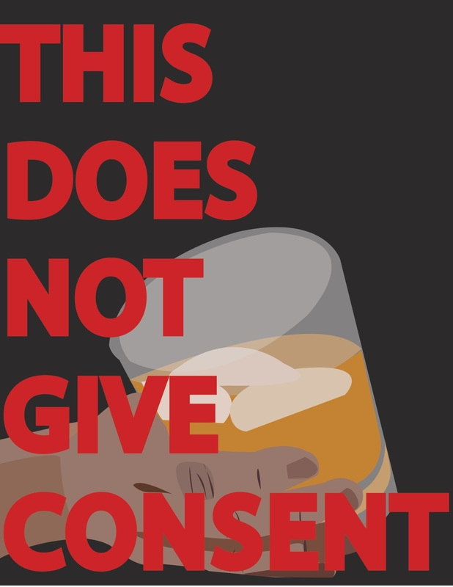
THE DESIGN
Notice this flyer, is indicating an alcoholic beverage is not consent.
What exactly is it not giving consent for?
Most likely it is stating intaking alcohol is no consent for sexual activities whether from male or female.

Slide 9
COLOR & DESIGN
A red octagon in driving usually would indicate a stop sign. This eight-sided red sign is used throughout roads to have safer roadways.

Slide 10
COLOR
We picturing the color yellow, I think of various items to go along with it. However, when I think of the color yellow I instantly think of bananas.
One great color to associate with yellow is the color black. It helps brighten the soft color and makes it easier to read.

