Slide 1
Artificial Intelligence (AI)
By Devin matkozich

Slide 2
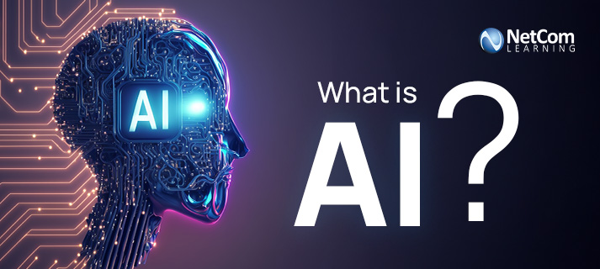
What is Artificial Intelligence?
Artificial Intelligence (AI) is when technology helps computers replicate human learning, problem solving, and decision making.

Slide 3
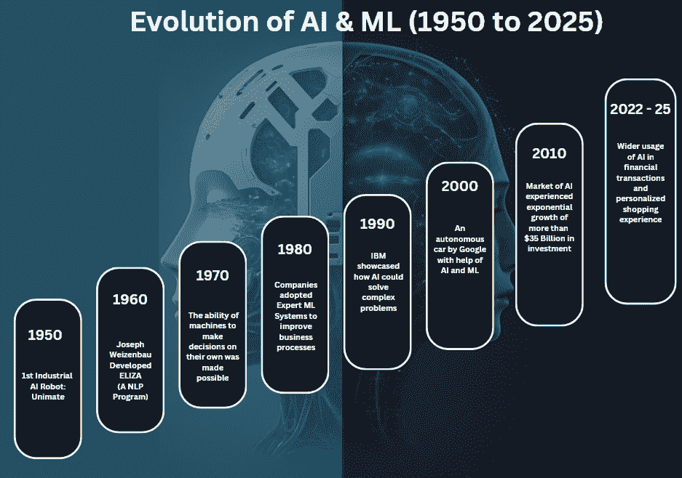
Timeline of how AI has evolved over time

Slide 4
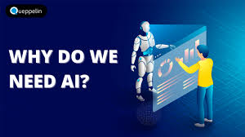
Why we use AI
  AI can be beneficial in automating repetitive and time-consuming tasks.
  It can quickly process massive amounts of data.

Slide 5
When AI is used
AI is often used when large amounts of data needs to be processed.
If human labor is too expensive AI is used as a cost friendly choice.
AI is also used to spot trends in large amounts of data, which would take humans much longer to process.

Slide 6
How AI is used
First data is collected.
Next, AI tries to find patterns from that data.
Then, the systems makes predictions based on the observations.
Lastly, results are then reviewed and monitored for future use.

Slide 7
What AI is used for
AI has many uses:
Cybersecurity
Chatbots for customer service
Recommendation systems (Netflix, Spotify)
Predictive analytics

Slide 8
AI helping IT infrastructure
Strengthens cybersecurity defense
System for detecting failures before they can be abused
Diagnosis issues as they happen
Optimize storage and lower costs

Slide 9
AI Pros
  Faster at processing data than humans
  Long term cost can be cheaper than human labor
  Great at handling repetitive tasks
  Easy to scale with demand

Slide 10
AI Cons
Upfront cost can be high
AI does not have empathy when looking at data
Taking jobs that humans would have had
Security risks

Slide 11
Who uses it
Every big tech company:
IBM
Amazon
Google
Microsoft
Meta
Tesla
Netflix

Slide 12
Who produces it
Google – Gemini
Microsoft – Copilot
OpenAI - ChatGPT

Slide 13
How AI has changed through the lens of chess
  In 1951, AI in chess started with early rule-based system. Alan Turing published a program that was theoretically able to play chess.
  In 1989, Garry Kasparov (Chess World Champion) first defeated IBM’s Deep Thought AI in a chess game
  In 1996, Kasparov defeated IBM’s Deep Blue in a bit closer match.
  Then in 1997, IBM’s Deep Blue AI beat Garry Kasparov. This shocked the world being the first chess AI to defeat a grandmaster let alone being one of the best players of all time.
  In present day, the modern chess AI has surpassed humans by far. Reaching what's believed to be a FIDE rating of at least 3400.

Slide 14
AI in the future
Generative AI (GenAI) will become more popular with movies, shows, and music adopting it.
AI usage on smartphones will increase.
Stricter AI regulations especially regarding GenAI.

Slide 15
How it affects me
Instead of making a bad logo in photoshop, I have used AI to make one for an eBay store I run.
It has also been very helpful when trying to remember specific details about a certain topic, like if I can only remember a small part of a movie, it can usually give me the name.
I used to always use very niche reddit forums for fixing problems but now AI can fill that void for me.
I also enjoy gaming so updating my pc can be helpful for performance. With the surge of AI Ram prices have gone through the roof, which makes it difficult to upgrade my pc.

Slide 16
Sale of AI
According to Stanford, in 2024 corporate AI investment has reached $252.3 billion which is 13x of what was invested in 2014.
By 2033, the United Nations suggests that the AI market is supposed to hit $4.3 trillion dollars.

Slide 17
References
Krishnamurthy, B. (n.d.). The Evolution of Chess AI. Built In. https://builtin.com/artificial-intelligence/chess-ai
Stryker, C., & Kavlakoglu, E. (2025, November 17). What is Artificial Intelligence (AI)?. IBM. https://www.ibm.com/think/topics/artificial-intelligence
AI market projected to hit $4.8 trillion by 2033, emerging as dominant Frontier Technology. UN Trade and Development (UNCTAD). (2025, April 7). https://unctad.org/news/ai-market-projected-hit-48-trillion-2033-emerging-dominant-frontier-technology
Economy: The 2025 AI index report: Stanford Hai. Home. (n.d.). https://hai.stanford.edu/ai-index/2025-ai-index-report/economy

