Slide 1
Invention PowerPoint
Adrianna Dillard

Slide 2
Free write #1
The criminal justice system is a very complex system. It consists of the laws of the land and what is socially acceptable. The criminal justice system is an important component in the world. As every country has some form or manner of social control. The criminal justice system in American consist of courts, police, and the prison system.

Slide 3
Freewrite #2
My opinion on the criminal justice system is that the system is a good idea, I feel as though that it had the intentions of being something productive. However, it was founded as a means to control slaves after slavery was ended, and I feel as though that still shows. Also, some people let their personal feelings and beliefs get in the way of there job and so that can cause tension in the workforce.

Slide 4
Free write #3
My feelings towards the criminal justice system are complex. I am very interested in it, and have been since a young age. I have decided to major in the subject, so that I could help change the narrative of the system. I have a passion for helping people especially my community. So, this is where my interest came from. Overall, I feel as I have a good amount of knowledge of the topic, as well as current issues and events on the topic.

Slide 5
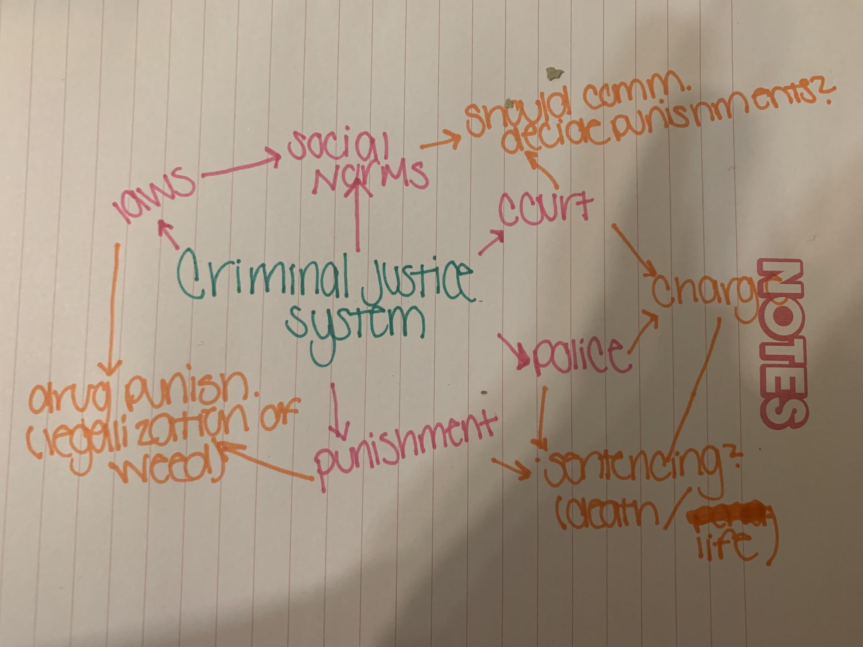

Slide 6
Invention strategy
The Criminal Justice System
Black on blakc crime
Humane sentencing
False convictions
Accuracy of photo lineups
Police brutality
Fair sentencing
Punishment for juveniles

Slide 7
Journalistic questions: Who, what, when, where, why
In the criminal justice system, police brutality is a major issue. This has been an issue for decades, but more recently the situation has resurfaced in Minnesota, because the death of George Floyd has cause a public outcry for justice in the system.

Slide 8
Invention strategies discovery questions
A) Yes, Rodney King "police brutality"​
B) Police brutality is cause by many things, but more recently, racial profiling has been at the center of it ​
C) Police brutality is a major issue in today's society. It involves the use of excessive force against civilians and has resulted in the loss of many lives. ​
D) This has resulted in rioting and protesting across the country​
G) From my generation I can remember the Trayvon Martin case, and more recently the George Floyd case ​
I) I am against police brutality because I feel as though in some of the more recent cases it has cause a lot of disruption and uproar in the world, and morally, it isn't right to target people because of race or gender​
J) I responded by studying a criminal justice major so I can educate myself on the issue and also help others along the way. I feel like the first step to changing something you don’t like is to be proactive so that you can be the change you wanna see ​

