Slide 1


Narrative Network
Presented by:
CDT Cole Bonham
CDT Evan Schranz

Slide 2


Overview of our research:
Receive the files
Analyze the data
Make conclusions based on analysis of data
Sojourners70s.csv
Sojourners80s.csv
Sojourners90s.csv
Sojourners00s.csv
Sojourners10s.csv

Slide 3
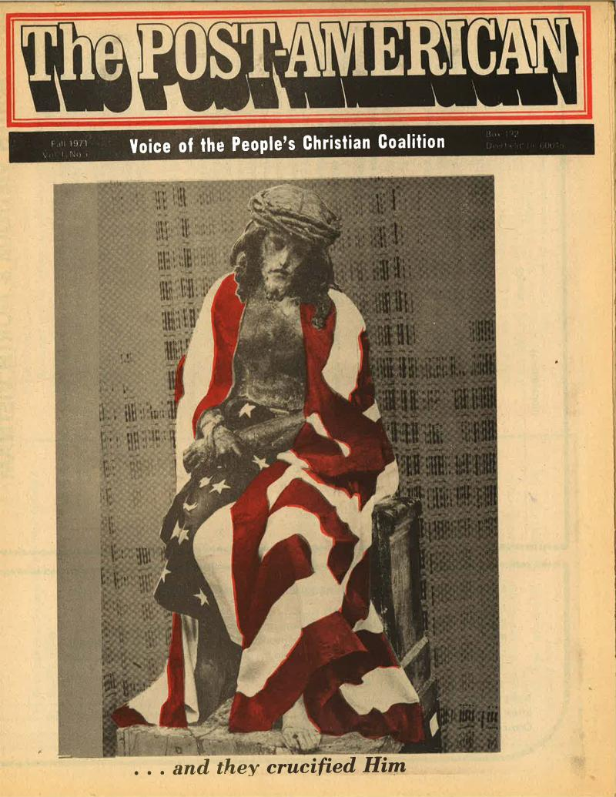

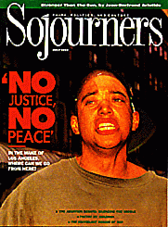
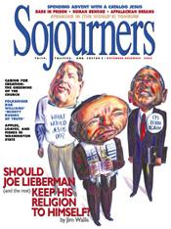
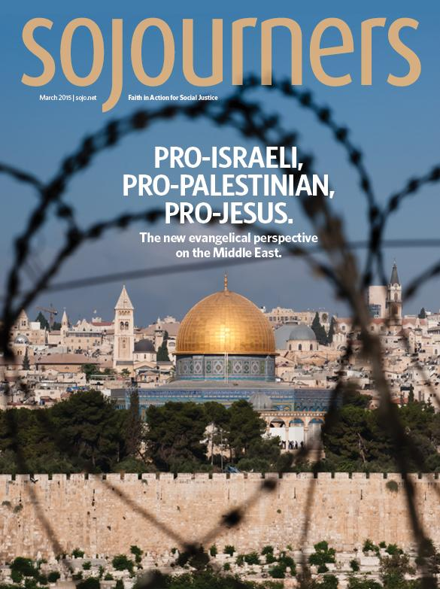
What is Sojourner Magazine?
Sojourner: Fall 1971
Sojourner: March 1981
Sojourner: July 1992
Sojourner: Nov-Dec 2000
Sojourner: March 2015

Slide 4
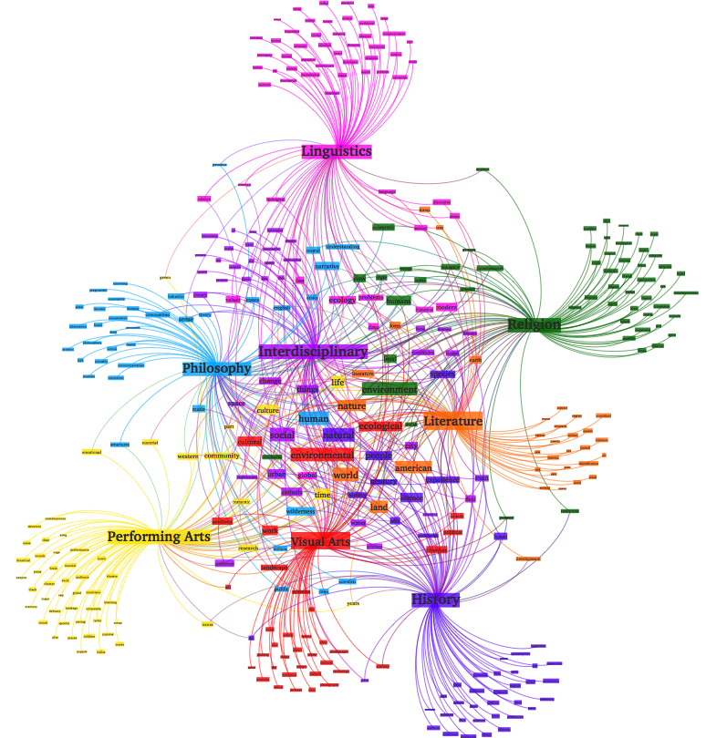
Significance of Narrative Networks:
impacts all aspects of interdisciplinary studies
helps us gather data to better understand conceptual text
gives information that allows us to formulate precise conclusions about a topic within specific disciplines

Slide 5





What we used & Initial process:

Slide 6
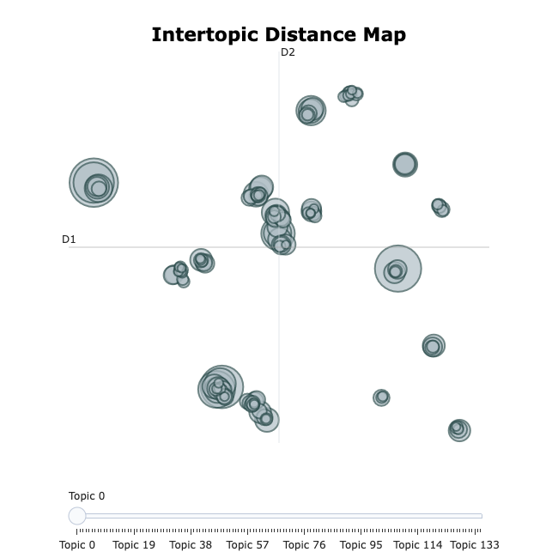


Data process:

Slide 7
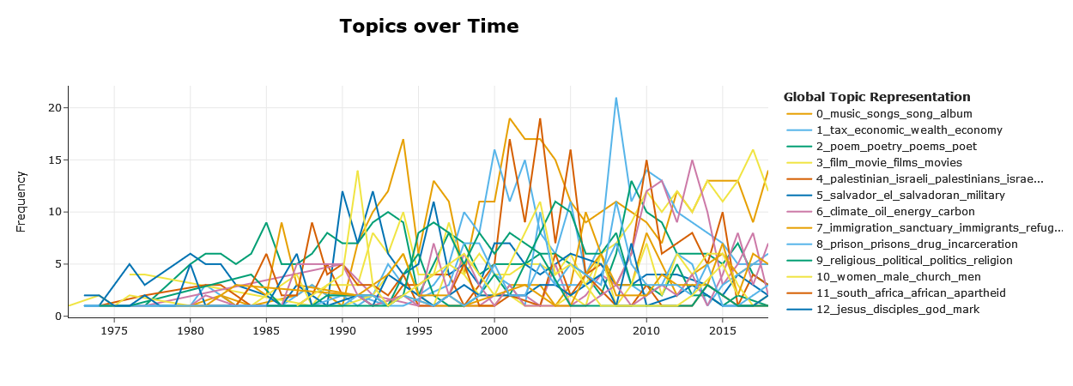
Data process:

Slide 8
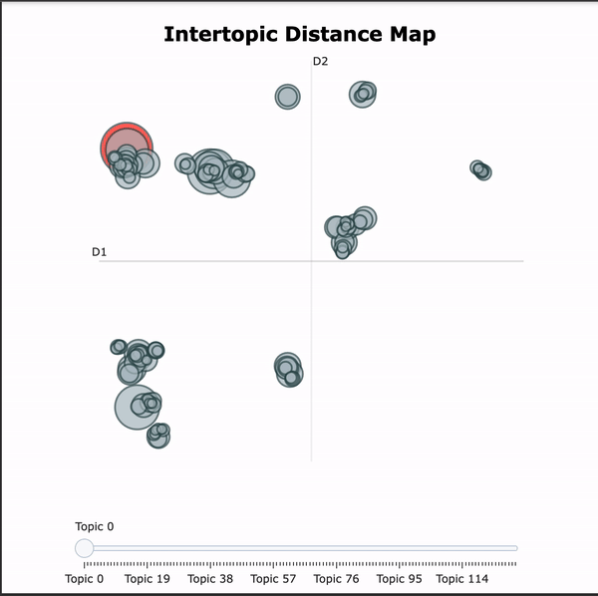
Some Notable topics 1970s- 2015:
T4: Palistinian, Israeli, Palestinians, Israelis
T7: Immigration, Sanctuary, Immigrants
T13: black, white, racism, racial, race
T19: abortion, prolife, abortions, prochoice, woman

Slide 9
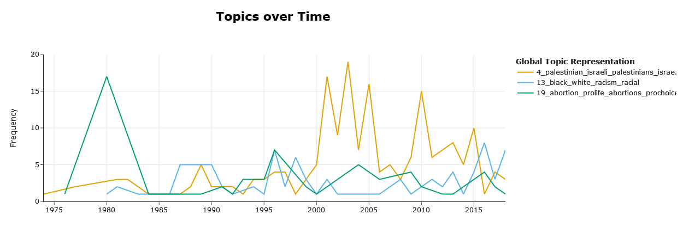
Notable topics 1970s- 2015:
T4: Palestinian, Israeli, Palestinians, Israelis
T13: black, white, racism, racial, race
T19: abortion, prolife, abortions, prochoice, woman

Slide 10
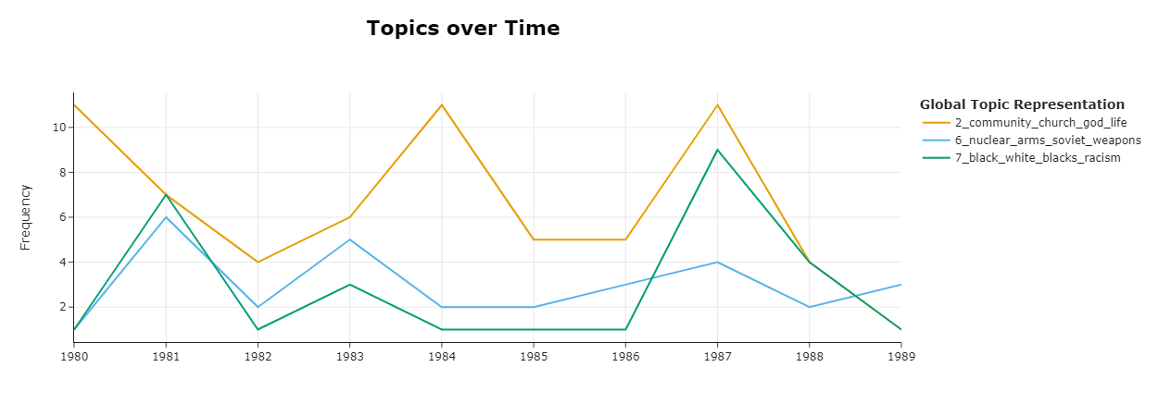
Notable topics 1980-1989
T2: god, community, church, life
T6: nuclear, weapons, soviet, arms
T7: black, white, racism, king

Slide 11
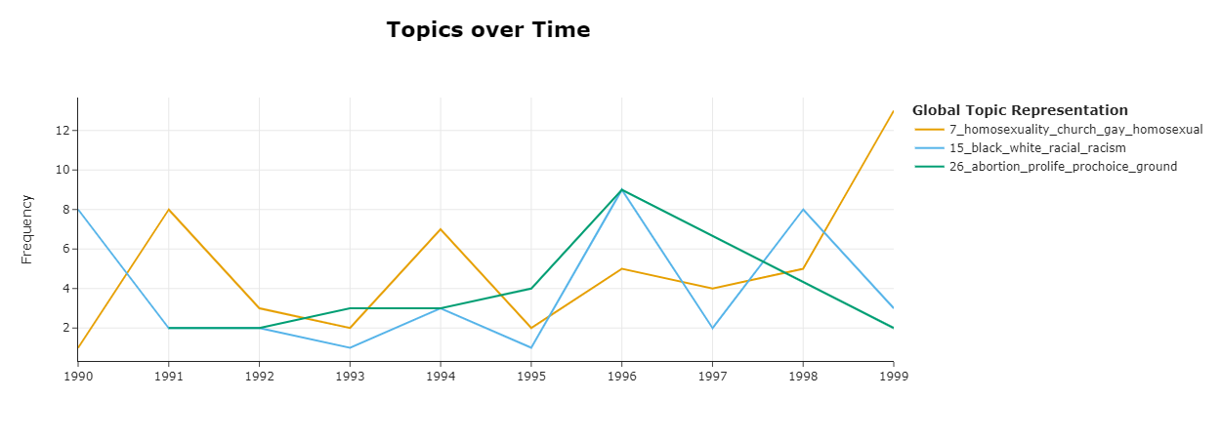
Notable topics 1990-1999
T7: homosexuality, church, gay *
T15: black, white, racial, racism
T26: abortion, pro-life, pro-choice, ground*

Slide 12
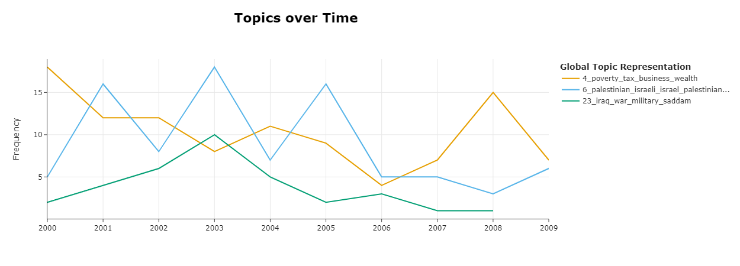
Notable topics 2000-2009
T4: tax, poverty, business, wealth*
T6: Palestine, Israel
T23: Iraq, War, military, Sadam *

Slide 13
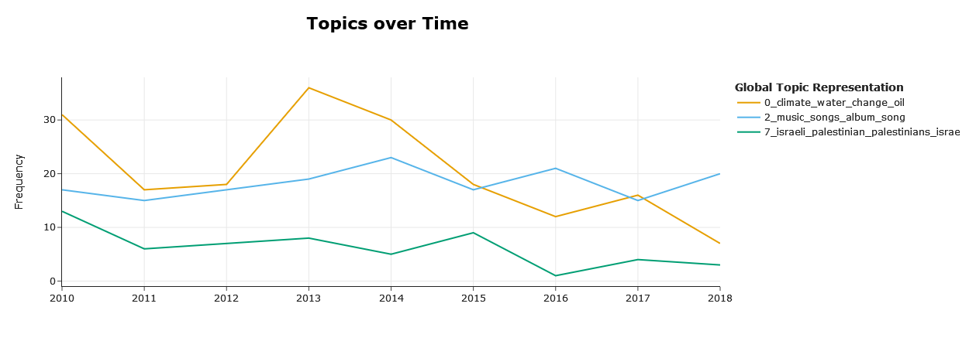
Notable topics 2010-2020
T0:climate, water, change, oil
T2: music, songs, album, song*
T7: israeli, palistinian, palestinians, israel

Slide 14
Most Used Words through the Decades:
70s: God, people, us
80s: people, God, us
90s: people, us, God
0s: people, God, us
10s: God, people, us
3 Most Used Words through the Decades without religious words:
70s: people, us, world
80s: people, us, would
90s: people, us, would
0s: people, us, would
10s: people, us, would

Slide 15
Top 3 most Prolific Authors & words they used by decade:
70s
Jim Wallis 38 : world, God, life
Wesley Granberg 21 : one, God, would
Clark H Pinnock 13: God, us, Jesus
80s
Jim Wallis 131 : people, us, God
Danny Duncan Collum 119: people, Reagan, one
Joyce Hollyday 117: one, people, us
90s
Jim Wallis 124: people, new, political
Joyce Hollyday 85 : one, us, God
Jim Rice 85: people, form, said
0s
Rose Marie Berger 173 : people, form, value
Jim Wallis 116: people, faith, political
Danny Duncan Collum : form, value, Sojourners
10s
Jim Wallis 106: people, us, Sojourners
Danny Duncan Collum 105 : value, form, feedback
Ed Spivey Jr : one, Please, form

Slide 16
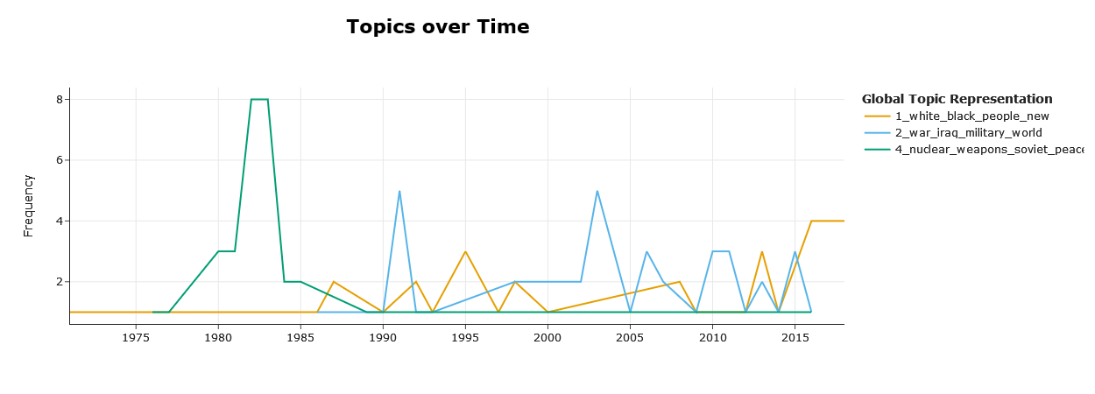
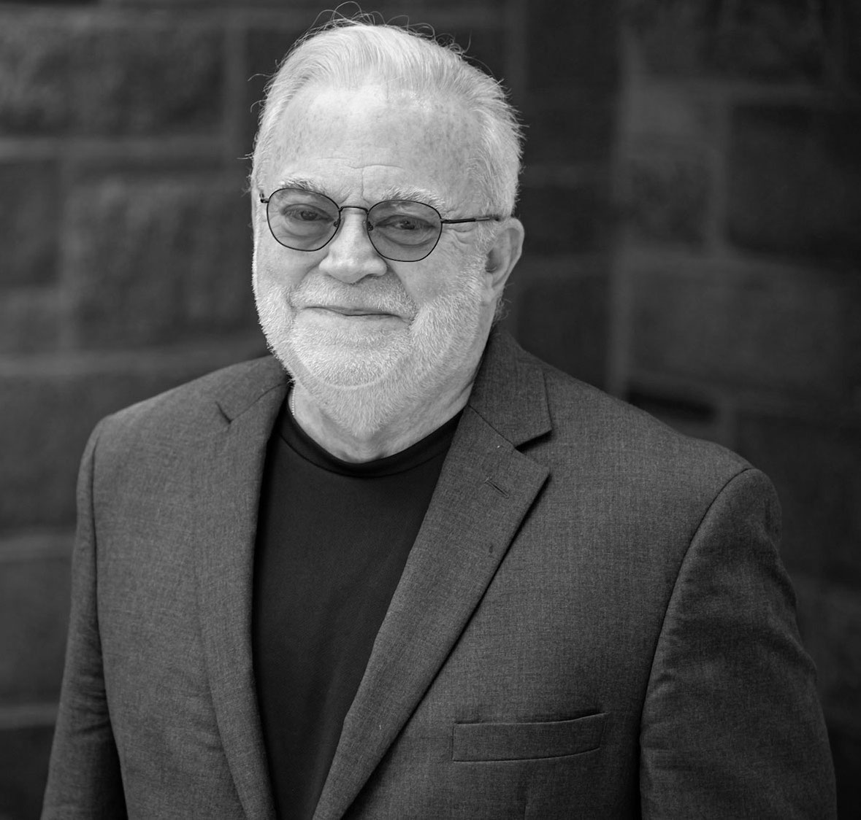
Author Profile: Jim Wallis
Notes:
-Founder
-Most prolific
-3 Main subjects

Slide 17
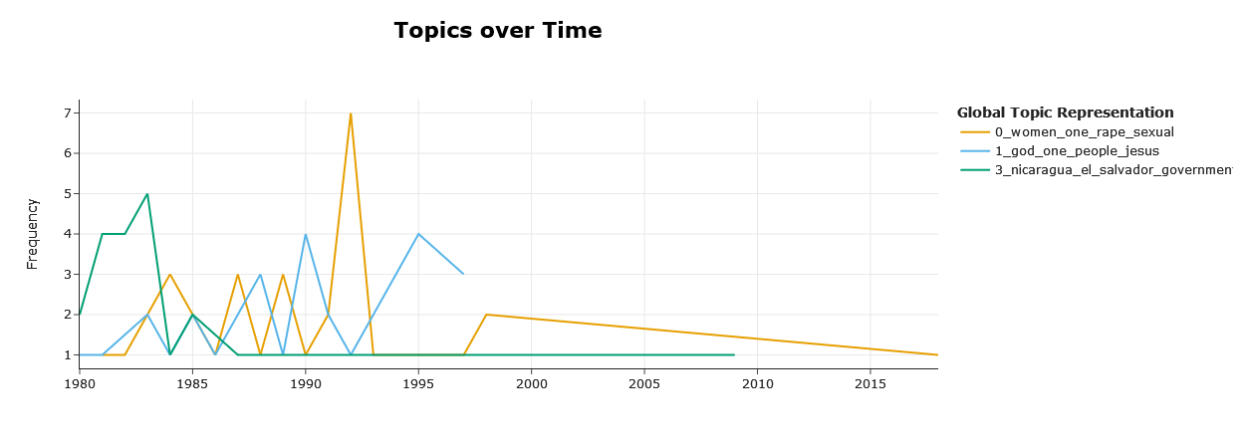
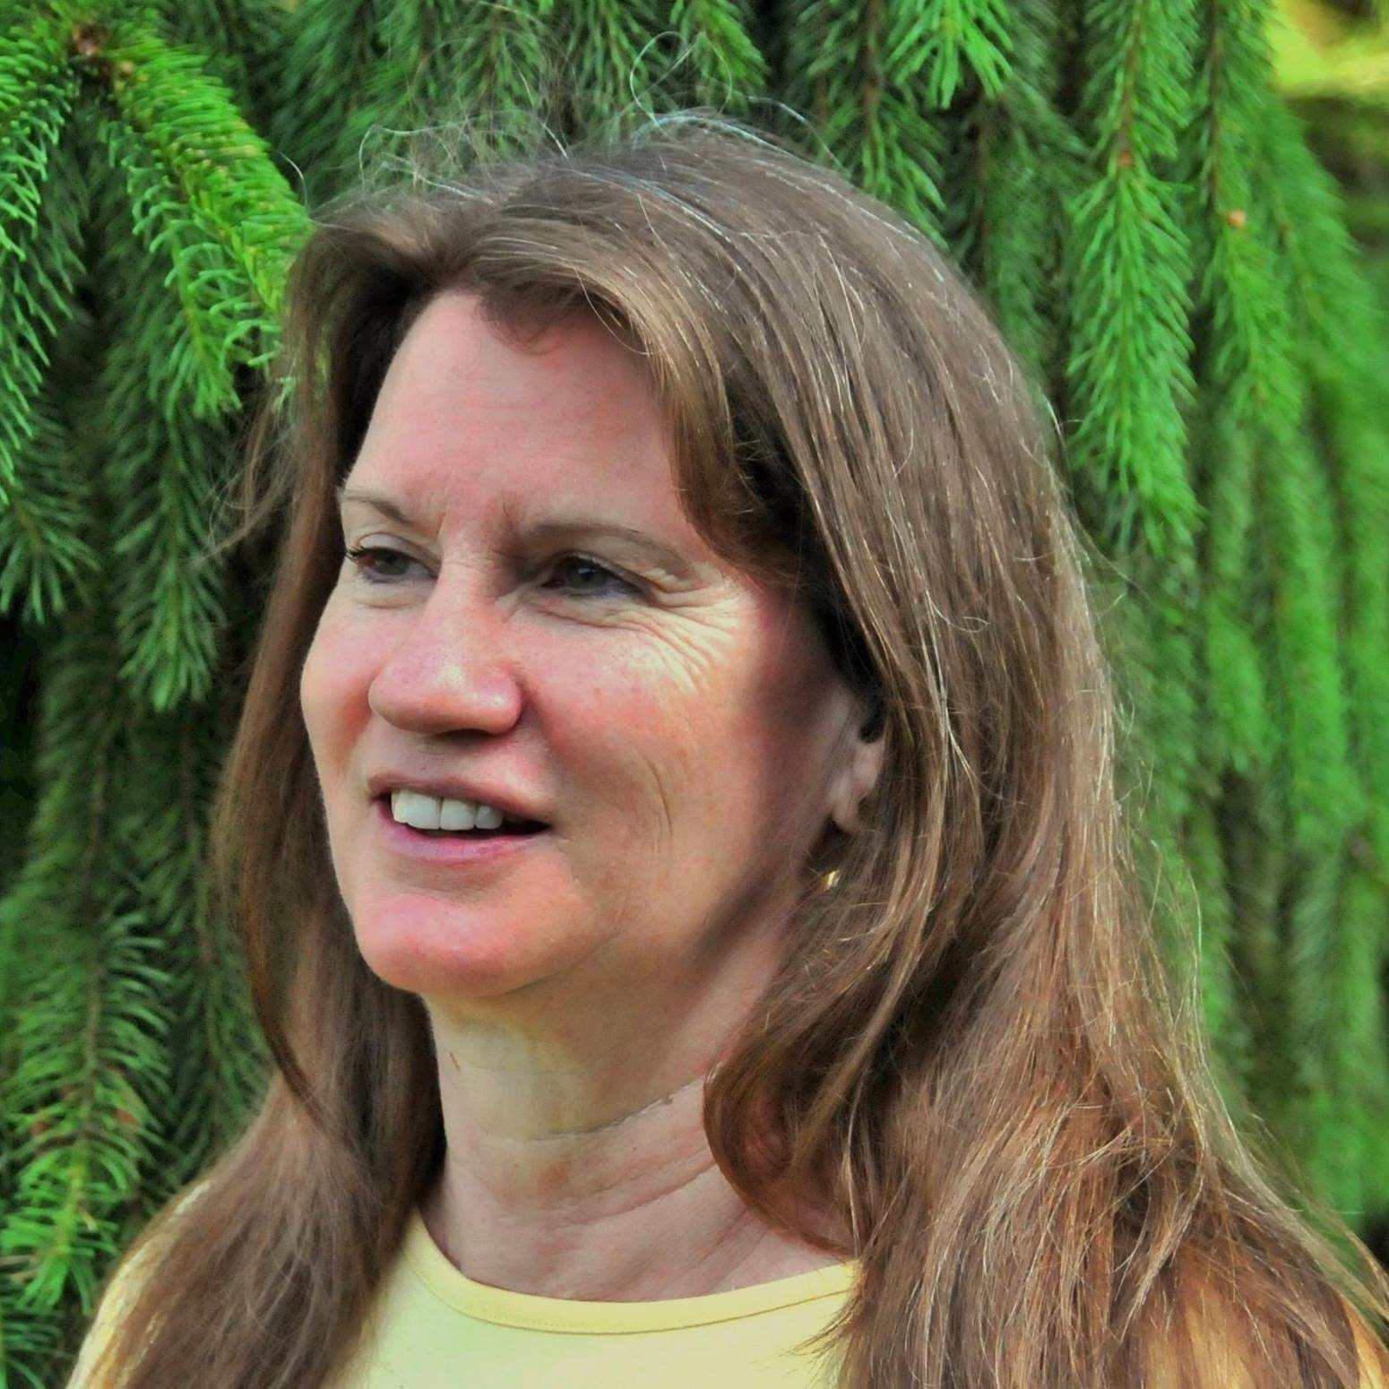
Author Profile: Joyce Hollyday
Notes:
-First Prominent Female
- South American Countries and then Women’s issues
- Faded in the 90s and 2000s

Slide 18
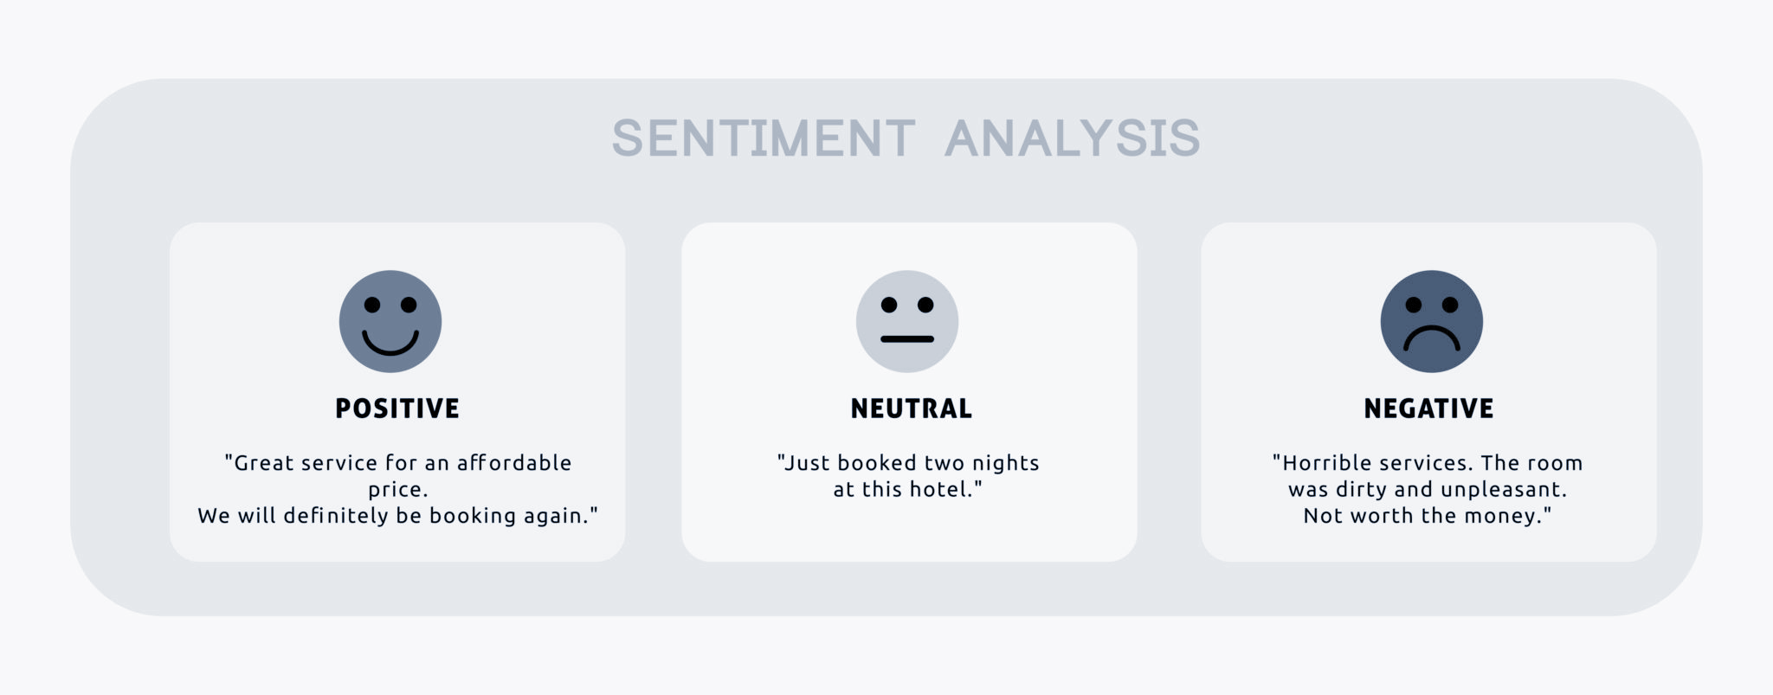
Sentiment Analysis: Overview
Notes:
-First Prominent Female
- South American Countries and then Women’s issues
- Faded in the 90s and 2000s

Slide 19
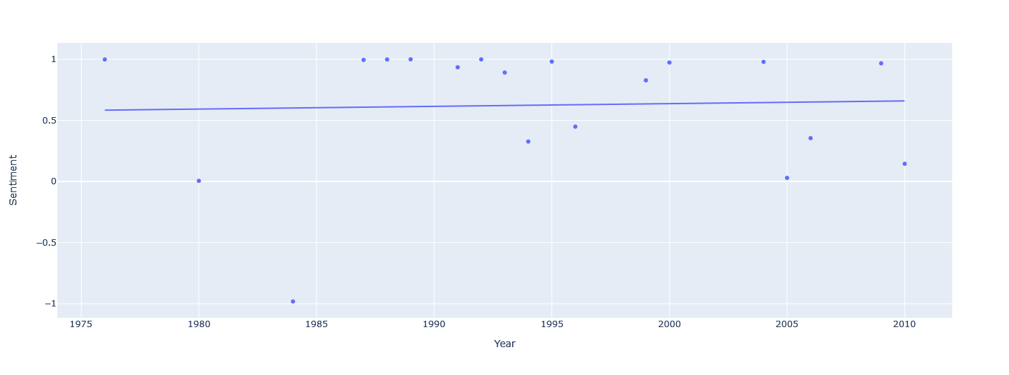
Sentiment Analysis: Average Sentiment of Abortion by Year

Slide 20
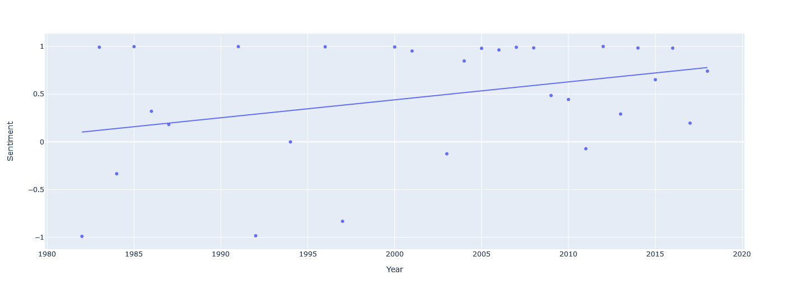
Sentiment Analysis: Average Sentiment of Immigration by Year

Slide 21




Significance
People’s Daily (PRC)
~3,000,000
Hamshahri (Iran)
~50,000
Russian Gazette
(Russia)
~166,000
Rodong Sinmun (DPRK)
~600,000

Slide 22
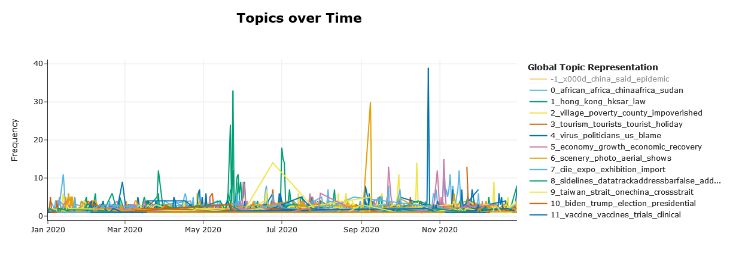
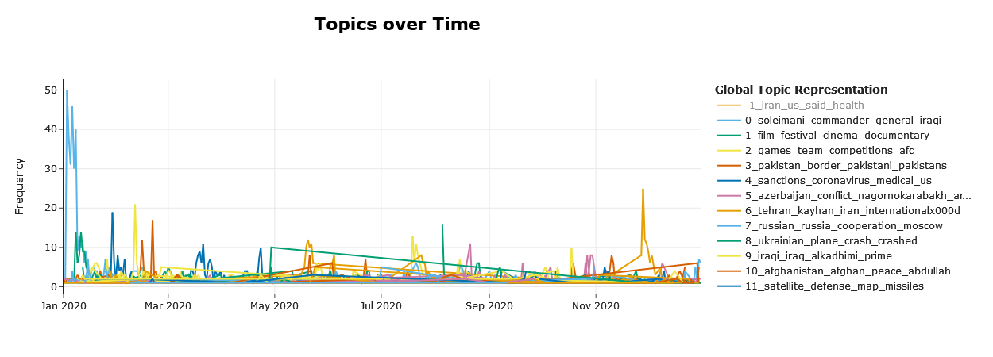
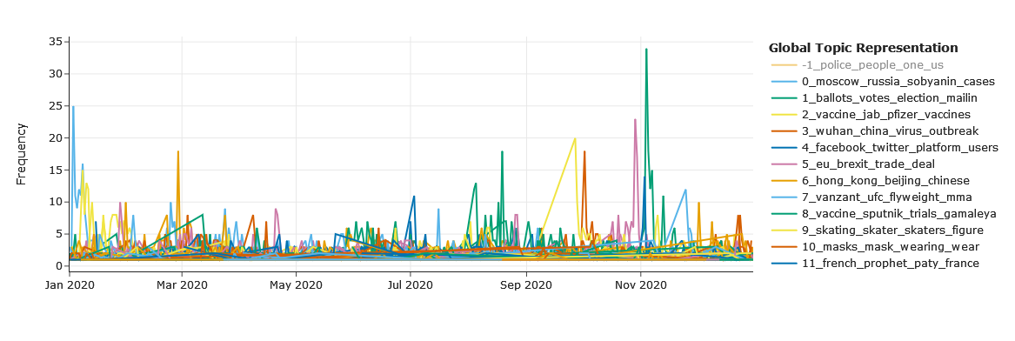
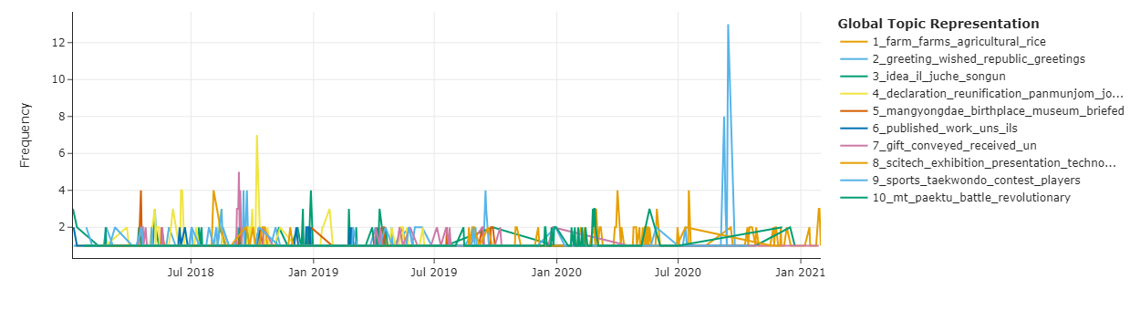
Practical Application
Iran
China
Russia
DPRK

Slide 23
Citations
Fisher, Scott. 2021. “Iran’s Islamic Republic News Agency (IRNA) Articles from Dec. 2011Dec. 2020.” https://doi.org/doi:10.7910/DVN/ALU2WQ.
———. 2022a. “China’s People’s Daily Articles from 12 May 2007 to 31 Dec 2020.” https://doi.org/doi:10.7910/DVN/HWNN7S.
———. 2022b. “Russia Today (RT) Articles from 21 JUN 2006 to 31 DEC 2020.” https://doi.org/doi:10.7910/DVN/MGBBUE.
Fisher, Scott, and Graig Klein. 2020. “Rodong Sinmun Articles from Jan 2018Dec. 2019.” https://doi.org/doi:10.7910/DVN/Q8TA9T.
“Media Landscapes.” 2019. Media Landscapes. European Journalism Centre. 2019. https://medialandscapes.org/.
‌

