Slide 1
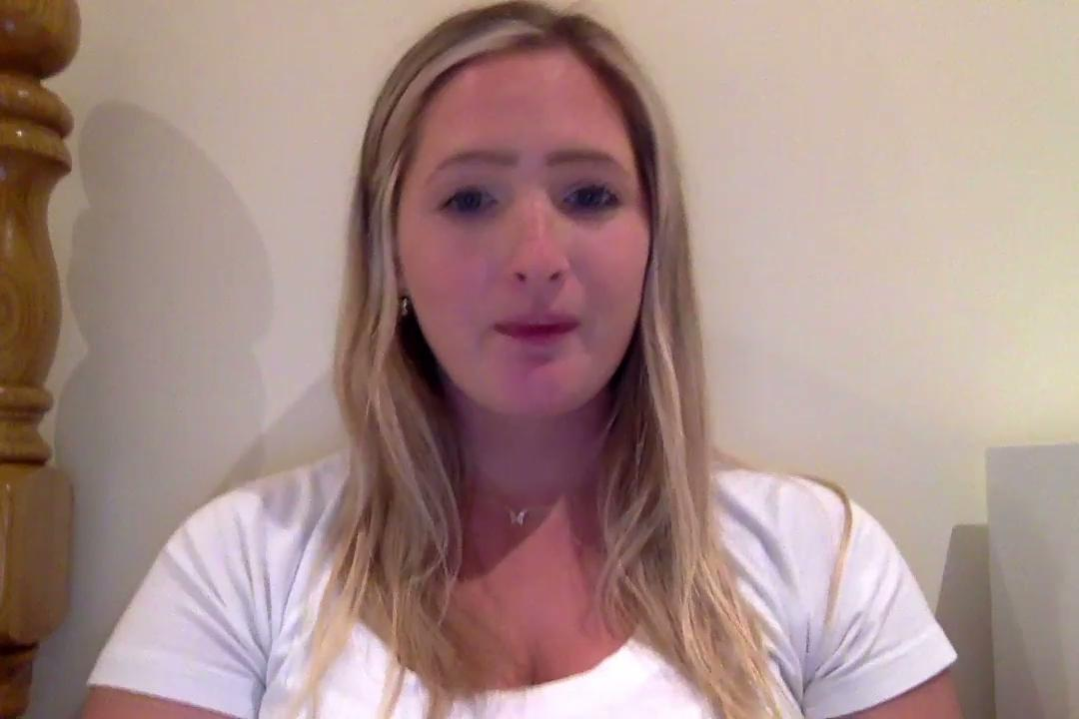
Final Project: Team 3
Lauryn Buchanan, Giao Dinh, Gillen Hurst, Tyler Lee, and Azjah Roberts

Slide 2
Table of Contents
Introduction…………………………………………………………...Slide 3
Table of GDP/per capita………………………...…………...Slide 4
Report of GDP/per capita…………………………………….Slide 5
Table of Educational cost/per capita………………….Slide 6
Report of Educational cost/per capita……………….Slide 7
Table of Life Expectancy………..…………………………….Slide 8
Report of Life Expectancy…………………….……….…...Slide 9
Other Findings……………………………………………………..Slide 10
Summary………………..…………………………………………….Slide 12
References………………………..……………………...Slides 13 & 14
Notes:
Here is our table of contents. First, I will quickly address what we are going to talk about in this presentation. On slide 3 we talk about our introduction. Slide four will address the report listing of GDP/per capita. On slide 5 is the report listing of GDP/per capita. Slide 6 will show the table of Educational cost/per capita and slide 7 will show the report listing of educational cost/per capita. Slide 8 will show the table of Life Expectancy and Slide 9 will have the report listing of the life expectancy. Slides 10 through 12 will address other findings that we found interesting that applied to our project. On slide 13 and 14 will show the references we used to collect data for our team project.

Slide 3
Introduction
This presentation shows the different correlations between nations wellbeing such as GDP/per capita and life expectancy. This presentation also shows the different correlations between income, education level and fatalities cases from COVID-19 using data from tables and reports.
Notes:
This presentation will show the different correlations between nations wellbeing such as GDP/per capita and life expectancy. Also in this presentation we will shows the different correlations between income, education levels and fatality cases from COVID-19 using data from tables and reports we generated through SAS. We collected data for 15 years starting from the year 2005 all the way to 2020.
The best way to achieve a balance is not only to consider a balance between employees' needs and their jobs, but it is also best if the employees have a good relationship with the employer and to have a better working atmosphere.

Slide 4
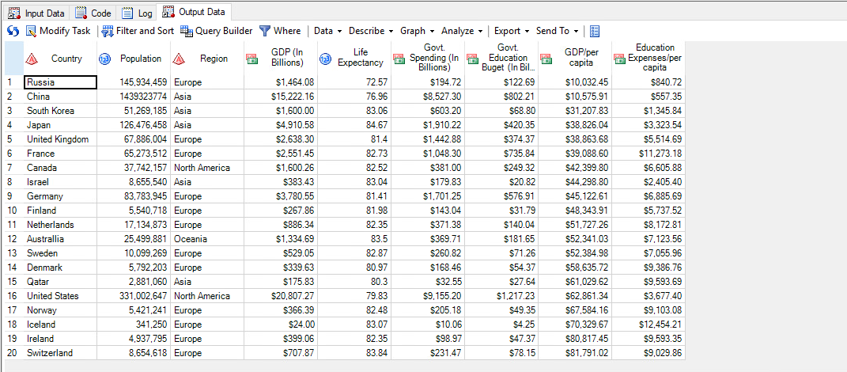
Table sorting nations by GDP/per capita

Slide 5
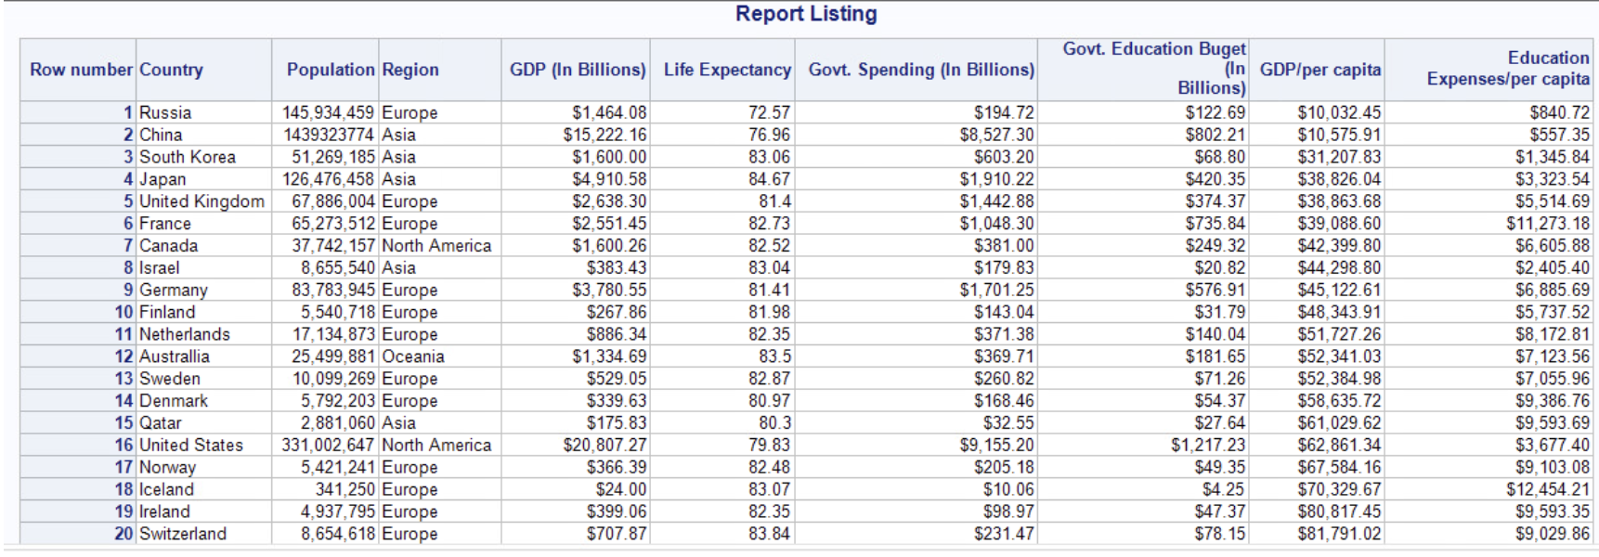
Report

Slide 6
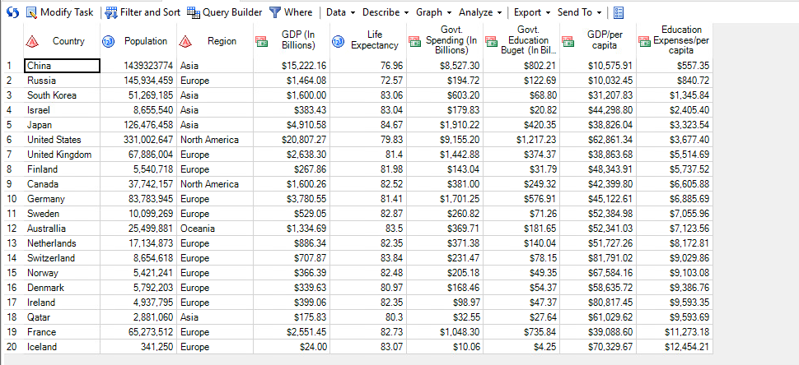
Table sorting nations by Educational cost/per capita

Slide 7
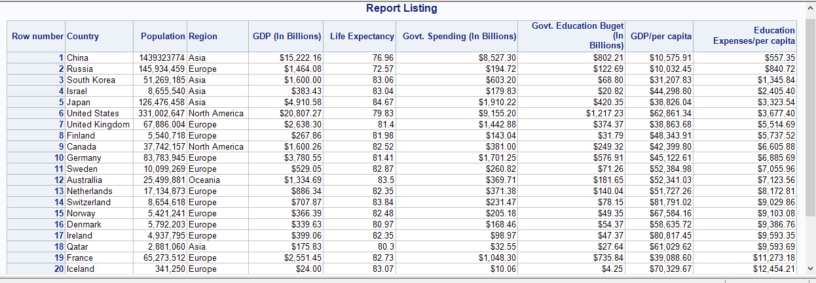
Report
Notes:
Mostly, this project focuses on how much the government spends on education expenses for the last 15 years over the GDP and life expectancy. Besides, the impact of Covid-19 pandemic had caused so much on people’s daily routine, their health, financial, and schooling globally but also causing other problems (World Health Organization, 2020). This pandemic creates more chances for cyber attacks when there are more targets (e.g., institutions and infrastructure’s financial sectors) as people have to quarantine and work from home more. A huge amount of funds are used to handle the current situation as a way to keep the nation economically not much impacted but also help the residents from being affected by the Covid-19. However, there are further lists of expenses the government needs to work on to bring back a normal life.

Slide 8
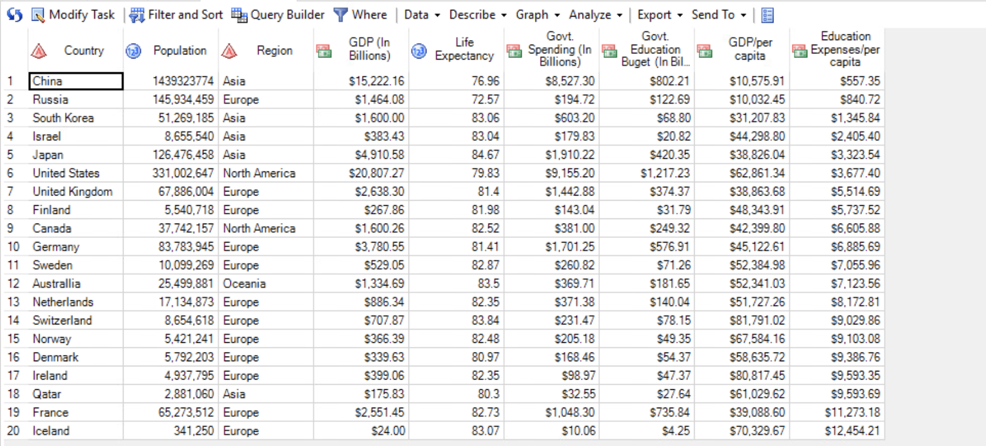
Table sorting nations by life expectancy
Notes:
On this slide I will discuss the table by sorting the nations by the life expectancy. I will do so for China, Russia, South Korea, Israel, Japan, The United States, The United Kingdom, Finland, Canada, Germany, Sweden, Australia, Switzerland, Norway, Denmark, Ireland, Qatar, France, and Iceland. On the next page we will discuss the results we generated through the data collection by running the data through SAS.

Slide 9
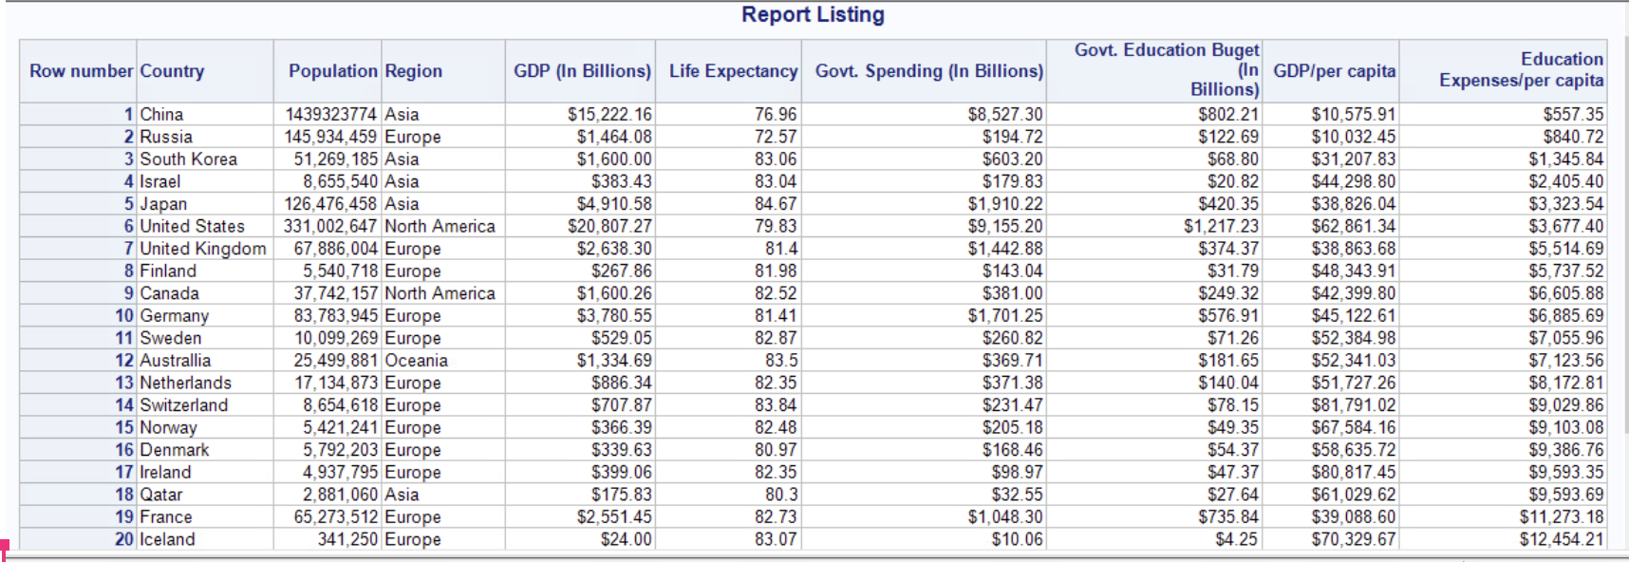
Report
Notes:
After running the data collection through SAS we generated the Report for the nations by the life expectancy. We found that The United States had a life expectancy of 79.83. When we did our research we found that the average life expectancy was 78.54 years in 2018. So the life expectancy has increased slightly. The country that had the highest life expectancy was Japan with 84.67. The country that had the lowest life expectancy was Russia with 72.57. South Korea and Israel had very similar life expectancy rates with 83.06 and 83.04. Switzerland had the second highest life expectancy with 83.84. The second lowest life expectancy was in China. China had a life expectancy rate of 76.96. I would definitely be interesting to see the life expectancy for these different counties by the end of 2021 due to COVID-19.

Slide 10
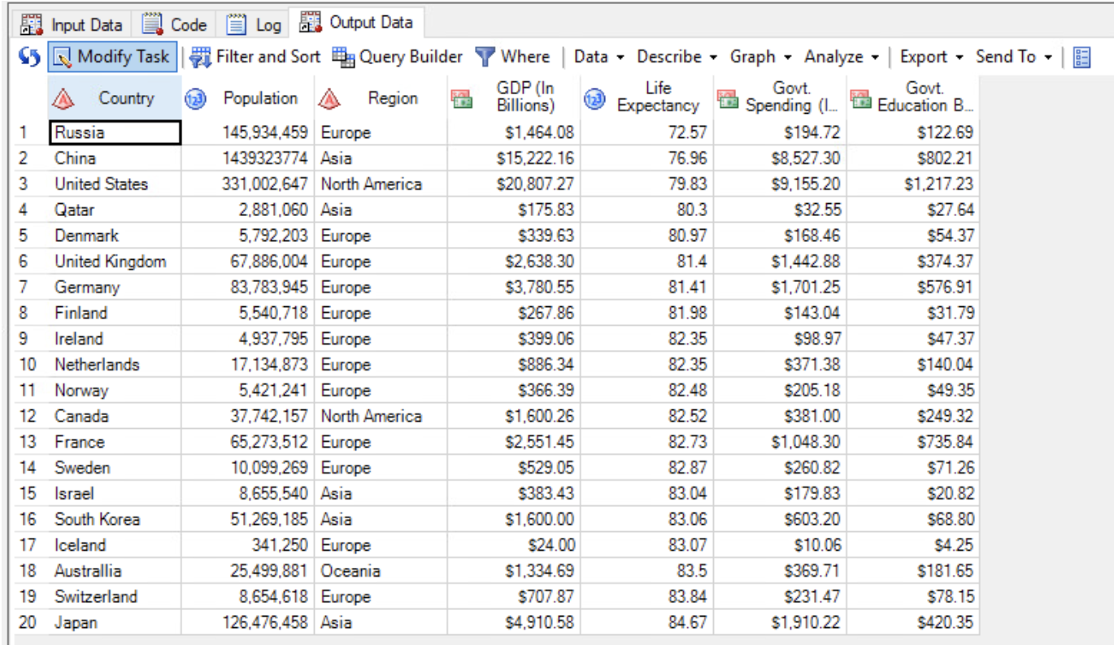
Other Findings Table

Slide 11
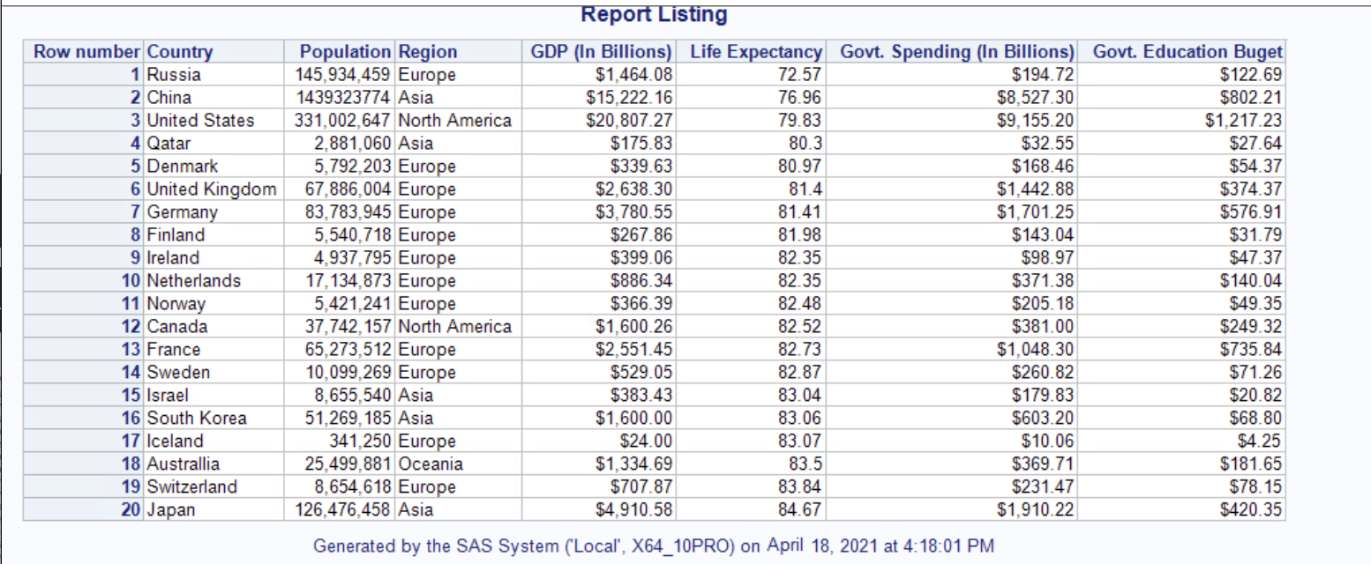
Other Findings Report

Slide 12
Summary
20 countries
Data collection from 2005-2020
The data measured cam determine a correlation among education rate and COVID-19, however this cannot equal causation.
Causation can be a result of numerous factors such as wellbeing, refraining from tobacco and alcohol use, diet and income disparity.
Countries such as the European Nordic countries, Japan and Korea are extremely healthy and retain healthy diets. Because of this they are not as susceptible to obesity and underlying health conditions contributed from obesity.
Geolocation might be a correlation in how COVID-19 spread. Countries like Australia and Iceland were not nearly as impacted compared to continental countries with neighboring nations.
You can find correlations however causation doesn't stem entirely through education or income.

Slide 13
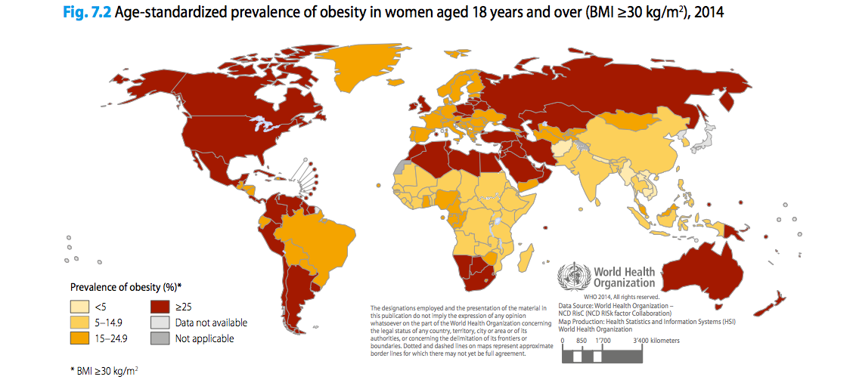
Additional Information

Slide 14
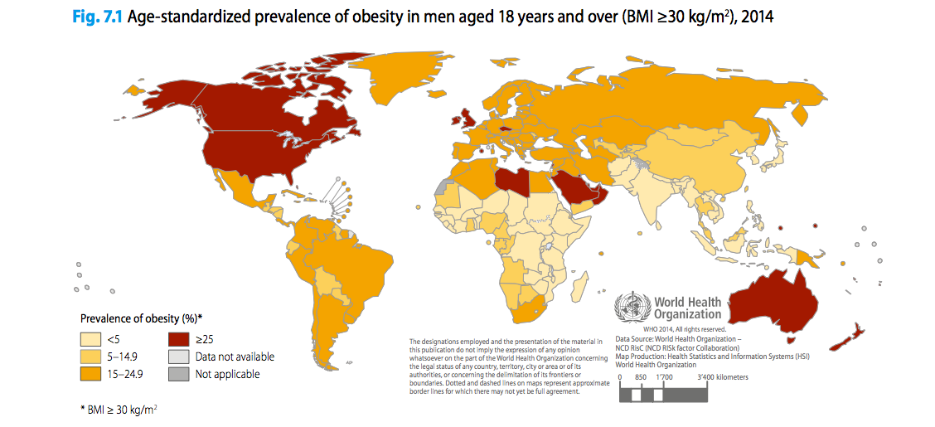
Additional Information

Slide 15
References
Agence France Tresor. (n.d.). The State budget. https://www.aft.gouv.fr/en/state-budget
American Addiction Centers. (n.d.). Global Drinking Demographics. AAC. https://www.alcohol.org/guides/global-drinking-demographics/
Australian Bureau of Statistics. (2020, April 28). Government Finance Statistics, Annual. https://www.abs.gov.au/statistics/economy/government/government-finance-statistics-annual/latest-release
Canada. (2020, February 27). 2020–21 Estimates. https://www.canada.ca/en/treasury-board-secretariat/services/planned-government-spending/government-expenditure-plan-main-estimates/2020-21-estimates.html
Capar, R. (2020, October 7). Everything you need to know about Norway’s 2021 budget. Norway Today. https://norwaytoday.info/finance/everything-you-need-to-know-about-norways-2021-budget/
Chen, J. (2010, March 1). Government to increase spending on education. China Daily. http://www.chinadaily.com.cn/china/2010-03/01/content_9515384.htm
China Government Expenditures. (2020, December 31). Moody’s Analytics. https://www.economy.com/china/government-expenditures/
Deutsche Welle. (n.d.). German parliament passes record budget. DW. https://www.dw.com/en/german-parliament-passes-record-budget/a-51463550
ED. (n.d.). U.S Department of Education Fiscal Year 2020 Budget Summary. https://www2.ed.gov/about/overview/budget/budget20/summary/20summary.pdf

Slide 16
References
Informational Monetary Fund. (n.d.). World Economic Outlook Databases. IMF. https://www.imf.org/en/Publications/SPROLLs/world-economic-outlook-databases#sort=%40imfdate%20descending
International Monetary Fund. (2011). Government expenditure, percent of GDP. https://www.imf.org/external/datamapper/exp@FPP/USA/JPN/GBR/SWE/ITA/ZAF/IND/CHL/FRA/GRC/NLD/ESP/RUS
Jacobs, S. (2017, June 25). Australia’s economy is being cushioned by a big increase in government spending. Business Insider Australia. https://www.businessinsider.com.au/australias-economy-is-being-cushioned-by-a-big-increase-in-government-spending-2017-6
Population Estimates and Projections | Data Catalog. (2020, December 18). The World Bank. https://datacatalog.worldbank.org/dataset/population-estimates-and-projections
Statista. (2021, March 31). Government expenditure as share of the gross domestic product (GDP) in Russia 2025. https://www.statista.com/statistics/275349/government-expenditure-as-share-of-the-gross-domestic-product-gdp-in-russia/#statisticContainer
The World Bank. (n.d.). World Development Indicators. https://datatopics.worldbank.org/world-development-indicators/
TRADING ECONOMICS. (n.d.). Canada Government Spending. https://tradingeconomics.com/canada/government-spending
UIS. (n.d.). Data for the Sustainable Development Goals. http://uis.unesco.org/
UNDP. (n.d.). Human Development Reports. http://hdr.undp.org/en/content/education-index
Welfare State Developments in the Russia. (n.d.). Scribd. https://www.scribd.com/document/402678438/Welfare-State-Developments-in-the-Russia-pdf
World Health Organization. (n.d.). WHO Coronavirus (COVID-19) Dashboard. https://covid19.who.int/
World Health Organization, World Health Organization, gamapserver.who.int/gho/interactive_charts/ncd/risk_factors/obesity/atlas.html.
Notes:
Here are our references we used throughout the team project. Hope you enjoyed our team project and have a great end to the semester. Thanks!

