Slide 1
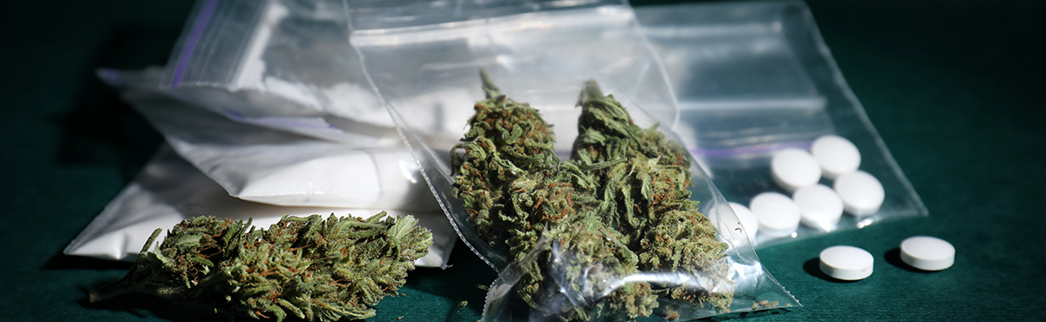
Hijacking the brain:
How Cocaine, Methamphetamine, Alcohol, and Cannabis Alter Neurochemistry and Influence Criminal Behavior
Hayden Neider
10/6/2025

Slide 2
Agenda
Personal Perspective Statement
Introduction to Neurochemical Hijacking
Substance Breakdown
Behavioral and Criminal Outcomes Synthesis
Rehabilitation, Policy, and Prevention
References
Neurochemical Breakdown
Conclusion and Future Directions
Implications for Law Enforcement Practice

Slide 3
Personal Perspective Statement
As a future law enforcement professional, I believe understanding how substances like cocaine, methamphetamine, alcohol, and cannabis alter brain chemistry is essential. These drugs hijack neurotransmitter systems, influencing behavior, decision-making, and impulse control. By studying their neurochemical effects, I aim to better interpret addiction, aggression, and impaired judgment in real-world scenarios, and apply that knowledge to investigations, crisis response, and rehabilitation. This topic bridges biology and criminal justice, helping officers respond with both precision and empathy.

Slide 4
Introduction To neurological Hijacking
Neurochemical hijacking → drugs override brain signaling
Disrupts: decision-making, impulse control, emotional stability
Criminal justice impact: violence, impaired driving, acquisitive crime, recidivism
Substances studied: Cocaine, Methamphetamine, Alcohol, Cannabis
Interdisciplinary lens: neuroscience + criminology + policing

Slide 5
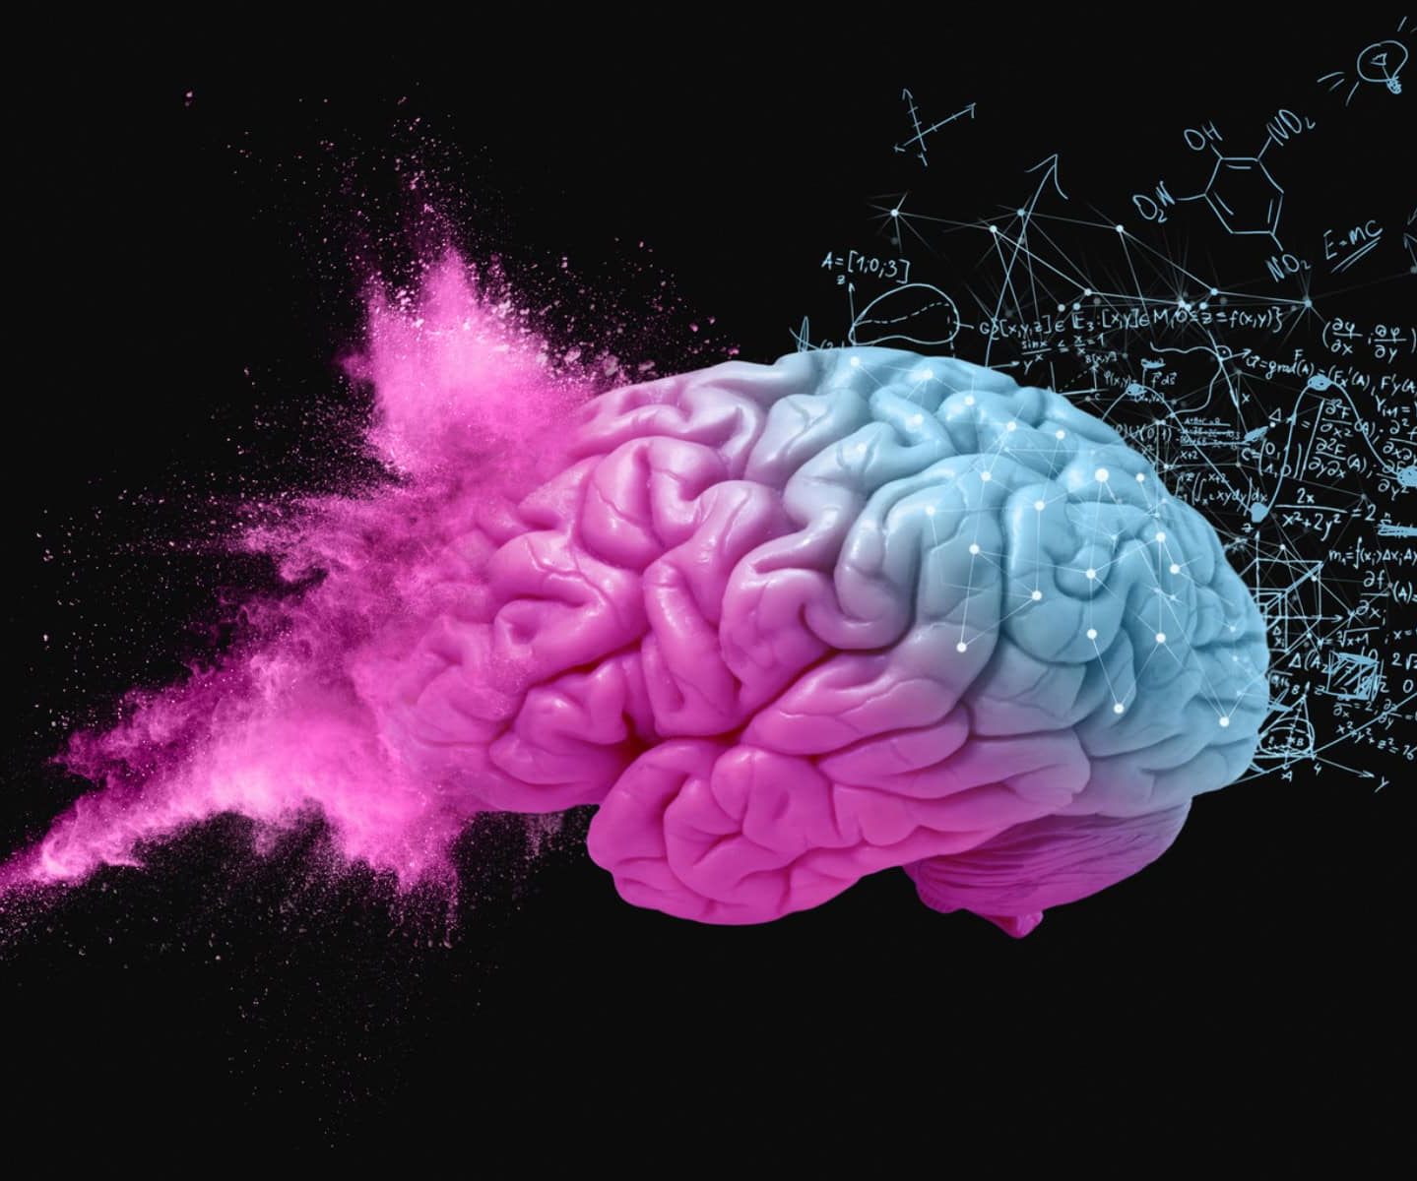
Neurochemical Background
Brain regulation depends on balance of key systems
Dopamine → reward prediction, motivation, compulsive seeking when hijacked
GABA & Glutamate → inhibitory/excitatory balance, judgment, impulse control
Serotonin → mood stability, aggression, anxiety regulation
Endocannabinoid system → synaptic tuning, stress response, perception, memory
Acute use → short-term intoxication effects
Chronic use → neuroadaptations: tolerance, craving, withdrawal, executive deficits
Justice impact: acute crises vs. chronic impairments

Slide 6
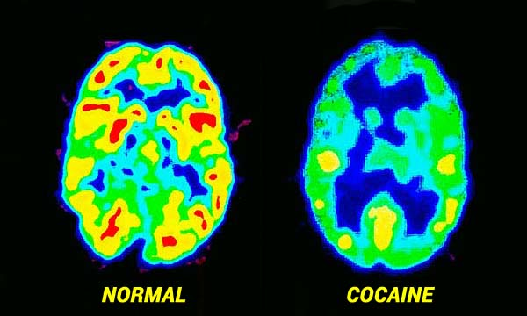
Substance- Cocaine
Mechanism: Blocks dopamine transporter (DAT) → dopamine in reward pathways
Acute effects:
Euphoria, confidence, low risk assessment
Irritability, agitation, paranoia, transient psychosis
Chronic effects:
Dopamine receptor downregulation → anhedonia, low motivation
Impaired executive function → poor impulse control, compulsive seeking

Slide 7
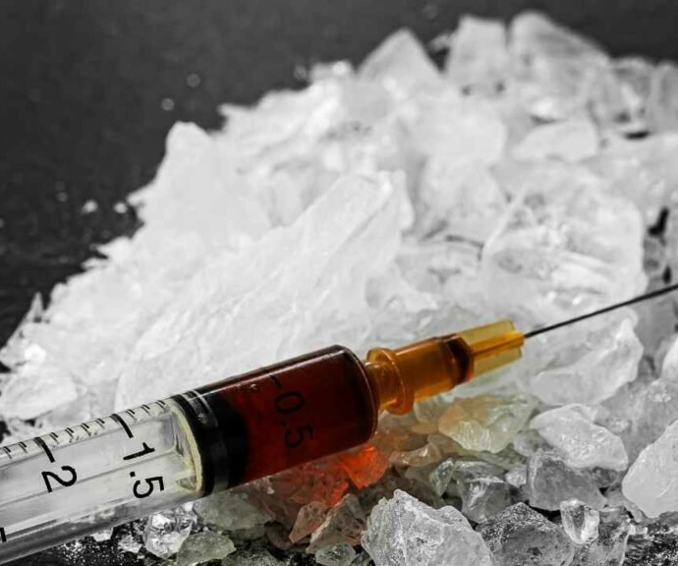
Substance- Methamphetamine
Mechanism:
Reverses dopamine transporter flow
Forces dopamine release from presynaptic terminals
Disrupts vesicular storage → prolonged dopamine surge
Neurotoxic damage to dopamine & serotonin terminals
Acute effects:
Intense stimulation, prolonged wakefulness, heightened arousal
Severe irritability, pressured speech, hypervigilance
High doses → stimulant-induced psychosis (hallucinations, paranoia, violent behavior)
Chronic effects:
Neural circuit damage → cognitive decline, executive dysfunction, memory deficits
Heightened impulsiveness, poor decision-making, compulsive drug-seeking
Emotional instability, difficulty with social reintegration

Slide 8
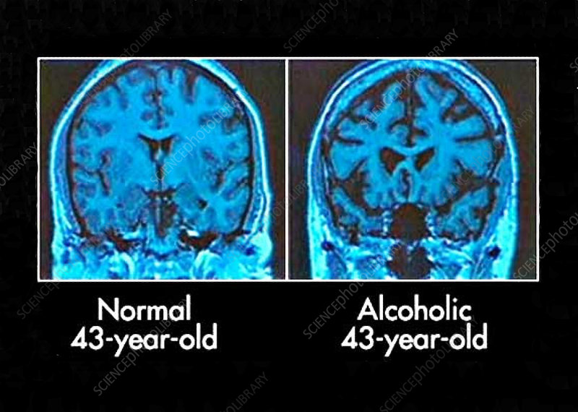
Substance- Alcohol
Mechanism:
Potentiates GABA inhibition
Antagonizes NMDA glutamate excitation
Alters balance of inhibition vs. arousal → impaired executive control
Acute effects:
Disinhibition, poor risk assessment
Impaired working memory
Lower aggression threshold → impulsive behavior
Chronic effects:
Neuroadaptive changes → altered receptor expression
Frontal lobe deficits → persistent impulsivity, executive dysfunction, emotional instability
Long-term misuse → cognitive decline, dependence, recidivism risk

Slide 9
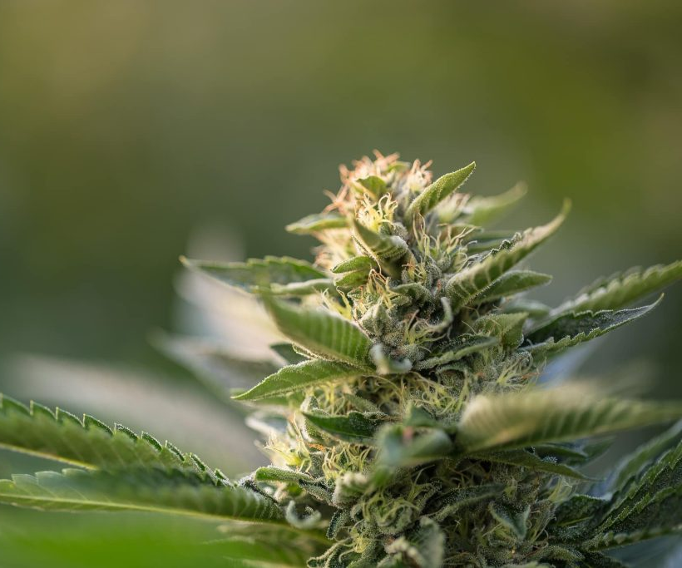
Substance- Cannabis
Mechanism:
THC binds to CB1 receptors
Regulates presynaptic neurotransmitter release
Indirectly influences dopamine signaling in reward pathways
Alters perception, memory, emotional balance
Acute effects:
Altered time perception, slowed psychomotor function
Short-term memory impairment
Sedation or reduced motivation
Anxiety, disorganization, transient paranoia (in vulnerable individuals)
Chronic effects:
Impaired attentional control, learning, executive function
High-potency products → psychiatric risks (persistent anxiety, psychotic-like symptoms)
Reduced academic/occupational performance
Complicates rehabilitation efforts

Slide 10
Behavioral and Criminal Outcomes synthesis
Core insight: Chronic use reshapes behavior → impacts justice outcomes
Common deficits:
Eroded executive function
Weakened impulse control
Destabilized emotional regulation
Amplification of risk:
Trauma, psychiatric illness, socioeconomic stressors → acute crises
Example: paranoia, aggression, acquisitive crime Unpredictability:
Rapid shifts: agitation, confusion, emotional volatility
Observable cues: slurred speech, slowed reactions, hypervigilance
Cycle of justice involvement:
Intoxication → initial offense
Neuroadaptations → sustained impulsivity, repeated arrests/incarceration

Slide 11
Implications for law enforcement practice
Beyond punishment: adapt strategies to neurochemical disruption
Training focus:
Stimulants → hypervigilance, pressured speech, agitation
Alcohol → disinhibition, aggression
Cannabis → slowed reactions, memory impairment
Operational protocols:
Address medical risks (hyperthermia, withdrawal, polysubstance)
Coordinate with EMS, preserve evidence, protect safety
Investigative practices:
Adjust interviews for impaired memory & perception
Delay questioning or adapt techniques for reliability
Recognize chronic deficits → inform sentencing/diversion
Bridging safety & rehabilitation:
Diversion programs, treatment courts, recovery initiatives
Neuroscience-informed training & crisis response

Slide 12
Rehabilitation, Policy, prevention
Rehabilitation:
Neurobiologically informed → target brain + behavior
Medication-assisted therapies → stabilize withdrawal, reduce craving
Cognitive remediation → restore executive function
Trauma-informed therapies → address adversity, reduce relapse
Policy:
Punitive approaches → cycles of incarceration & relapse
Diversion programs, treatment courts, community recovery
Prioritize rehabilitation → reduce prison burden, improve outcomes
Cross-sector collaboration: law enforcement + public health + mental health
Prevention:
Focus on adolescents/young adults → vulnerable brains
Education: risks of high-potency cannabis, stimulant misuse, binge drinking
Community programs → schools, families, peer networks
Build resilience, reduce initiation, improve public health

Slide 13
Conclusion and Future Directions
Neurochemical disruptions:
Dopamine, GABA, glutamate, serotonin, endocannabinoids → distinct behavioral phenotypes
Cocaine/meth → arousal & impulsivity
Alcohol → lowered inhibition, aggression
Cannabis → impaired cognition, psychomotor control
Chronic convergence:
Impaired executive function
Emotional dysregulation
Elevated recidivism risk
Future directions:
Training: neurobehavioral education for first responders
Forensic research: refine intoxication-behavior links
Policy: expand rehab (MAT, cognitive remediation, trauma-informed therapy)
Prevention: focus on adolescents, high-potency risks

Slide 14
References
Ma L, Steinberg JL, Moeller FG, Johns SE, Narayana PA. Effect of cocaine dependence on brain connections: clinical implications. Expert Rev Neurother. 2015;15(11):1307-19. doi: 10.1586/14737175.2015.1103183. Epub 2015 Oct 29. PMID: 26512421; PMCID: PMC4651809.
Dhein S. Different Effects of Cannabis Abuse on Adolescent and Adult Brain. Pharmacology. 2020;105(11-12):609-617. doi: 10.1159/000509377. Epub 2020 Jul 6. PMID: 32629444.
Jayanthi S, Daiwile AP, Cadet JL. Neurotoxicity of methamphetamine: Main effects and mechanisms. Exp Neurol. 2021 Oct;344:113795. doi: 10.1016/j.expneurol.2021.113795. Epub 2021 Jun 26. PMID: 34186102; PMCID: PMC8338805.
Spear LP. Effects of adolescent alcohol consumption on the brain and behaviour. Nat Rev Neurosci. 2018 Apr;19(4):197-214. doi: 10.1038/nrn.2018.10. Epub 2018 Feb 15. Erratum in: Nat Rev Neurosci. 2018 Jul;19(7):439. doi: 10.1038/s41583-018-0007-2. PMID: 29467469.
Kuhn BN, Campus P, Klumpner MS, Chang SE, Iglesias AG, Flagel SB. Inhibition of a cortico-thalamic circuit attenuates cue-induced reinstatement of drug-seeking behavior in "relapse prone" male rats. Psychopharmacology (Berl). 2022 Apr;239(4):1035-1051. doi: 10.1007/s00213-021-05894-9. Epub 2021 Jun 28. Erratum in: Psychopharmacology (Berl). 2022 Jul;239(7):2365. doi: 10.1007/s00213-021-05919-3. PMID: 34181035.
Fasciano J, Hatzidimitriou G, Yuan J, Katz JL, Ricaurte GA. N-methylation dissociates methamphetamine's neurotoxic and behavioral pharmacologic effects. Brain Res. 1997 Oct 10;771(1):115-20. doi: 10.1016/s0006-8993(97)00801-9. PMID: 9383014.
Magill M, Kiluk BD, Ray LA. Efficacy of Cognitive Behavioral Therapy for Alcohol and Other Drug Use Disorders: Is a One-Size-Fits-All Approach Appropriate? Subst Abuse Rehabil. 2023 Feb 19;14:1-11. doi: 10.2147/SAR.S362864. PMID: 36844999; PMCID: PMC9948631.
Carrà G, Nicolini G, Crocamo C, Lax A, Amidani F, Bartoli F, Castellano F, Chiorazzi A, Gamba G, Papagno C, Clerici M. Executive control in schizophrenia: a preliminary study on the moderating role of COMT Val158Met for comorbid alcohol and substance use disorders. Nord J Psychiatry. 2017 Jul;71(5):332-339. doi: 10.1080/08039488.2017.1286385. Epub 2017 Feb 14. PMID: 28635556.
Becker MP, Collins PF, Schultz A, Urošević S, Schmaling B, Luciana M. Longitudinal changes in cognition in young adult cannabis users. J Clin Exp Neuropsychol. 2018 Aug;40(6):529-543. doi: 10.1080/13803395.2017.1385729. Epub 2017 Oct 23. PMID: 29058519; PMCID: PMC6130912.
Baldaçara L, Ramos A, Castaldelli-Maia JM. Managing drug-induced psychosis. Int Rev Psychiatry. 2023 Aug-Sep;35(5-6):496-502. doi: 10.1080/09540261.2023.2261544. Epub 2024 Feb 1. PMID: 38299647.
Magill M, Kiluk BD, Ray LA. Efficacy of Cognitive Behavioral Therapy for Alcohol and Other Drug Use Disorders: Is a One-Size-Fits-All Approach Appropriate? Subst Abuse Rehabil. 2023 Feb 19;14:1-11. doi: 10.2147/SAR.S362864. PMID: 36844999; PMCID: PMC9948631.

