Slide 1
Periodontal Instruments
Notes:
Throughout the semester, you learned about Periodontal. Today we will introduce periodontal instruments. We will talk more about the instruments that used for assessment and treatment for the periodontal and classifications of the periodontal instrument, how each type of the periodontal instruments can be used.

Slide 2
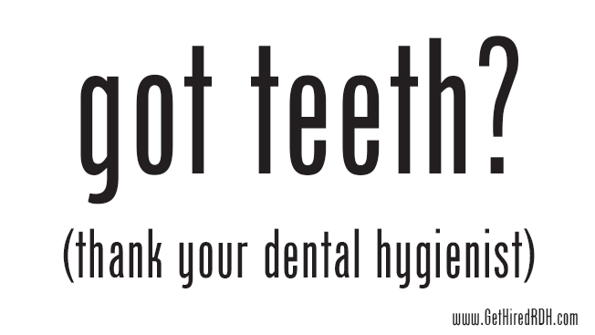

Slide 3
Objectives
1.Identify the parts of the periodontal instrument.
2.Classify the two primary use of the periodontal instruments.
3.Describe the use of the specialized periodontal instrument.
4.Distinguish the differences between the types of periodontal instruments.
5.Demonstrates the advantages of the hand scaler and ultrasonic scaler.

Slide 4
Periodontal instruments
Periodontal instruments are designed to remove calculus, root planning surfaces, curetting the gingiva, and remove diseased tissue.
It is performed for supra and subgingival, and it can be done using
a non-surgical or surgical approach.

Slide 5
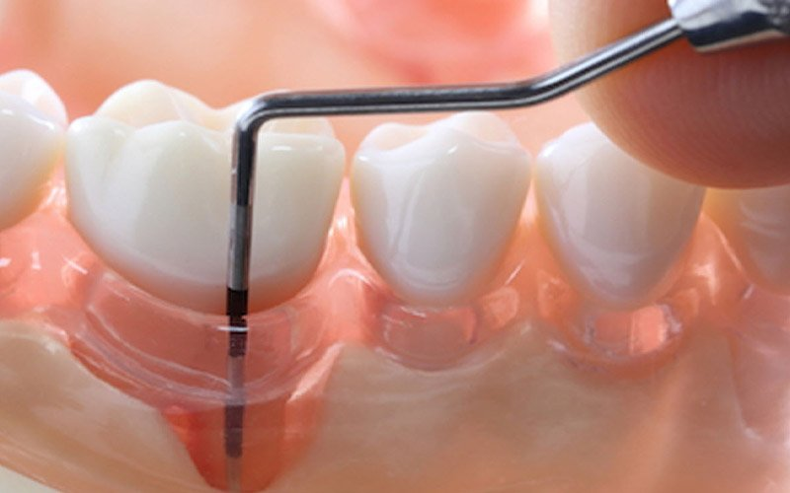
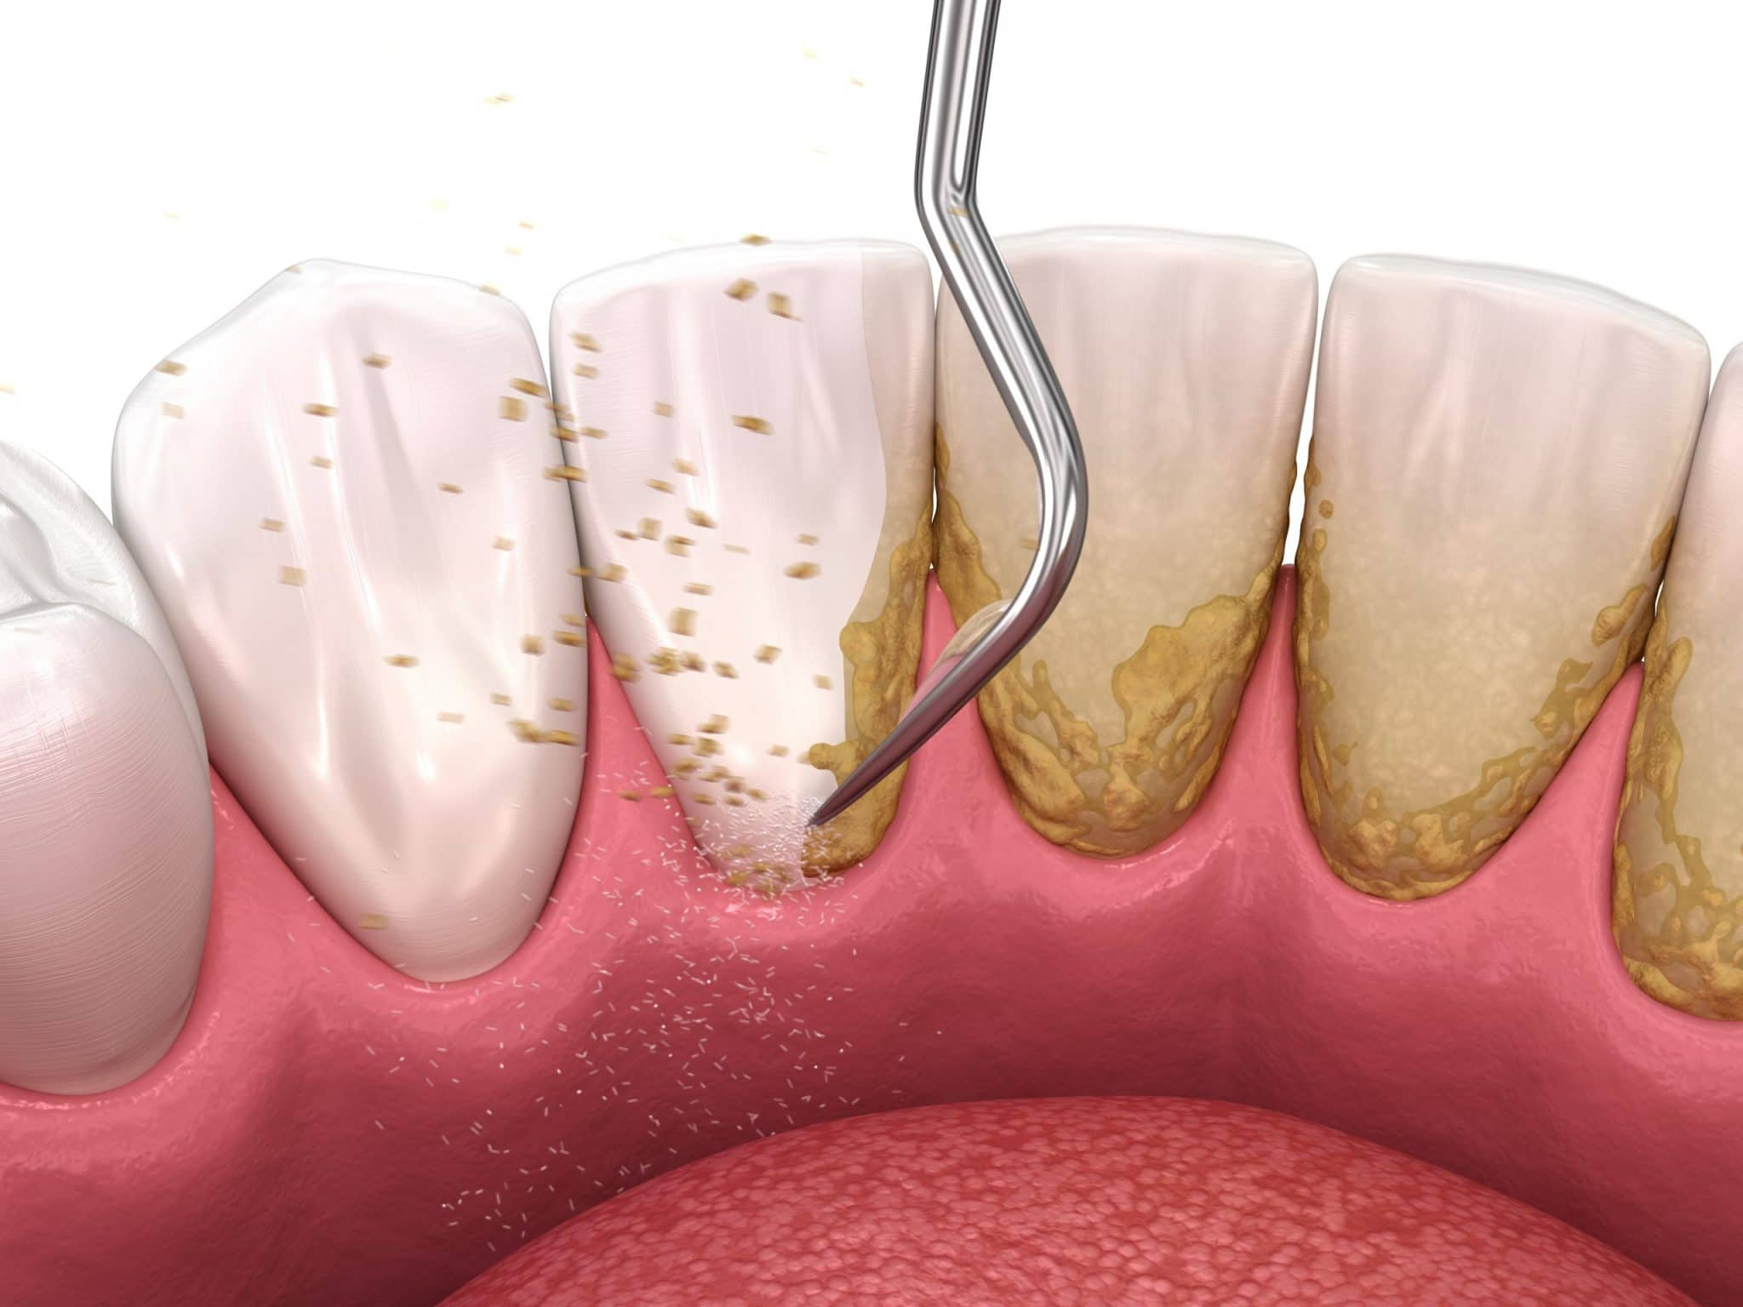
Periodontal instruments can be divided into:
Assessment Instruments.
Therapeutic Instruments.

Slide 6
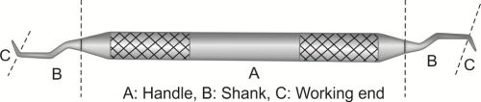
PARTS OF THE PERIODONTAL INSTRUMENT
Handle : For holding the instrument.
Shank : Located between the handle and the working-end.
Working-End: The part that does the work.
Notes:
Handle—the part of a periodontal instrument used for holding the instrument.
Shank—a rod-shaped length of metal located between the handle and the working-end of a dental instrument.
Working-End—the part of a dental instrument that does the work of the instrument.

Slide 7
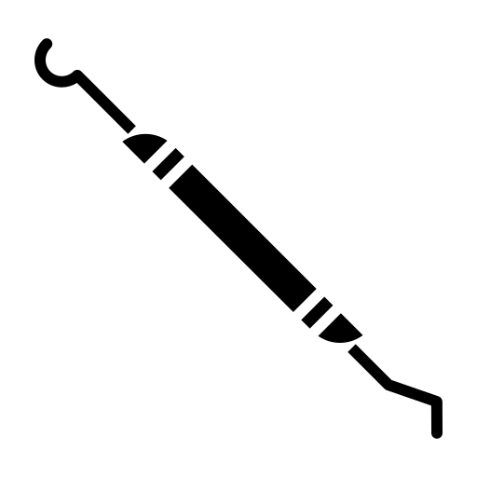
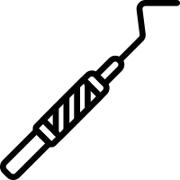
Single ended and Double- ended Designed
Single-ended instruments are less efficient to use because the clinician must stop more often to lay down one instrument and pick up another.
Double-ended instruments allow the clinician to simply flip the instrument to use the other working-end.
Notes:
Note: Periodontal instruments are available in single-ended and double-ended
Note:
Most double-ended instruments have paired working-ends that are exact mirror images of each other.
Some double-ended instruments have unpaired (dissimilar) working-ends

Slide 8
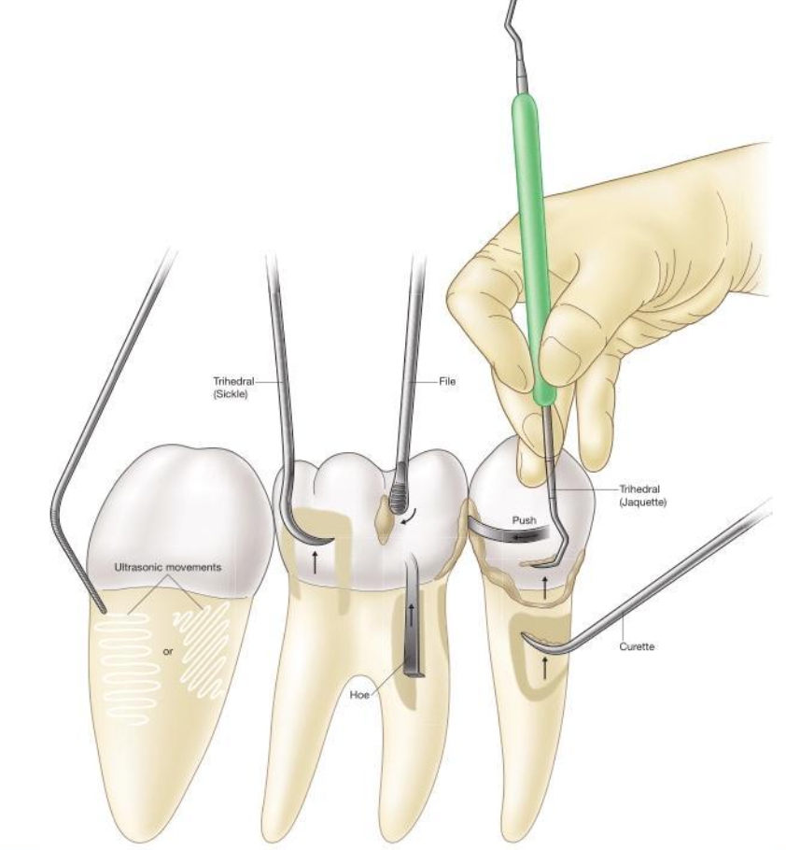
Use of periodontal instruments for Dental hygiene:
Remove calculus
Smooth root surfaces
Measure periodontal pockets

Slide 9
Classifications of Periodontal Instruments:
Therapeutic Instruments
Periodontal Scalers
Periodontal Curettes
Periodontal Files
Ultrasonic
Assessment Instruments
Periodontal Explorers
Periodontal Probes

Slide 10
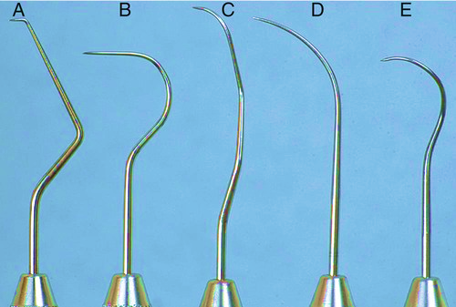
Periodontal Explorers
Has thin working ends to adapt around root surfaces easily
offers perfect tactile information on the location of subgingival calculus deposits
Used For :
Locate supragingival and the subgingival calculus deposits
Check the roughness or smoothness of the root surfaces
Notes:
Note: Periodontal explorers are longer and curved than explorers that used for caries detection

Slide 11
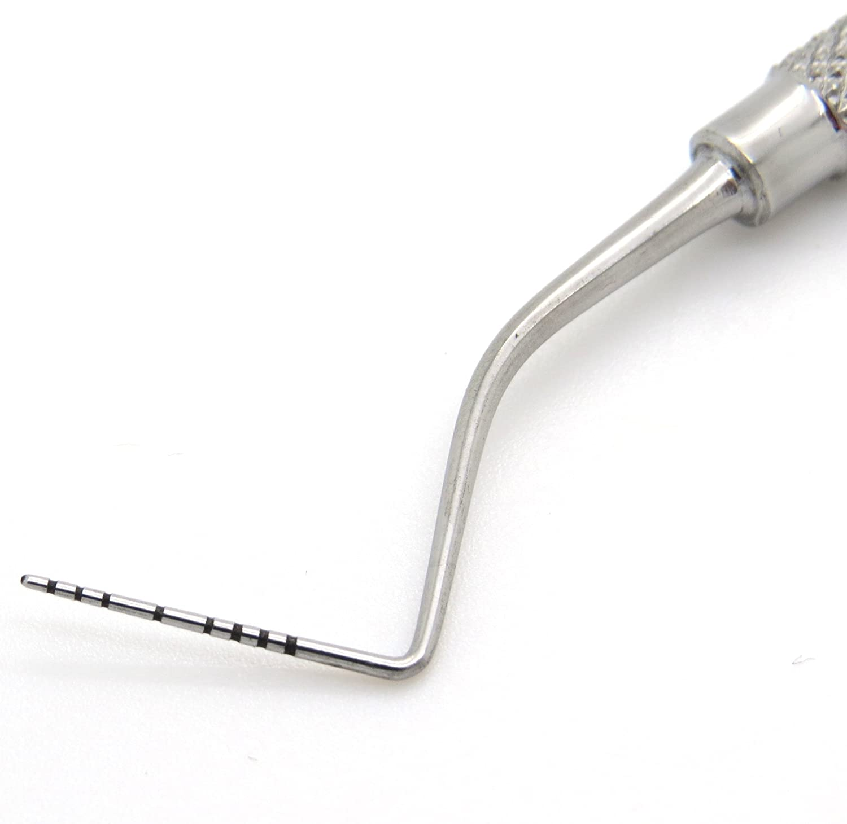
Periodontal Probes:
Marked in millimeter.
Tapered to fit into the gingival sulcus and has rounded tip not to injure the soft tissues
Measure the depth of gingival sulcus and periodontal pockets
Measure clinical attachment levels.

Slide 12
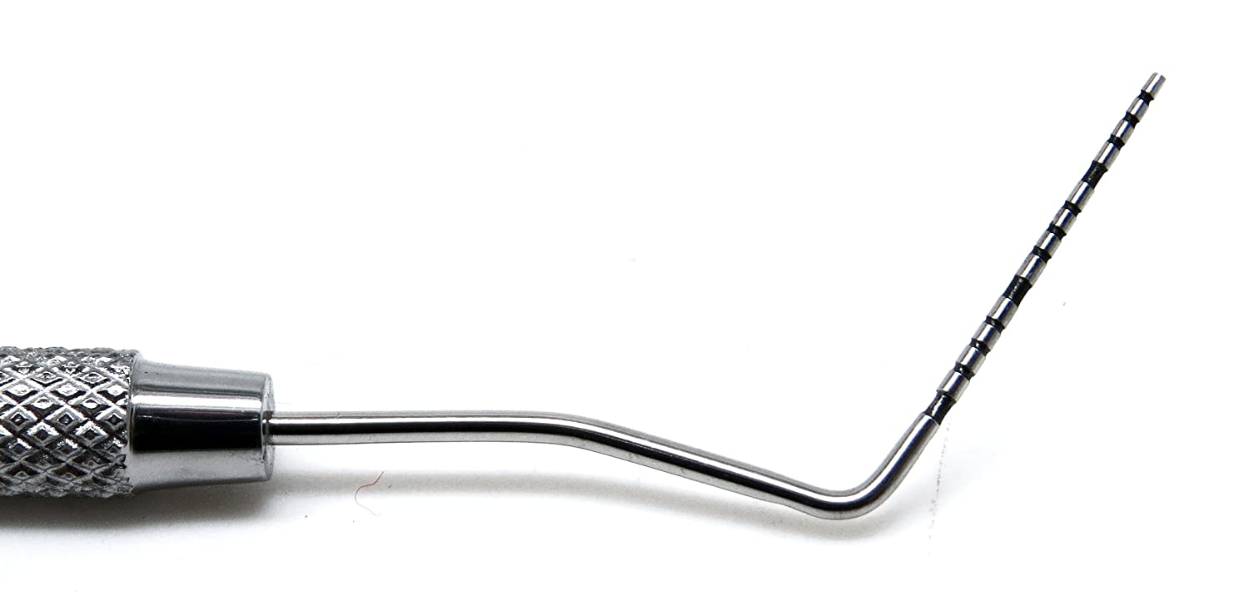
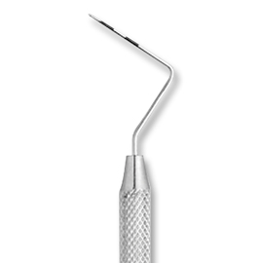
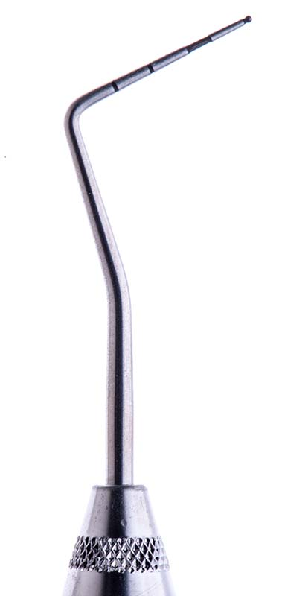

Types of Periodontal probes
UNC-15 probe
Williams Probe
Marquis color coded probe
University of Michigan probe
(WHO) probe
Notes:
Wiliams probe – has 10mm
Marquis color-coded probe. 3mm in each section
UNC-15 probe, A 15 mm long
University of Michigan probe with 10mm (1,2,3,4,5,6,7,8,9,10)
World Health Organization (WHO) probe, 11.5 mm (0.5, 3.5, 8.5, 11.5)

Slide 13
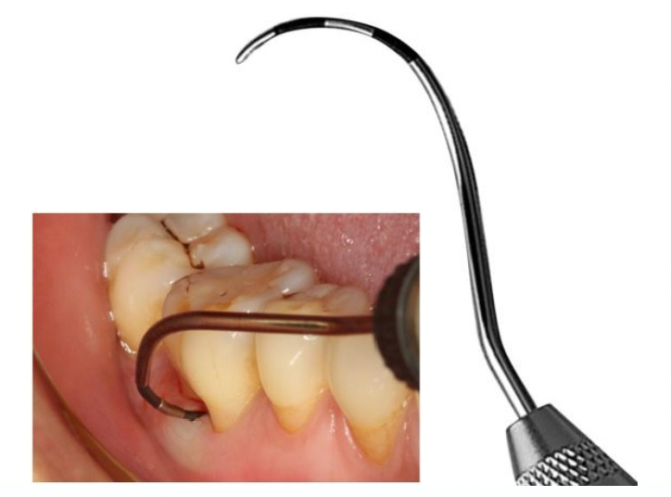
Furcation probes
Furcation probes is also known of Nabers Probe
Measure the horizontal and vertical pocket depths of multirooted teeth

Slide 14
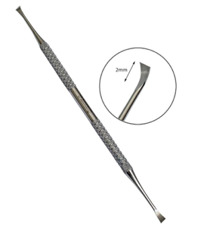
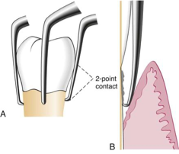
Periodontal Scalers:
1 - Chisel Scalers
Used to remove supragingival calculus from the anterior teeth
2- Hoe Scalers:
Remove heavy supragingival calculus
Effective when used on buccal and lingual surfaces of posterior teeth

Slide 15
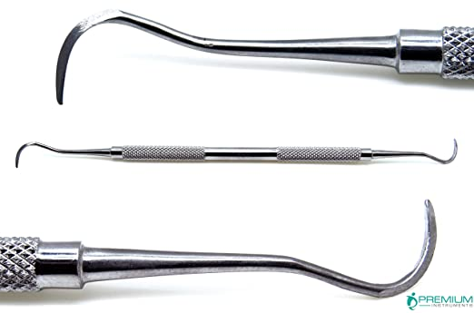
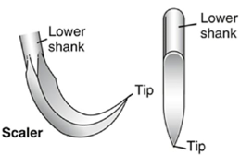
Periodontal Scalers:
3 -Sickle scalers:
Remove large deposits of supragingival calculus.
Two cutting edges that converge in a highly pointed tip and have a flat surface.

Slide 16
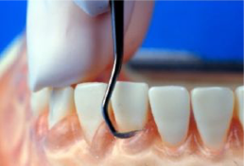
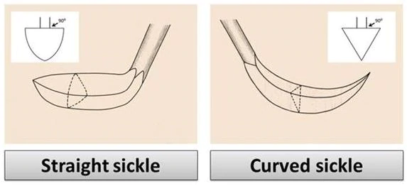
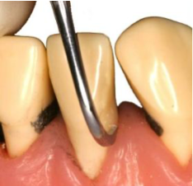
Types of Sickle Scalers:
Sickle scaler straight blade:
a long, straight shank is used to remove calculus
from the anterior areas.
Sickle Scaler Curved Blade:
A contra-angle shank, is designed to remove calculus
from the posterior teeth.
Notes:
Note: The differences between the two types of the sickle scalers are that one of them is straight blade and the other is curved blade

Slide 17
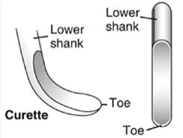
Periodontal Curettes:
Have a rounded end, with one or two cutting edges
USED FOR :
Removing deep subgingival calculus.
Removing soft tissue lining of a periodontal pocket.
Root planning.
Notes:
Curettes have a rounded end, in contrast of sickle scalers, which have a pointed end.

Slide 18

Types of periodontal curettes:
A- Universal Curettes:
Designed to adjust to all tooth surfaces.
Have two cutting edges, one on each side of the blade.
Double-ended.

Slide 19
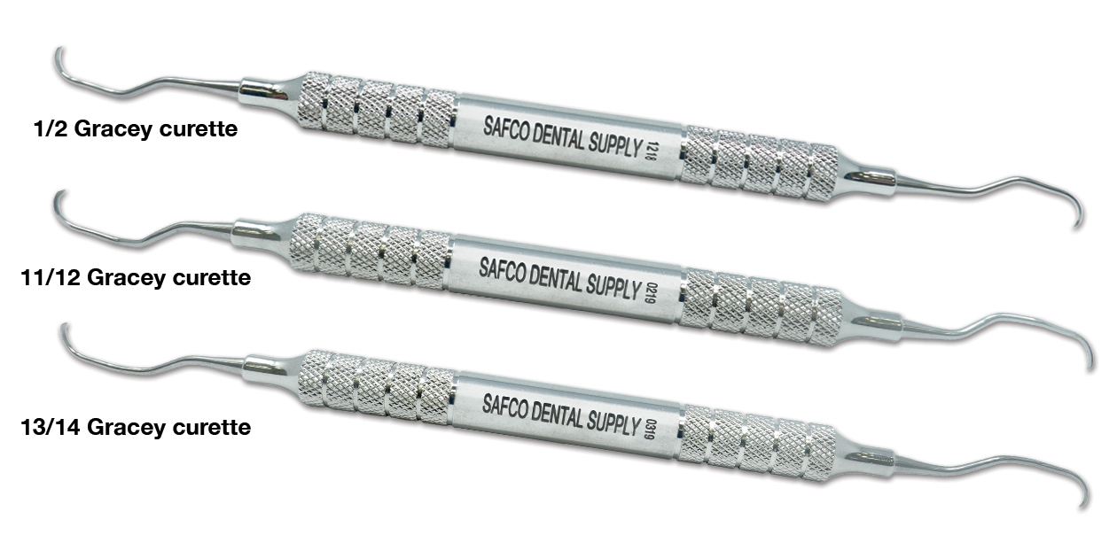
Types of periodontal curettes:
A- Gracey Curettes:
Designed to adopt to specific tooth surfaces (mesial or distal)
Only have one cutting edge and rounded working end
Allow for deep scaling and root planning.

Slide 20
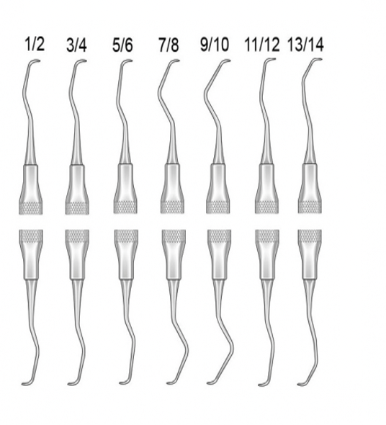
Types and using for Gracey Curettes
Gracey Number 1/2, 3/4
Anterior teeth (Incisors and canines)
Gracey Number 5/6
Anterior teeth and premolars
Gracey Number 7/8, 9/10
Posterior teeth (Buccal and lingual surfaces)
Gracey Number 11/12
Posterior teeth (Mesial)
Gracey Number 13/14
Posterior teeth (Distal)
Notes:
The number indicates the specific area the Gracey curette will be used in

Slide 21
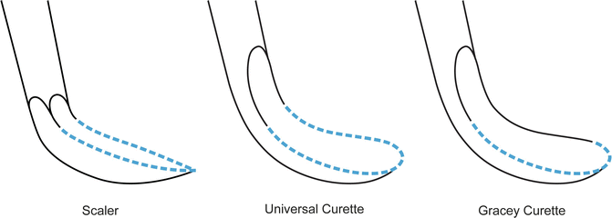
Difference of Cutting Edge of Scaler and Curettes

Slide 22
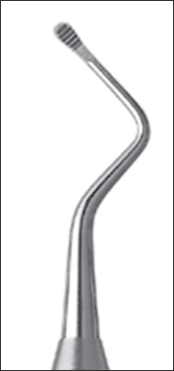
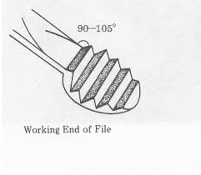
Periodontal Files:
Used to crush or fracture extremely heavy calculus
Each working-end of a periodontal file has several cutting edges.

Slide 23
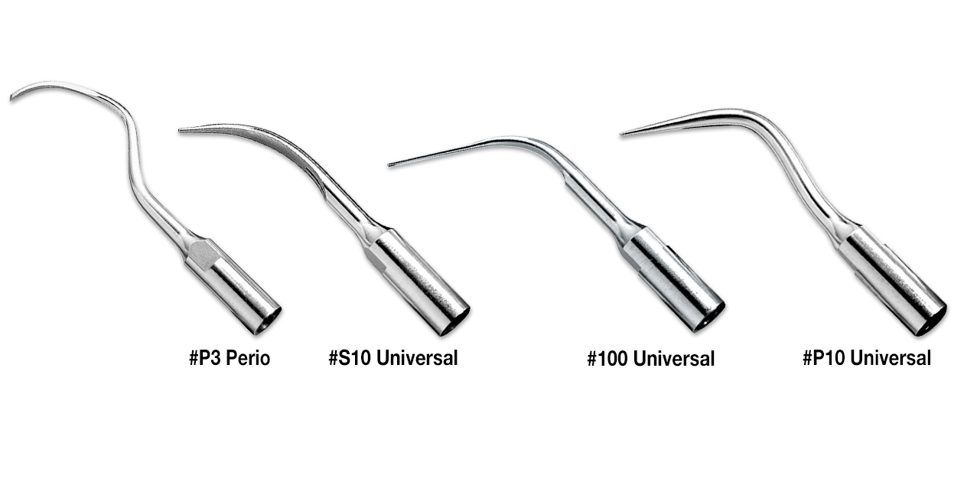
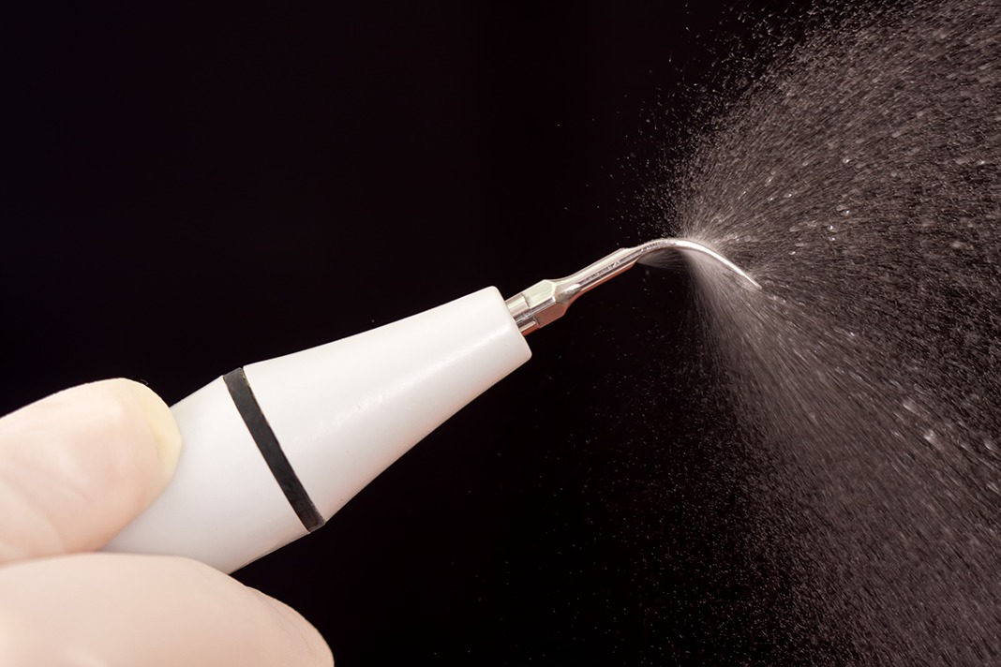
Periodontal Ultrasonic:
Removes calculus quickly
High-frequency sound waves into mechanical energy in the form of extremely fast vibrations at the instrument's tip.
Water at the tip avoids the buildup of heat.
Water from the tip washes debris and bacteria from the pocket's base.

Slide 24
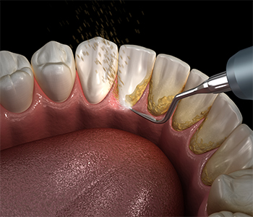
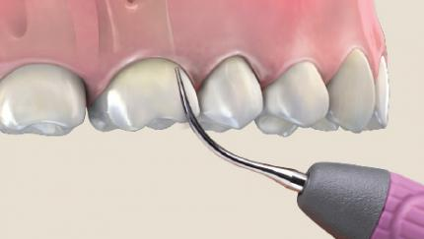
Ultrasonic Used for:
Removing supragingival calculus
Removing difficult stains.
Removing subgingival calculus.
Removing plaque, and endotoxins from the root surface
Cleaning of furcation areas.

Slide 25
Hand and Ultrasonic Scaling:
Hand Scaling
Ultrasonic Scaling
H
U
Advantages:
Advantages
Great tactile sensitivity.
More control
Area-specific designs to improve access.
Improved healing time.
The water supply keeps the operating field clean.
With correct application, repetitive motions are reduced.
Tissue distention is reduced.
H
U
Notes:
In terms of removing calculus and tooth plaque, both ultrasonic and manual scaling treatments are equally effective.

Slide 26
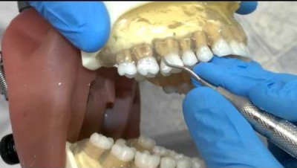
Gracey Instrumentation Basics
Notes:
Q: what should you use to measure the horizontal and vertical pocket depths of multirooted teeth?
A: Furcation probes (Nabers probe)
Q: In which types are The periodontal probe instrument involved?
A: assessment instrument

Slide 27
Critical Thinking :
Case Study:
Questions :
What is the appropriate periodontal instrument that can be used to measure the periodontitis' stage of risk?
what is the appropriate Gracey curettes that can be used to remove the calculus from tooth #19?
what are the appropriate Gracey curettes that can be used to remove the calculus from teeth #24 and #25?
A periodontitis risk comes in with an adult patient. The patient has moderate calculus on the mesial lingual of tooth #19 and heavy calculus on the lingual of teeth #24 and #25.

