Slide 1
Impression Materials
By: Hisham Alhamrayn
Notes:
An accurate record of the dimensional characteristics of oral soft & hard tissues structures is vital in dentistry. Today we will discuss the relationship between impression material and dental health.

Slide 2
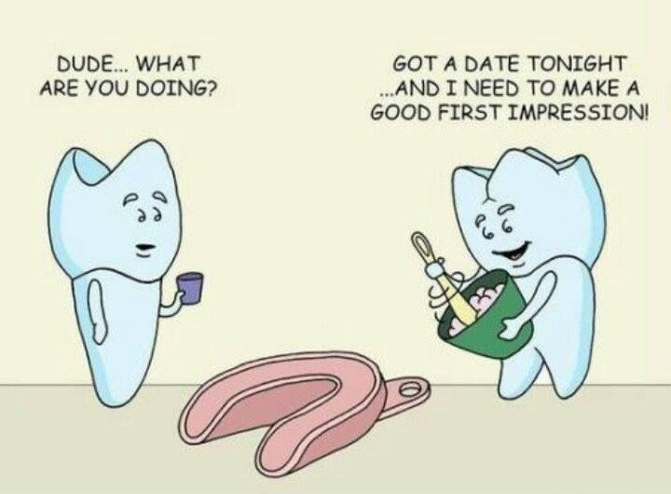
Notes:
Note:
The impression materials must be both safe and easy to manipulate for the patient.

Slide 3
Objectives
Define the dental impression and impression materials.
List the classification of impression materials.
Describe the uses of dental impression materials.
Summarize the Impression techniques.
Share the advantages and disadvantages of each impression material.

Slide 4
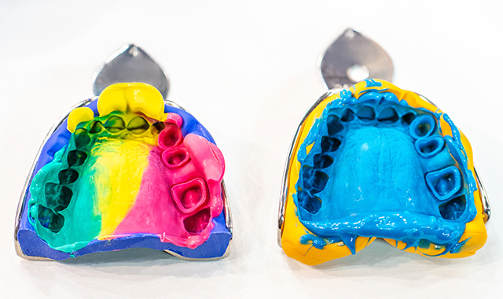
Impression materials
Impression material Definition:
The materials used to record the shape accurately and dimensional characteristics of teeth to precisely transfer the impression to the model
Dental Impression Definition:
The dental impression is the negative replica of the oral soft & hard tissues.
Notes:
Dental impressions let dental work to be performed even when the patient is not present.

Slide 5
Uses of dental impression materials:
The dental impression materials are used to copy the oral soft & hard tissues for:
- Analyze and diagnose a clinical case
- Build occlusal splints and mouthguards
- Treatment planning
- Maintaining records

Slide 6
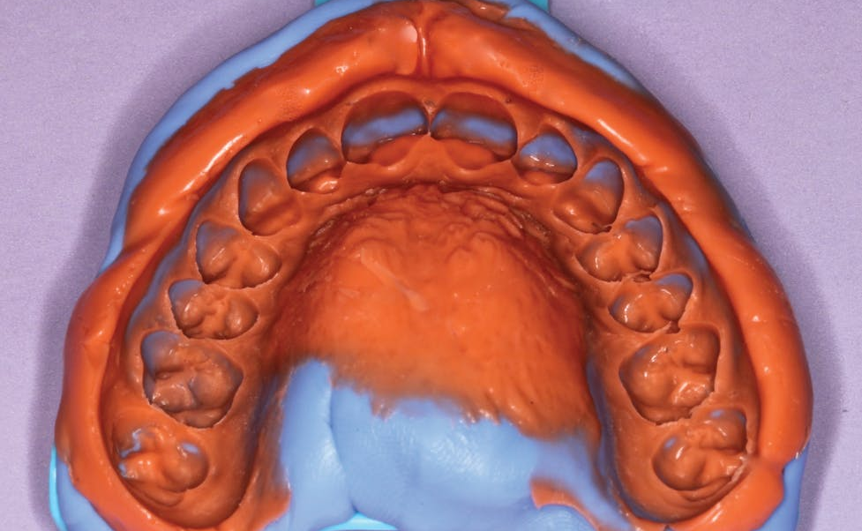
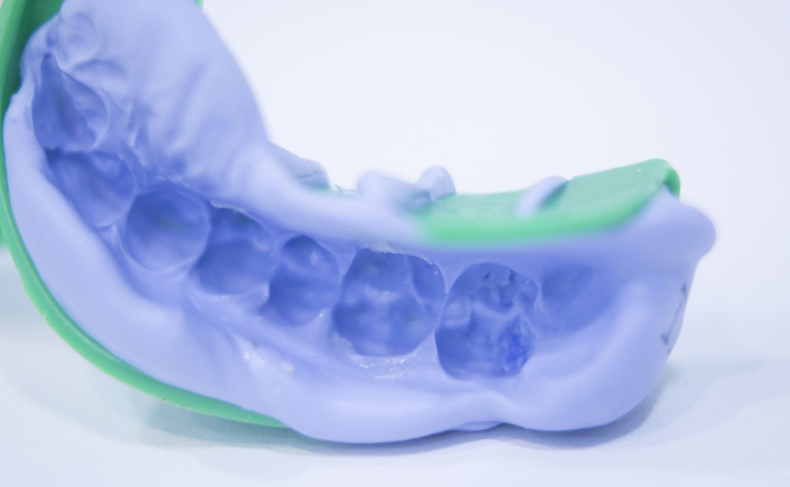
Impression techniques:
1- Full dentures impression
2- Partial dentures impression
3- Fixed prosthodontics

Slide 7
#Classification of impression materials:
Non-elastic (Rigid):
Material is complex and not suitable for the final impression.
Types of non-elastics:
- Impression Plaster
- Impression compound
- Zinc oxide-eugenol
- Impression waxes
Notes:
Note:
Non-elastics material cannot be used in areas where undercuts

Slide 8
Classification of impression materials (count):
2- Elastic:
The elastic is flexible at the time of removal from the mouth
Types of elastics:
Hydrocolloids:
Reversible (Agar)
Irreversible (Alginate)
b. Elastomers:
- Polysulfide
- Silicones
- Polyether
Notes:
Note: hydro mean water, colloids mean gelatin substance

Slide 9
Requirement for impression materials:
1- Sufficiently fluid to reproduce all of the fine details.
2. Suitable setting time
3. Acceptable to the patient(pleasing odor, color, and taste)
4. Safe (Not toxic or irritant)
5. Sufficient mechanical strength
6. Dimensionally stable
7. Good keeping qualities

Slide 10
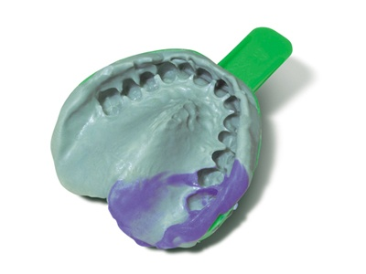
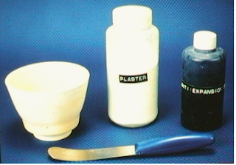
Impression Plaster:
Used for final impression for a complete denture.
Rarely used these days

Slide 11
Impression Plaster:
Advantages
Disadvantages:
Simple to mix
Work time 2-3 minutes
Set time 2-3 minutes
Low cost
Good accuracy and dimensional stability
Insufficient strength
rough surface finish
Abrasion resistance is poor
Rigid when set

Slide 12
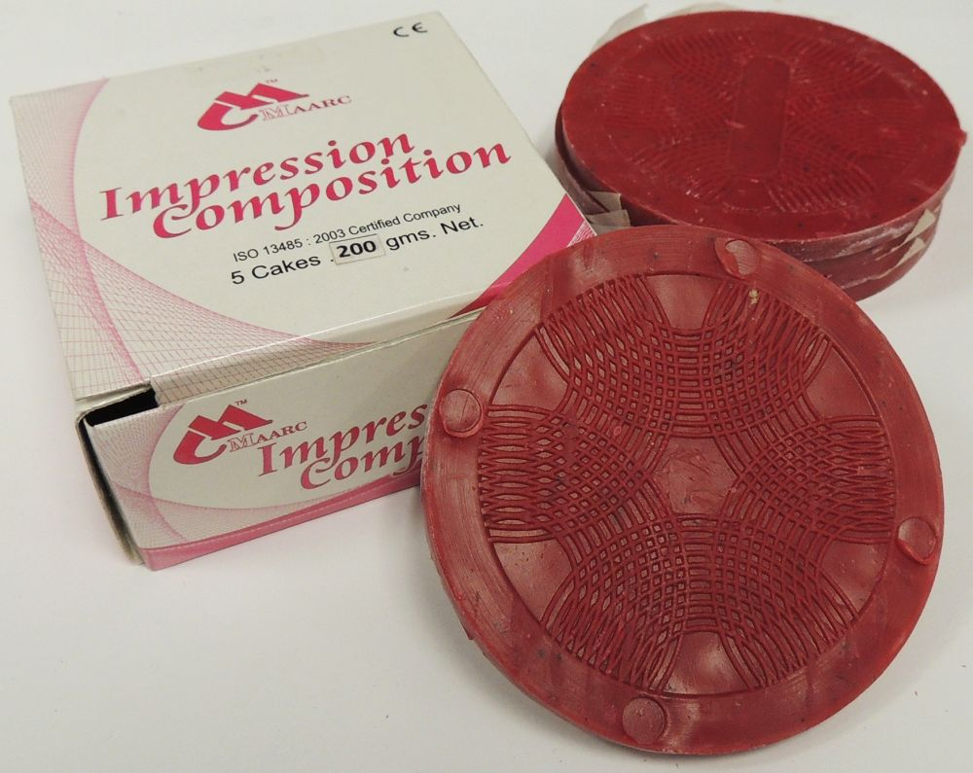
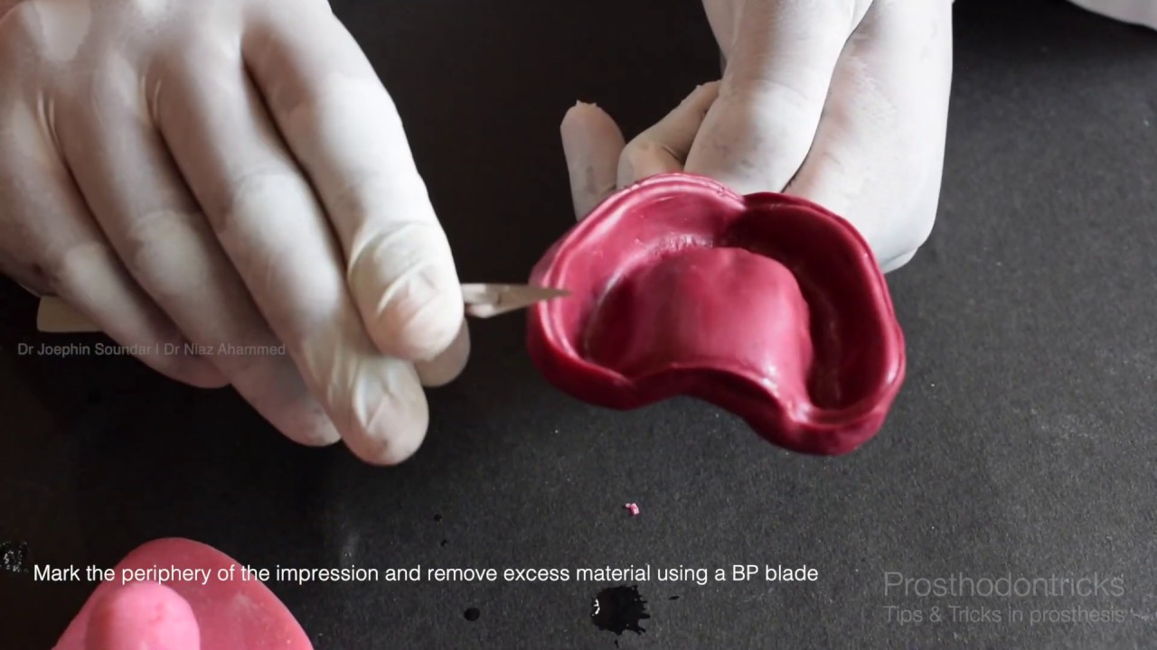
Impression compound:
A thermoplastic, rigid and reversible impression material.
Types of impression compound:
Types1: Low fusing impression compound. Making primary impression for an edentulous ridge.
Types 2: High fusing impression compound. Making impression tray.
Notes:
Note: (it can be reused in the same patient if an impression needs to be repeated). It is known as a modeling compound).
Note: in 1857, Charles Stent created a thermoplastic modeling compound similar to today's impression compound

Slide 13
Impression compound:
Advantages:
Disadvantage:
Added or removed until achieved a good impression.
Reused for the same patient.
Not record fine details.
Poor dimensional stability

Slide 14
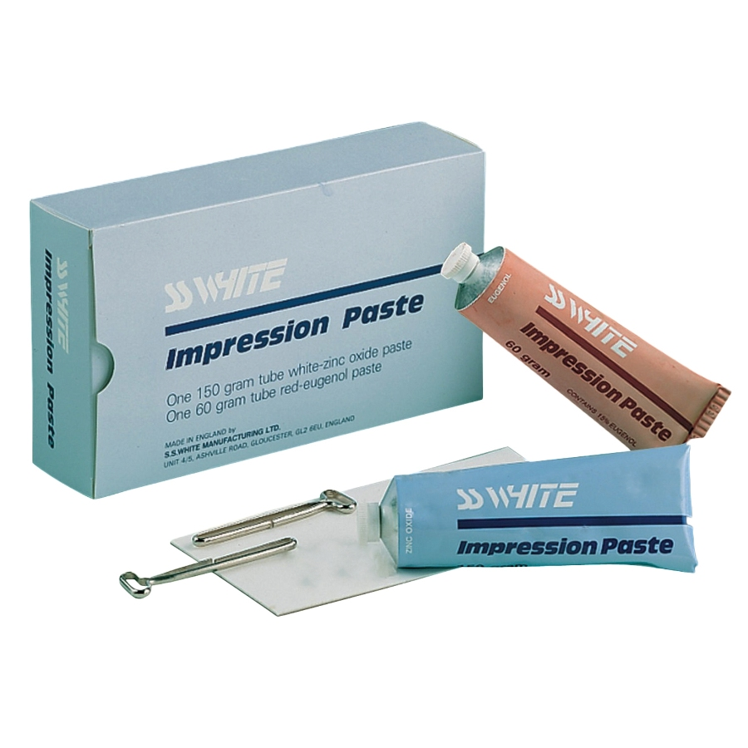
Zinc oxide-eugenol:
Used for final impression for complete denture
Advantages:
Low-cost and simple to use
Good flow aids in the recording of small details
Good dimensional stability
Disadvantage:
Setting time varies depending on temperature and humidity
It is not compatible with stock trays
Fragile
Notes:
Note: It is wash impression

Slide 15
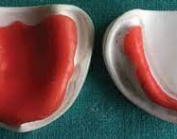
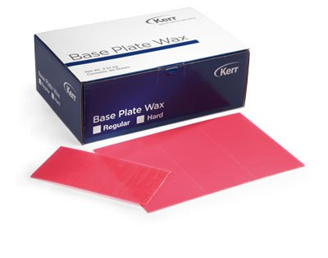
Impression waxes:
Used to record the edentulous ridge
Used to correct a small imperfection in other impressions.
Used as bite registration
Notes:
Note: Wax was the only impression material used in dentistry until the mid-19th century

Slide 16
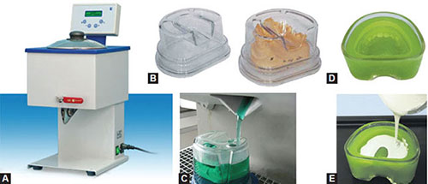
Hydrocolloid impression:
1- Agar (Reversible)
Used for crown and bridge impression.
rarely used now
the first elastic impression material to be used in dentistry.
Notes:
Note: rarely used now due to the need for special conditioning units and water-cooled trays for impression taking.

Slide 17
The agar impression
Advantages:
Disadvantages:
Dimensionally accurate
No mixing is required
Reversible
Affordable
Tears easily
Dimensional instability
Infection control is a difficult task.
Material prepared in advanced
Water bath is required

Slide 18
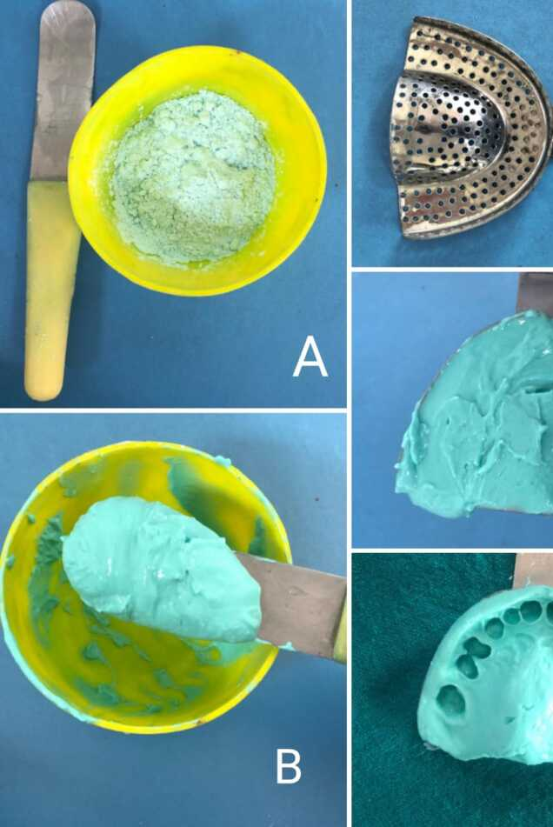
Hydrocolloid impression:
2- Irreversible (Alginate):
Most widely used impression material
Used as Diagnostic casts for treatment planning

Slide 19
The Alginate Impression
Advantages:
Disadvantage:
Inexpensive
Easy to use
Hydrophilic
Good impression
Low tear strength
Dimensional instability

Slide 20
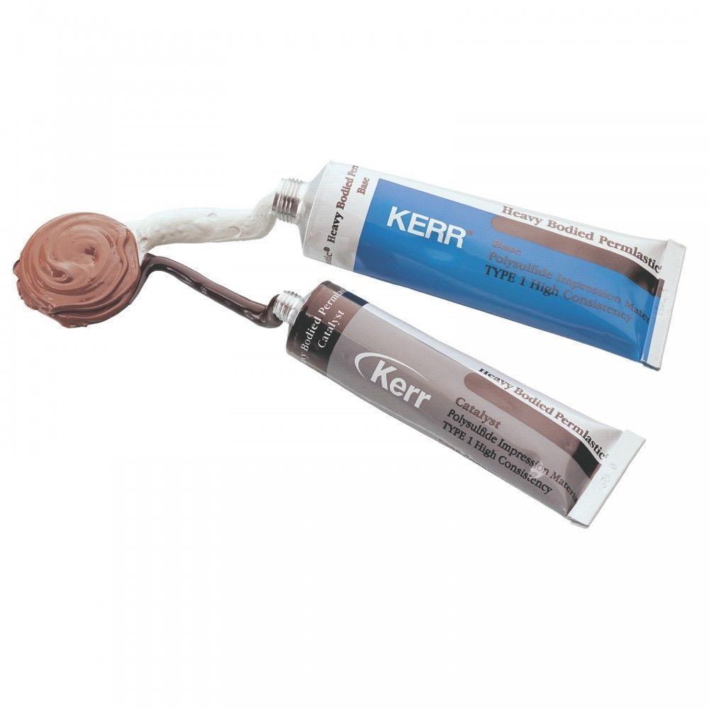
Elastomers impression:
1-Polysulfide:
Useful For a long working time
Advantages:
Long working time
High tear resistance
Margins easily seen
Disadvantages:
Requires custom trays
Good with stone
Stains clothing
Bad odor.
Impression to be poured within 1 hour
Notes:
Note: When accuracy is needed, such as when preparing crowns and bridges or implant placement, elastomers are necessary.

Slide 21
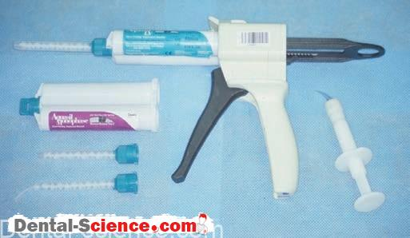
2- Silicone:
Addition Silicone:
The most widely used impression material in fixed prosthodontics
Advantages:
Highly accurate
High dimensional stability
Pour up to one week
Disadvantages:
Hydrophobic

Slide 22
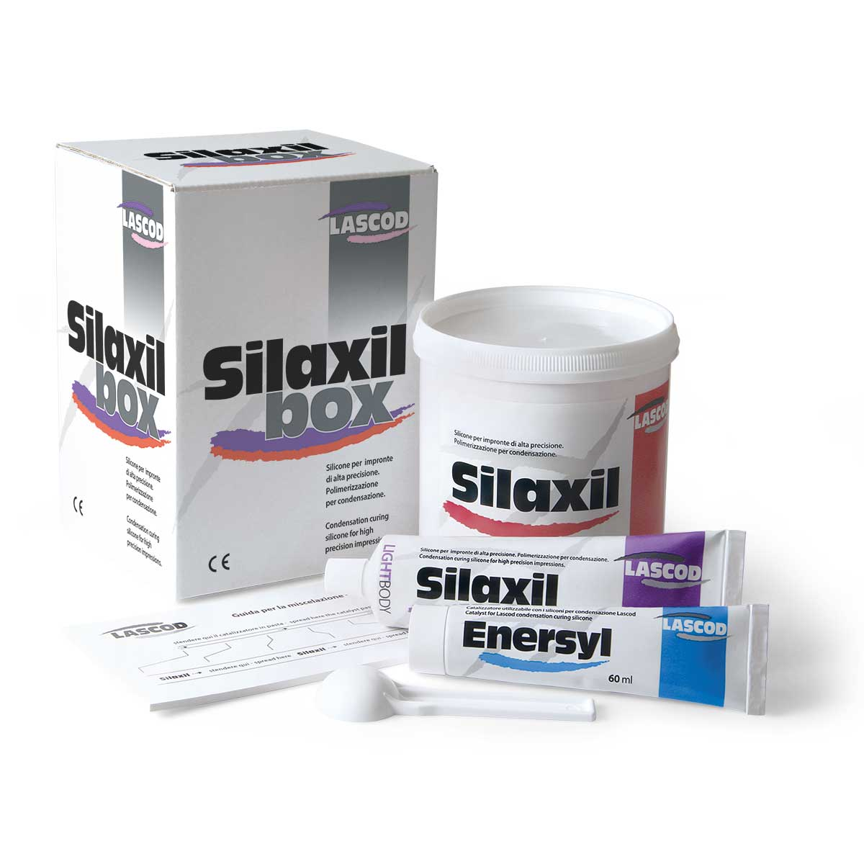
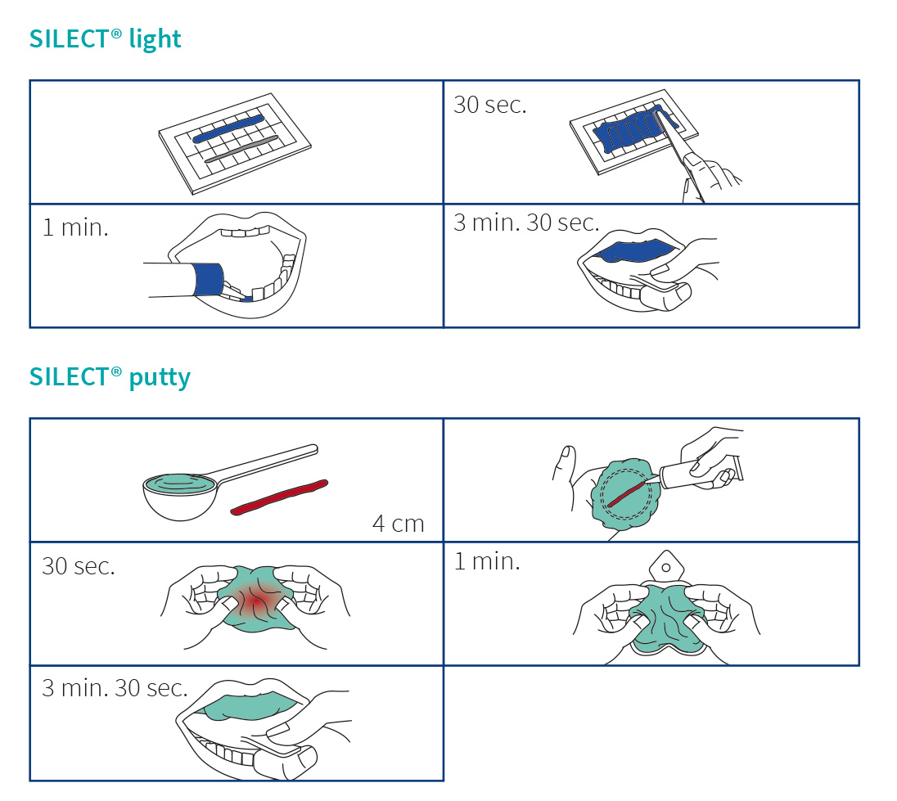
2- Silicon (count):
b. Condensation Silicone:
More affordable than other elastomeric materials
Advantages:
Excellent elasticity recovery
Good odor and flavor.
Accurate reproduction
Disadvantages:
Pour immediately
Dimensional deformation over the time

Slide 23
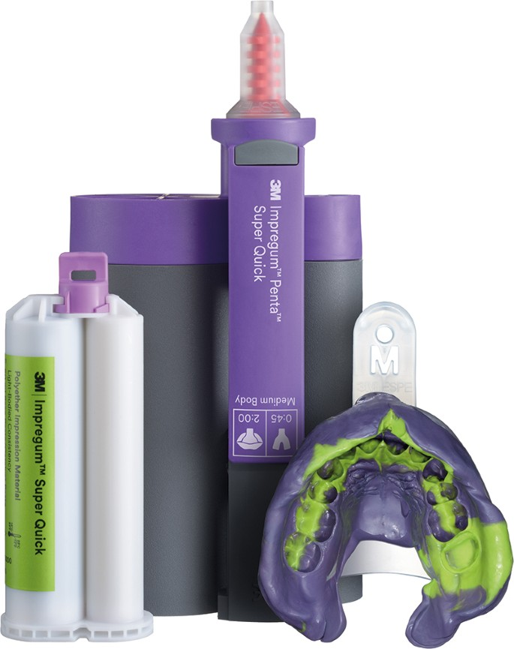
3- Polyether:
Supplied in two pastes catalyst and base
Advantages:
Fast setting
Clean
Auto mix dispense
Least hydrophobic
Good stability
Disadvantages:
Bitter taste
Absorbs water
Leaches components
Expensive

Slide 24
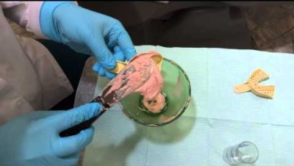
Objectives

Slide 25
Critical Thinking Activity
Case:
Assume that a patient came to your dental clinic, and you checked on his teeth, and everything was great. You cleaned his teeth, and when you finished, he told you that he wanted to do a bleaching tray.
Q: What is the appropriate impression material can be used to do bleaching tray?
Q :after you got the impression from the patient and the patient left the clinic, you noticed an imperfection in the impression. What can you do?

