Slide 1


Pool Float/Raft
Engineering Challenge
+
Notes:
Brief Intro statement: Hannah
Get Zoom meeting pulled up on Dreden’s (team 3), Jerome’s (team 4), and Mya’s (team 6) iPads.

Slide 2

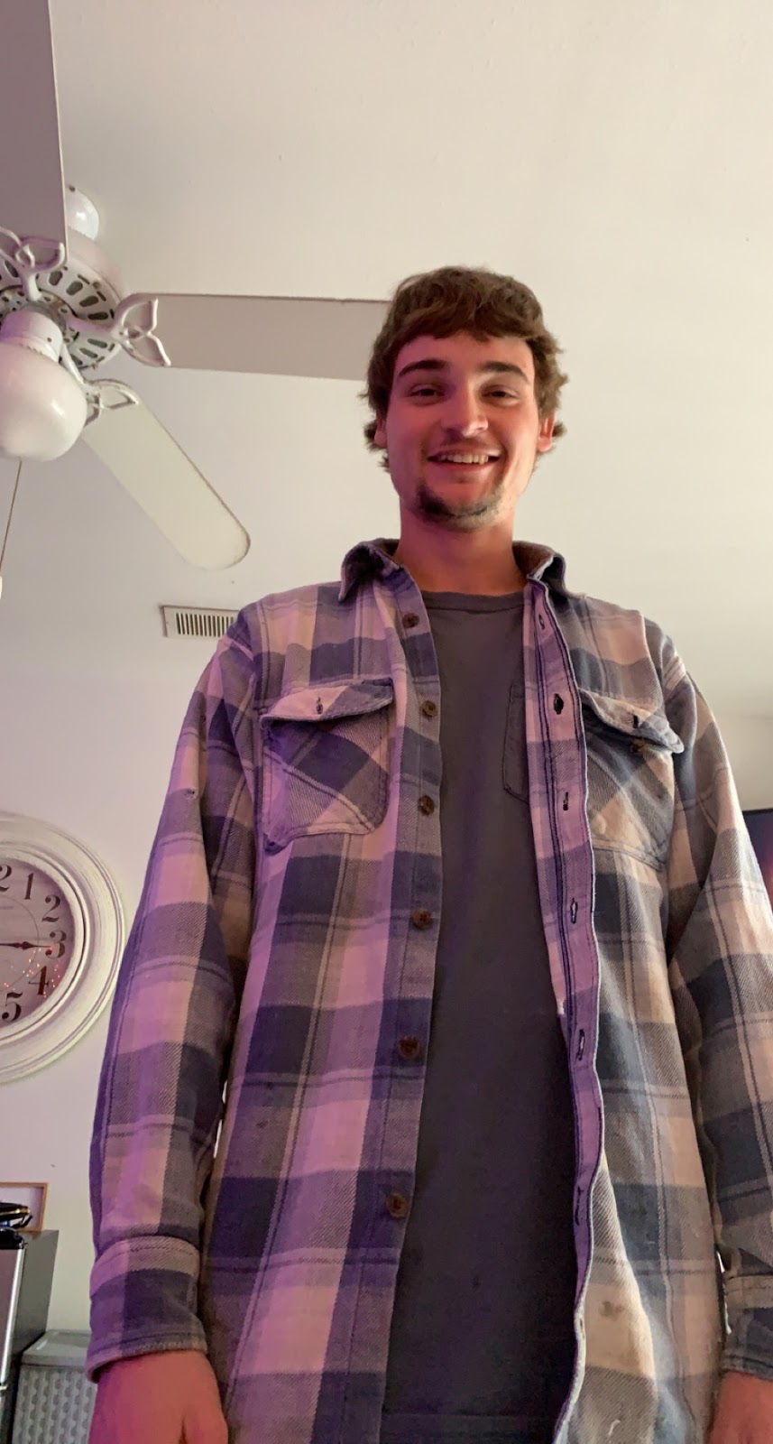
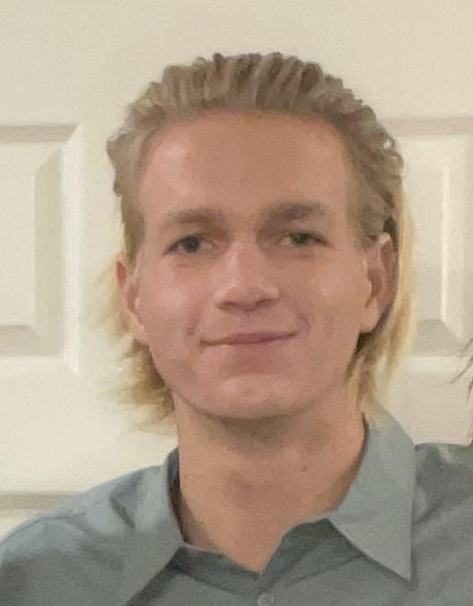

Your lifeguards
(aka engineering students)
Mr. Tyler
Mr. Hunter
Mr. Colin
Notes:
(1 min) Engineers reintroduce themselves to the kids

Slide 3
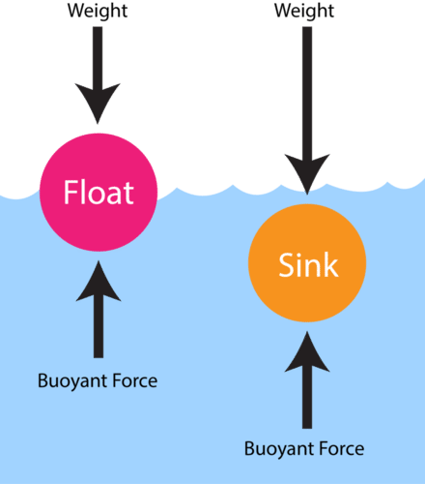
displacement?
density?
buoyancy?
Do you remember…
The weight or volume of the water an object pushes away.
The weight of something compared to its size.
The upward force of a liquid on an object.
Notes:
Hannah (3-5 min)
References
https://flexbooks.ck12.org/cbook/ck-12-middle-school-physical-science-flexbook-2.0/section/12.6/primary/lesson/buoyancy-ms-ps/

Slide 4


The Engineering Design Process
Make a model
Can you put these steps in the right order?
Define the problem
Reflect & Redesign
Plan solutions
Test the model
Notes:
Colin (5 min)
Engineers challenge the kids to put the steps of the EDP in order and guide them through it.

Slide 5
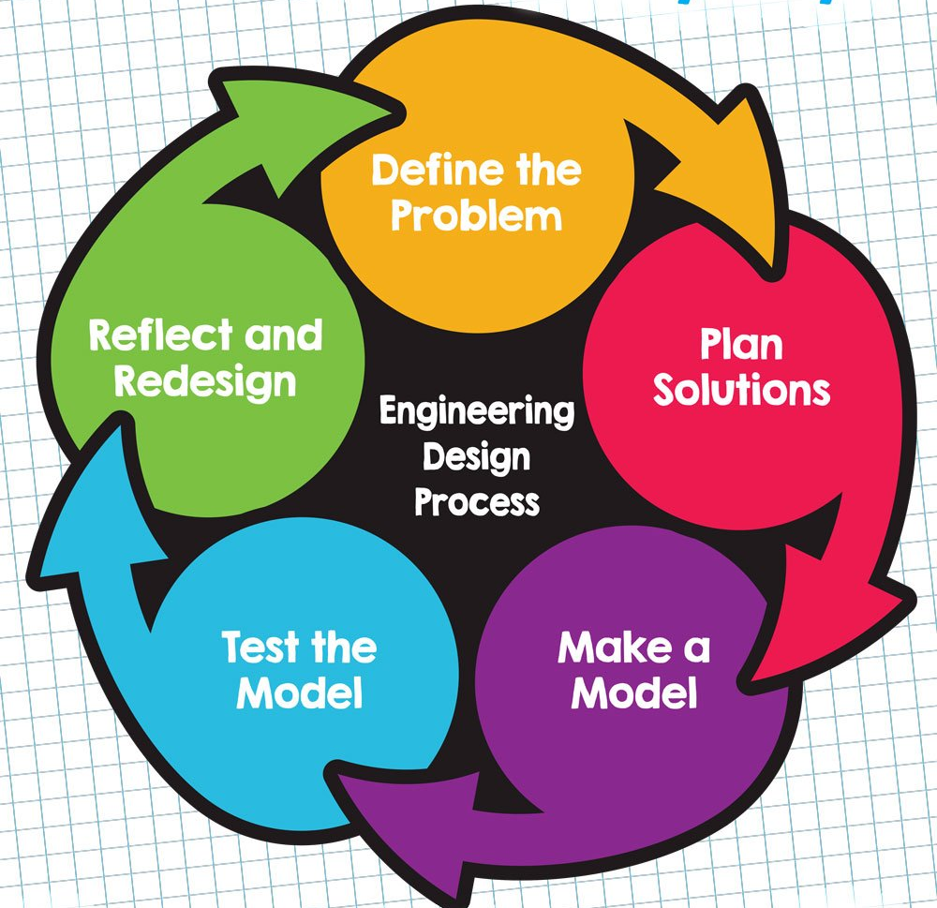

The EDP is cyclical: the steps are meant to be repeated.
Engineers don’t build perfect prototypes on the first try. Failing and retrying is what makes engineering fun!
Notes:
Hunter (2 min)
Engineers emphasize that the EDP is cyclical and that we’ll be using it today

Slide 6

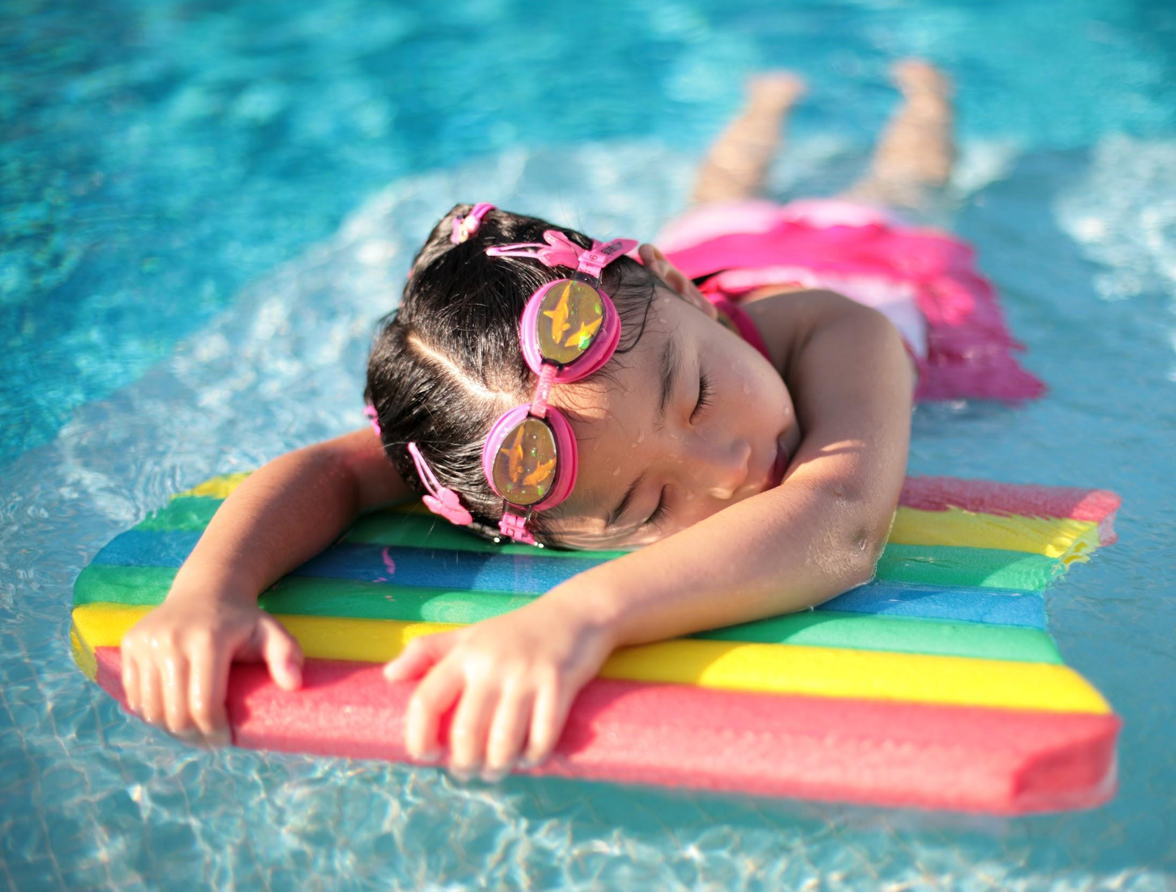

Design & Build an Eco-Friendly
Pool Float or Raft!
Your challenge:
Most pool floats are made from plastic, which isn’t the best for our planet. Let’s reimagine what they’re made from!
We need YOU to brainstorm some new eco-friendly designs, choose one, then build it!
Notes:
Savannah introduces challenge aka defines the problem. (1-2 min) Pass out worksheets here?

Slide 7
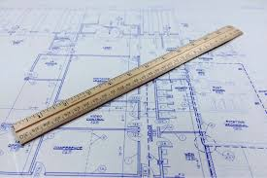
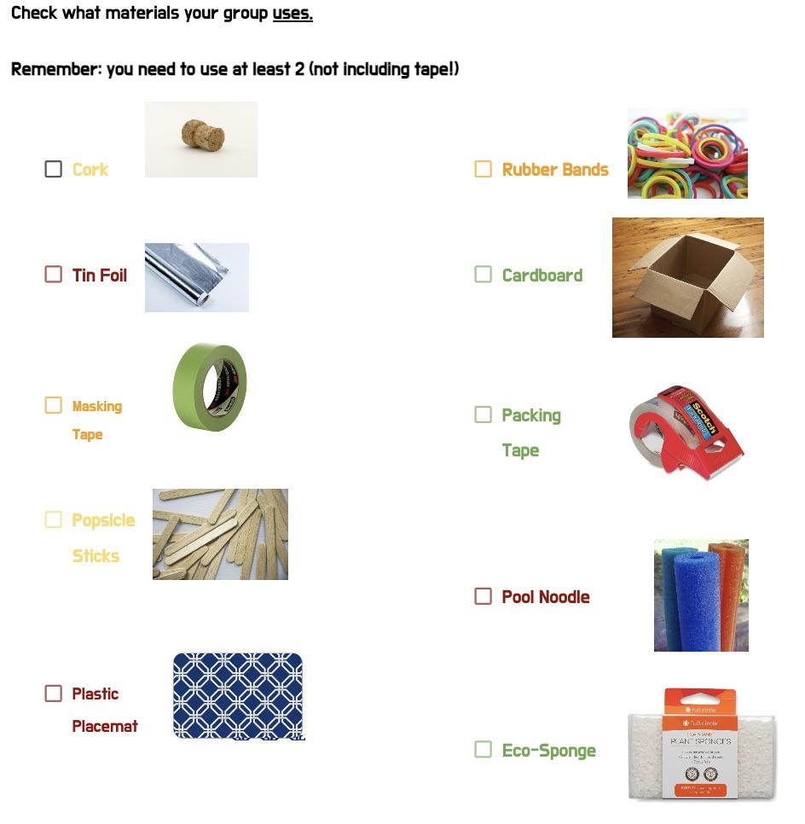
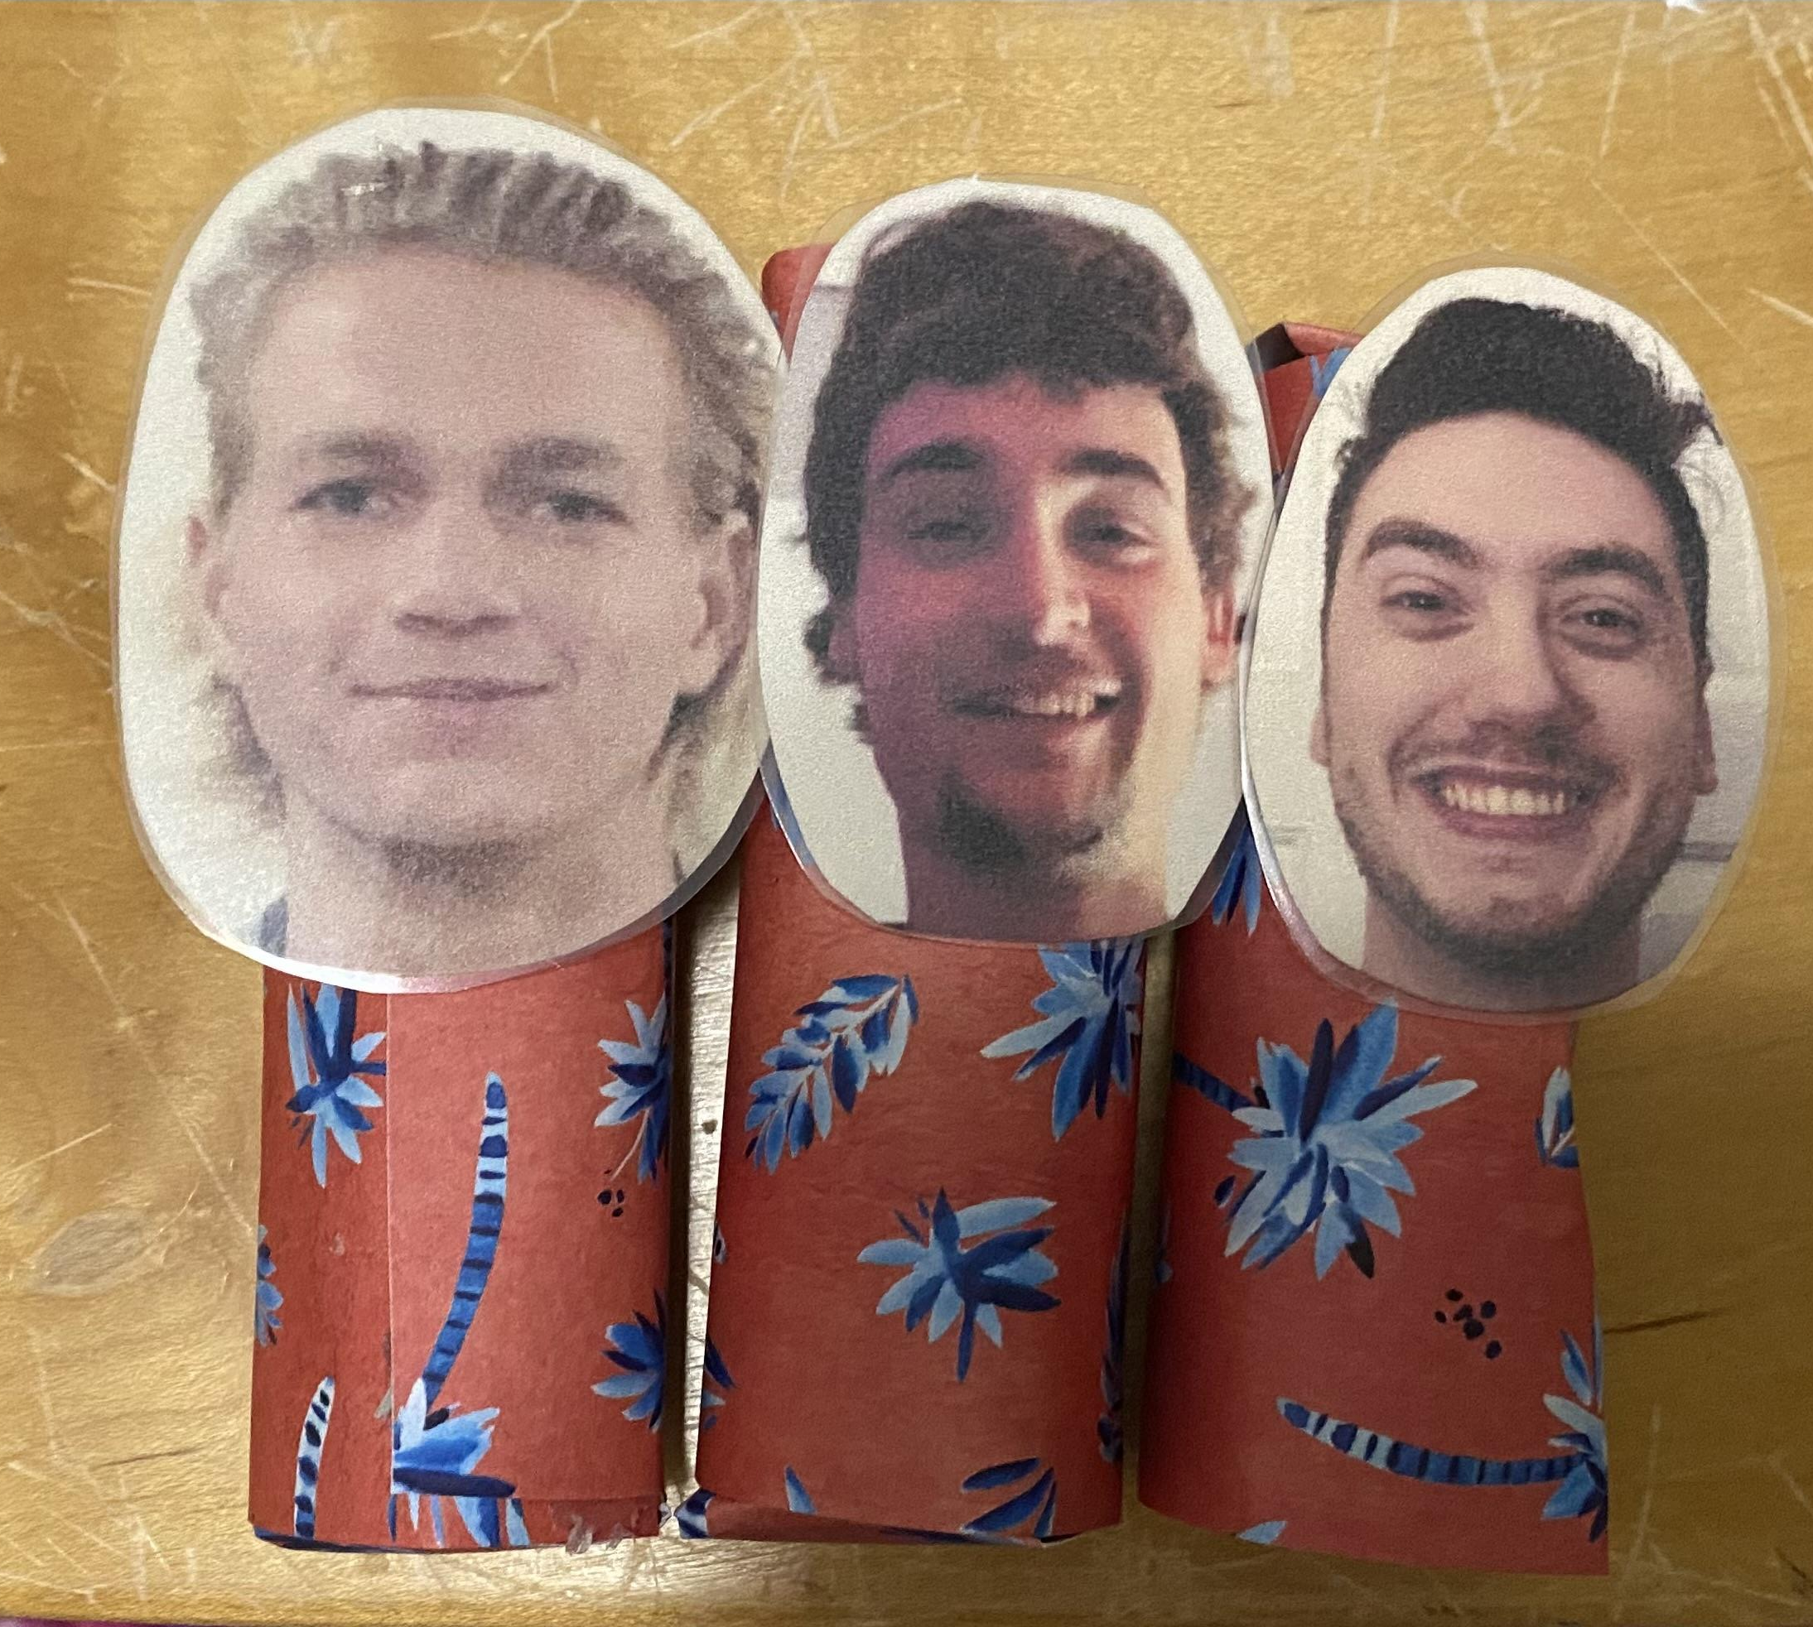

You’ll need to:
Have at least
2 prototype sketches
Use at least
2 different materials
(not including tape + can’t use basket)
Make your float buoyant enough to support at least 1 “person”
Make your raft as eco-friendly as possible
Notes:
Savannah explains prototype constraints and requirements (2 min)

Slide 8
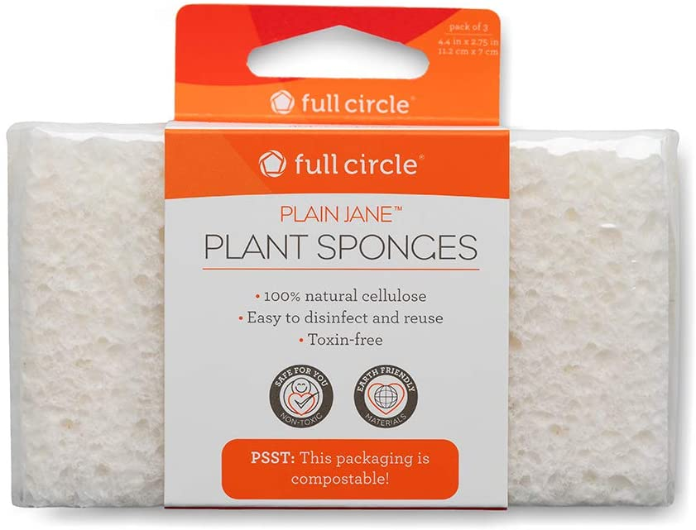
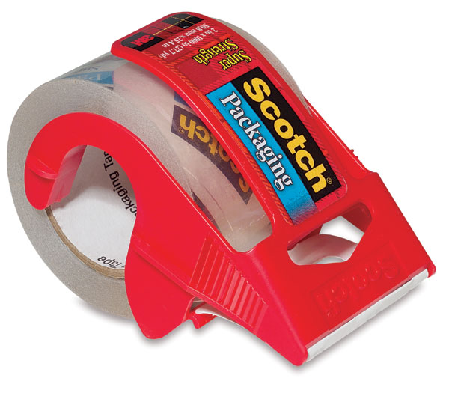
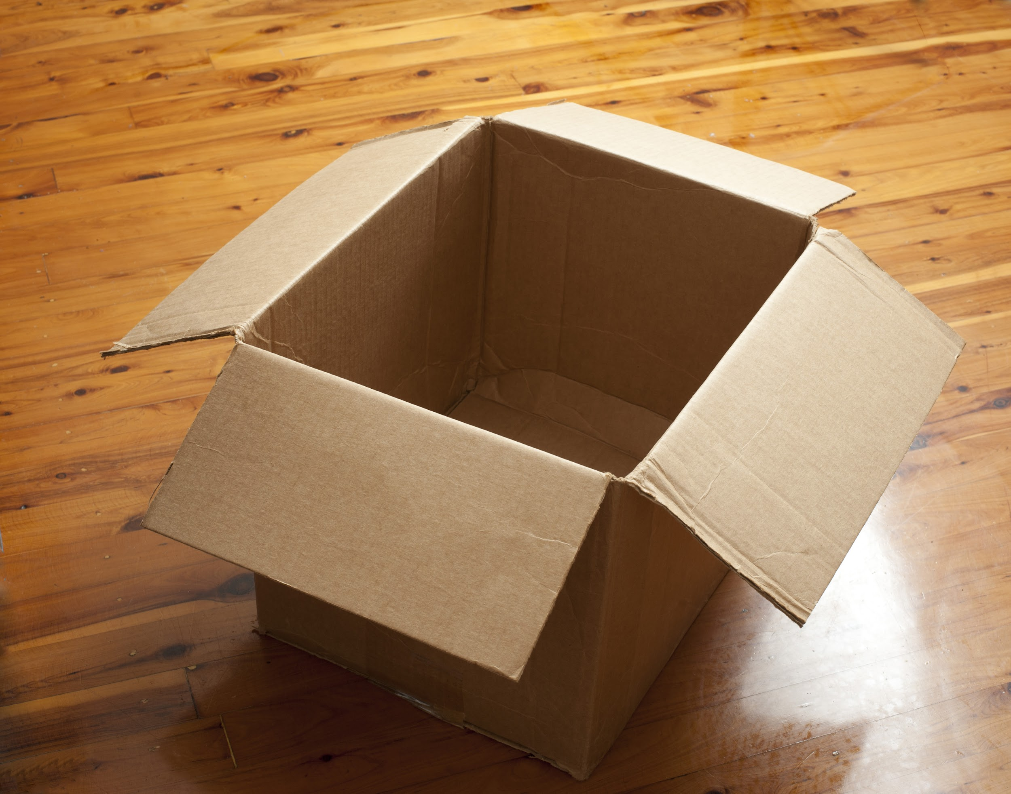
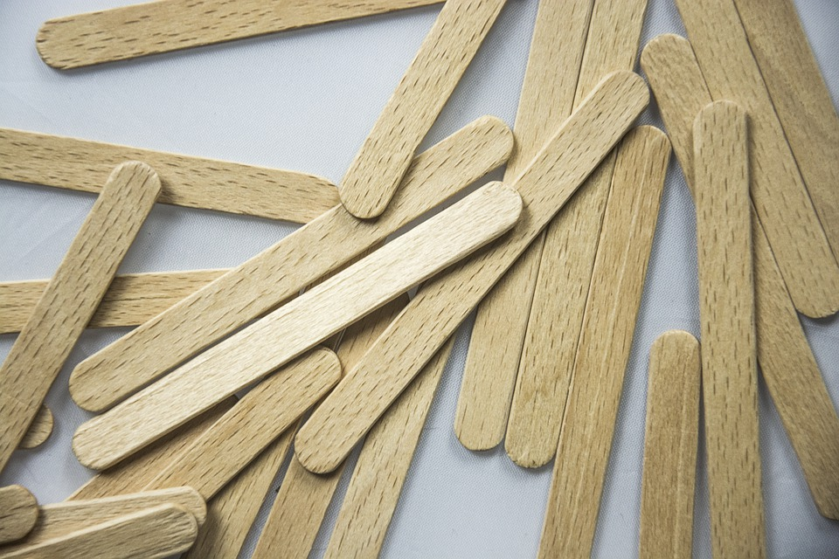
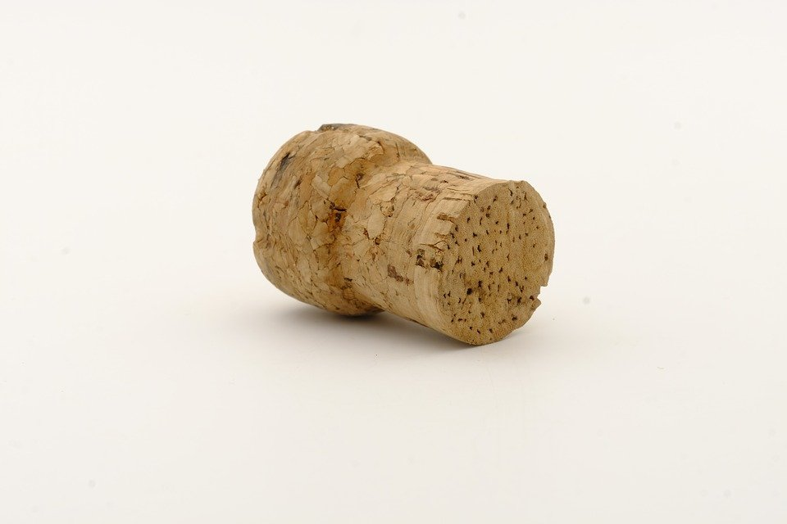
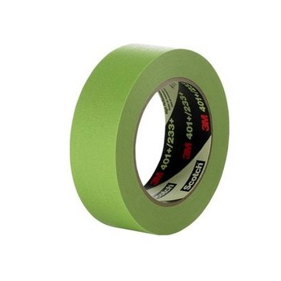
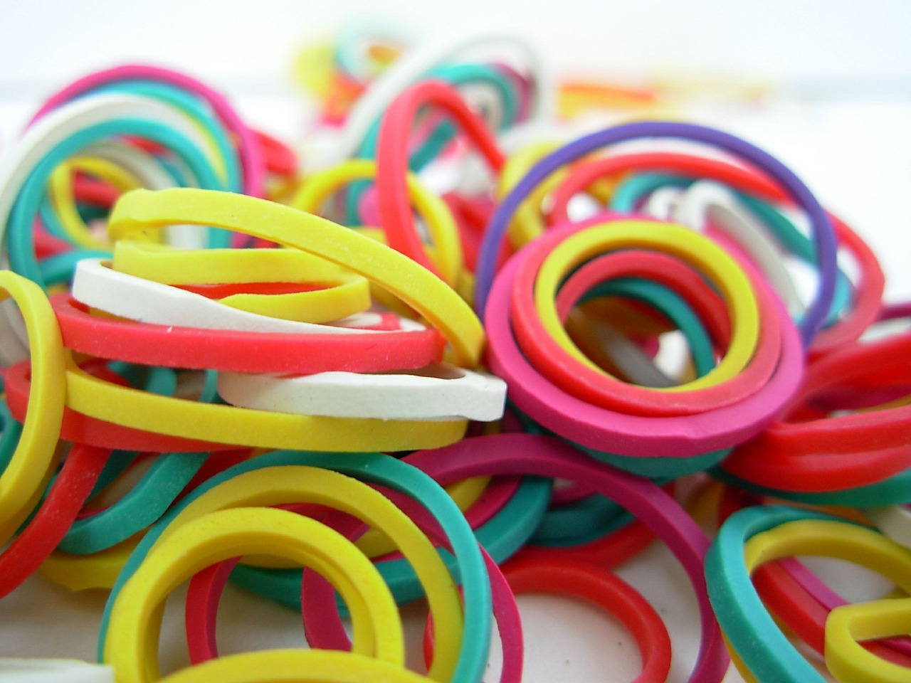
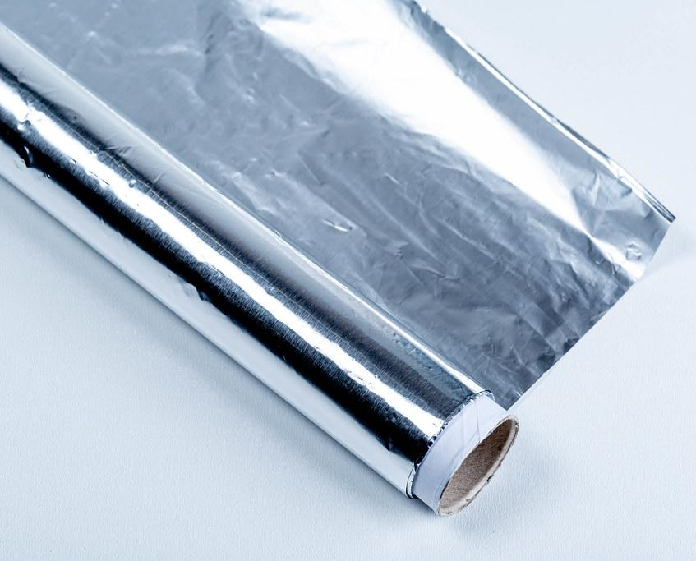

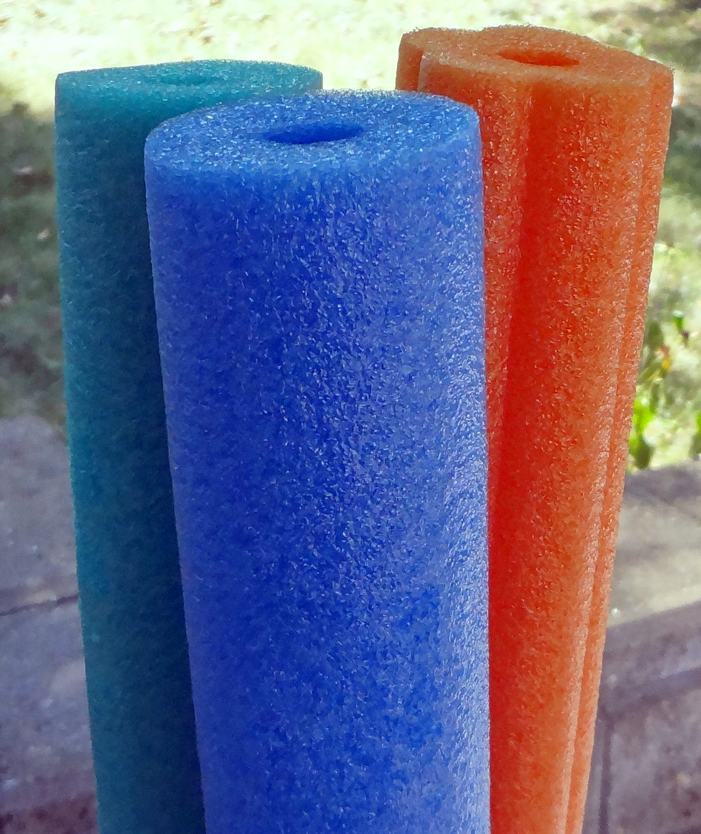

Eco Friendly Scale
Green: breaks down in less than 1 year ________ 3 points
Yellow: breaks down in 1-5 years ______________ 2 points
Orange: breaks down in 5-100 years __________ 1 point
Red: breaks down in 100+ years _______________ 0 points
The more points the better!
Notes:
Tyler (2 min)
Could say something like “in addition to the density and buoyancy of these materials, be thinking about where they fall on the eco-friendliness scale.” (to incorporate their science vocab)

Slide 9
5th grade teams
Team 1:
Imani
Celestestine
Josiah
Terrion
Team 2:
Adrianna
Jamari
Tae’Shaun
Kei’Montae
Team 3:
David
Jahariah
Korzale
Dreden
Team 4:
Ha’ziyah
Jerome
Harmonte
Leland
Team 5:
Samiyah
Keon
Ze’niyah
Jadyn
Team 6:
Alaura
Mya
Cayden
Notes:
Taryn facilitates the kids getting into teams (1-2 min)
Mrs. Graham would like us to use Dreden’s (team 3), Jerome’s (team 4), and Mya’s (team 6) iPads for the Zoom meeting

Slide 10



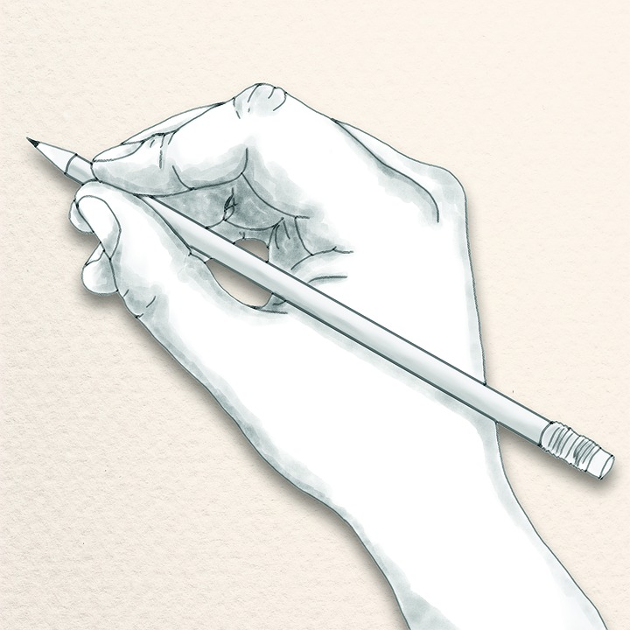

Team Roles
Moderator
Designer
Tech Support
Presenter
Makes sure everyone is on task & being respectful of each other’s ideas
Sketches the team’s collaborative prototype ideas
Holds the iPad and alerts the ODU teachers when the team has a question for the engineers
Shares the team’s ideas when testing prototypes & places prototype in the “pool”
Notes:
1-2 min Taryn explains roles, students have 1 min to assign them. After roles, pass out baskets of materials. Segue into brainstorming & sketching

Slide 11
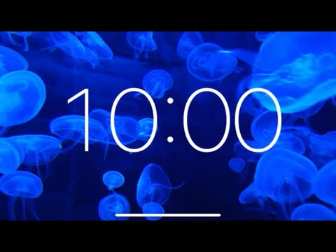
Brainstorming & Sketching
(aka Plan Solutions, step 2 of the EDP)
REMEMBER:
2 designs
At least 2 materials
Support at least 1 person!
Eco-friendly!
Notes:
Hannah explains that it’s time for initial brainstorming and sketching (aka imagine solutions of EDP). Remind them to keep requirements in mind

Slide 12
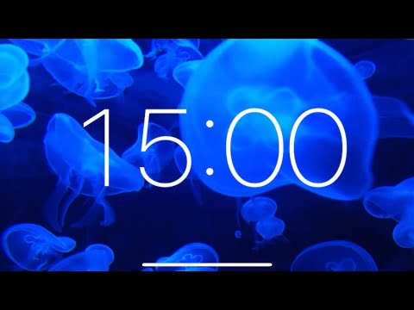
Ready, set… build!
(aka Make a Model, step 3 of the EDP)
Notes:
Ed students pass out iPads to 3 teams (so engineers can converse with them and see what they’re doing) and walk around the room assisting students as needed during the build

Slide 13
Time to test our models !
(step 4 of EDP)
Notes:
~ 6 min

Slide 14
Reflect & Redesign
(Step 5 of the EDP)
Notes:
_________ announces it’s time to reflect and redesign

Slide 15
Time to rebuild!
(Step 3 of the EDP)
Notes:
Key time to emphasize that the EDP is cyclical, going back to step 3

Slide 16
Time to test our
new & improved designs!
(step 4 of the EDP)

Slide 17
What have we learned today?
Notes:
Savannah asks students to share their biggest takeaways from the lesson, what have they learned, etc. Look at everyone’s models side by side

Slide 18
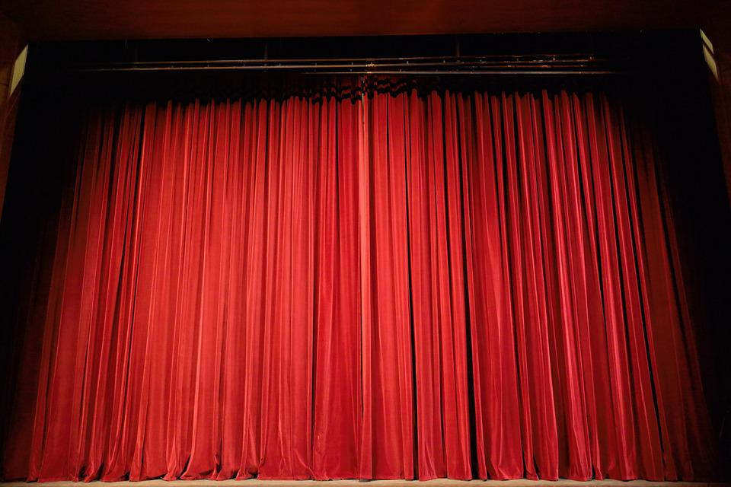


Ed+Gineering Challenge
Awards
Notes:
Taryn & Hannah give out certificates, goody bags + newsletters
final goodbye

