Slide 1
U.S. Military Branches
Define/Describe Speech

Slide 2
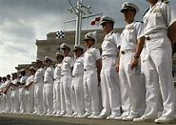
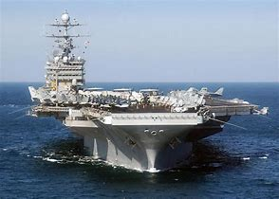
United States Navy
The mission of the Navy is to maintain, train, and equip combat-ready naval forces capable of winning wars.

Slide 3
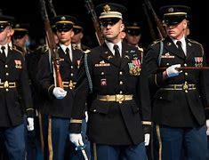
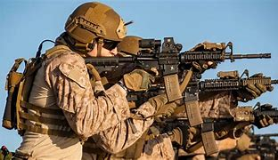
United States Army
The mission of the army is to deploy, fight, and win out Nation’s wars by providing ready, prompt, and sustained land dominance.

Slide 4
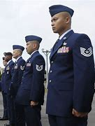
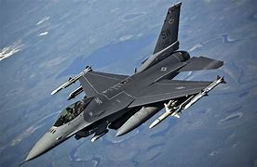
United States Air Force
The mission of the Air Force is to fly, fight, and win - airpower anytime, anywhere.

Slide 5
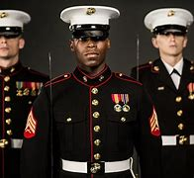
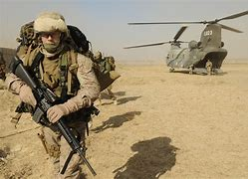
United States Marine Corps
The mission of the Marine Corps is to seize or defend advanced naval bases and to conduct such land operations.

Slide 6
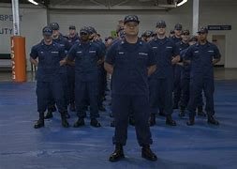
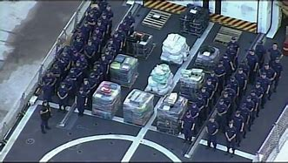
United States Coast Guard
The mission of the Coast Guard is to ensure our Nation’s maritime safety, security and stewardship.

Slide 7
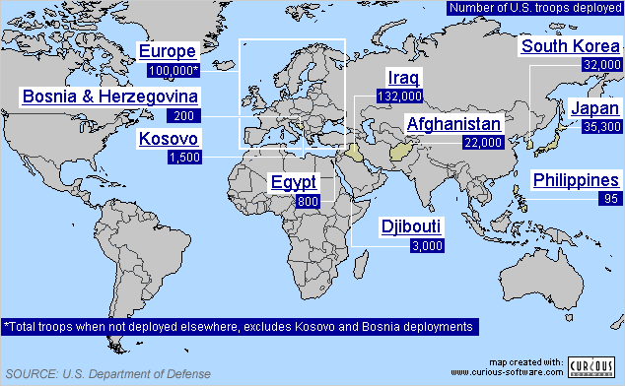
U.S Troops deployed around the World ( Includes all branches )

